Slide 1
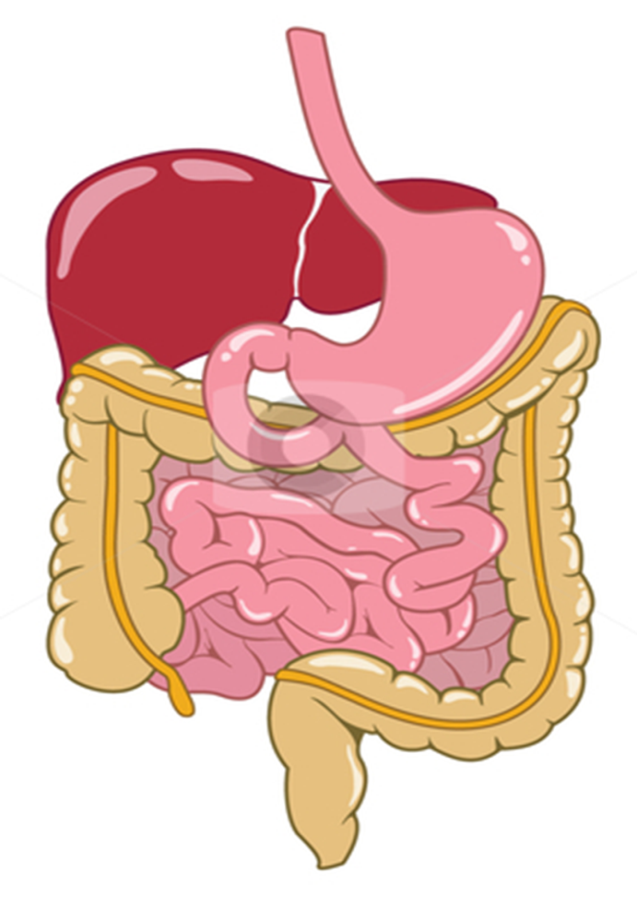
Digestion and food absorption
Nutrition
is taking in of materials for energy, growth and development
Balanced diet
is the intake of food of all food groups ( Carbohydrates , proteins , fats, vitamins , water , mineral ions , fibers) in the correct proportions to
provide molecules for metabolism and sufficient energy for the body
The diet of a person is affected by:
Age
Sex
Occupation
Climate
Special conditions: pregnancy,
lactation, health problems

Slide 2
Age:
Old people:
Less fats
More vitamins
More minerals
Children:
More proteins
More calcium
More carbohydrates
Sex:
Males require more food than females of the same age and size for larger muscle masses
Occupation:
Hard workers need more amounts of food

Slide 3
Pregnancy:
More proteins
More calcium and vitamin D
More iron
Lactation: production of breast milk for feeding the baby
More proteins
More vitamins
More calcium
More fluids
Health problems:
Diabetic: avoid eating large amounts of carbohydrates
Heart patients: less fats, less cholesterol, less salts
Climate:
Hot weather: more fluids, less carbohydrates

Slide 4
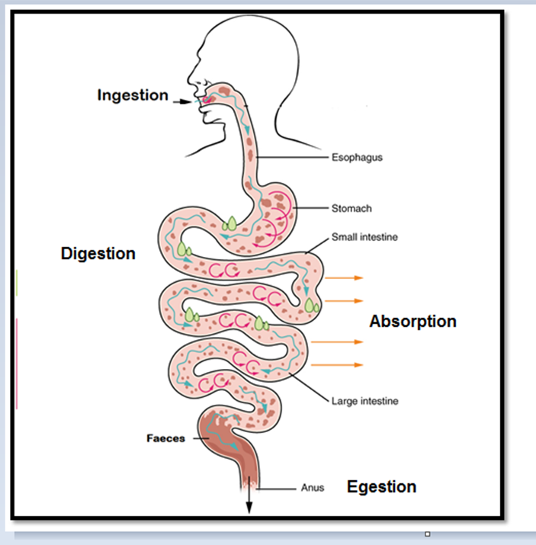
Digestion occurs in the alimentary canal
Alimentary canal:
long tube starting at the mouth and ending at the anus
Digestion: a biological process
where food is broken down into
smaller, simpler, water-soluble
substances that can be easily
absorbed by the body cells
Two types of digestion:
Mechanical digestion
Chemical digestion

Slide 5
Mechanical digestion:
The breakdown of food into smaller pieces WITHOUT chemical change to food molecules
Large pieces Smaller pieces
This process is done by:
Teeth: larger surface area, mixed with saliva and exposed to enzymes
Stomach

Slide 6
II- Chemical digestion:
The breakdown of large insoluble molecules into small , soluble molecules
Complex molecules insoluble Simple soluble molecules
Enzymes which break down complex food into simpler soluble substances
Examples:
Carbohydrases; amylase
Proteases; pepsin
Lipases

Slide 7
The Process of digestion
In the Mouth:
Ingestion: taking in of substances e.g. food and drinks, into the body through the mouth
Mechanical digestion: Teeth in the mouth grind food into smaller pieces which increases the surface area of food

Slide 8
Teeth

Slide 11
Tooth parts:
1. Root: attach the tooth to the jaw bone by cement and tough fiber
2. Neck: between the root and the crown
3. Crown: above the gum level

Slide 12
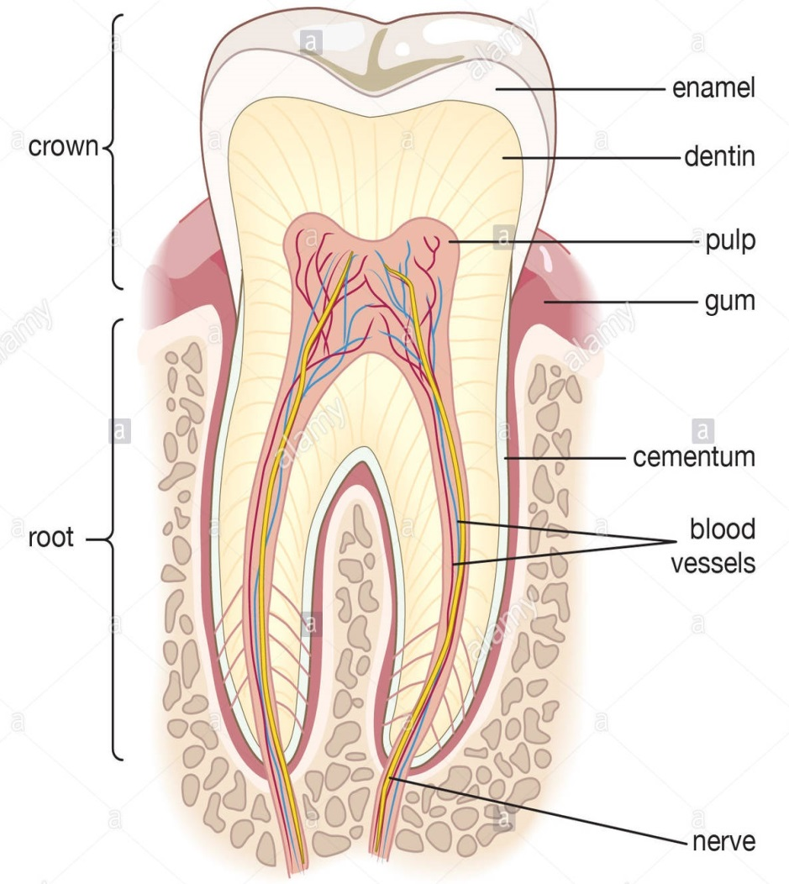
Internal parts of the tooth:
Enamel:
hardest substance in our body (harder than bone)
outermost non-living layer forming a hard protective cover around the crown
97% Calcium phosphate
2. The Dentine:
underneath the enamel
softer than the enamel but still about as hard
as bone
forms the remainder of the tooth except the
pulp cavity
3. Pulp Cavity:
Contains nerve , capillaries, and lymph vessels
the living part of a tooth
supply the tooth with oxygen and nutrients

Slide 14
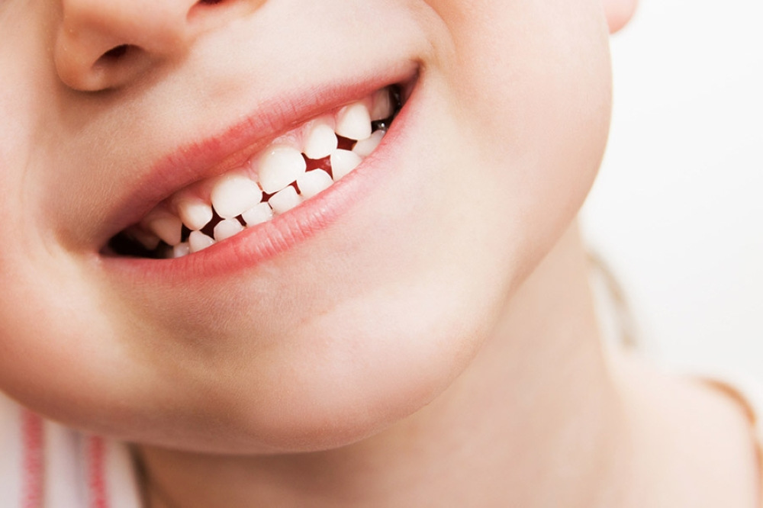
Teeth:
break food particles into smaller ones
Mix food with saliva to make it easier to swallow
increase the surface area for chemical digestion
Milk teeth: (Aka Deciduous teeth)
grow through gums
21 or 22 months old a child will have the 20 teeth milk teeth
at age 7, permanent teeth start to replace milk teeth
32 adult teeth

Slide 15
Tooth decay (Dental Caries):
caused by bacteria found in the mouth along with remaining food particles
Plaque: invisible layer of bacteria on the surface of teeth
bacteria feed sugary substances producing an acid that dissolves calcium salts
found in the enamel

Slide 16
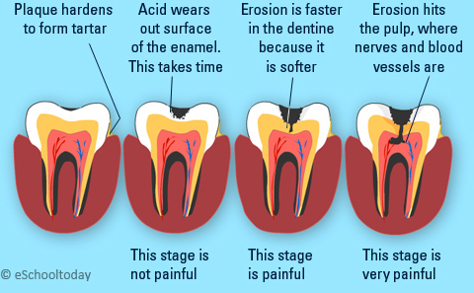
the acid breaks the softer dentine underneath
a cavity is formed in the tooth
bacteria can enter the cavity and penetrate until the decay reaches the nerves in the pulp cavity which causes pain
not washing the teeth , the plaque can become hardened and form tartar; this has to be removed by a dentist

Slide 17
Dental Care
Growing healthy teeth:
Food rich in calcium ( Dairy Products) and vitamin D (Which helps in the absorption of calcium) maintain a strong enamel
Fluoride from fluoridated water or tooth paste
Maintaining Healthy teeth
Brush teeth at least twice a day
Regular visits to the dentist
Avoid eating sweets before going to bed
Don’t use your teeth to open bottles or crush nuts
Using tooth paste
alkaline and so neutralizes acid near the teeth
contains antibacterial substances such as mint
contain fluoride; helps strengthen the enamel and reduce the acid damage

Slide 18
Teeth found at the back of the mouth are more prone to decay because they are hard to reach when brushing
Dentists advice the use of toothbrush with a small head that allow the bristles to reach into the crevices between the teeth
Gum disease; if plaque is not removed, the bacteria may infect your gums, so the gums become inflamed and may bleed when you brush your teeth

Slide 19
Chemical digestion in mouth:
Saliva consists mainly of water with amylase enzyme dissolved in it
Saliva contains, salts, Lysozymes and mucus
Saliva production is affected by:
Taste
Smell
Thinking about food
Amylase begins the breaking down of starch in food into maltose (Disaccharide)
Lysozymes digest food in between the teeth to reduce teeth decay (breaking down plaque)
Amylase needs neutral pH to work by salts such as K+, Cl - , HCO3-1 (buffer)
Mucus helps form and lubricate bolus
Saliva makes food more soluble

Slide 20
Swallowing:
Epiglottis; cartilage covering the entrance of trachea makes a bridge over the entrance trachea preventing food from passing through
Soft palate closes the entrance to the nasal cavity
Muscles between the rings of cartilage of trachea contract to reduce the diameter of the trachea
Movement and contraction of the larynx (Adam’s apple) moves the trachea upwards so no food enters

Slide 21
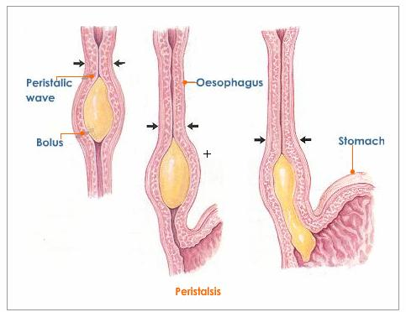
bolus enters the oesophagus
moves by peristalsis of circular and longitudinal muscles
behind the food: circular muscles contract and longitudinal relaxes
in front of the food: circular relaxes and longitudinal contracts
pushes food forward
move down the oesophagus into the stomach

Slide 23
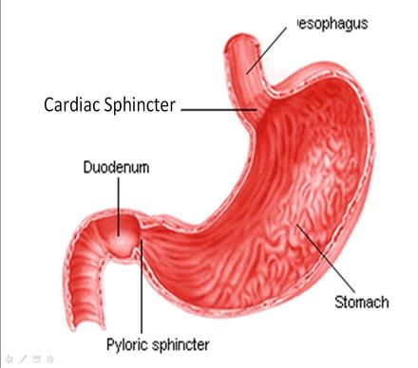
In the stomach:
a muscular organ
contains muscles that contract and relax to churn food
contains elastic fibres that make it change its size
surrounded by 2 sphincter muscles
Cardiac Sphincter:
at the entrance
when it relaxes it causes food to
enter the stomach from the oesphagus
Pyloric sphincter:
at the exit
when it relaxes it allows food
to exit into the small intestines ( duodenum)

Slide 24
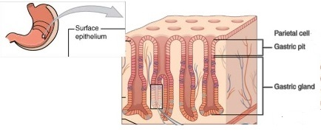
Walls of the stomach:
Gastric Glands produce gastric juice which contains:
Hydrochloric acid (HCL)
Acidic medium(pH 2) for pepsin to work
kill harmful bacteria in food by denaturing their enzymes protecting us from food poisoning
Protease enzymes, pepsin and renin
Pepsin begins the digestion of proteins to short polypeptide chains
Renin coagulates (clots) the milk proteins to make it easier for pepsin to work on them
After food is mixed with the gastric juice and enzymes it is called chyme

Slide 25
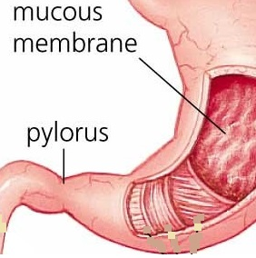
Goblet cells in the stomach secrete mucus:
protect it from HCl
prevent the stomach from digesting itself
damage to mucus layer causes stomach ulcer
Three methods for preventing the auto digestion of the alimentary canal (gut):
Production of large quantities of mucus
The lining of the canal is thick
Secretion of enzymes happens only when food is in the stomach

Slide 26
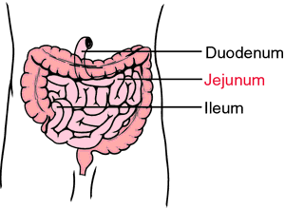
In the small intestines : (duodenum and Ileum)
In the duodenum:
first part of the small intestines
receives two kinds of juices:
Bile Juice from the liver (stored in gall bladder)
Pancreatic juice from the pancreas
Bile Juice:
produced in the liver
stored in the gall bladder
doesn’t contain enzymes
moved through the bile duct
contains bile pigment
contains organic bile salts that help in fat digestion
contains inorganic bile salt

Slide 27
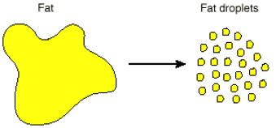
Organic bile salts | Inorganic bile salts (NaHCO3)
Emulsification of fat Activate the production of pancreatic lipase | Neutralize stomach acidic food Alkaline solution (pH>7) for enzymes

Slide 28
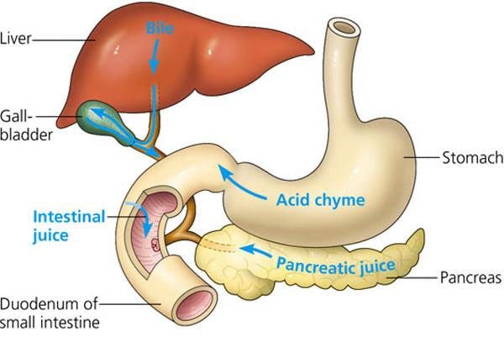
2. Pancreatic juice:
carried to the small intestines by
the pancreatic duct
Contains:
NaHCO3
protease called trypsin
carbohydrase Amylase
Lipase starts to digest fats into
fatty acids and glycerol (partially)
Trypsin continues to break large
proteins into short polypeptide chains
Amylase breaks down the polysaccharides that were not broken down in the mouth into maltose

Slide 29
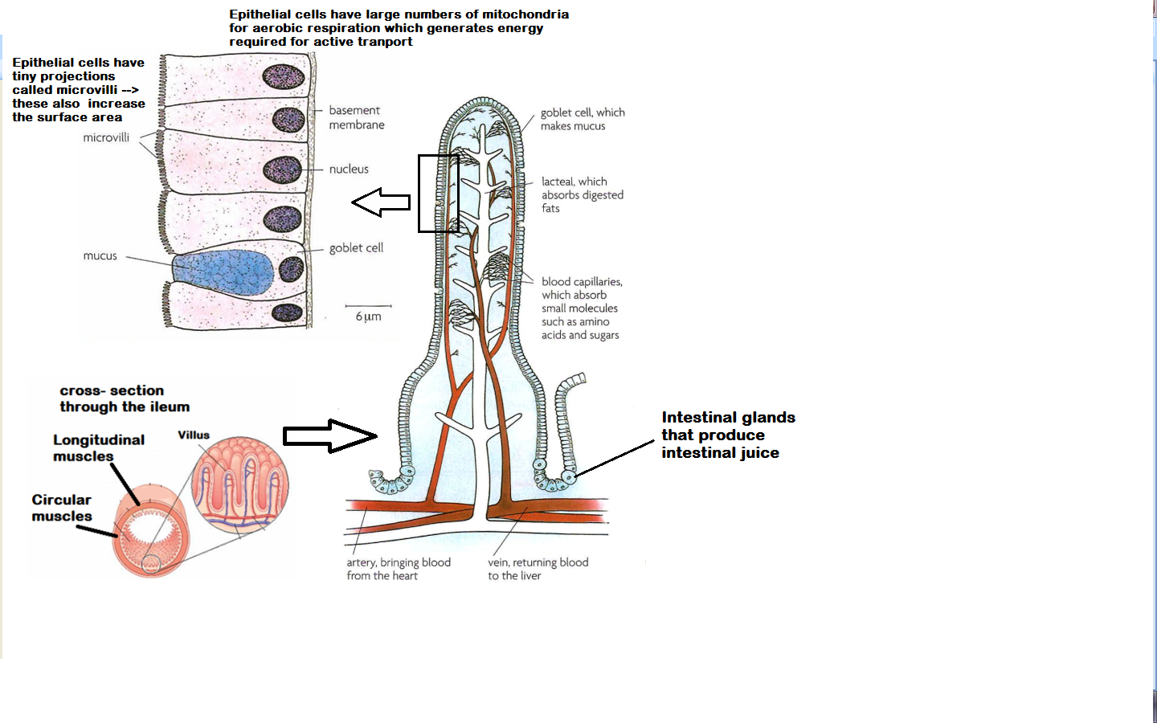
B. Ileum:
Long (6m)
Digestion is completed

Slide 30
Inner walls of both parts are covered with tiny projections called villi
Intestinal enzymes: enzymes produced by the cells of villi

Slide 31
Enzyme | Action
Sucrase | Sucrose into glucose and fructose
Lactase | Lactose into glucose and galactose
Maltase | Maltose into glucose
Lipase | Fats into fatty acids and glycerol
Peptidase | Polypeptides into amino acids

Slide 32
Intestinal juice contains NaHCO3
Maltase and peptidase are attached to the epithelial cell membranes
Absorption:
movement of small food molecules and ions through the wall of the intestines and into the blood
Feature | Mechanism of increasing absorption rate
Microvilli | Large surface area for more efficient absorption
Thin walls, one cell thick, network of blood capillaries | Reduces diffusion distance of food into capillaries
Lacteals | Lymphatic vessels that absorb fats (fatty acids and glycerol)
Very long | Large surface area
Circular, longitudinal, villus muscles | Increase contact with food to maintain concentration gradient

Slide 33
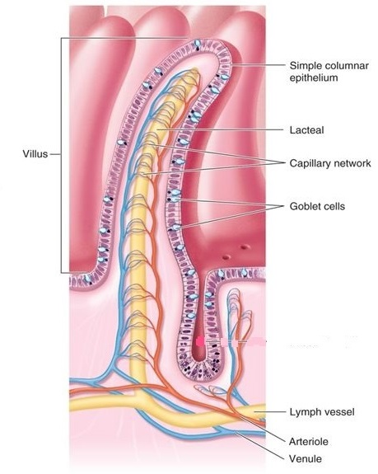
Structure:
Goblet cells:
produce mucus
Blood capillaries:
epithelial cells, absorption,
diffusion, osmosis, active
transport, hepatic portal vein
Lacteals: absorption of
fatty acids and glycerol

Slide 34
Large intestine:
Undigested food caecum colon

Slide 35
Water and minerals are reabsorbed from the undigested food in the large intestines
Semi-solid faeces contain undigestible food/fibers, cellulose, dead cells and bacteria
Faeces are stored in the rectum
Faeces are removed outside the body through the anus in a process is called egestion (defaecation)
Egestion:
passing out of food that has not been digested or absorbed , as faeces, through the anus
Colon absorbs much less water than the small intestines
Loss of large amount of water in faeces causing diarrhea which leads to dehydration of the body

Slide 36
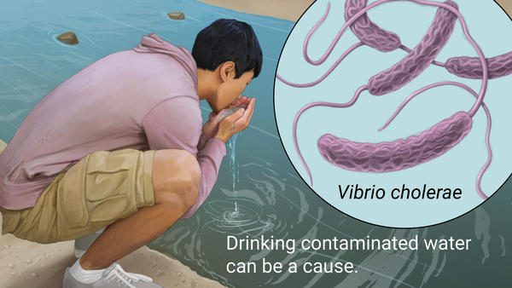
Diarrhoea : is defined as the loss of watery faeces
Food poisoning usually causes watery faeces
Cholera:
is an example of a disease that causes diarrhoea
caused by a bacterium that is found in water contaminated by faeces
infected people handle food without washing their hands pass cholera
transmitted by eating undercooked seafood caught in water polluted by sewage
the bacterium produces a toxin that causes small intestines to secrete chloride ions into the alimentary canal
water moves by osmosis from blood to alimentary canal and then out of the body
loss of water and salts from the blood result in dehydration

Slide 37
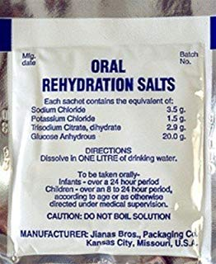
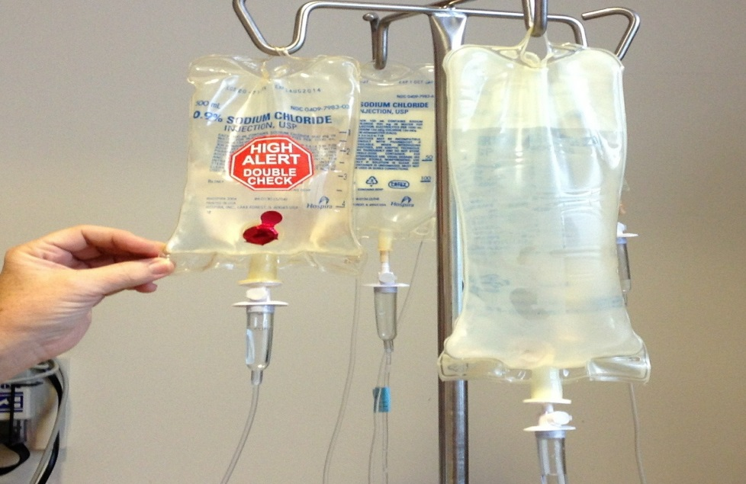
Dehydration:
loss of water and salts from the body as a result of severe vomiting and/or diarrhea which causes dehydration of the body cells
causes kidney failure or death especially in children if not treated
Oral rehydration treats diarrhea
Fluid injection through veins

Slide 38
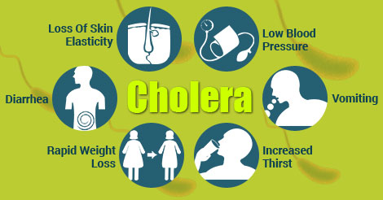
Other symptoms include :
weakness , rapid heart rate , low blood pressure and muscle cramps
Treatment :
Oral rehydration therapy , Antibiotics
Methods of prevention:
1- Clean drinking water
2- Building sanitation facilities
3- Constructing sewage treatment systems
4- Washing hands and cooking food thoroughly

Slide 39
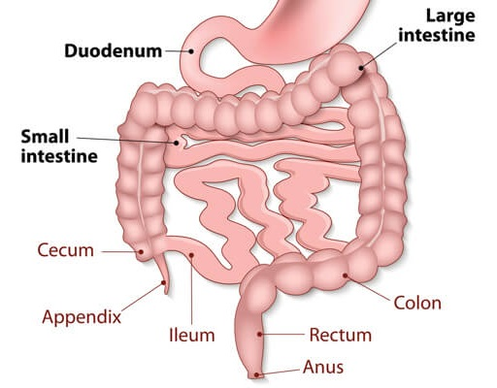
Notes:
Caecum and appendix contain lymph nodes so they play role in immunity and can digest cellulose
Ileum and duodenum make up the small intestines
Caecum , colon , rectum and anus make up the large intestines
Large intestines are wider than duodenum and ileum

Slide 40
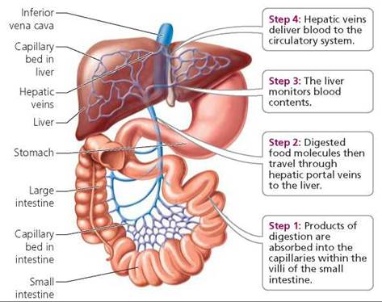
Factors that assist the movement of food in the gut (alimentary canal):
1. Peristalsis
2. Gravity
3. Mucus as a lubricant
Liver regulates the composition of nutrients in blood, hepatic portal vein carries nutrient-rich blood to liver
Some nutrients will stay in blood
Some will be stored in liver
Some will be converted into
another form

Slide 41
Glucose is converted into glycogen; regulate blood glucose level
Excess amino acids are deaminated; regulate amino acids and proteins
Detoxification
Storage of vitamins and minerals; liver stores vitamins A ,D , B12 and the mineral Iron
Production of Fibrinogen; blood clotting
Production of bile; fat digestion

Slide 42
Assimilation:
the movement of digested food molecules into the cells of the body where they are used, becoming part of the cells
Hepatic portal vein carries deoxygenated blood
Digestive system Liver Heart Lungs
Heart Body cells
Ingestion
Digestion
Absorption
Assimilation
Egestion

Slide 43
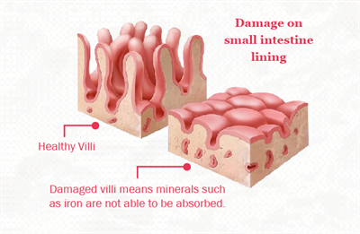
Coeliac Disease:
Autoimmune disease that is triggered by gluten
Gluten is a protein found in many grains, gives elastic texture
Small intestine becomes inflamed and unable to absorb nutrients

