Slide 1
Today we are going to learn a new sound.

Slide 2
G g

Slide 3
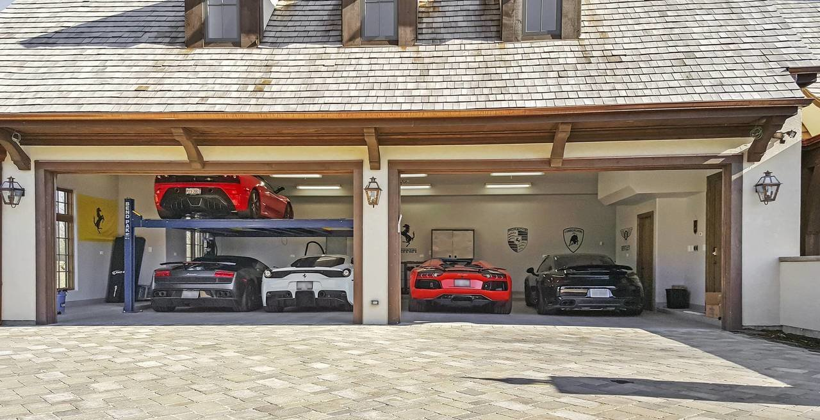
garage

Slide 4
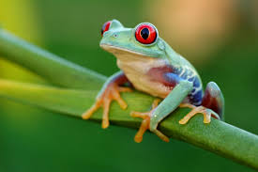
frog

Slide 5
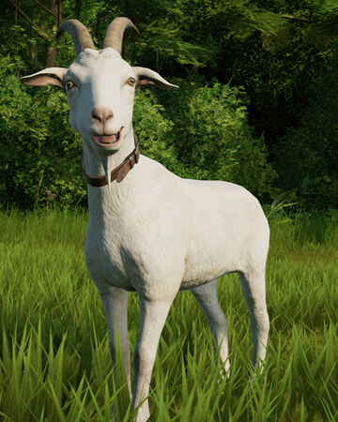
goat

Slide 6
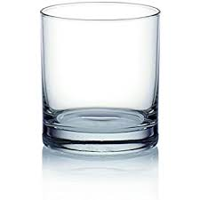
glass

Slide 7
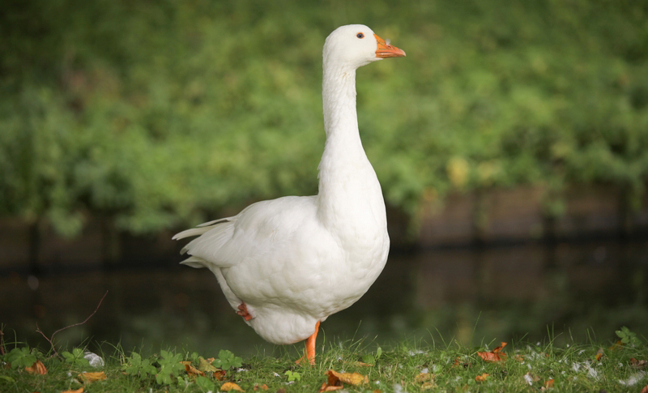
goose

Slide 8
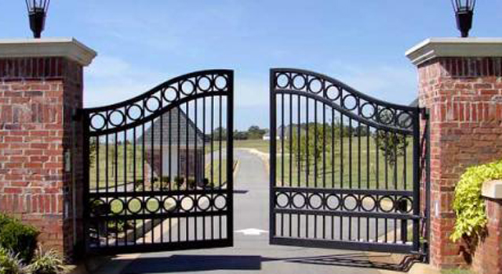
gate

Slide 9
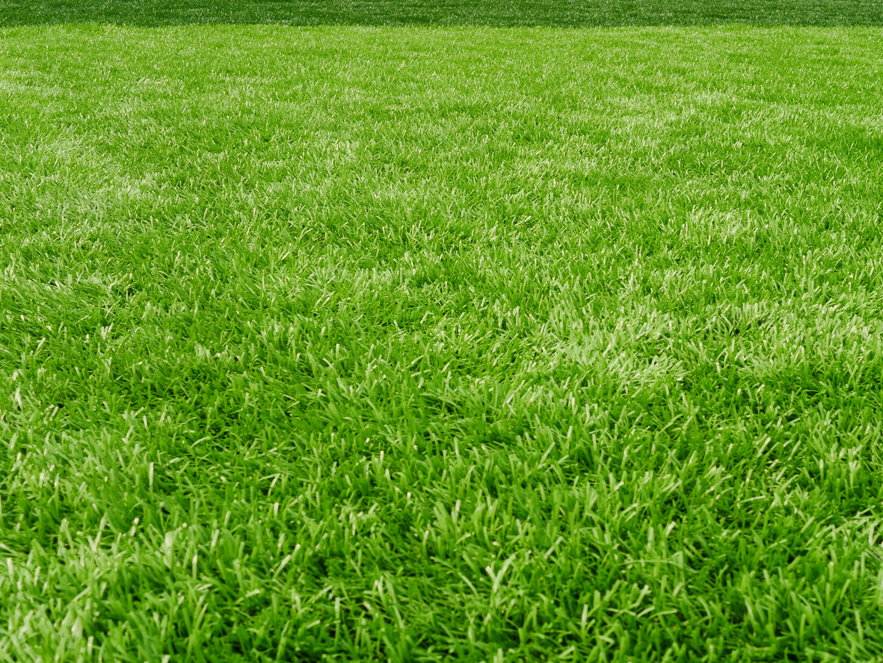
grass

Slide 10
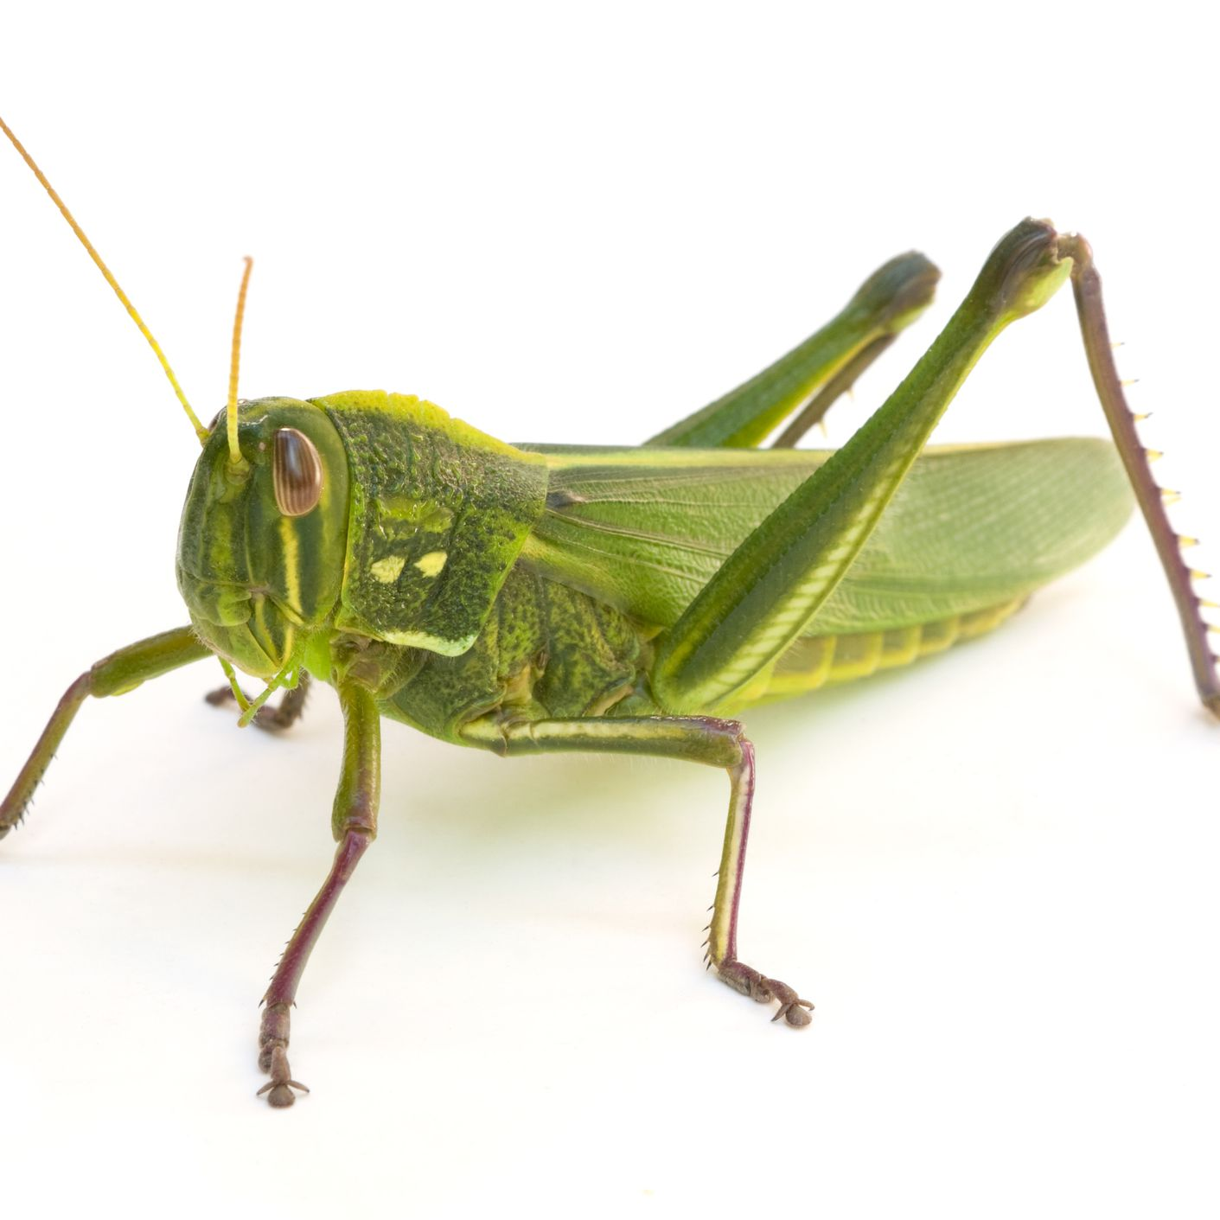
grasshopper

Slide 11
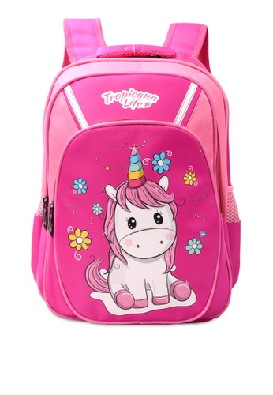
bag

Slide 12
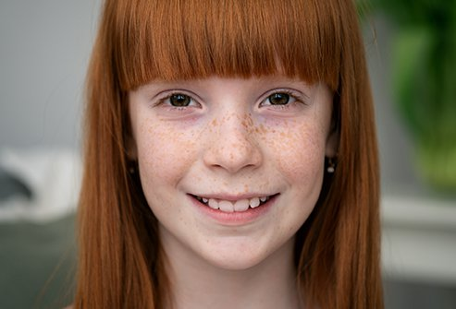
girl

Slide 13
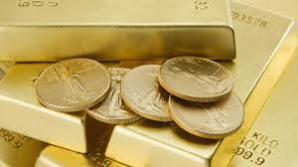
gold

Slide 14
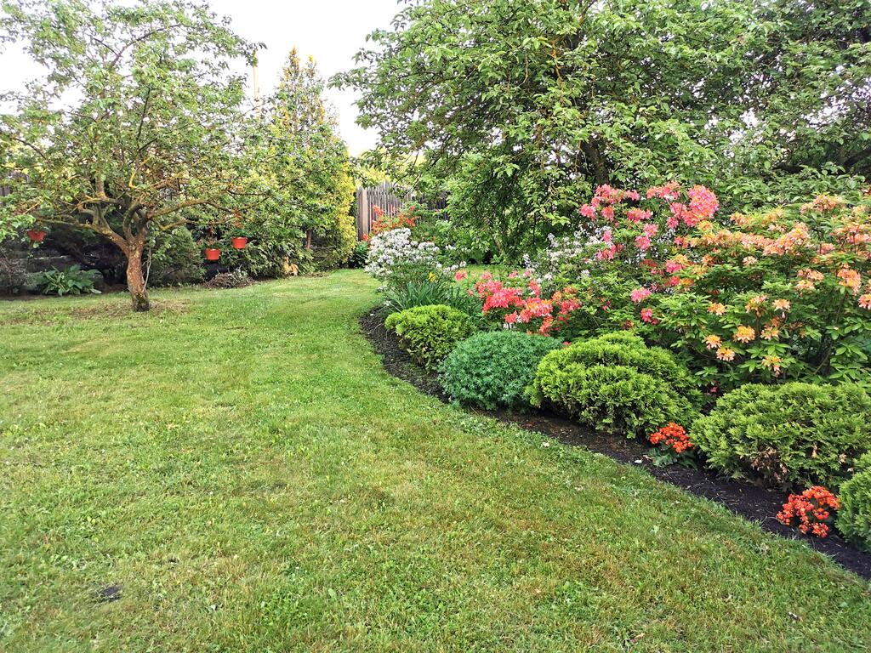
garden

Slide 15
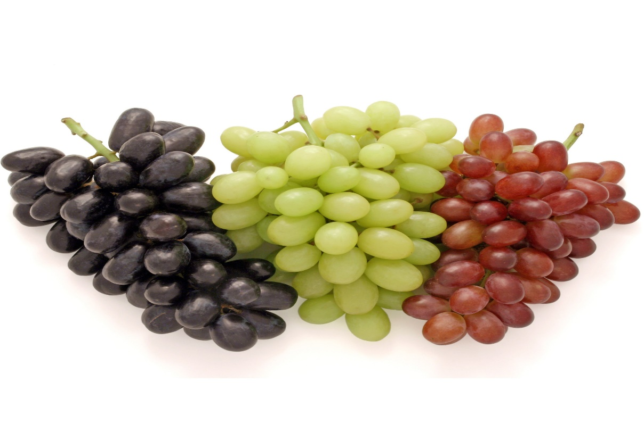
grapes

Slide 16
gate

Slide 17
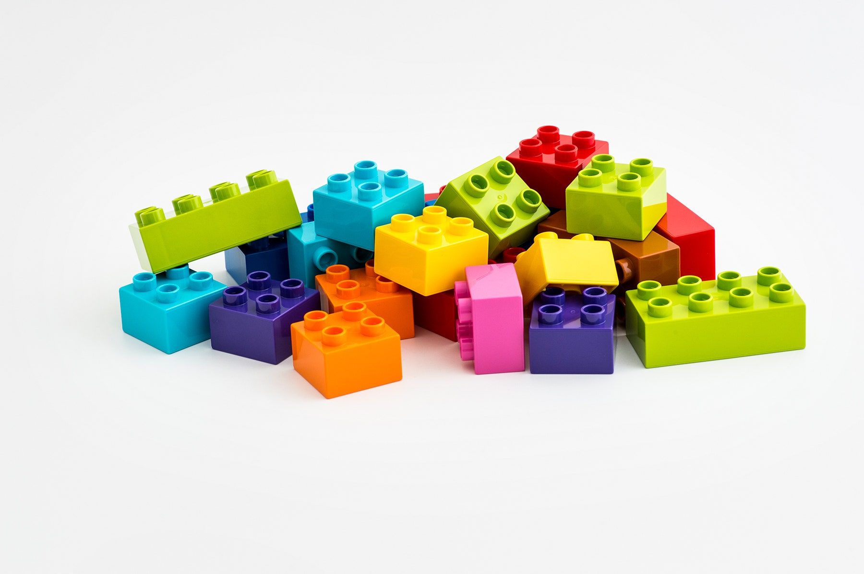
Lego

Slide 18
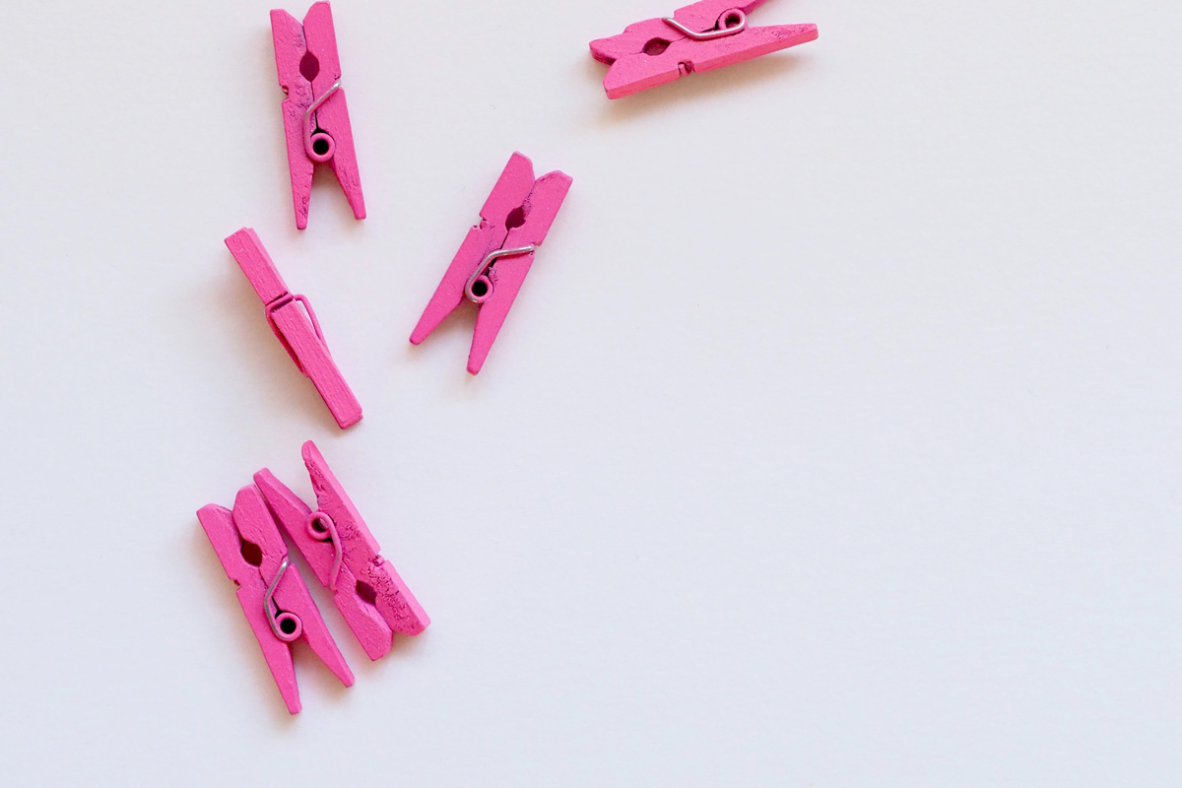
peg

Slide 19
dig

Slide 20
tag

Slide 21
get

Slide 22
grip

Slide 23
grin

Slide 24
lag

