Slide 1
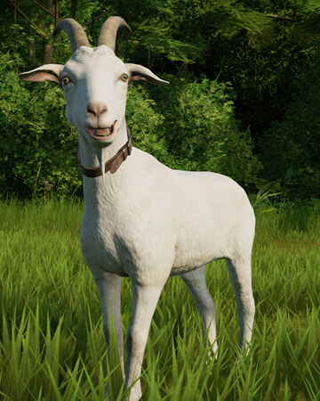
goat

Slide 2
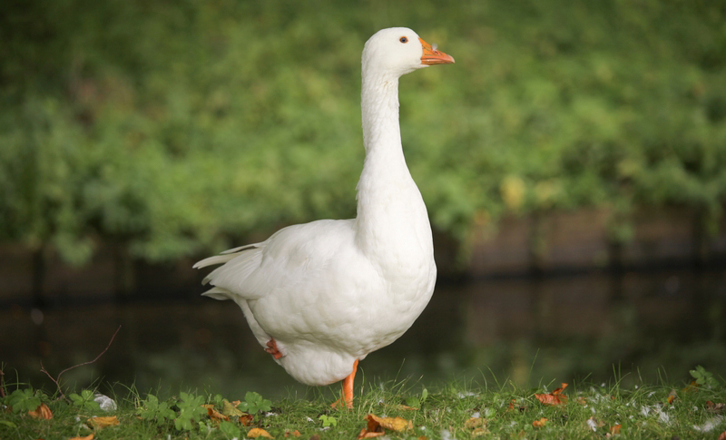
goose

Slide 3
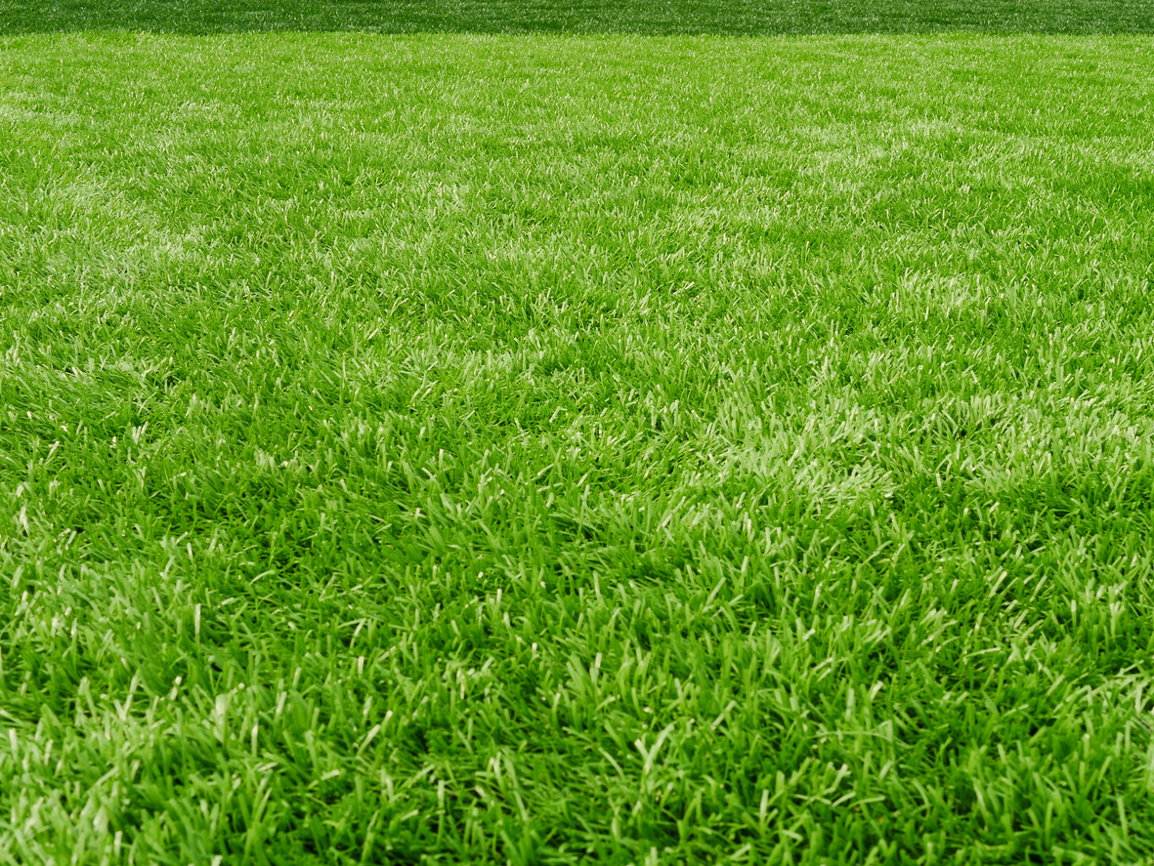
grass

Slide 4
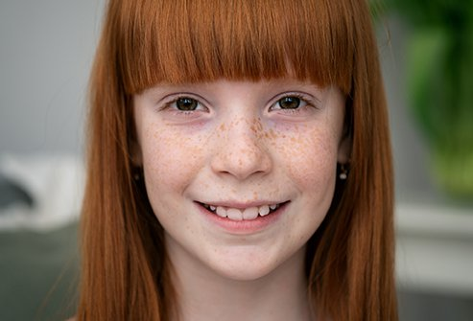
girl

Slide 5
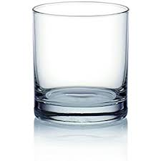
glass

Slide 6
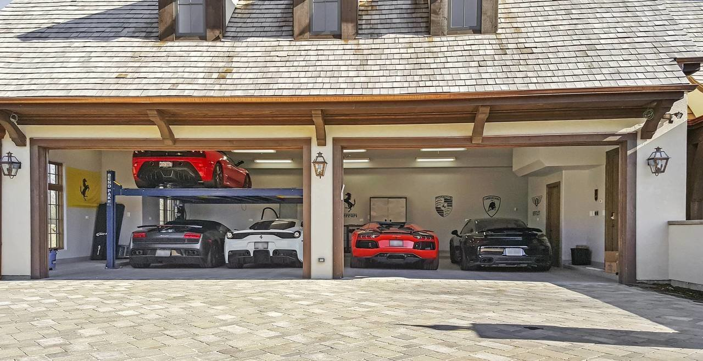
garage

Slide 7
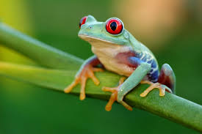
frog

Slide 8
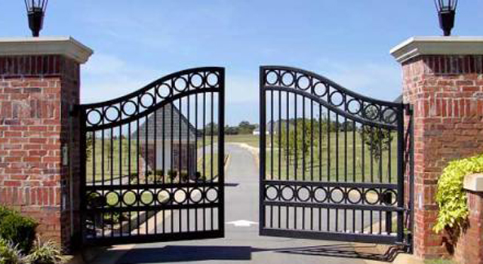
gate

Slide 9
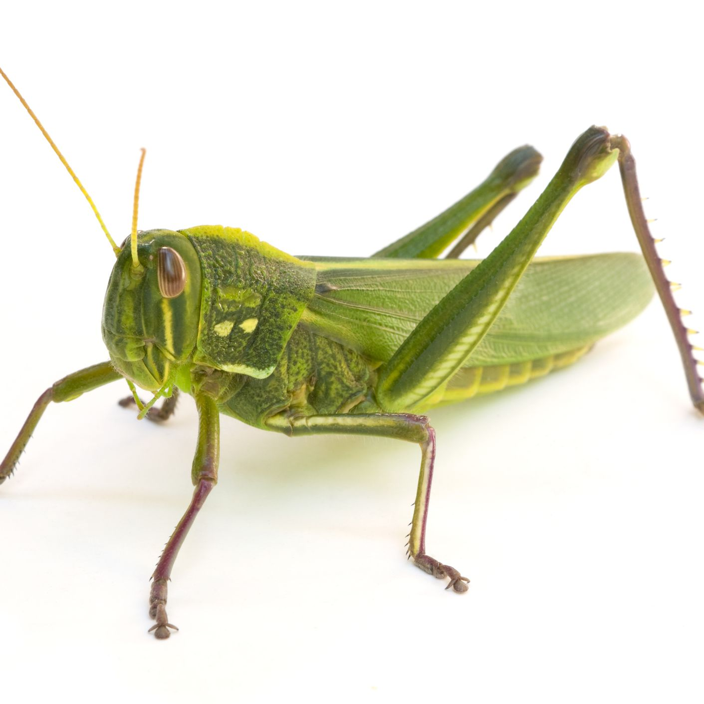
grasshopper

Slide 10
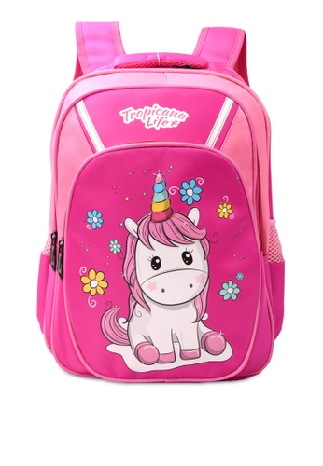
bag

Slide 11
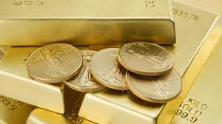
gold

Slide 12
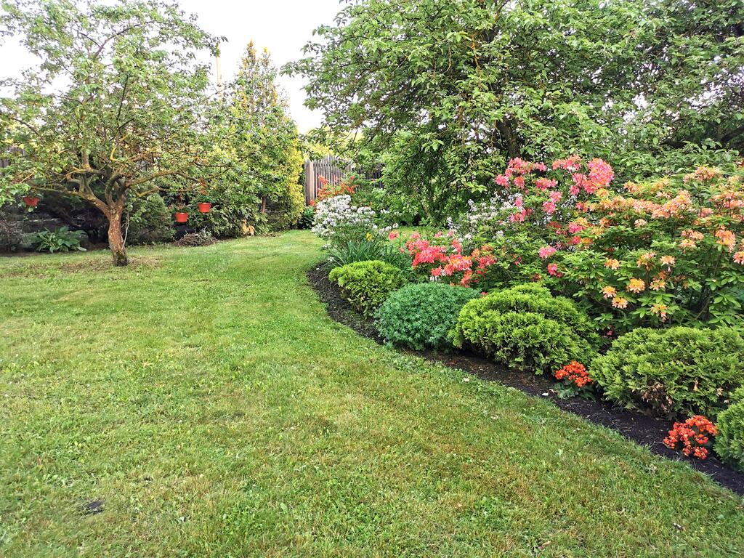
garden

Slide 13
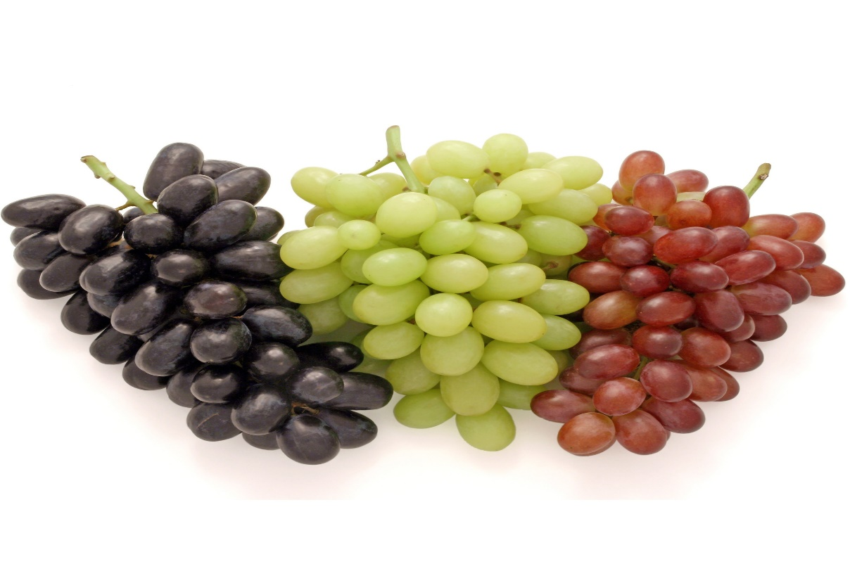
grapes

Slide 14
gate

Slide 15
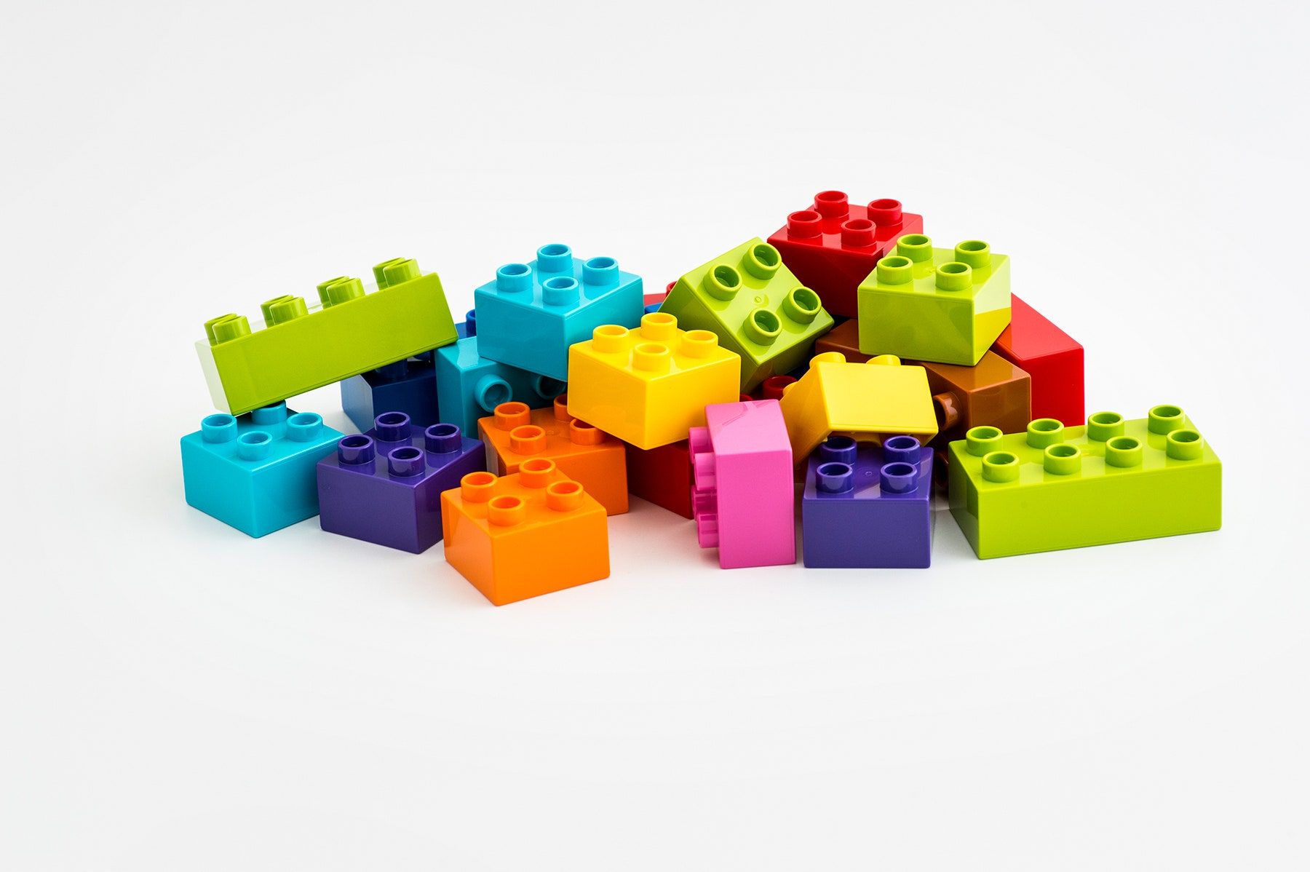
Lego

Slide 16
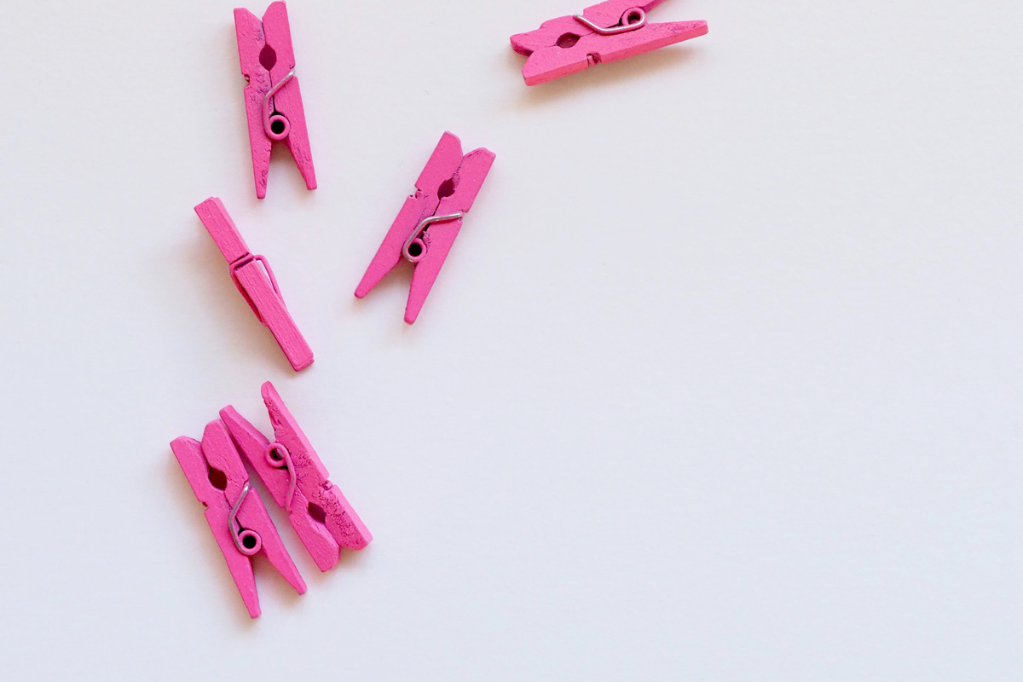
peg

Slide 17
bag
. . .

Slide 18
rag
. . .

Slide 19
pig
. . .

Slide 20
gap
. . .

Slide 21
peg
. . .

Slide 22
dig

Slide 23
tag

Slide 24
get

Slide 25
grip

Slide 26
grin

Slide 27
lag

Slide 28
grand
. . . . .

Slide 29
grass
. . . .

Slide 30
grind
. . . . .

