Slide 1
The Automation Paradox

Slide 2
Why is the writer’s claim about automation a paradox? Paragraph 3

Slide 3
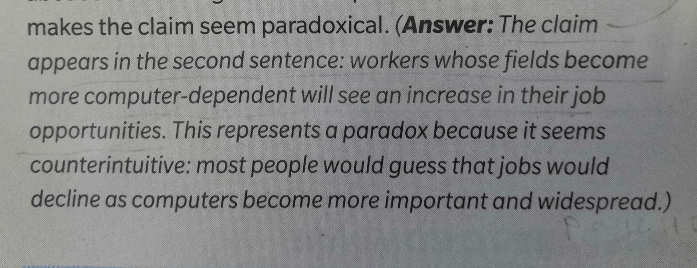
Analyze Why is the writer’s claim about automation a paradox?

Slide 4
How do the results of the software study relate to the writer’s claim?

Slide 5
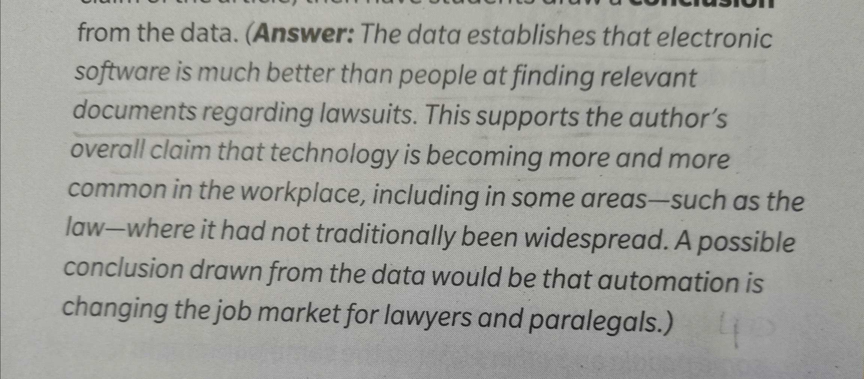
Number and Stats

Slide 6
How does the information in the graph support the writer’s claim?

Slide 7
Analyze Graphic Features

Slide 8
How does the writer use these transitions to connect ideas? In paragraph 6

Slide 9
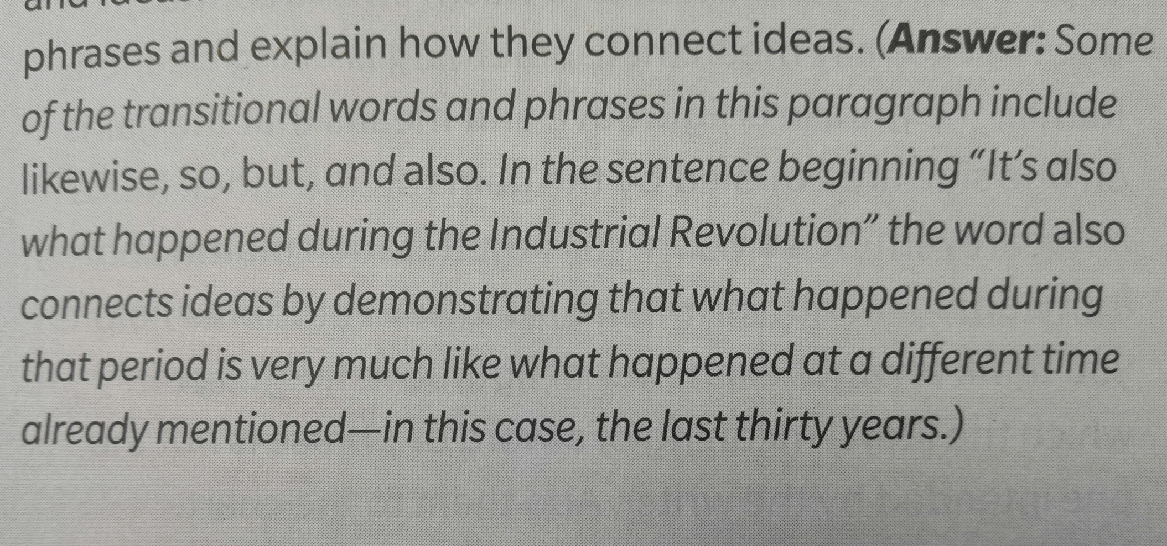
Language Conventions

Slide 10
How do the results of the Mckinsey and Company study relate to the writer’s argument?

Slide 11
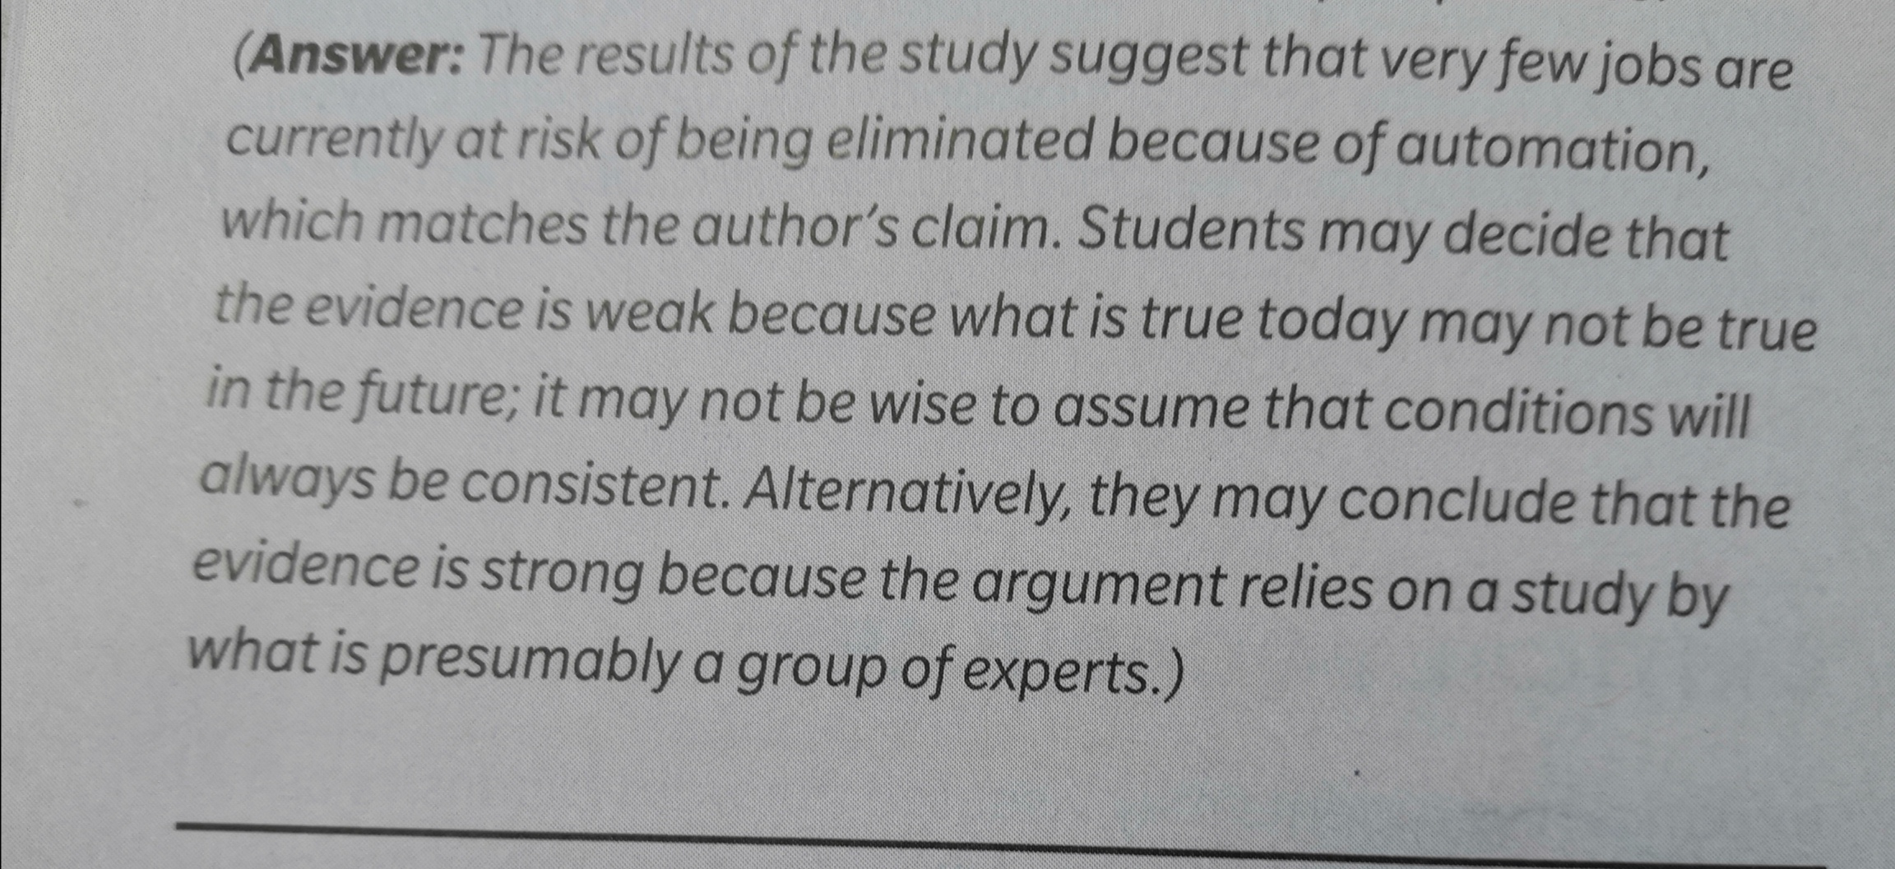
Numbers and stats

Slide 12
Choose the correct answer:
1-What is the main idea that’s presented by Bessen in “The Automation Paradox”
The effects of technology in the workforce.
2-What is the author’s claim in “The Automation Paradox”?
The author believes computer automation has a positive impact on jobs and employment.
3-According to the essay the negative great impact of technology has mostly affected:
Blue-collar workers
4- Beliefs, feelings or thoughts are considered as :
an opinion
5- It will require some workers to gain new skills to meet the demands of a changing workforce.
a-True
b-False

