Slide 1


Slide 2
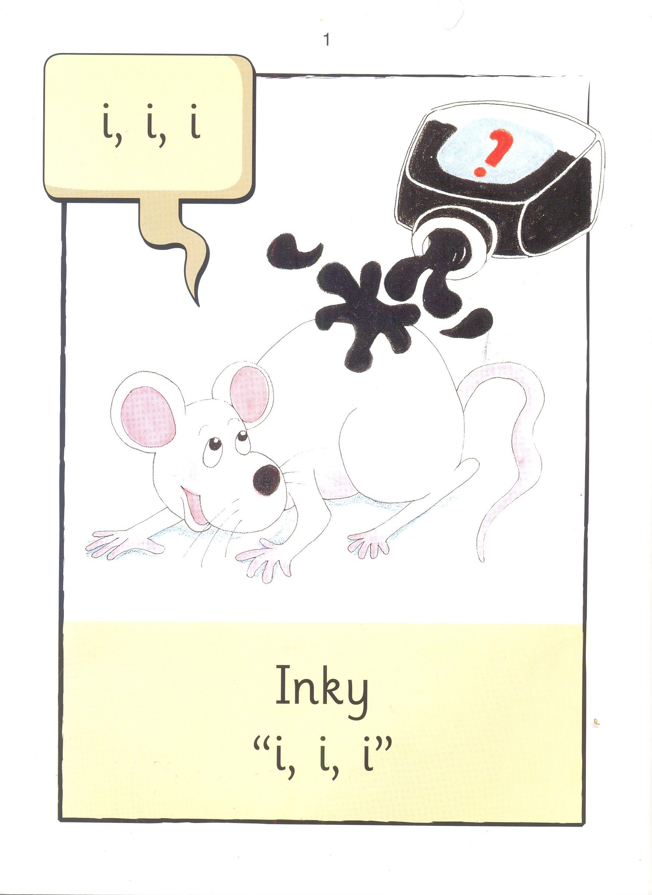

Slide 3


Slide 4
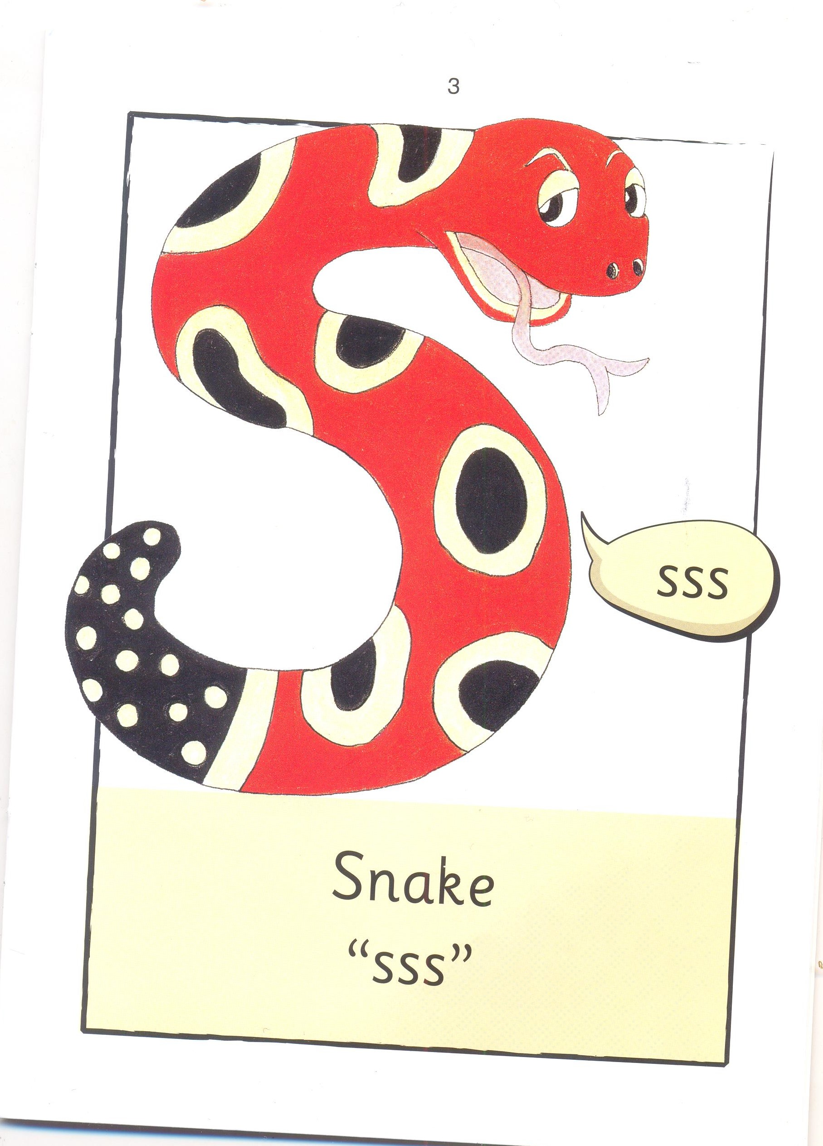

Slide 5
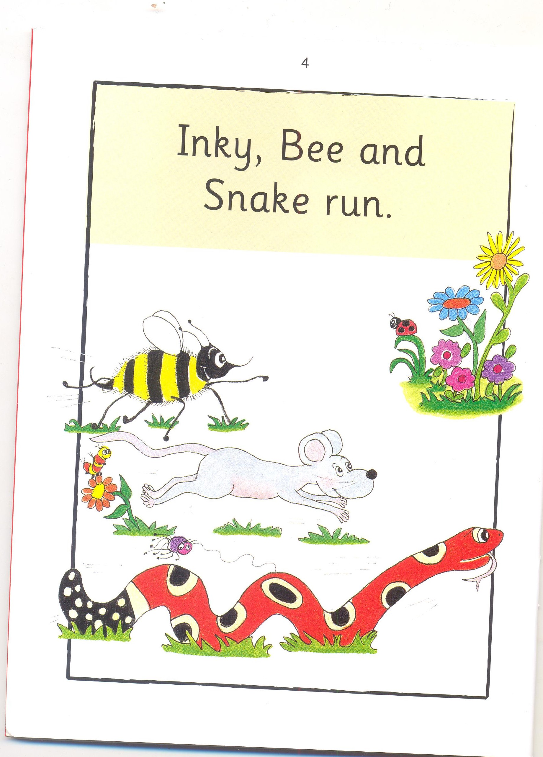

Slide 6
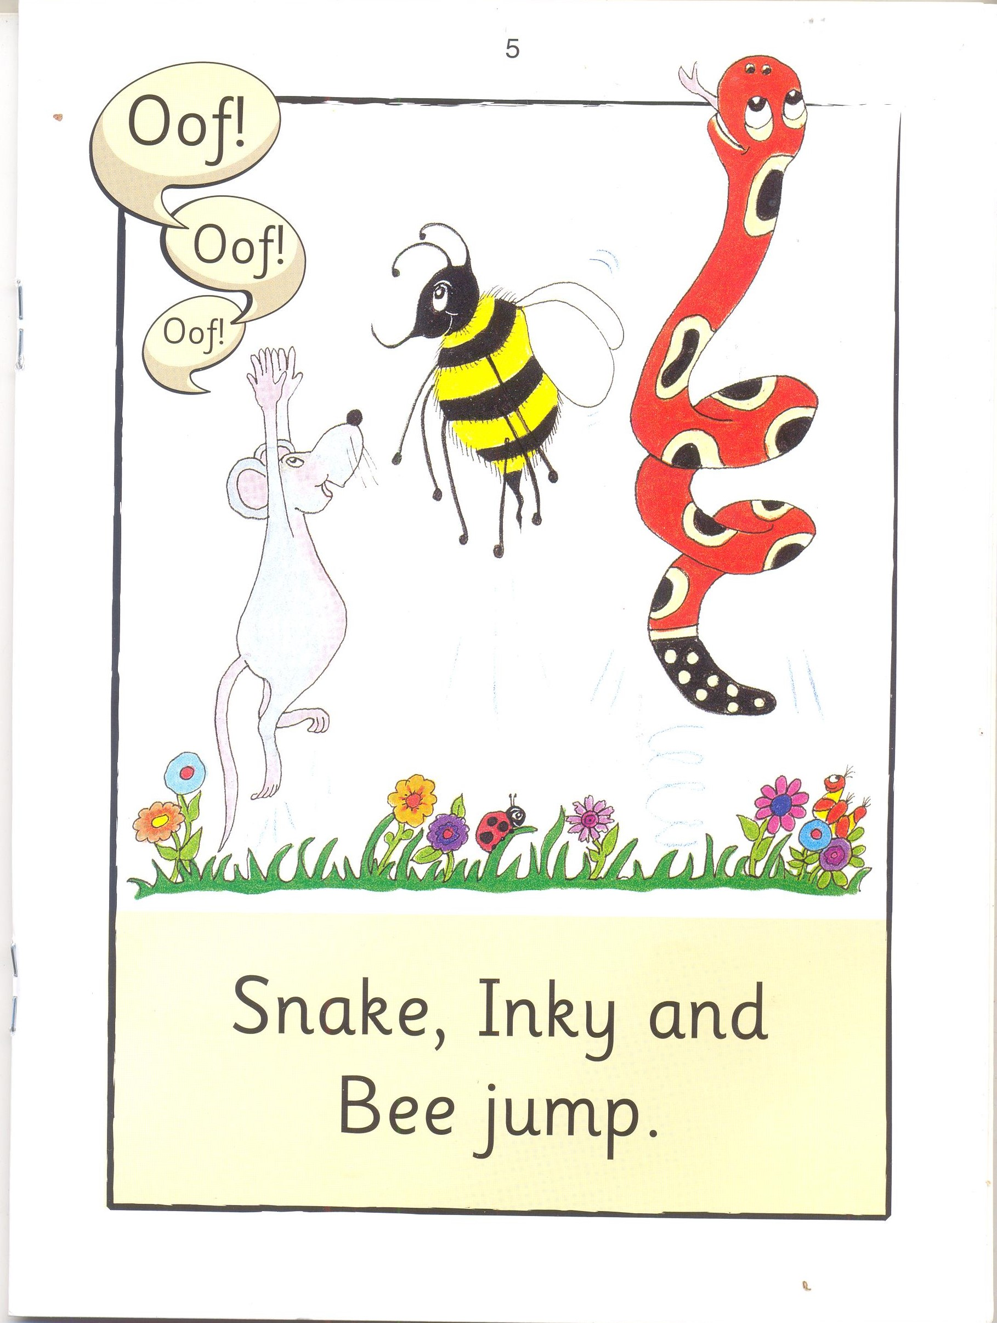

Slide 7
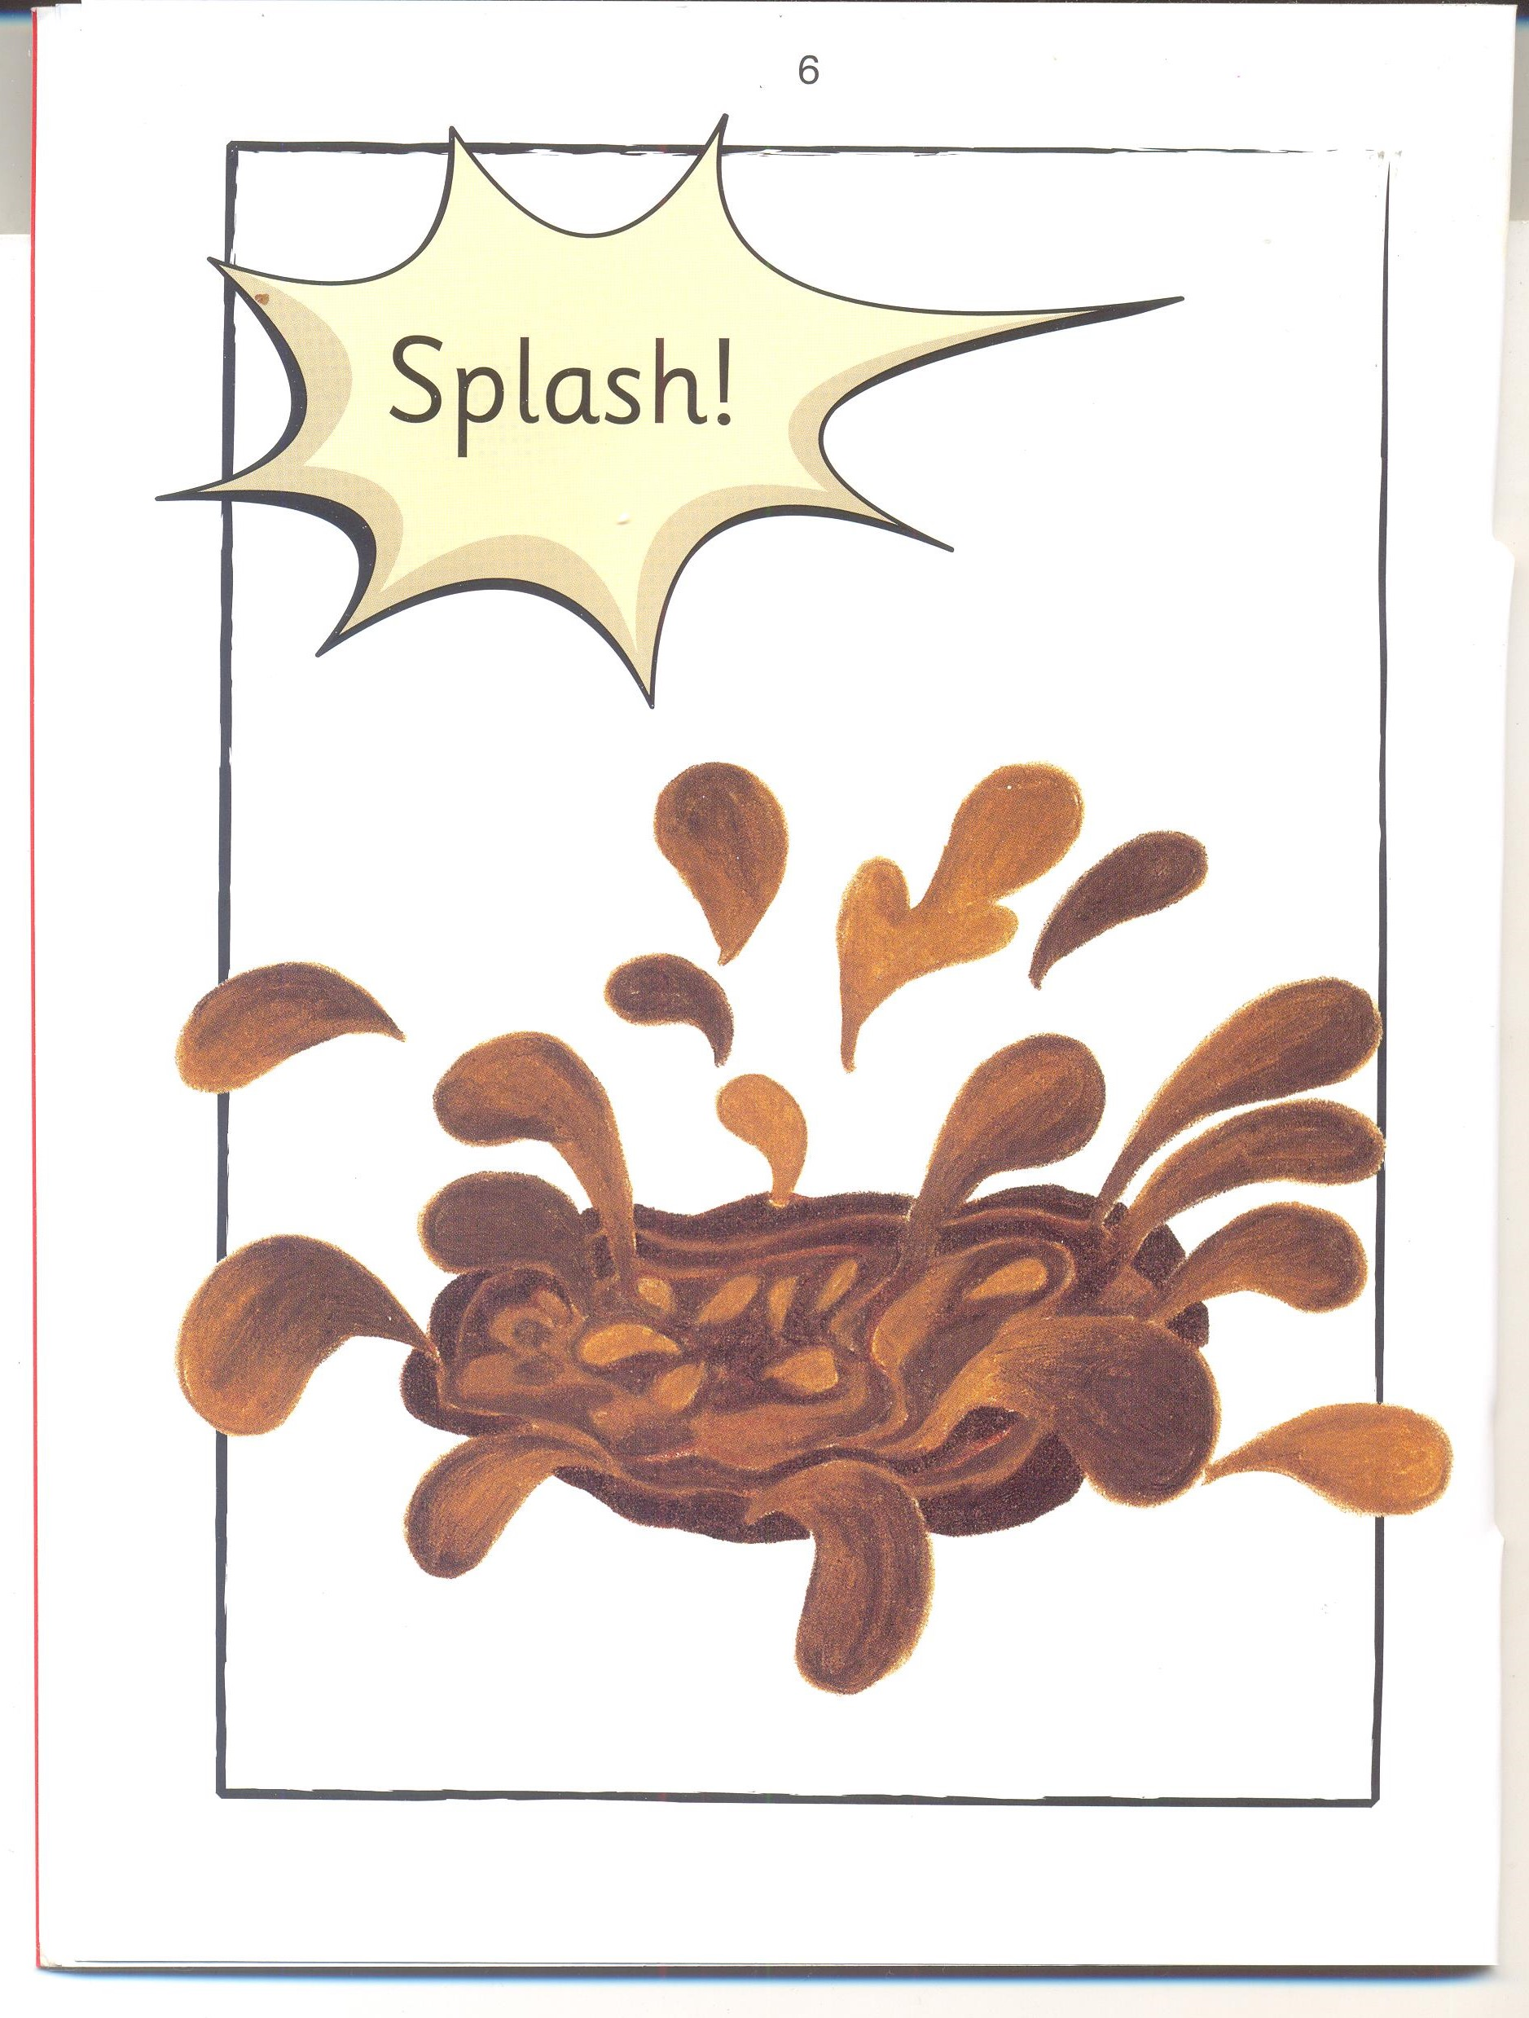

Slide 8
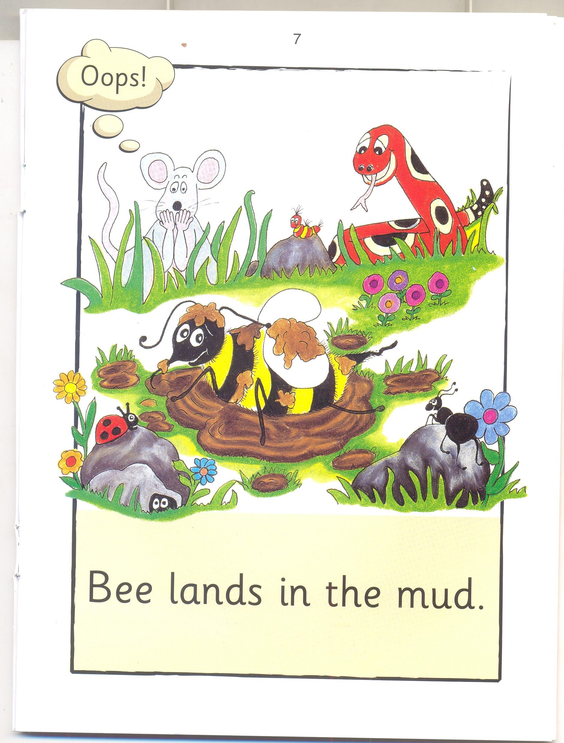

Slide 9
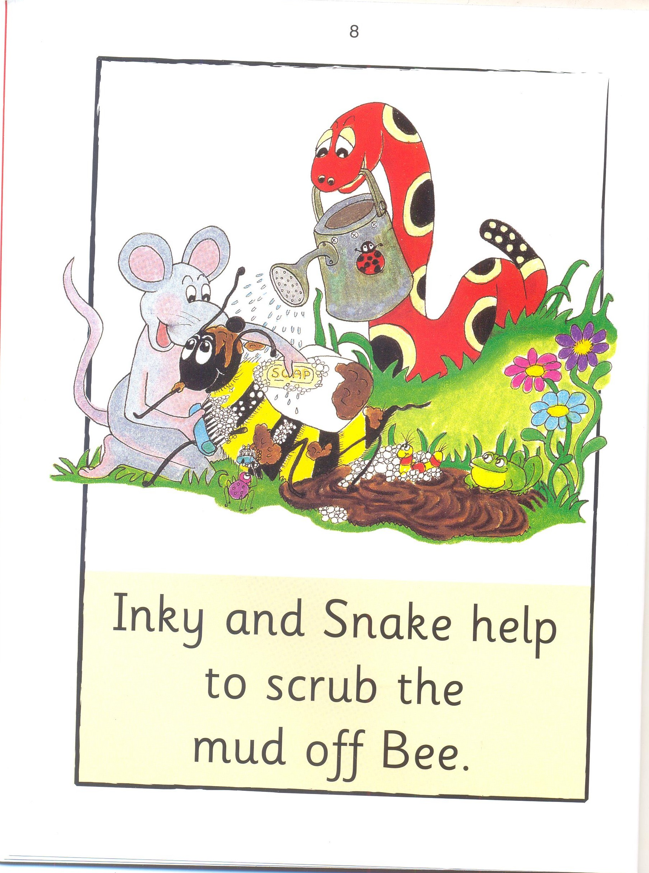

Slide 10
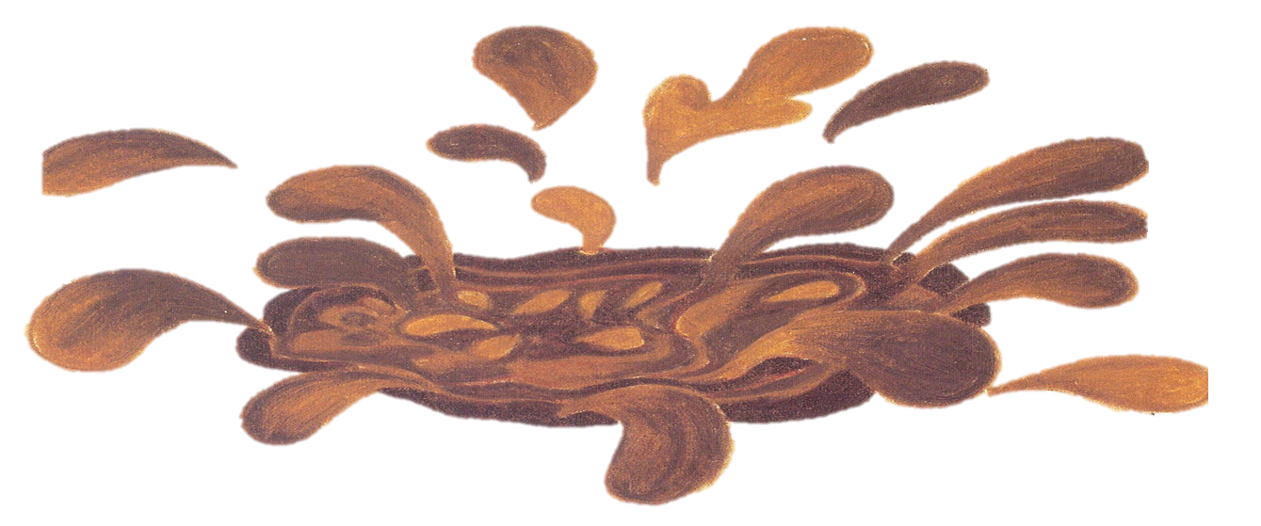


Inky Mud
l 2

Slide 11
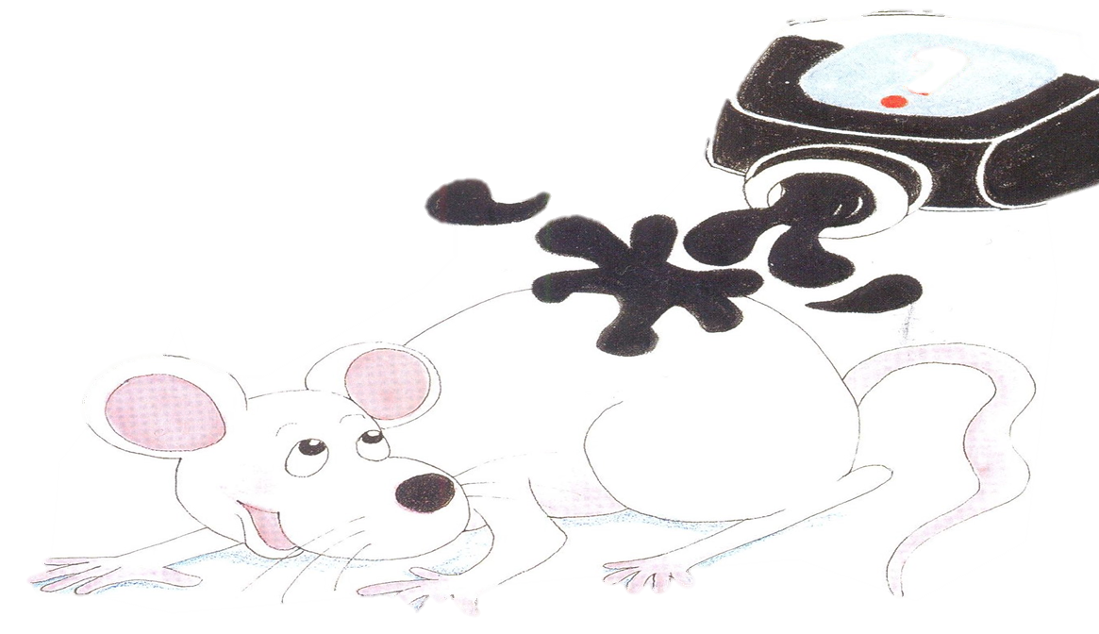


Bee Inky
I 2

Slide 12
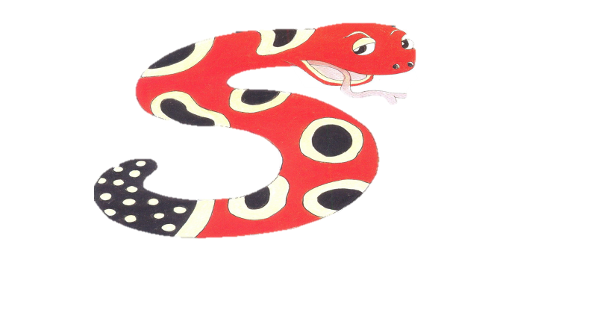


Mud Snake
I 2

Slide 13
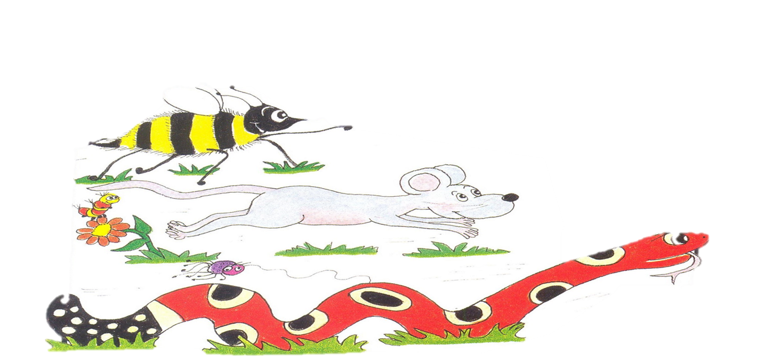

run jump
I 2

Slide 14



Jump run
I 2

Slide 15
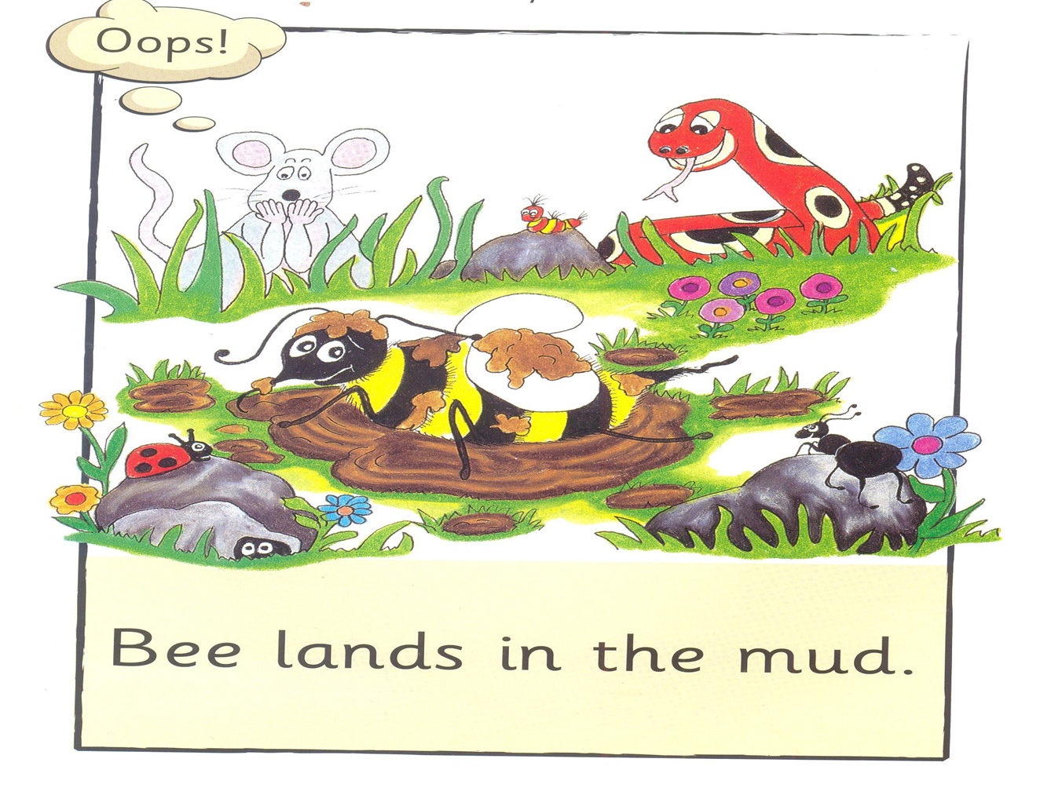

jumps lands
I 2

Slide 16
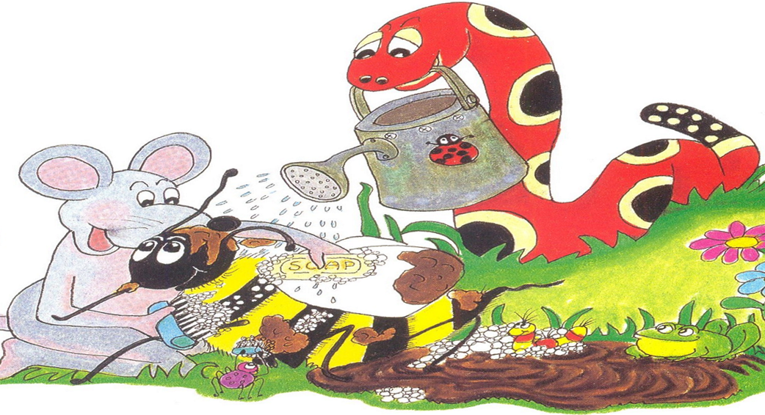


lands scrub
I 2

Slide 17
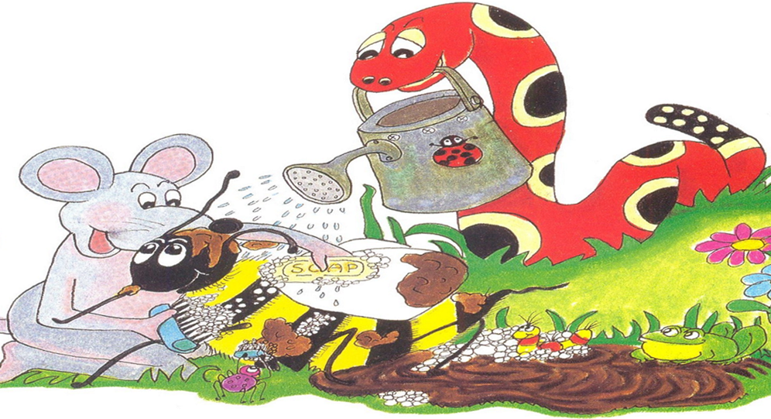


help jump
I 2

Slide 18
Mud

Slide 19
m
u
d

Slide 20

Inky

Slide 21
Bee

Slide 22
Snake

Slide 23
and

Slide 24
run

Slide 25
jump

Slide 26
splash

Slide 27
in

Slide 28
the

Slide 29
lands

Slide 30
help

Slide 31
to

Slide 32
scrub

Slide 33
off

