Slide 1
Lewis structure and covalent compounds
Study Sheet #3

Slide 2
Learning Objectives:
Define covalent bonds.
Explain how covalent bonds form.
Describe the properties of covalent compounds.
Use the Lewis structure to represent covalent bonds.
Key words:
Octet Rule
Valence electrons
Lewis structure

Slide 3
Types of chemical bonds:
2- Covalent bond:
The sharing of electrons between atoms. This type of bonding occurs between two atoms of the same element or of elements close to each other in the periodic table. This bonding occurs primarily between nonmetals.

Slide 4
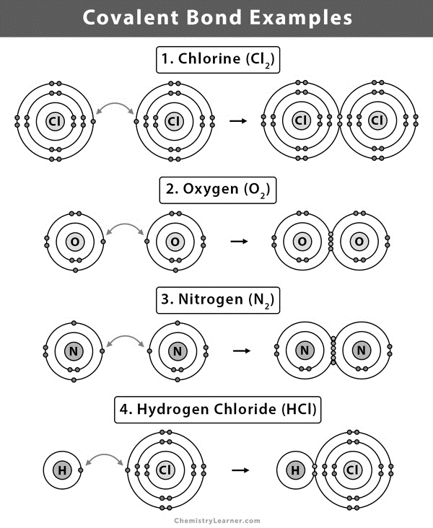

Slide 5
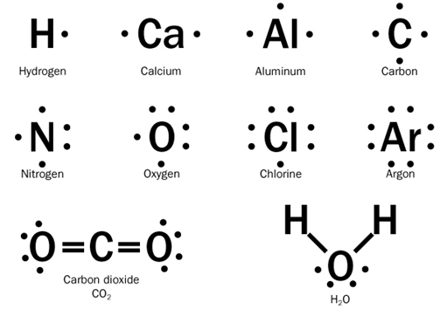
Using Lewis structure:
Only draw the valence electrons of each element (as dot or cross), then pair the single electrons between the two atoms.
The number of valence electrons of any representative element is the same as the group number of the element in the periodic table

Slide 6
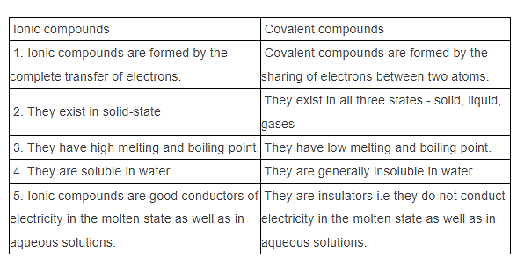
Examples of forming covalent bonds

