Slide 1





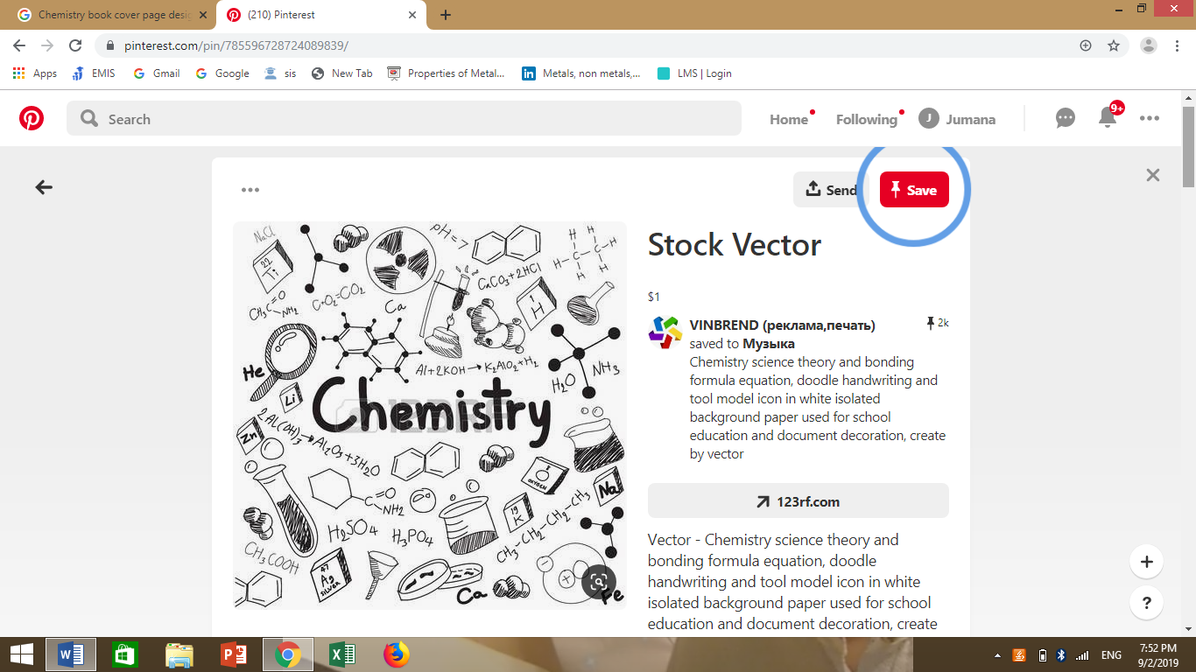
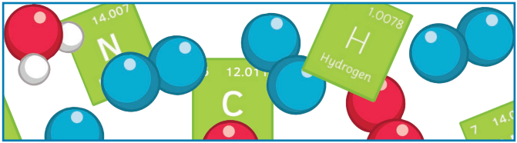

Elements, Compounds and Mixtures

Slide 2
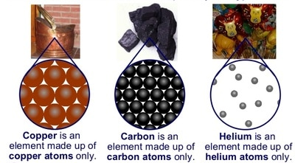
WHAT ARE ELEMENTS ?
An element is a substance made up of only one kind of atom.
Elements are pure substances that cannot be broken down into simpler substances.
** 118 elements are known and they are arranged in a table called the periodic table.

Slide 3
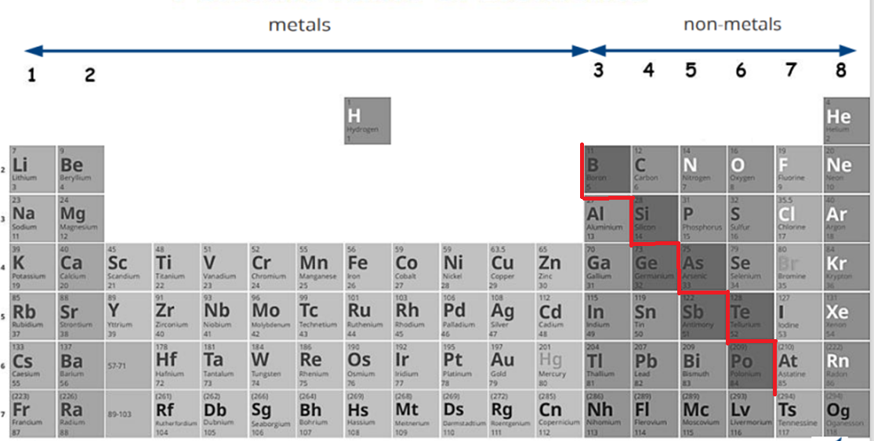


Slide 4
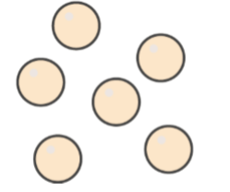
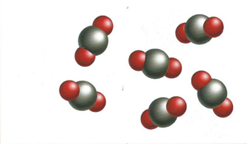
Substances made from only one type of atoms are called ELEMENTS.
Substances made up of different types of atoms are called COMPOUNDS.
Compounds are chemically joined together by chemical bonds.
ELEMENT COMPOUND

Slide 5
https://edpuzzle.com/media/655f05fccd9bdf4199324859

Slide 6

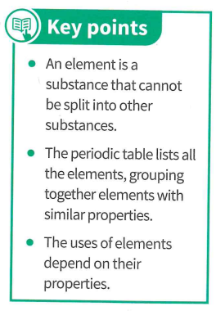

Slide 7
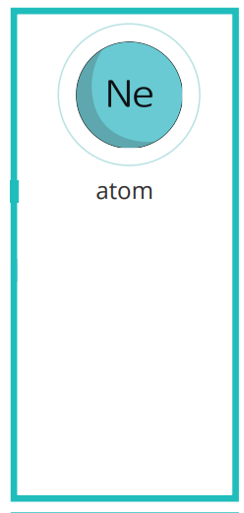
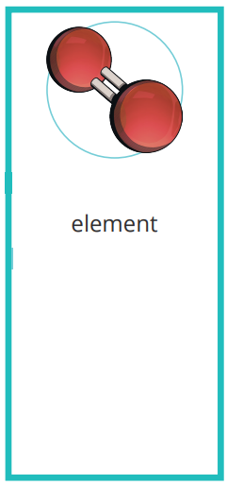
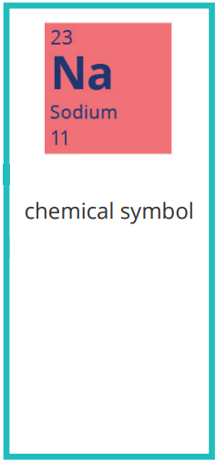
The smallest particle of a chemical element.
Contains electrons, protons and neutrons.
A substance that cannot be broken down into another substance.
Each element is made up of its own type of atom.
Most chemical elements are represented symbolically by two letters, generally the first two in their name.

Slide 8

Why do we use the chemical symbols?

Slide 9
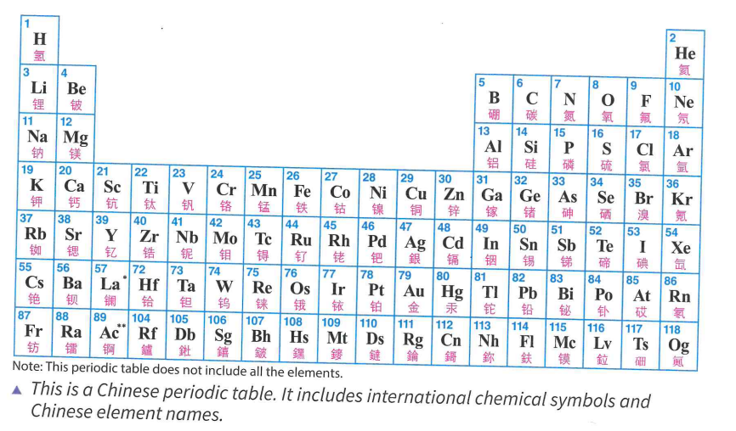

Slide 10
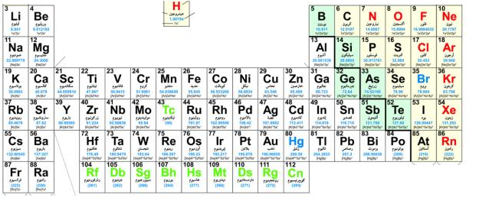

Slide 11
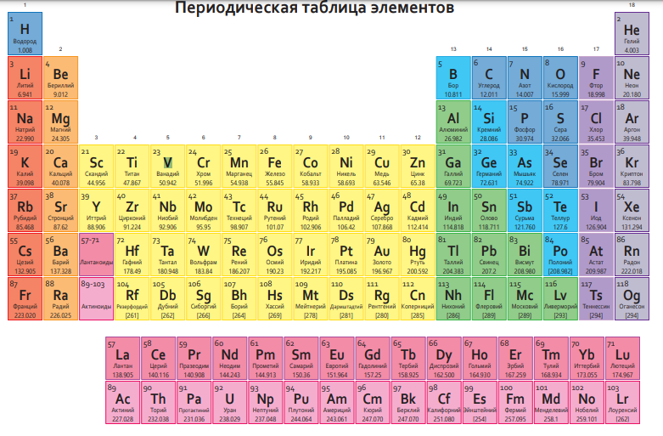

Slide 12
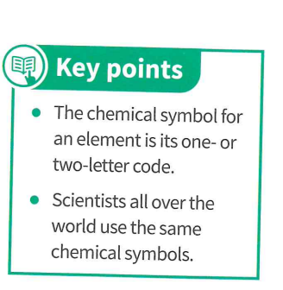

Slide 13
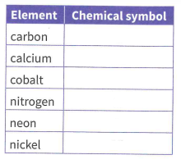
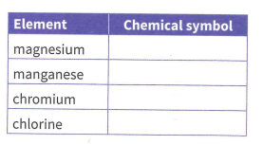
C
Ca
Co
N
Mg
Ne
Mn
Ni
Cr
Cl

