Slide 8
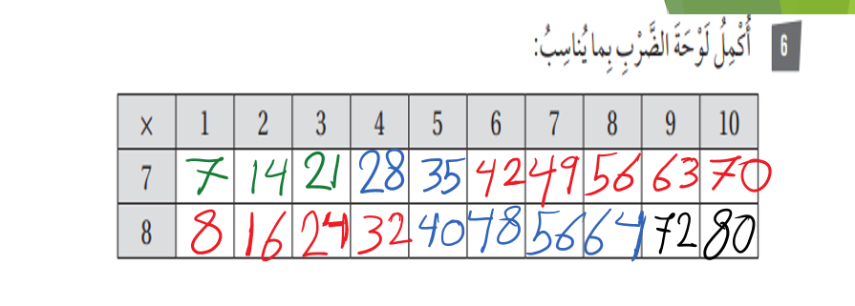
https://wordwall.net/ar/resource/26442994

