Slide 1
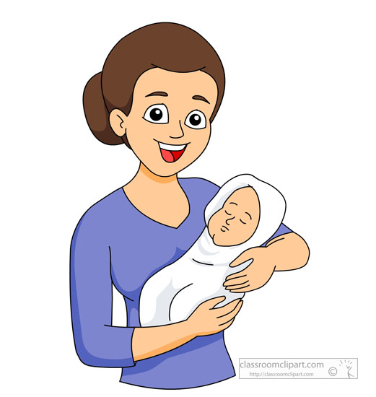
mother
.
.
.
.

Slide 2

mountain
.
.
.
.
.
.

Slide 3

mirror
.
.
.
.

Slide 4
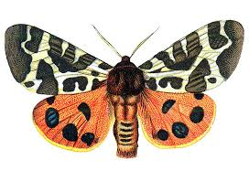
moth
.
.
.

Slide 5

mouse
.
.
.

Slide 6
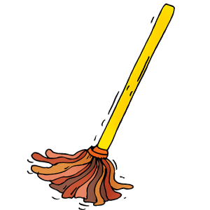
mop
.
.
.

Slide 7

mat
.
.
.

Slide 8
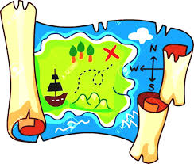
map
.
.
.

Slide 9

man
.
.
.

Slide 10
man

Slide 11
men

Slide 12
him

Slide 13
mug

Slide 14
lamp

Slide 15
camp

Slide 16
mom

Slide 17
stem
.
.
.

