Slide 1
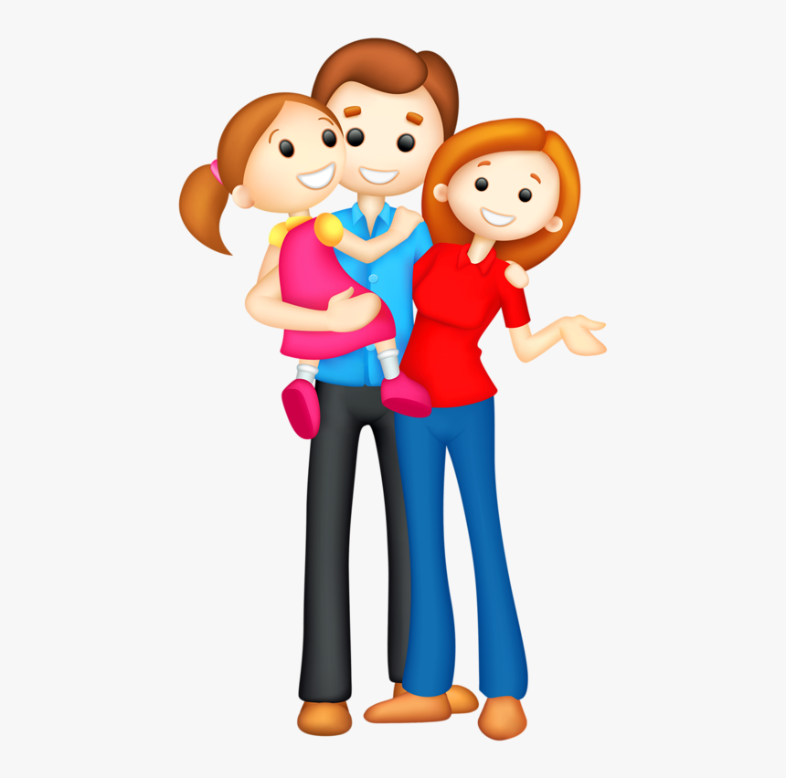
dad

Slide 2
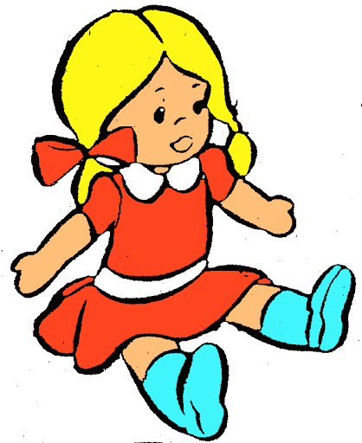
doll

Slide 3
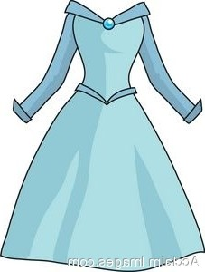
dress

Slide 4
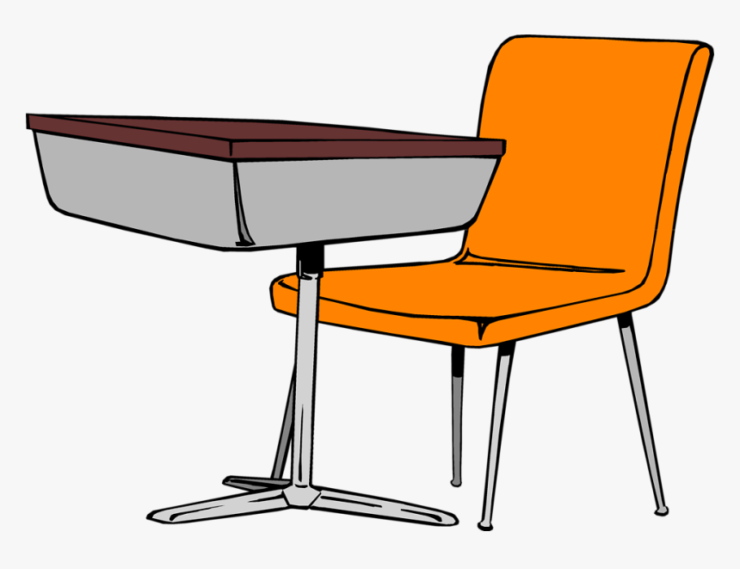
desk

Slide 5
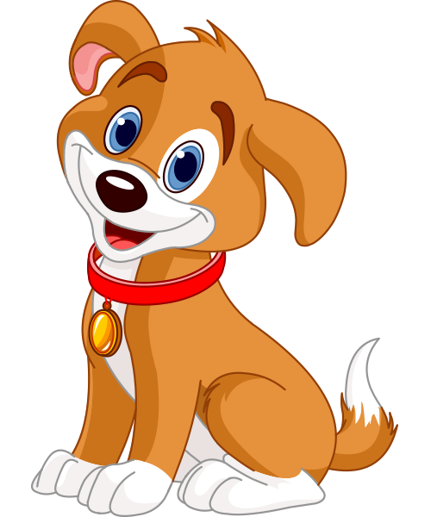
dog

Slide 6

drum

Slide 7
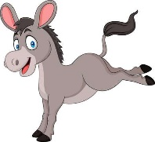
donkey

Slide 8

dots

Slide 9
dip

Slide 10
pad

Slide 11
din

Slide 12
had

Slide 13
den
.
.
.

Slide 14
dad

Slide 15
red

Slide 16
add

Slide 17
send

Slide 18
spend

Slide 19
sad

