Slide 1
Daily message
Today , we are going to read tricky words.

Slide 2
Tricky words

Slide 4
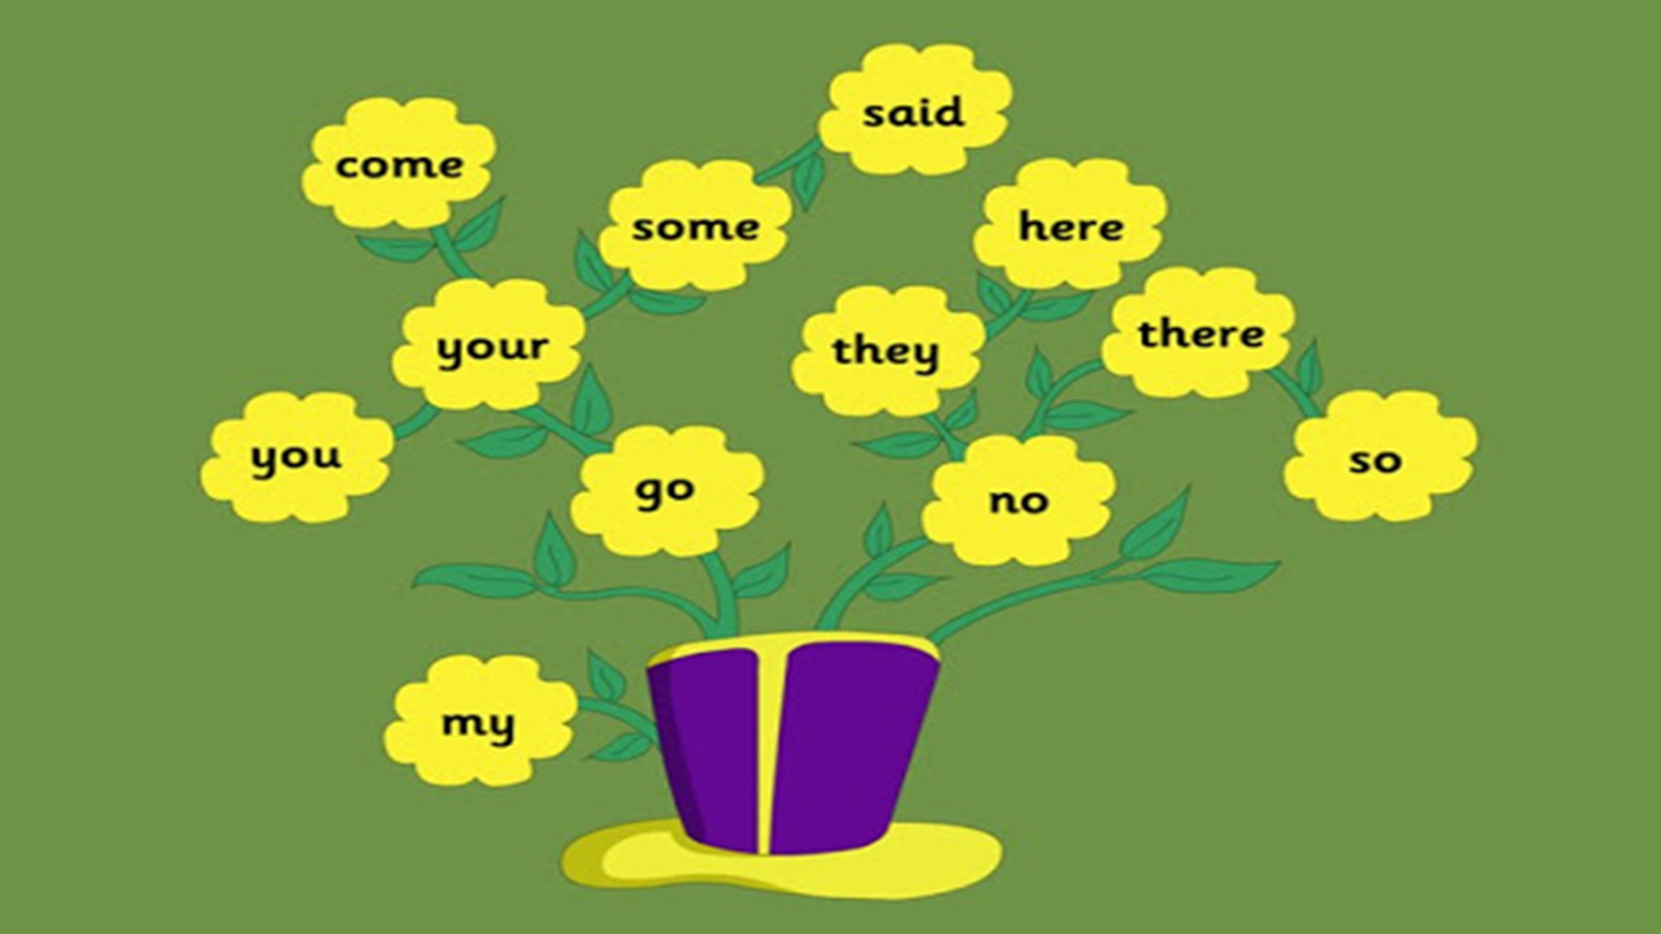

Slide 5
he

Slide 6
be

Slide 7
we

Slide 8
me

Slide 9
she

Slide 10
the

Slide 11
Page 41

