Slide 1
Magnets

Slide 2
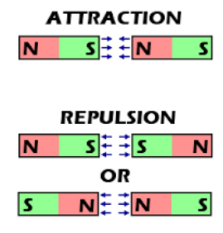
The properties of magnets
Magnets have 2 poles.
A North and a South pole
Like poles repel each other
Unlike Poles attract each other

Slide 3
Magnetic Materials
Some materials are attracted to magnets. These are called magnetic materials.
Iron, cobalt and nickel are all magnetic materials that are elements.
Some of the alloys or oxides of these elements are also magnetic.
Steel is magnetic because it contains mainly iron. Lodestone or magnetite contains iron oxide which is also magnetic.

Slide 4
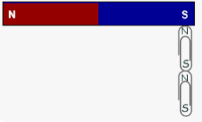
Magnetic Materials
A piece of magnetic material is attracted to a magnet, but it will not be repelled by it.
Only magnets repel each other.
Magnetizing:
Iron and steel can be magnetized by being close to a magnet.
Iron is easy to magnetize, but if you remove the magnet the iron is no longer magnetized
Steel is harder to magnetize compared to iron but it stays magnetized when you remove the magnet for a period of time

Slide 5
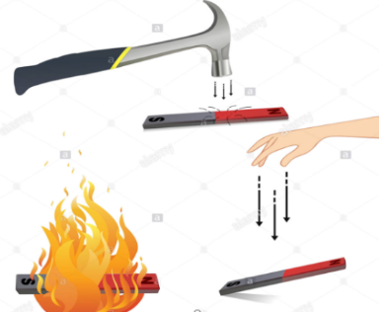
Demagnetizing Magnets:
You can not turn a permanent magnet off but you can demagnetize it by:
Heating it up to a high temperature
Hitting it with a hammer

Slide 6
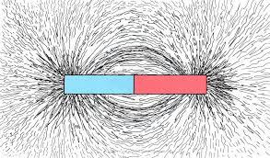
Magnetic Fields:
The magnetic field of a magnet is the region around the magnet where magnetic materials experience a force.
The magnetic field of a bar magnet has the following shape:
Scientists learned the shape by using iron fillings around a
bar magnet and saw the pattern.
The magnetic field is strongest at the poles and decreases as we move away from the poles.

Slide 7
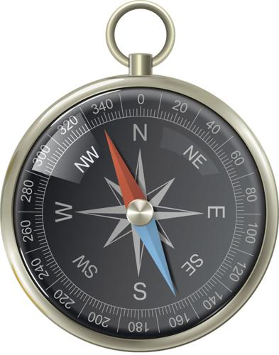
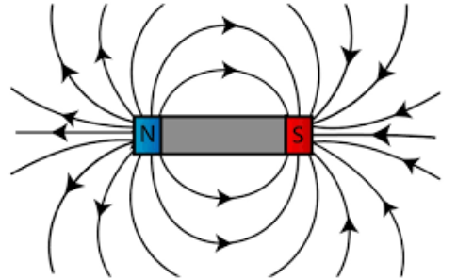
Magnetic Fields:
The magnetic field of a magnet moves from the north pole of the magnet to the south pole of the magnet.
We know this by using a tiny compass as the video shows:
https://www.youtube.com/watch?v=NWUgK8W-4JM&ab_channel=vt.physics

Slide 8
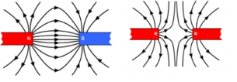
Magnetic Fields:
When we bring two magnets next to each other their magnetic fields would interact as shown here:
Attraction
Repulsion

Slide 9
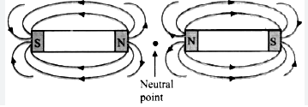
Magnetic Fields:
When the two bar magnets are repelling each other you will notice that there is a space between the two magnets called the neutral point, in the neutral point there is no magnetic field meaning that if a magnetic material was placed in it, it will not get attracted to either magnet.

Slide 10
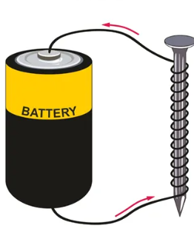
Electromagnets
Electromagnets are magnets that can be turned on or off. It is made by using a coil of wire and a battery.
Electromagnets are more useful than permanent magnets because:
1- You can turn it on and off
2- An electromagnet can be made much stronger than a permanent
magnet of the same size.

Slide 11
How to Make Electromagnets Stronger:
The strength of an electromagnet depends on:
1- The number of turns or loops that you coil the wire, the more turns you have the stronger the magnet is
2- The type of core (nail), using a magnetic material as the core makes it
stronger.
3- The current (battery), more current will make the electromagnet stronger.

Slide 12
Questions
Fill in the blanks:
Iron south attracted to copper north repelled by
Magnetic materials such as __________, nickel, or steel can be magnetized. When you move a magnet near a magnetic material, the material will be ___________ the magnet, but it will never be _______ the magnet. _____________ nails are ____________ a magnet because each one becomes magnetized. If the pole that is touching the nail is a north pole, then the end of the nail touching the magnet has become a __________ pole.

Slide 13
Questions
2) A student has two magnets of different shapes:
Describe how she could find the magnetic field pattern around each magnet.
She uses her method to draw a diagram to show the magnetic field pattern. Describe how the pattern shows:
Where the field is strongest?
Where the north pole is?

Slide 14
Questions
3) Write T next to the statements that are true. Write F next to the statements that are false:
Replacing the iron core of an electromagnet with an aluminum core makes it stronger
An electromagnet with more coils will pick up fewer paper clips
Permanent magnets are always stronger then electromagnets
Unlike permanent magnets, electromagnets can be turned off

Slide 15
شكراً
Thank you

