Slide 1
Idioms

Slide 2
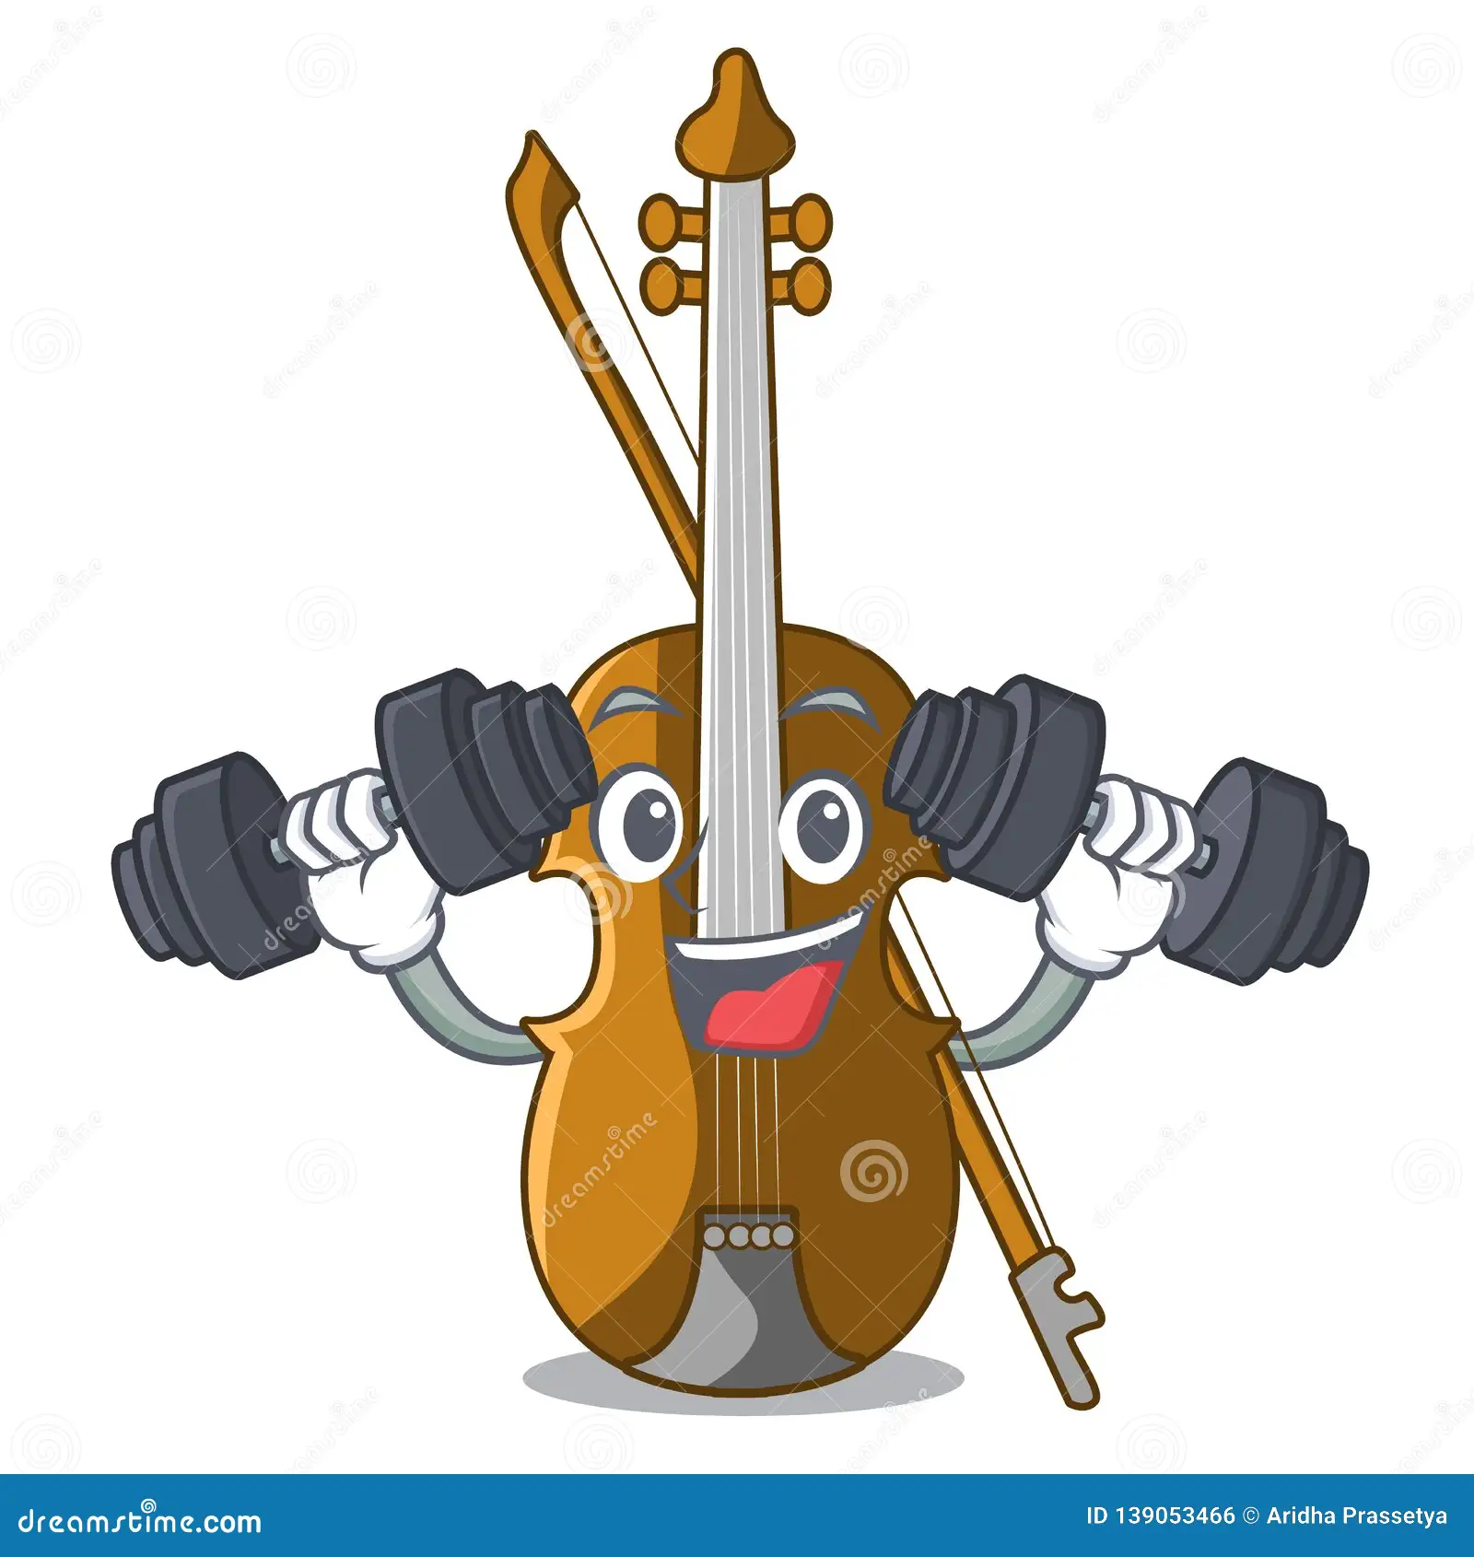
Fit as a fiddle I feel (as) fit as a fiddle this morning.
I feel (as) fit as a fiddle this morning.

Slide 3
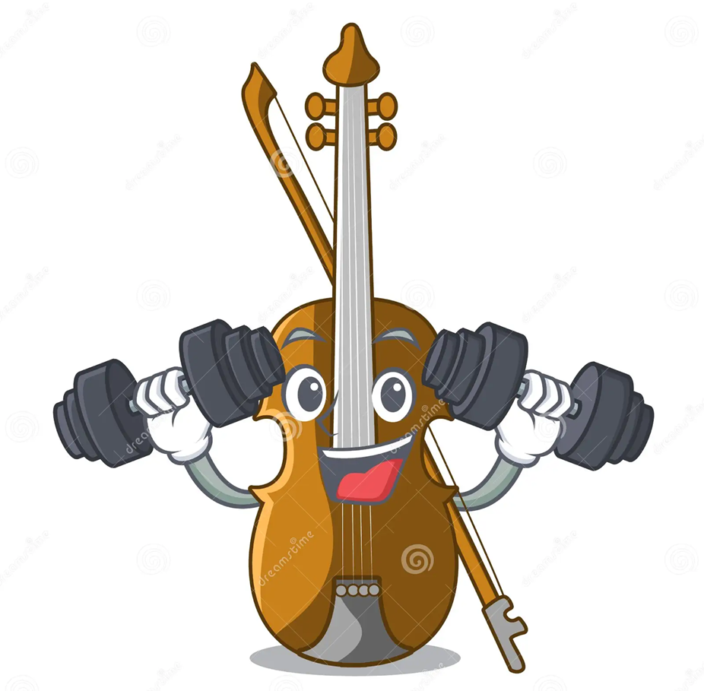
in good physical condition : very healthy and strong.

Slide 4
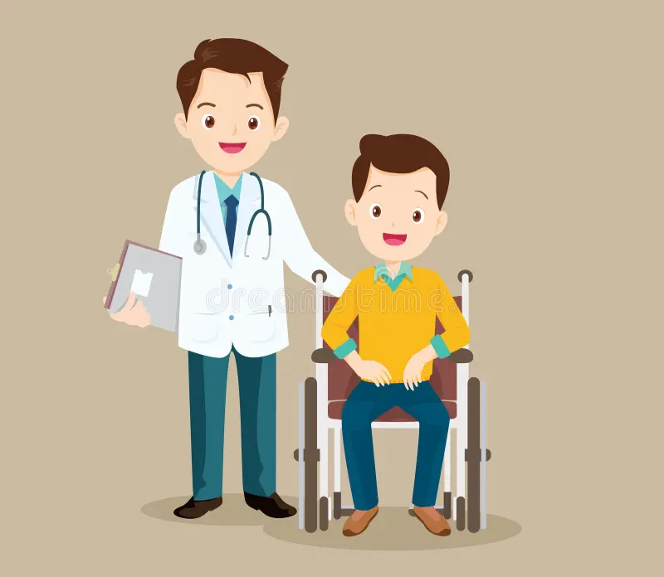
On the mend Sara was very ill after the accident, but she’s definitely on the mend now.

Slide 5
To become improved

Slide 6
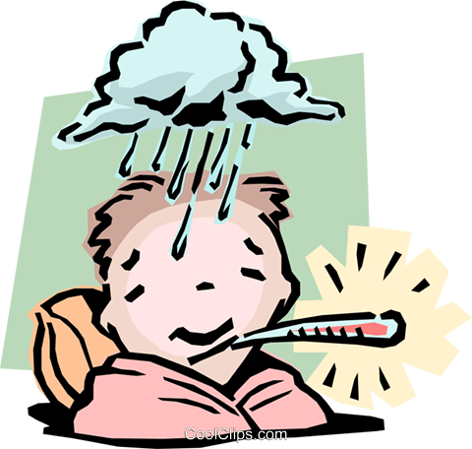
I'm feeling a bit under the weather - I think I'm getting a cold.

Slide 7
If someone is or feels under the weather, they feel ill:

Slide 8
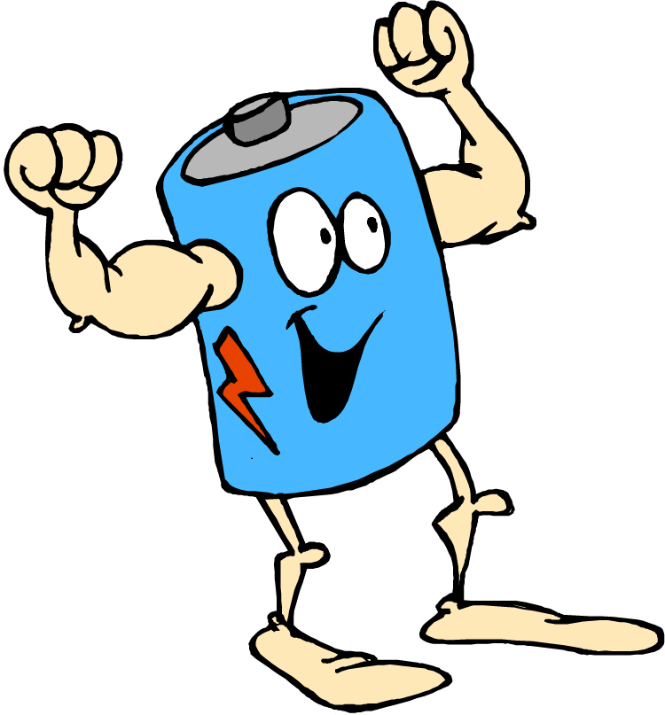
His grandchildren have given him a new lease of life.

Slide 9
An occasion when you become more energetic and active than before.

Slide 10
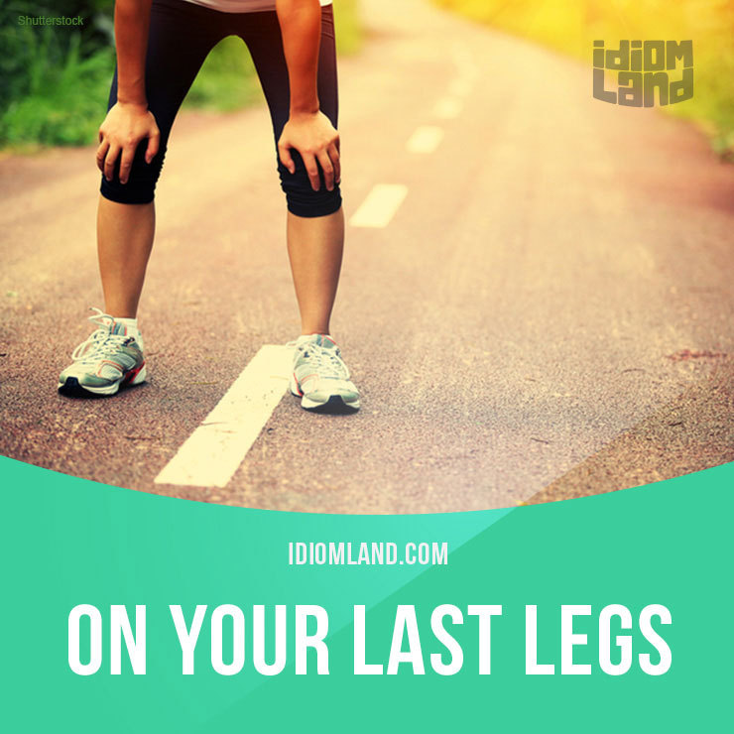
We'd been out walking all day and I was on my last legs when we reached the hotel.

Slide 11
is very tired

Slide 12
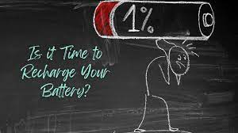
She took a trip to the South of France to recharge her batteries.

Slide 13
to rest and relax for a period of time so that you feel energetic again.

