Slide 2
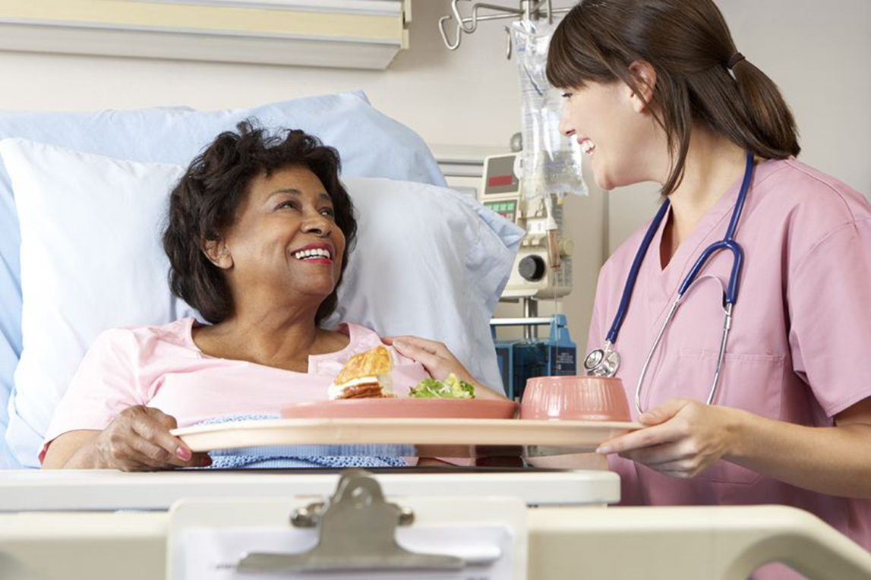
Recover/ injury/ treat/ symptom/ patient/ emergency

Slide 3
to bring back to normal position or condition She had a heart attack but is recovering well.

Slide 4
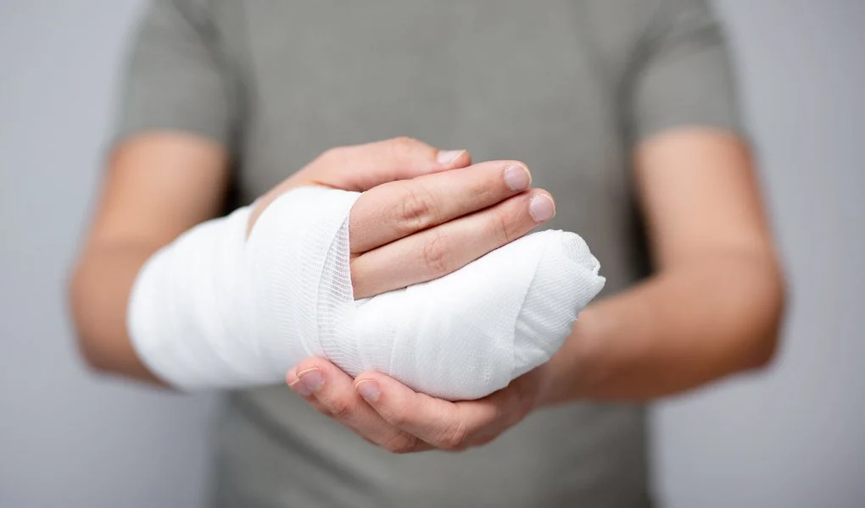
Recover/ injury/ treat/ symptom/ patient/ emergency

Slide 5
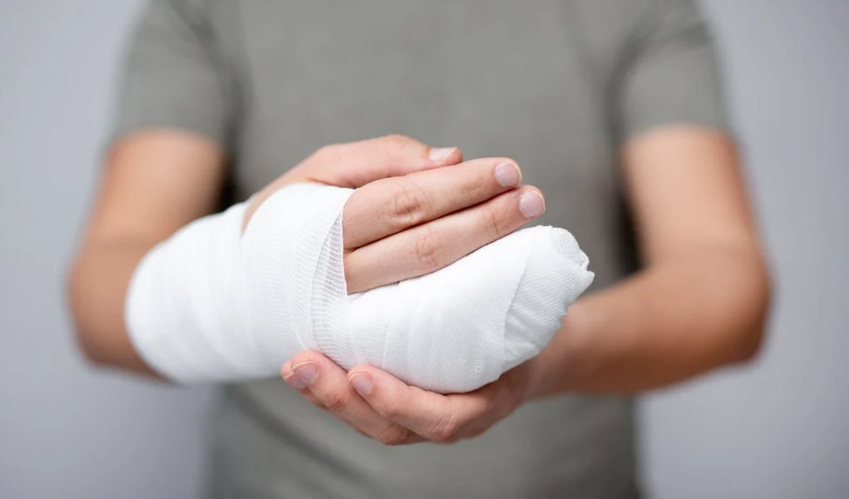
The team has been weakened by illness and injury. physical harm or damage to someone's body caused by an accident or an attack.

Slide 6
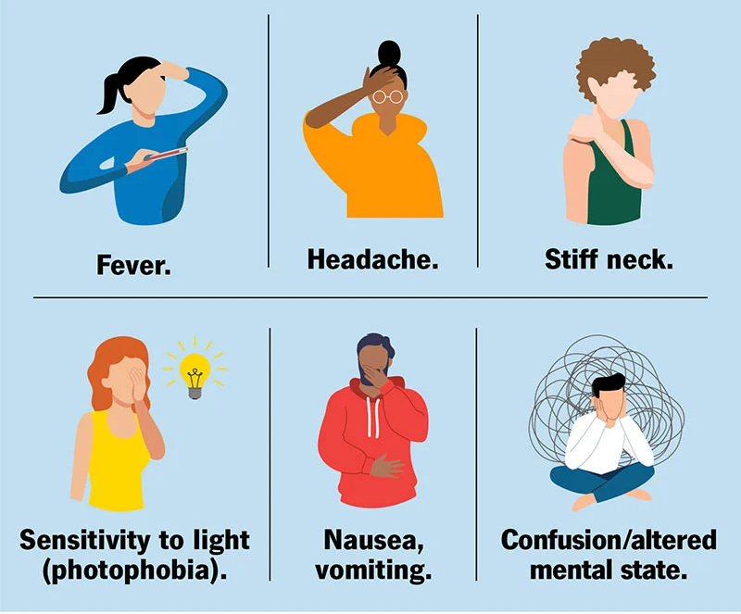
Recover/ injury/ treat/ symptom/ patient/ emergency.

Slide 7
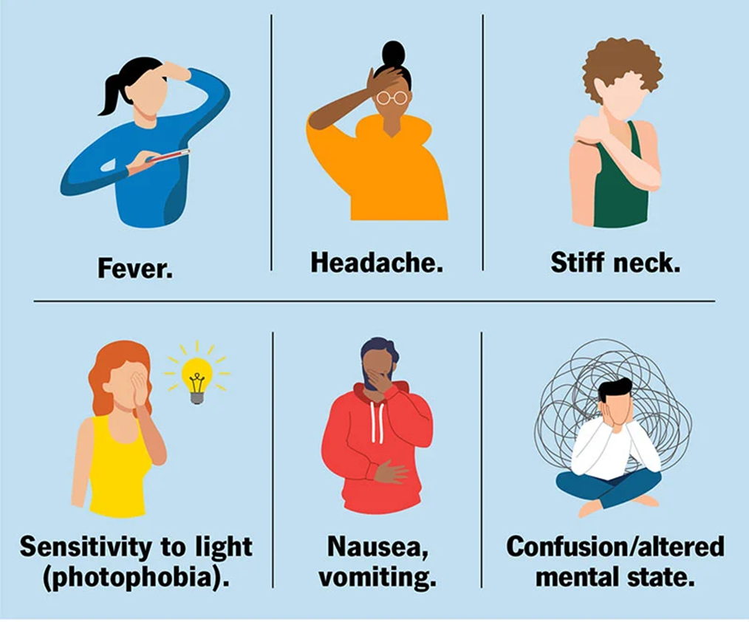
Any feeling of illness or physical or mental change that is caused by a particular disease. He's complaining of all the usual flu symptoms - a high temperature, headache, and so on.

Slide 8
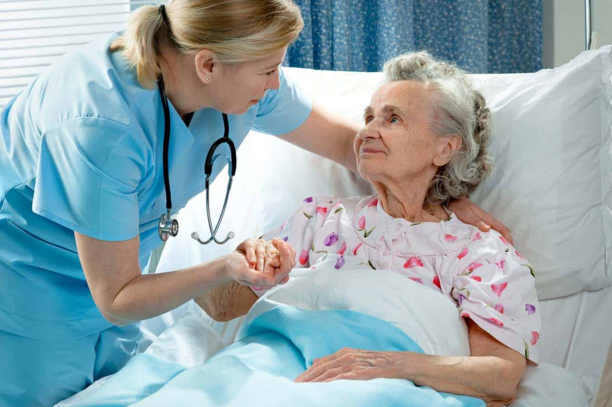
Recover/ injury/ treat/ symptom/ patient/ emergency.

Slide 9
An individual awaiting or under medical care and treatment. The hospital is equipped to handle 500 patients.

Slide 10
Recover/ injury/ treat/ symptom/ patient/ emergency.

Slide 11
Her quick thinking in an emergency saved the baby's life. An urgent need for assistance or relief.

