Slide 1
Unit 3 - Page 30 Ex. 4

Slide 2
Agriculture/ homegrown/ local/ generations/ inhabitants.

Slide 3
They cleared the land to use it for agriculture. the science or occupation of cultivating the soil, producing crops, and raising livestock.

Slide 4
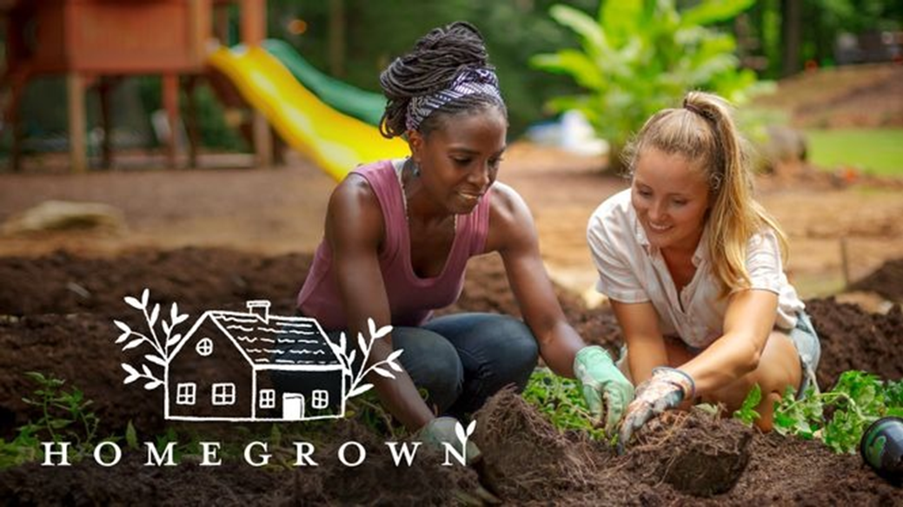
The family sells their homegrown vegetables at the local market.

Slide 5
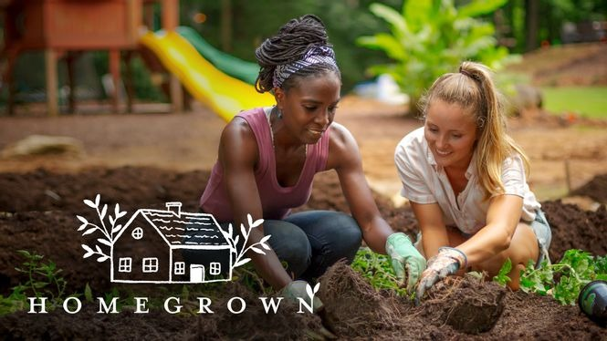
grown or produced at home or in a particular local area.

Slide 6
This is a local shop for local people: we don't get many outsiders here.

Slide 7
relating to, or characteristic of a particular place : not general or widespread

Slide 8
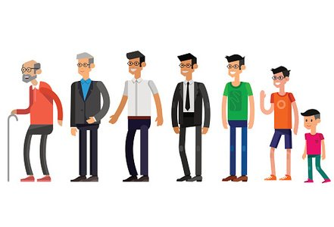
That song was popular with people from my father's generation.

Slide 9
All the living things in a group that are born or start to exist at about the same time, and are related to one that existed at an earlier point in time.

Slide 10
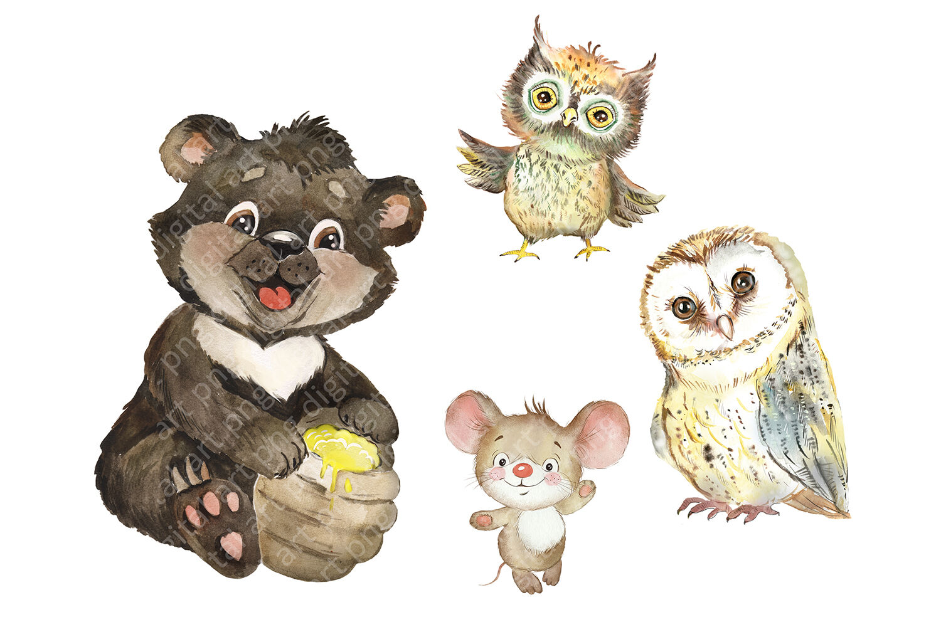
It was so exciting to see that our birdbox has some new inhabitants.

Slide 11
A person or animal that lives in a particular place.

