Slide 1






Folk Tales

Slide 2
Reading Stories https://worldstories.org.uk/reader/juha-stories/english/655
Joha, his son and the donkey https://www.youtube.com/watch?v=3MP1514wVkA&t=59s https://www.youtube.com/watch?v=Exyq53OvIV8

Slide 3
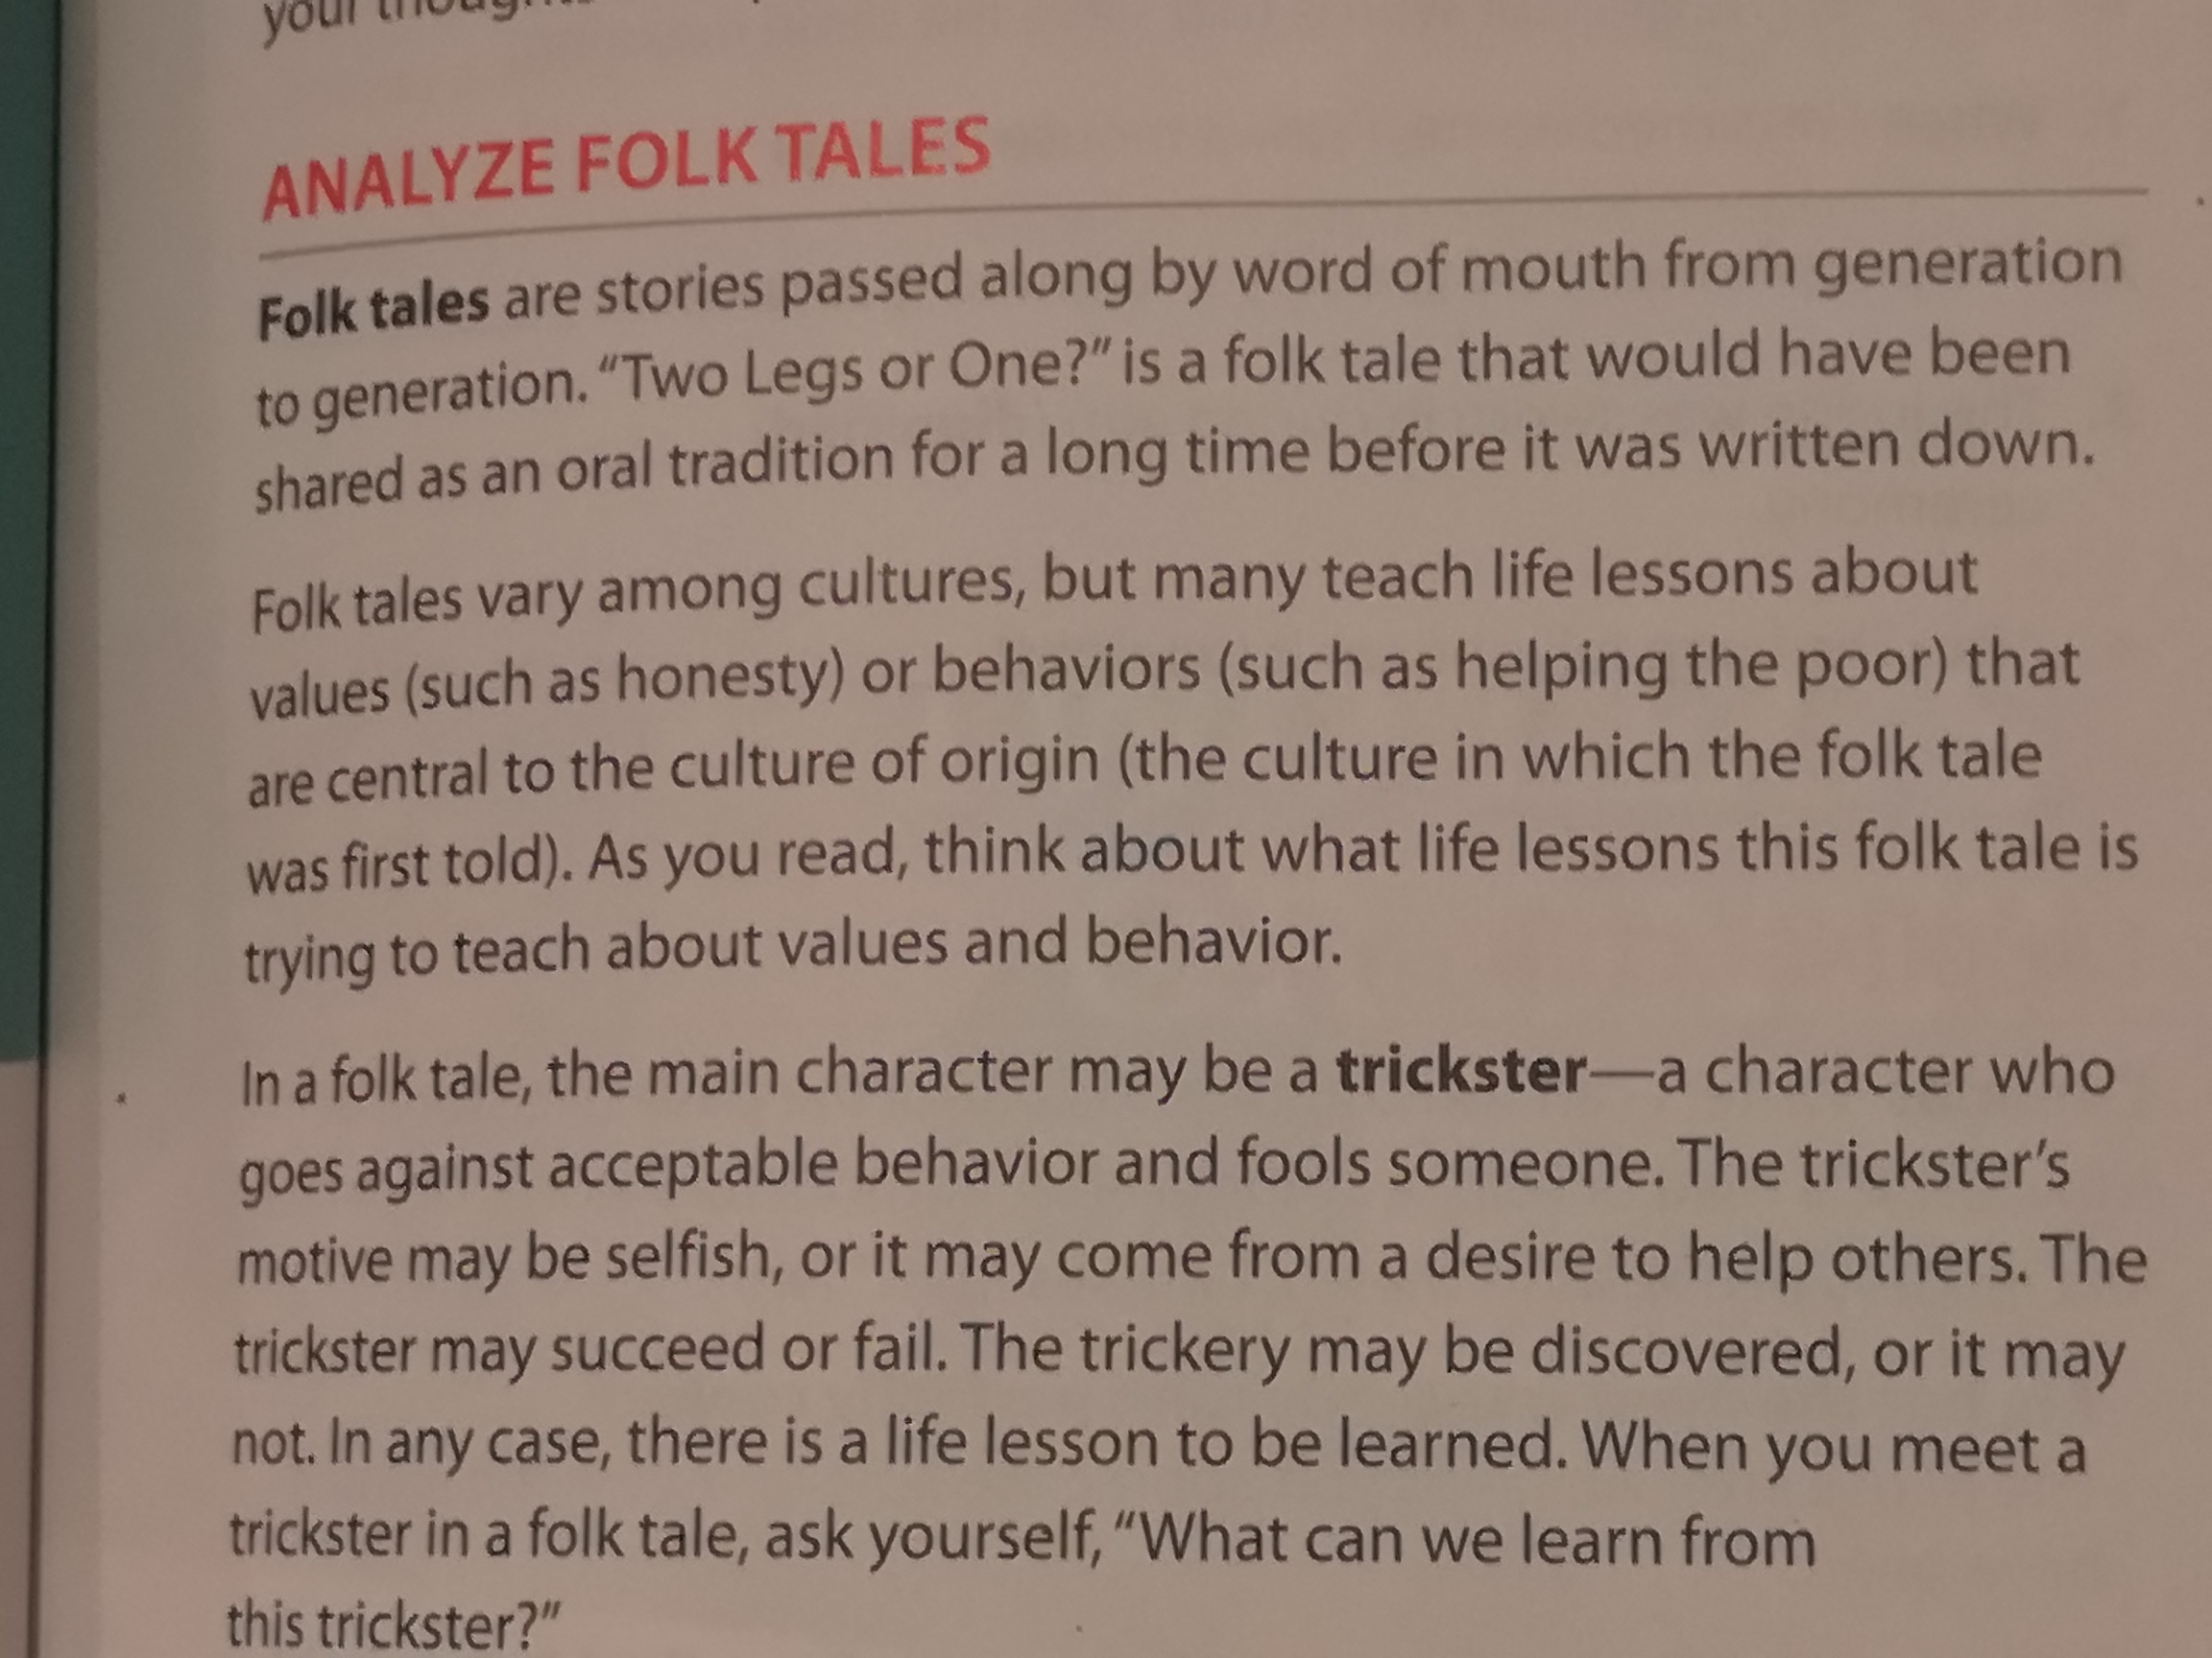


Slide 4


Slide 5
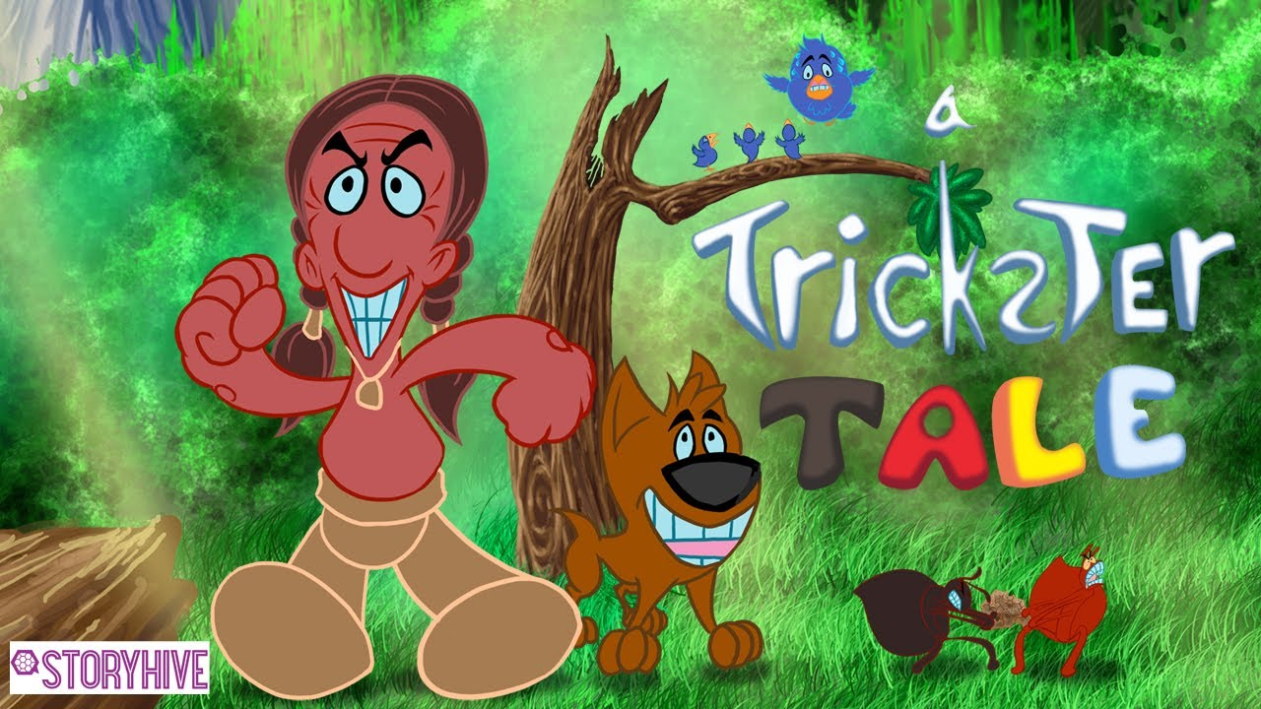
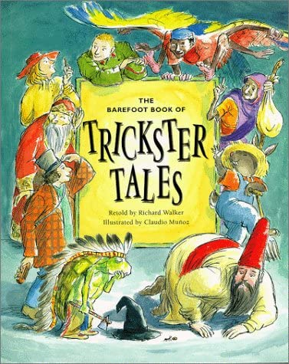

Slide 6

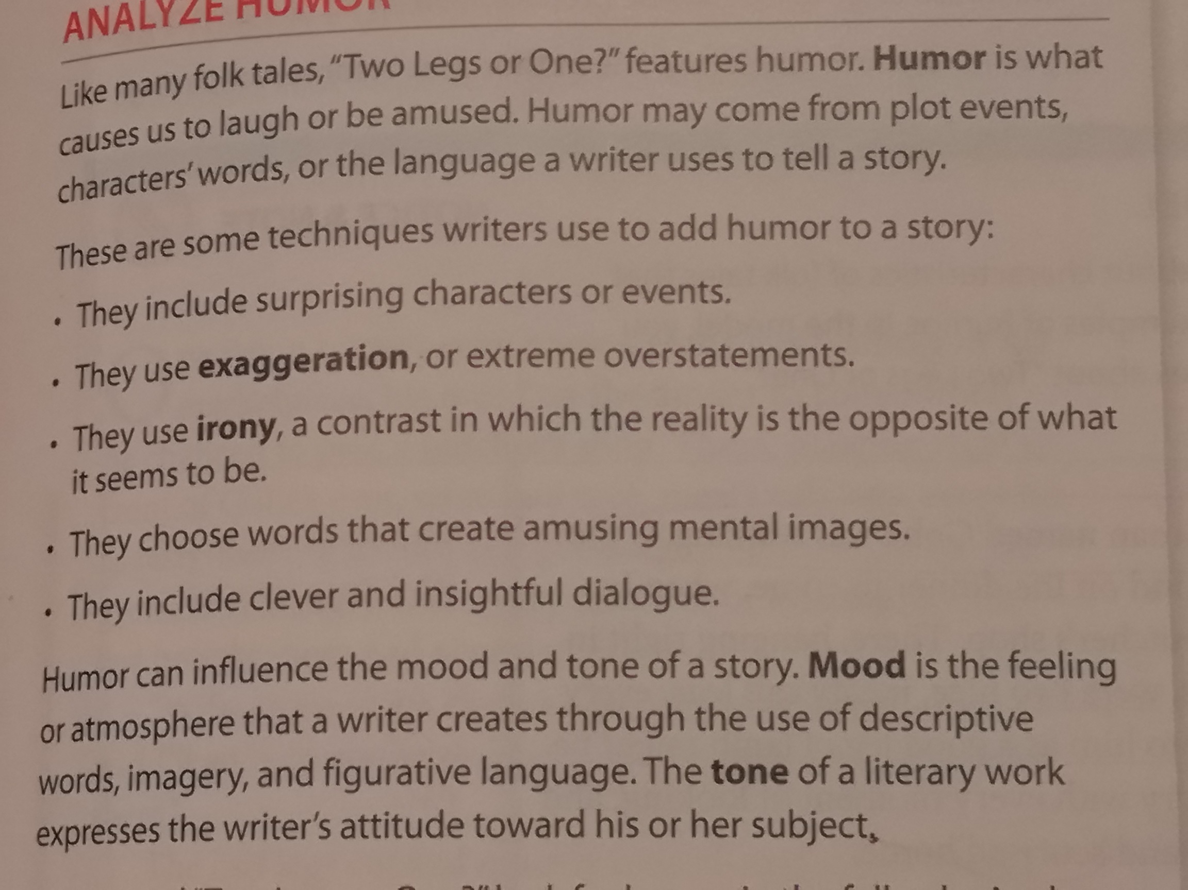
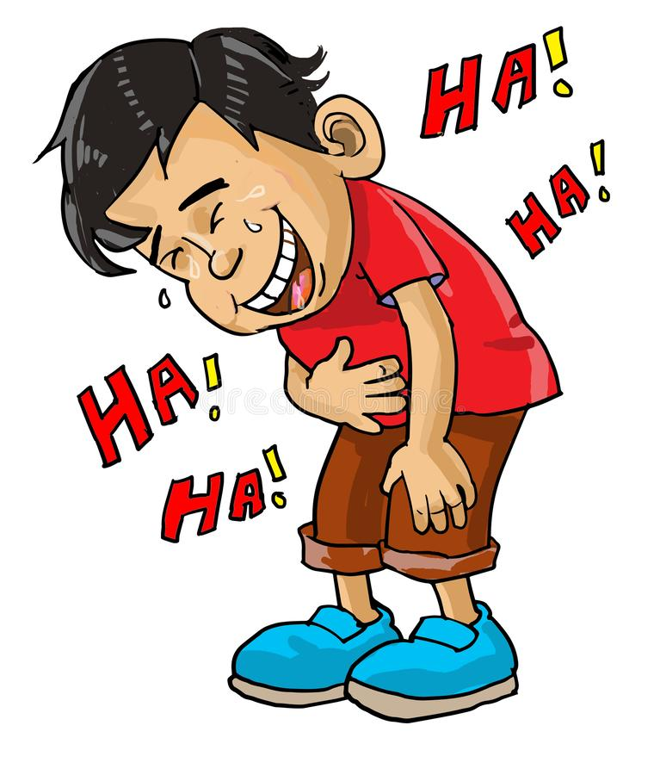
Humor

Slide 7
Techniques writers use to add humor.

Slide 8

Mood

