Slide 1
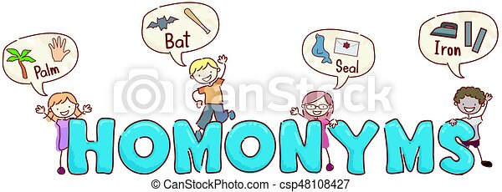
Homonyms
Unit 3 page 35

Slide 2
Homonyms: The words that are spelled and pronounced the same way but have different meanings.

Slide 3
Match

Slide 4
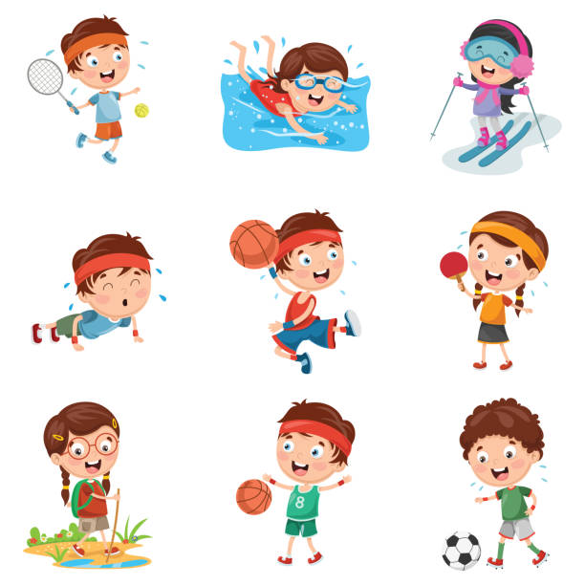
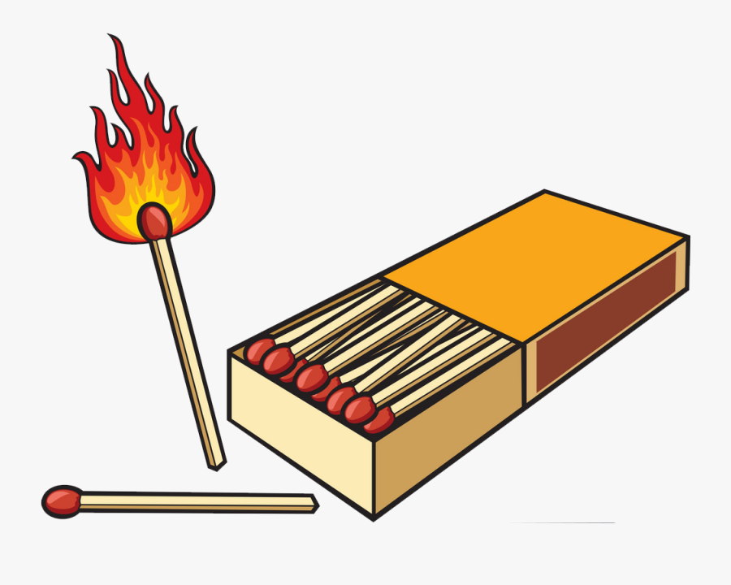
Match
Something you use to make flame.
A sports Contest

Slide 5
Clear

Slide 6
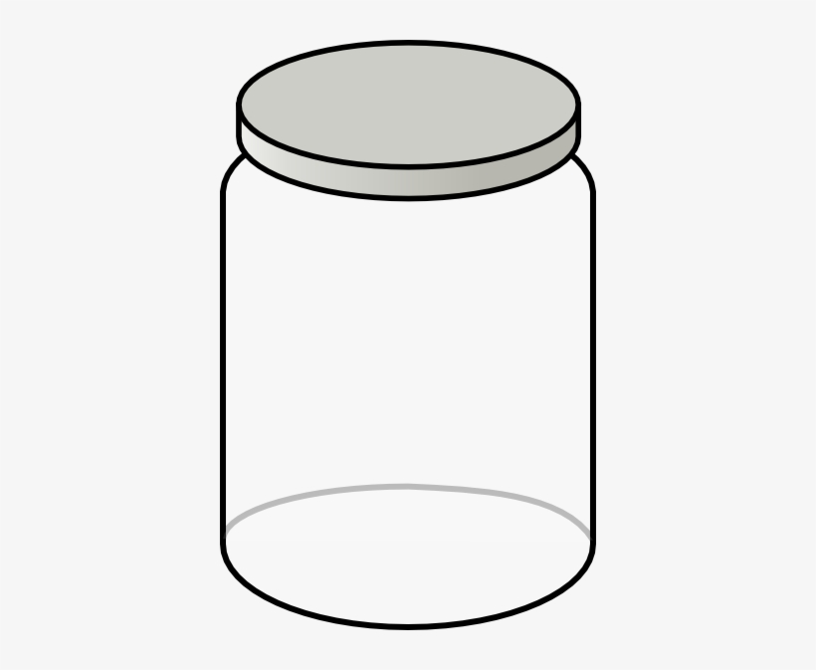
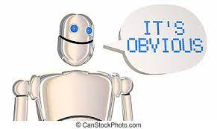
Clear
Empty or free from things
Plain and obvious

Slide 7
Bow

Slide 8
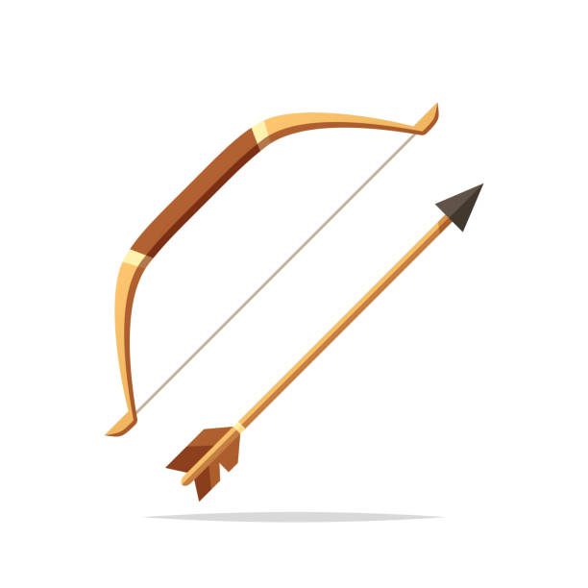

Bow
Something made of wood and string used to shoot an arrow.
A ribbon tied in a special way

Slide 9
Tie

Slide 10
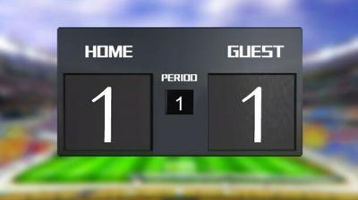

Tie
In sport when teams get same number of points
A piece of clothing men wear around their necks.

