Slide 1
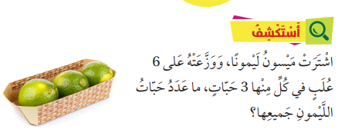
https://wordwall.net/ar/resource/21985037
https://wordwall.net/ar/resource/21985037

Slide 3
15-= 3- + 3+ 3+ 3+ 3
×
5
3
15

Slide 5
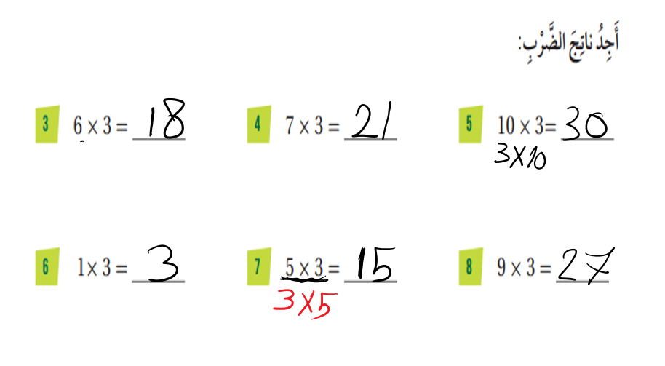

Slide 8
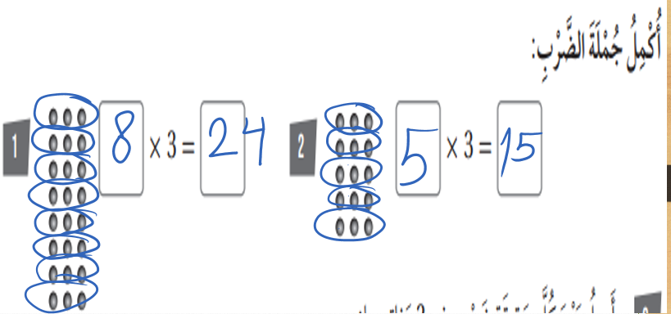

Slide 9
