Slide 2
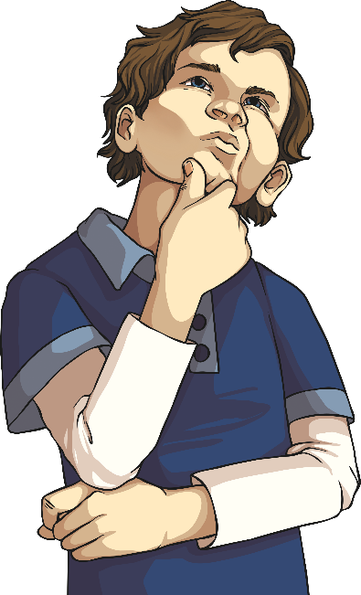
What Is Tense?
Tense is used to indicate the time in which something happens.
It is used to change verbs to show when the action took place – in the past, in the present or in the future.
The different tenses can be shown by changing the spelling of the verb in a sentence.

Slide 3
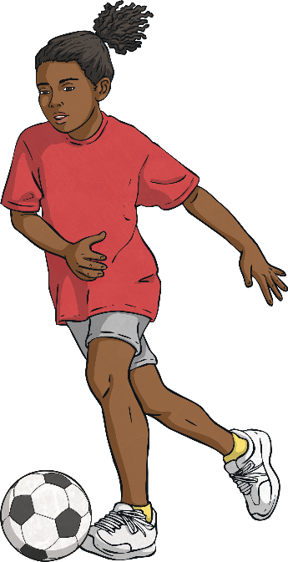
Simple Past Tense
The past tense is used for things that have already happened.
Past tense verbs often end in the suffix –ed, although there are some other tricky words that change in other ways (known as irregular verbs).
‘I played football yesterday.’
In this sentence, the action ‘play’ has already been done so it is in the past tense and has the –ed suffix.
‘Sally sang her favourite song.’
In this sentence, the action of singing has already been done so it is in the past tense. ‘Sing’ is changed to ‘sang’ as it is an irregular verb.

Slide 4
Examples of Simple Past Tense Verbs
-ed Suffix | Irregular Verb
walked | saw
visited | said
hoped | became
raised | bit
watched | bought
counted | could
explained | begun

Slide 5
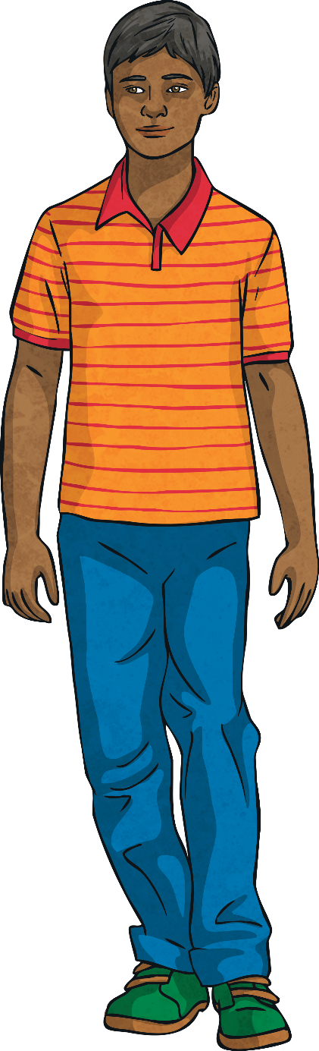
Fill the Gaps!
Identify the tense of the following sentences:
Tom walked down the street to school. He stopped to wait for a car to drive/go past before he crossed the road. He opened the school gate and hung up his coat on his peg.
walked
stopped
drive/go
crossed
opened
hung

Slide 6
Simple Present Tense
Repeated
The present tense is used for things that are happening at that moment.
The simple form of the present tense is used when writing about something that is repeated, is always true or is happening in a future time.
Eva wakes up at half past seven every morning.
I ride my bike every weekend.
I walk to school.
Always or generally true
The sun sets in the west.
I speak Urdu.
They live in a city.
Happening in a future time
The bus leaves at 9 o’clock.
The film starts at half past three.

Slide 7
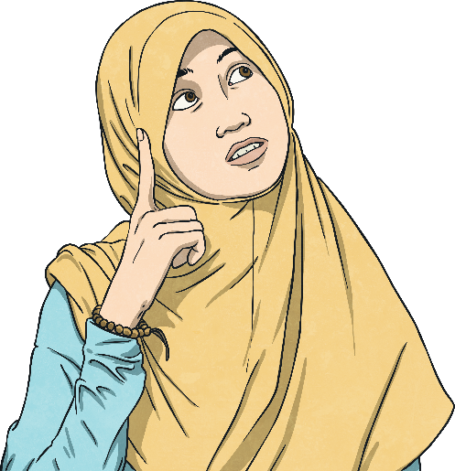
Simple Present Tense
The Rules
There are lots of little rules to remember when it comes to the verb used in present tense.
These rules help us to know what the ending of the verb should be so it makes sense.

Slide 8
Simple Present Tense
The Rules
The form of the verb depends on the subject.
run
I you we they
sing
laugh
jump
runs
sings
he she it
(third person)
laughs
jumps

Slide 9
Simple Present Tense
The Rules
The spelling of the verb depends on the ending of the verb.
Verbs ending in:
-o, -ch, -sh, -ss, -s, -x or -z
Add -es
Examples:
go
- wishes
– goes
wish
fix – fixes
buzz
- buzzes

Slide 10
Simple Present Tense
The Rules
The spelling of the verb depends on the ending of the verb.
Verbs ending in:
Vowel and -y
Just add -s
Examples:
say
– says
play
– plays
buy
- buys

Slide 11
Simple Present Tense
The Rules
The spelling of the verb depends on the ending of the verb.
Verbs ending in:
Consonant and -y
Remove –y and add -ies
Examples:
carry
– carries
cry
- tidies
– cries
tidy

Slide 12
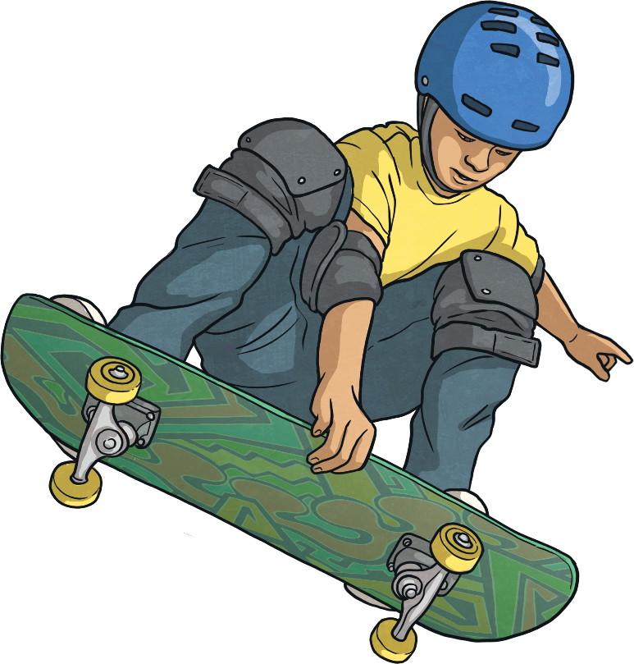
Be the Teacher!
Read each sentence and decide whether you think it is correct. If it is not, what should it be?
I rides my skateboard in the park.
I ride my skateboard in the park.
He likes both dogs and cats.
They goes to the shops.
They go to the shops.

Slide 13
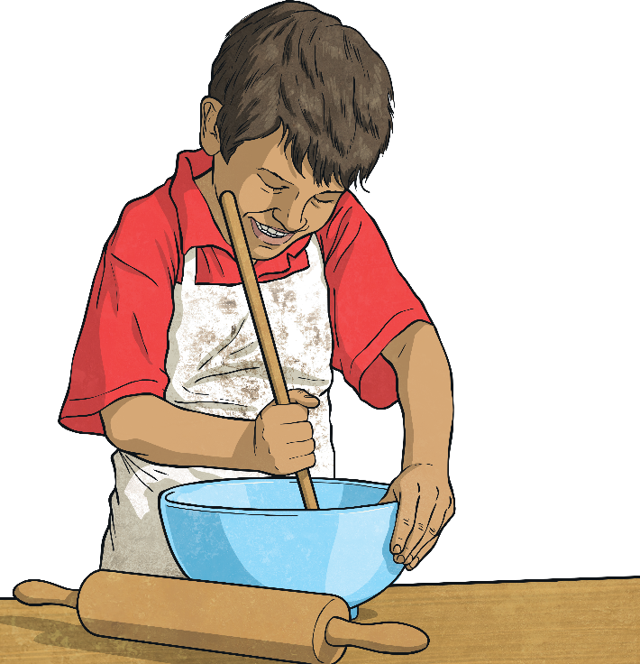
Simple Future Tense
The future tense is used for things that have not yet happened – they will happen in the future.
The future form of the verb in a sentence is usually preceded by the word will. The words shall or going to can also be used.
I will bake.
We shall go on holiday.
I am going to talk to him.

Slide 14
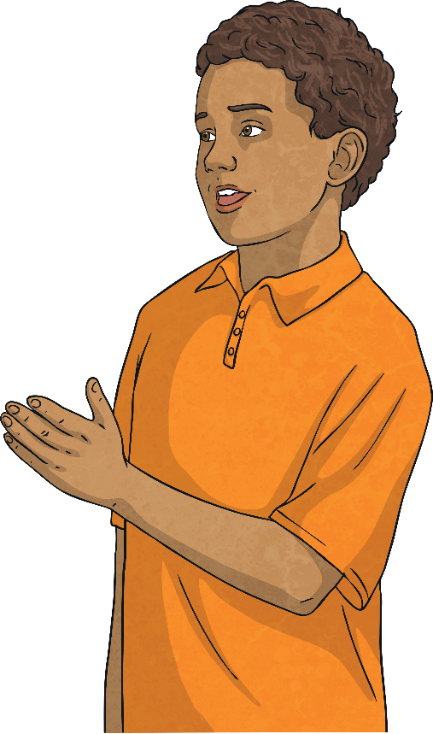
Simple Future Tense
You can also make the future tense negative in order to say that something will not happen.
You can do this by using won’t, will not, shall not or not going to in front of the verb.
I won’t bake.
We will not go on holiday.
I am not going to talk to him.

Slide 15
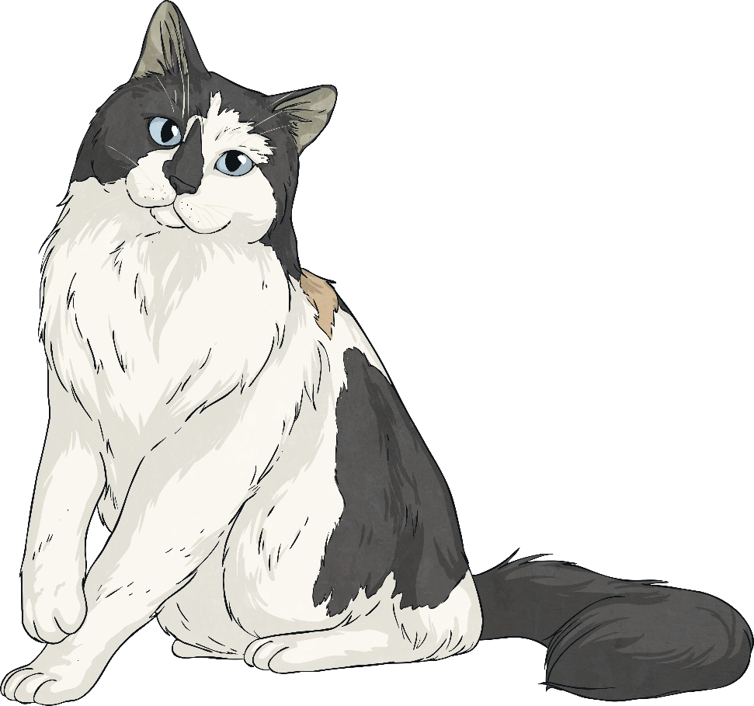
Change the Tense
What tense is this sentence in?
The cat sat on the mat.
This sentence is in simple past tense.
What would the sentence be in simple present tense?
The cat sits on the mat.
What would the sentence be in simple future tense?
The cat will sit on the mat.

Slide 16
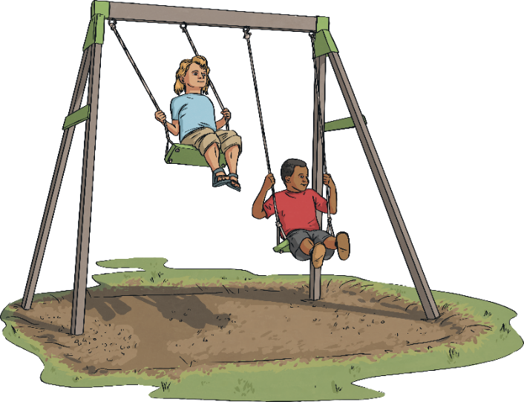
Change the Tense
What tense is this sentence in?
They play in the park.
This sentence is in simple present tense.
What would the sentence be in simple past tense?
They played in the park.
What would the sentence be in simple future tense?
They will play in the park.

Slide 17
Change the Tense
What tense is this sentence in?
She will meet you tomorrow.
Frank and Tom went to the zoo.
Ahmed sang his favourite song.
He skips down the road.
The dog lapped at the water.
Simple Future Tense
Simple Past Tense
Simple Past Tense
Simple Present Tense
Simple Past Tense

