Slide 1
Year 6 Grammar Revision
Tenses

Slide 2
Simple Present Tense: The Rules
In English, there are two basic tenses - present and past tense. The tense shows the timing of an action and changes the verb within a sentence.
Simple present tense sentences show an action that is…
A habit that is repeated:
We play hockey on Fridays.
General truths about something:
My school is near the park.
Unchanging situations:
I live with my family.
An instruction: Go to the corner and turn left.
They use the infinitive (simplest) form of a verb.
When referring to the third person, the present tense (infinitive) verb has an added –s. This only applies to regular verbs.

Slide 3
Simple Past Tense: The Rules
Within simple past tense, the action has already happened and been completed.
I played.
We played.
You played.
They played.
He played.
She played.
Regular past tense verbs have –ed added to the infinitive no matter who completed the action.

Slide 4
Progressive Tense: The Rules
The progressive tense (sometimes called continuous tense) usually describes verbs and events that are ongoing at a particular point in time. It is formed by combining the verb’s present participle (by adding –ing) with a form of the verb ‘to be’.
The mermaid is hiding behind the treasure chest.
In present progressive sentences, we use is, am or are before the –ing verb. In this present progressive sentence, the mermaid is still hiding.
The Gingerbread Man was running as he was being chased.
In past progressive sentences, we use was or were before the –ing verb. Past progressive sentences usually show an ongoing action while something else was happening too.

Slide 5
Perfect Tense: The Rules
The perfect tense describe actions that are completed over a period of time. It is formed by combining the verb’s past participle (usually by adding –ed or -en) with a form of the auxiliary verb ‘to have.’
The chef has baked lots of loaves.
In present perfect sentences, we use has or have before the past participle. In this present perfect sentence, the chef has baked loaves over a period of time.
The chameleon had changed colour before hiding from its predator.
In past perfect sentences, we use had before the past participle. In this past perfect sentence, the chameleon’s action had finished before it hid.

Slide 6
Tenses: The Tricky Bits
The trickiest part of recognising and using different tenses is when you have to deal with irregular verbs. Lots of verbs don’t change in a regular way to form their past tense versions or past participles, e.g.
The carrots grew.
Simple past tense using the irregular verb ‘to grow’.
In this present progressive sentence, The present participle ‘growing’ is used after the auxiliary verb ‘is’.
The calf is growing taller everyday.
I crossed the road to the sweet shop.
Simple past tense using the irregular verb ‘to cross’.

Slide 7
Tenses Quiz: Question 1
Tick which sentence is written in the past progressive tense.
Tick one.
After Polly finished her book, she swapped it.
Digger was burying his bone in the garden.
The baby zebra is learning to walk.
Since falling, Grandad had found it difficult to walk.

Slide 8
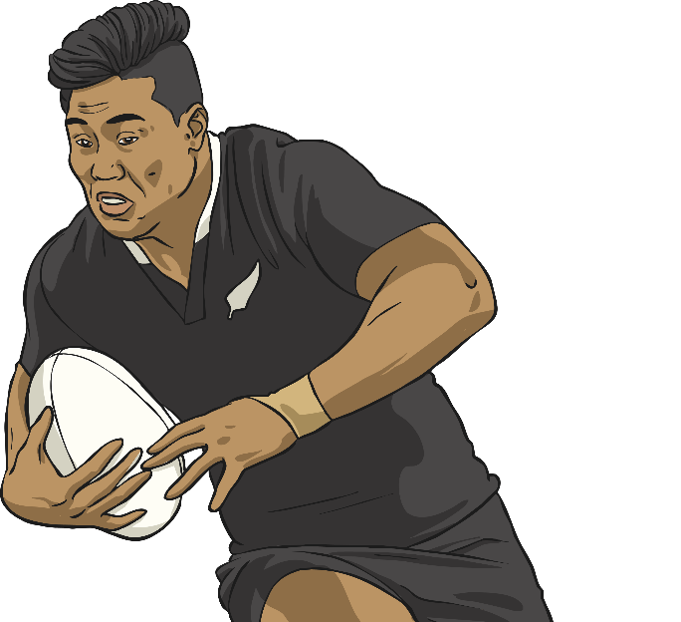
Question 2
Circle (by clicking on the word) the verb form that is in the present perfect in the passage below.
Bradley loves rugby and has wanted to be a professional rugby player for years. He was hoping for match tickets and was delighted when his parents gave him some for his birthday this year.
Incorrect Answer

Slide 9
Question 3
Complete each sentence by adding the correct past participle to these past perfect sentences (the first one is done for you).
Verb
eat
The boys had ________ their lunch.
eaten
sell
After a long time on the market, the house had ________ .
sold
freeze
After a few hours, the lollies had ________ in the freezer.
frozen

Slide 10
Are you feeling confident with tenses?

