Slide 2
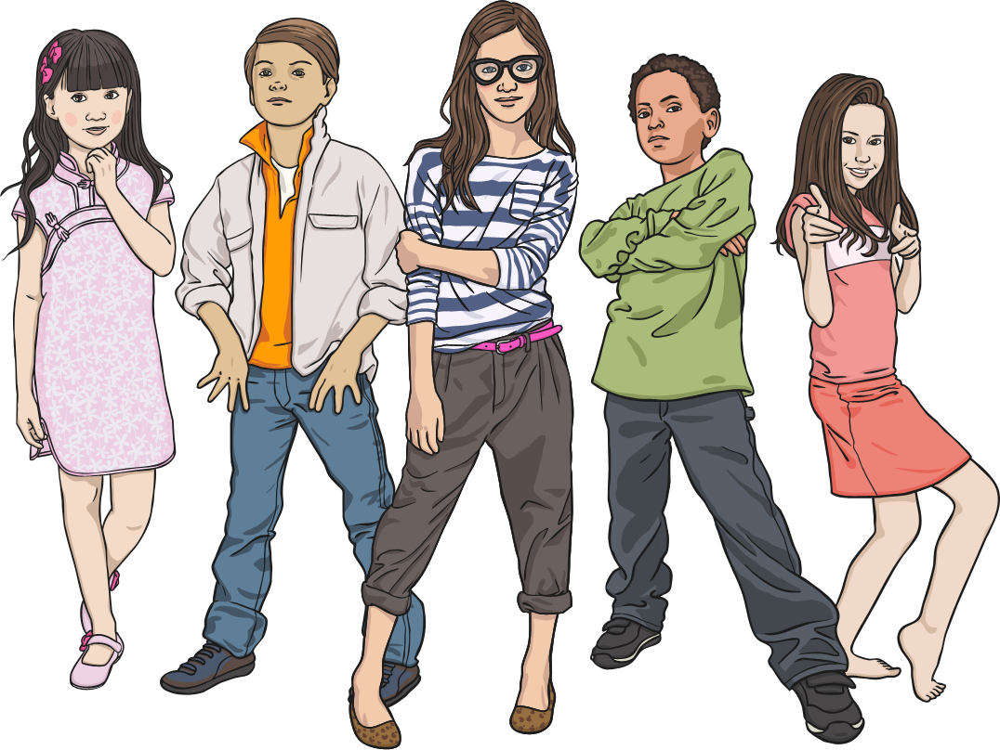
Aim
I can recognise the difference between a fact and an opinion.
CfE: To help me develop an informed view, I can recognise the difference between fact and opinion. LIT 1-18a

Slide 3
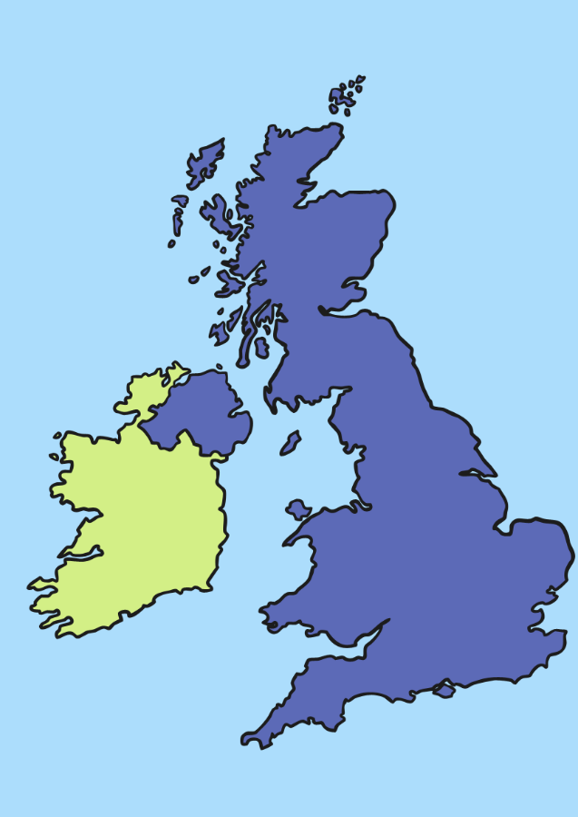

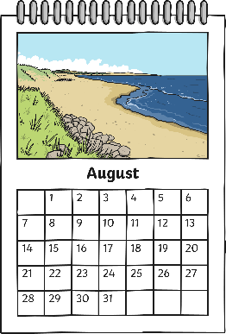
Fact or Opinion?
If something is a fact, it is known to be true. It can be proved.
For example:
Britain is an island.
There are 12 months in a year.
Rain is wet.

Slide 4


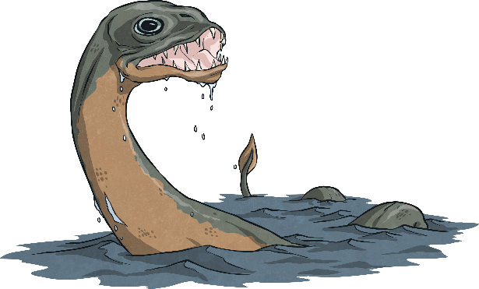
Fact or Opinion?
If something is an opinion, it is what someone believes. It has no proof.
For example:
Plants can talk.
The Loch Ness Monster exists.
Scotland is the best place ever!

Slide 5
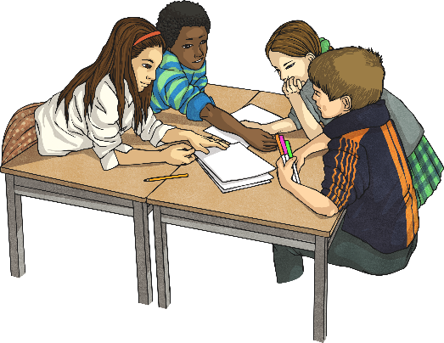


Fact or Opinion?
Can you decide which of these statements are facts or opinions?
London is the capital city of the UK.
Fact
Mount Everest is the highest mountain in the world.
Fact
Haggis is a delicious food.
Opinion

Slide 6

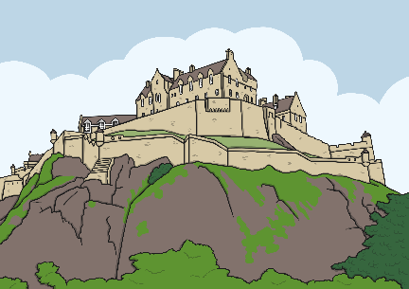

Fact or Opinion?
Can you decide which of these statements are facts or opinions?
It’s always cold in Scotland.
Opinion
Edinburgh Castle is in Edinburgh.
Fact
Rugby is the best sport.
Opinion

Slide 7
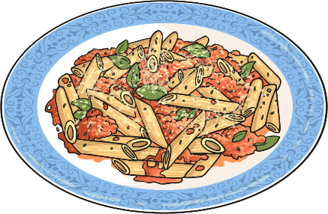


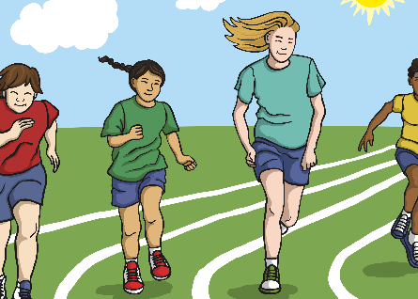
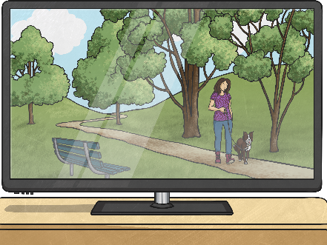
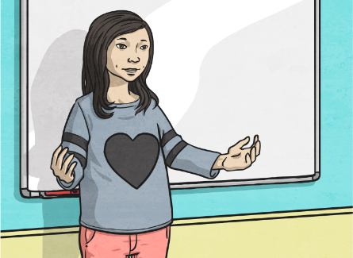
Fact or Opinion?
Can you make up your own statements using each of the following?
An opinion about food.
A fact about where you live.
A fact about Scotland.
An opinion about sport.
An opinion about a TV show.
A fact about your class topic.

