Slide 1






Balanced Diet

Slide 2

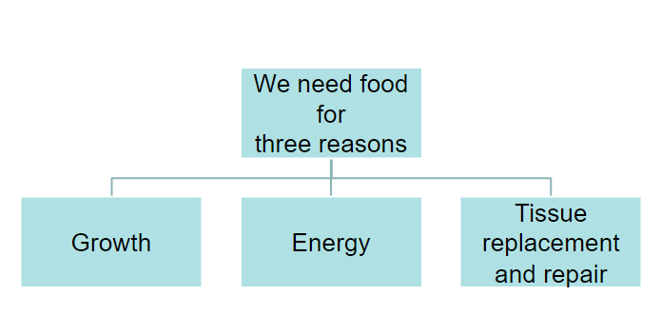
A healthy diet

Slide 3
What is a balanced diet?
A balanced diet gives your body the nutrients it needs to function correctly as it contains the right amounts of all the nutrients your cells need.
To get a balanced diet you have to eat a wide variety of foods.

Slide 4
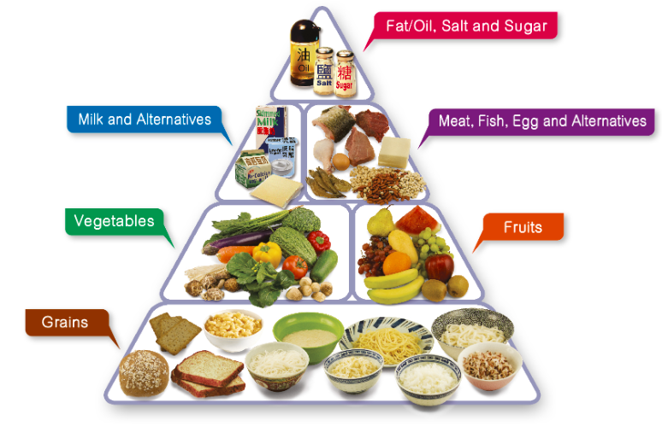
Healthy eating food pyramid
Eat Most – carbohydrates
Eat More - Vegetables and fruits
Eat Moderately - proteins
Eat Less - Fat/ oil, salt and sugar
Drink adequate amount of fluid every day
https://www.youtube.com/watch?v=tsgyWIsYvxs

Slide 5

Malnutrition
Malnutrition is a term which covers problems of both under and over nutrition.
Meeting the body’s needs for energy and nutrients is essential for good health.
Intakes of energy and/or nutrients below or in excess of needs over time can affect health and lead to health problems.

Slide 6
Questions
Q1) Which type of nutrient should you eat most of?
Q2) Explain why we should get our proteins from a variety of different foods.
Q3) Explain what amino acids are and why we need them.
Q4) Give two reasons why eating too many sweets can damage your health.

Slide 7
Questions
Q1) Which type of nutrient should you eat most of?
You should eat more carbohydrates than other nutrients.
Q2) Explain why we should get our proteins from a variety of different foods.
Each type of protein contains a different combination of amino acids, so we need to eat a variety of proteins to get all the amino acids we need.
Q3) Explain what amino acids are and why we need them.
Amino acids are small molecules that can be joined together to form the proteins needed to build and repair cells.
Q4) Give two reasons why eating too many sweets can damage your health.
Eating too many sweets can cause tooth decay and lead to obesity.

