Slide 1

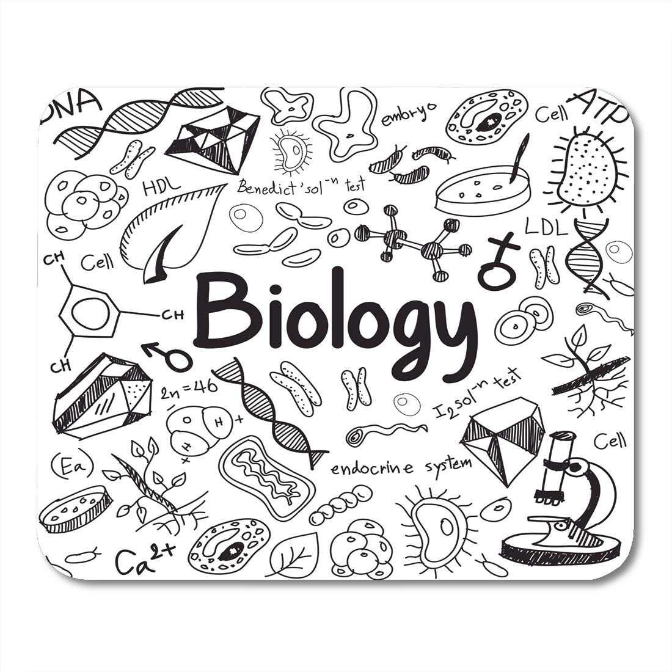
Lesson: (Cells)
Scholastic Year: 2020-2021
Grade: 6CS

Slide 2
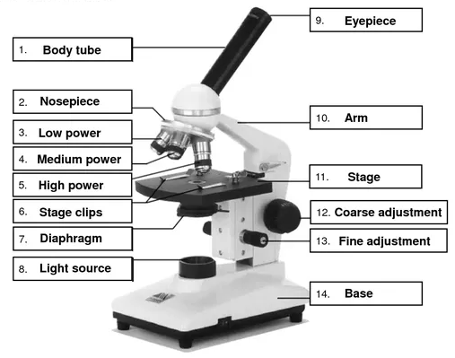
How does a microscope work?
Objective lenses

Slide 3
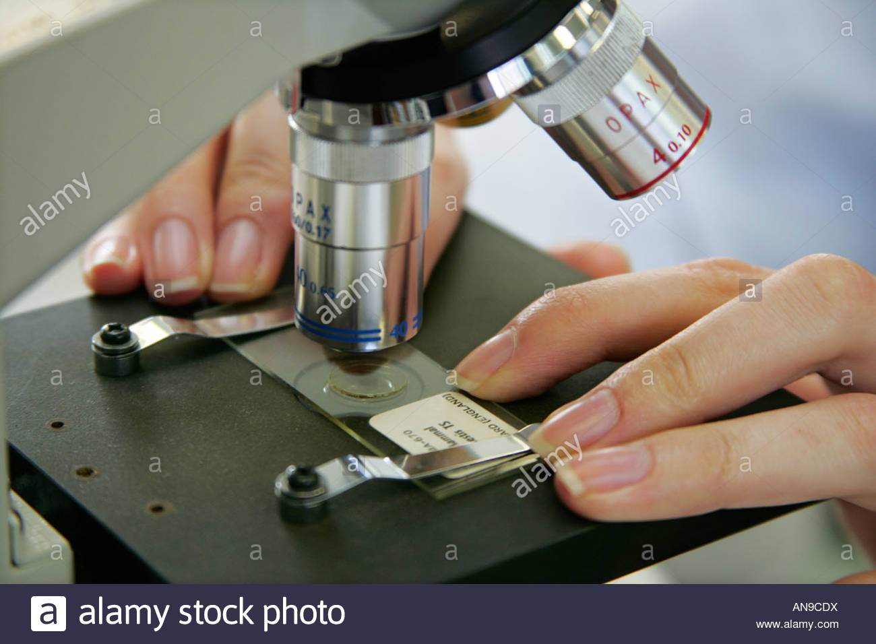
Specimen

Slide 4
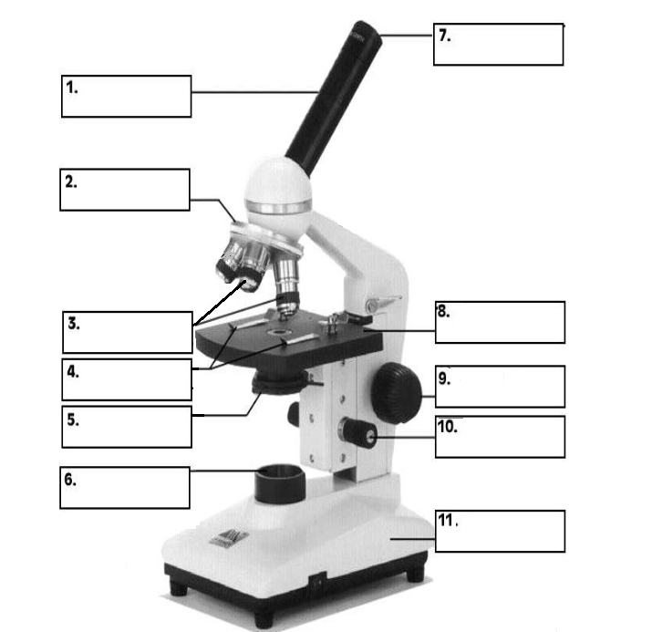
Use the words below to label the parts of a microscope.
Fine adjustment Nosepiece Stage clips light source Body tube Base
Eyepiece Coarse adjustment Objective lenses Diaphragm Arm Stage

Slide 5
Use the words below to label the parts of a microscope.
Fine adjustment Nosepiece Stage clips light source Body tube Base
Eyepiece Coarse adjustment Objective lenses Diaphragm Arm Stage
Body tube
Nosepiece
Objective lenses
Stage clips
Diaphragm
Light source
Eyepiece
Stage
Coarse adjustment
Fine adjustment
Base
Arm

Slide 6
The function of some parts of the microscope:-
Eyepiece: Eyepiece is the lens, present at the top and is used to see the objects under study (the specimen).
Nosepiece: nosepiece has holders for the different objective lenses. It allows the rotation of the lenses while viewing.
Objective lenses: Generally, three objective lenses are found on a microscope, the shortest lens is of the lowest power, and the longest lens is a high power lens.
Diaphragm: Diaphragm helps in controlling the amount of light that is passing through the opening of the stage.

Slide 7
Focusing knobs:
Coarse adjustment knob: Used for focus on scanning. Usually the low power lens is used.
2. Fine adjustment knob: Used for focus on the high power lens.

Slide 8
What is a cell?

Slide 9
Here’s what a “cell” is!
Cell - the smallest unit of an organism that carries on the functions of life.
https://www.youtube.com/watch?v=_u3GEXZPDa8

Slide 10
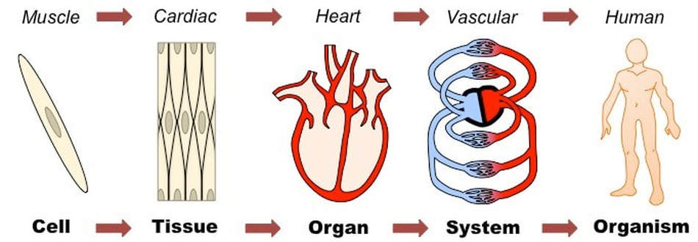
Levels of organisation
If similar cells work together they form a tissue.
Tissues work together to perform a specialized function. They form an organ, like the heart.
Various organs work together forming an organ system.
Organ systems make up organisms.

Slide 11
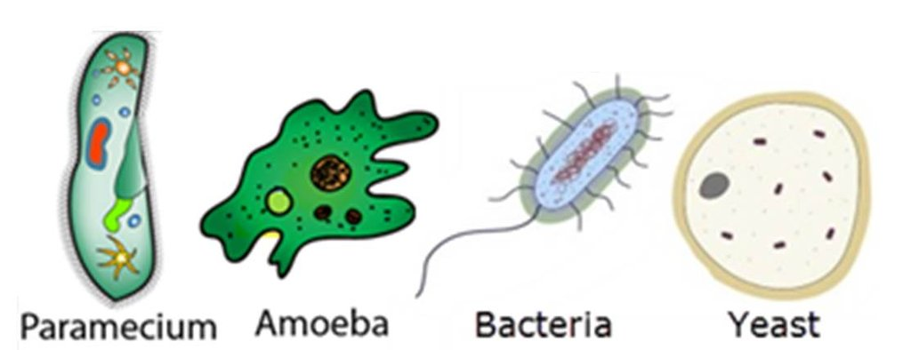
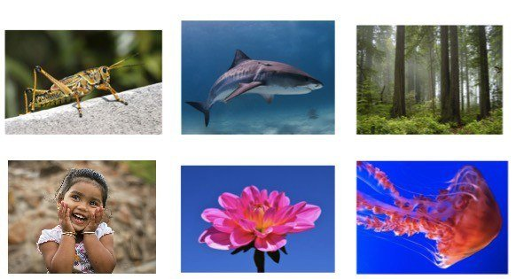
“All living things are made up of cells”
Some living things are made up of one cell or many cells.
Unicellular | Multicellular
Consist of just one cell | Consists of many cells
Ex. Bacteria, protozoa and yeast | Ex. Humans, animals, plants and insects

Slide 12
Specialized cells
Most plants and animals are multicellular. The human body is made up of around 200 different types of cell, all working together.
Most cells are specialized, meaning that each type of cell has a specific structure and function.
All cells have certain common features and structures called organelles.

Slide 13
Three common organelles
If we study a cell under a microscope, we would come across three features in almost every cell:
Nucleus Cell membrane Cytoplasm
All activities inside the cell and interactions of the cell with its environment are possible due to these features.

Slide 14
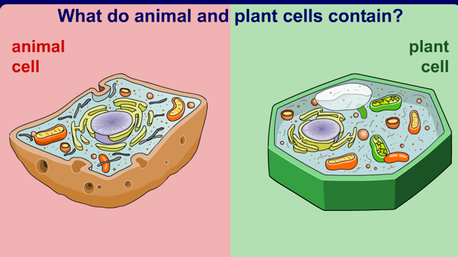

Slide 15
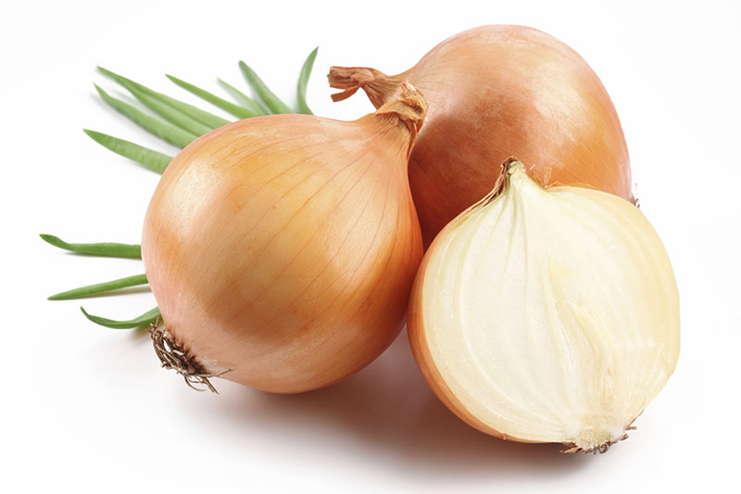
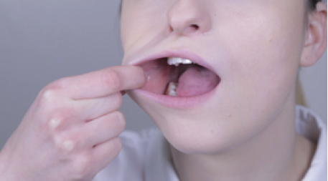
A closer look at animal and plant cells
Cheek cells are easily obtained and can be used to illustrate the main features of an animal cell.
Onion cells are easily viewed under a microscope and can be used to illustrate the main features of a plant cell.

Slide 16
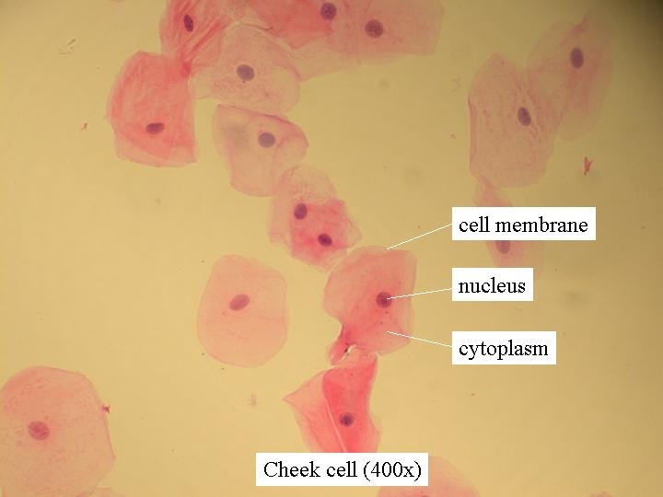
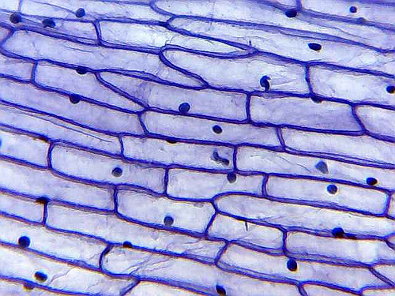
Cell wall
Onion cell

Slide 17
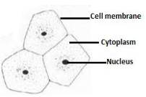
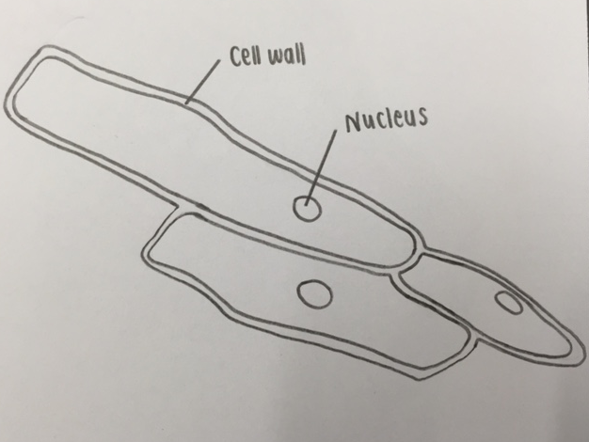
Try to draw!
Animal cell
Plant cell

Slide 18
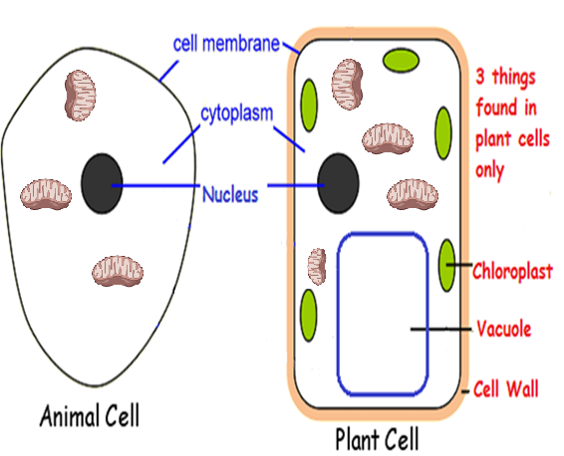
Parts of animal and plant cell
mitochondria

Slide 19
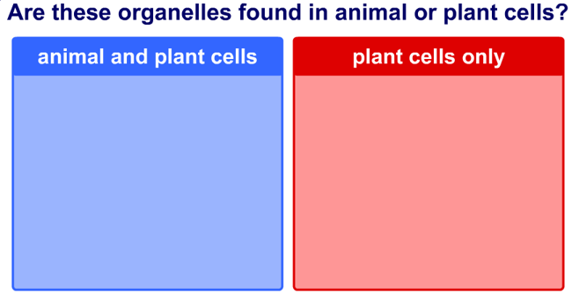
Animal or plant?
Chloroplasts, nucleus, cell wall, cytoplasm, large vacuole, mitochondria, cell membrane

Slide 20
Animal or plant?
Chloroplasts, nucleus, cell wall, cytoplasm, large vacuole, mitochondria, cell membrane
Nucleus
Chloroplasts
Cytoplasm
Cell wall
Cell membrane
Large vacuole
Mitochondria

Slide 21
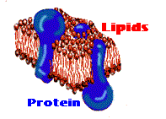
Cell Membrane
Structure:
the boundary of the cell
Function (job):
Maintains shape & size of the cell
Controls entry and exit of substances in and out of the cell “gatekeeper”

Slide 22
Cytoplasm
Structure:
Jelly-like fluid formed by 80% water
Function (job):
Organelles float in cytoplasm
All chemical reactions take place in the cytoplasm

Slide 23
Nucleus
Structure:
The location of cell’s genetic material (DNA)
Usually round/oval
Function (job):
Controls all the cell activities.
“Control center of cell”

Slide 24
Mitochondria
Structure:
Mitochondria are membrane-bound cell organelles
(mitochondrion, singular)
Function (job):
Perform cellular respiration. This means it takes in nutrients from the cell, breaks it down and turns it into energy.
“The powerhouse of the cell”
mitochondria

Slide 25
Chloroplast(ONLY IN PLANTS)
Structure:
Green, oval-shaped
Contains green pigment called chlorophyll that absorbs the sunlight energy.
Function (job):
Site of photosynthesis
Traps the sun’s energy which is used to convert CO2 and water into glucose and O2.

Slide 26
Large vacuole (ONLY IN PLANTS)
Structure:
Fluid-filled sac that floats in the cytoplasm
The large vacuole in plants is filled with a liquid called cell sap. It contains dissolved sugar and salts.
Function (job):
Stores water, food materials and waste products
Plant cells contain a large central vacuole - filled with water - helps give shape
In animal cells vacuoles are small in size, Whereas in plant cells, vacuoles are large.

Slide 27
Cell wall (ONLY IN PLANTS)
Structure:
Strong & rigid layer that surrounds the cell membrane.
Function (job):
Protects the cell’s contents.
Maintains the shape and structure of the cell.
Prevent damage to the cell caused by excess water intake.
The plant cell wall is made from cellulose.

Slide 28
How are plant and animal cells different?
Animal cells | Plant cells
Cell wall absent | Cell wall present
Chloroplasts absent | Chloroplasts present
Vacuoles are small | Large sap-filled vacuole

Slide 29
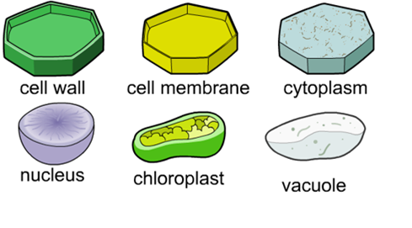
Match the organelle to the correct description
Which organelle is being described in each statement?
Absorbs sunlight and turns it into useable energy

Slide 30
Match the organelle to the correct description
Which organelle is being described in each statement?
Absorbs sunlight and turns it into useable energy

Slide 31
Match the organelle to the correct description
Which organelle is being described in each statement?
Stores water; food and wastes for cell. Very large in plant cells.

Slide 32
Match the organelle to the correct description
Which organelle is being described in each statement?
Stores water; food and wastes for cell. Very large in plant cells.

Slide 33
Match the organelle to the correct description
Which organelle is being described in each statement?
Controls all cell activities

Slide 34
Match the organelle to the correct description
Which organelle is being described in each statement?
Controls all cell activities

Slide 35
Match the organelle to the correct description
Which organelle is being described in each statement?
Semi-fluid substance inside cell where reactions take place; helps to support organelles

Slide 36
Match the organelle to the correct description
Which organelle is being described in each statement?
Semi-fluid substance inside cell where reactions take place; helps to support organelles

Slide 37
Match the organelle to the correct description
Which organelle is being described in each statement?
Controls what enters and leaves the cell

Slide 38
Match the organelle to the correct description
Which organelle is being described in each statement?
Controls what enters and leaves the cell

Slide 39
Match the organelle to the correct description
Which organelle is being described in each statement?
Made up of cellulose in plants; outer structural support for plant cells.

Slide 40
Match the organelle to the correct description
Which organelle is being described in each statement?
Made up of cellulose in plants; outer structural support for plant cells.

Slide 41
Video
https://www.youtube.com/watch?v=192M4oDLTdc

Slide 42
Glossary
cell – The basic structural and functional unit of life.
organelle – specialized structure that performs important cellular functions within a cell “little organ”
nucleus – The location of a cell’s DNA.
cytoplasm – The jelly-like material in which all cell’s organelles are found, and in which most cellular reactions occur.
cell membrane – The partially-permeable barrier that regulates substances entering and leaving a cell.
mitochondria – Perform cellular respiration.
cell wall – The rigid external coat that protects and supports plant cells.
chlorophyll – The green pigment found in chloroplasts.
chloroplast – The site of photosynthesis in plant cells.
Large vacuole – The fluid-filled cavity found in plant cells that stores water and nutrients.

Slide 43
