Slide 1
Enzymes
The Catalysts of Life
https://www.youtube.com/watch?v=6jz9WvfKDVc
https://www.youtube.com/watch?v=a0yGDipKWlo

Slide 2
Properties of enzymes
Enzymes are proteins that function as biological catalysts.
Catalysts: a substance that speeds up a chemical reaction.
Enzymes can help to break down a large molecule into smaller molecules.
All enzymes are proteins but not all proteins are enzymes.

Slide 3
Properties of enzymes
Enzymes are reusable. They can be used over and over again.
Although they take part in the reaction, they are not consumed (used up) in the reactions they catalyze.

Slide 4
Properties of enzymes
Enzymes are specific for what they will catalyze.
There are hundreds of different enzymes but each enzyme speeds up only one kind of reaction.

Slide 5
Properties of enzymes
Enzymes names usually end in – ase.
Such as:
amylase
Protease
Lipase

Slide 6
What do enzymes do?
Enzymes act as catalysts in cellular reactions.
Enzymes in the Digestive System:
In the digestive system, enzymes play a critical role in breaking down complex food molecules into simpler forms that can be absorbed by the body.
For example, amylase breaks down carbohydrates into sugars, proteases break down proteins into amino acids, and lipases break down fats into fatty acids and glycerol.

Slide 7
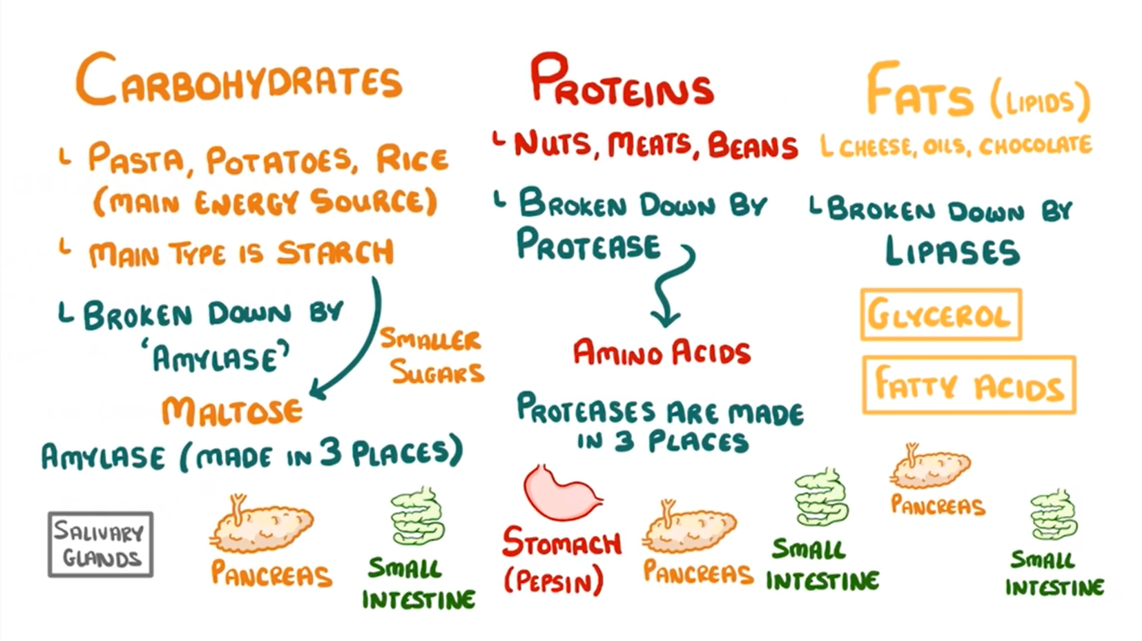

Slide 8
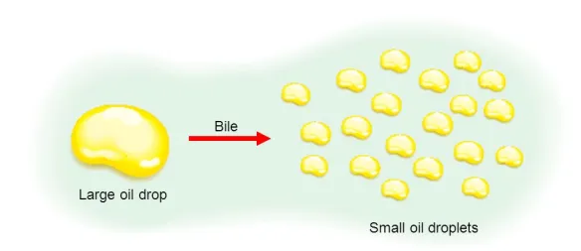
Helping our enzymes/ Emulsification
The process of lipid digestion begins in the duodenum, which is the first segment of the small intestine. The liver produces bile, a greenish-yellow fluid stored in the gallbladder and released into the duodenum when needed. Bile is essential for lipid digestion because it emulsifies fats, breaking them down into smaller droplets.
After bile has emulsified the fats, pancreatic lipase, an enzyme secreted by the pancreas, acts upon the emulsified fat droplets, breaking them down further.

Slide 9
Table of digestive enzymes
Nutrient | Enzymes used | Part of the digestive system in which digestion occurs
Carbohydrates (starch) | amylase | Mouth Small intestine
Protein | Protease | Stomach Small intestine
Lipids (fats and oils) | Lipase | Small intestine

Slide 10
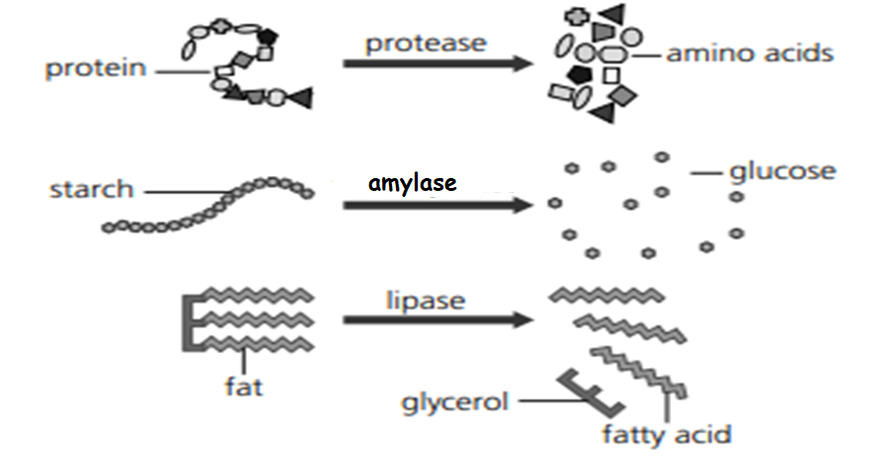

Slide 11
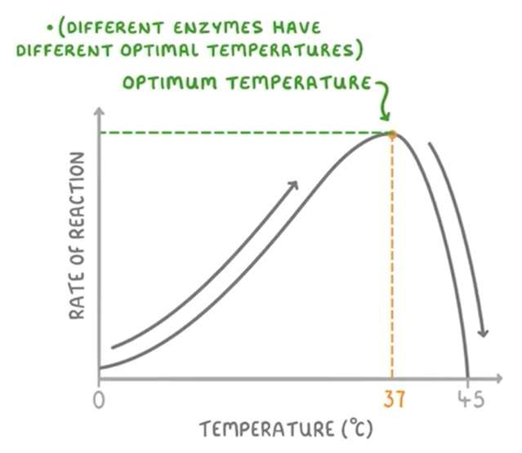
Factors Affecting Enzyme Activity:
Temperature: Enzymes have an optimal temperature at which they work most efficiently. Too high a temperature can denature the enzyme, while too low temperature may slow down the reaction.
The enzymes in our bodies work best at 37°C.

Slide 12
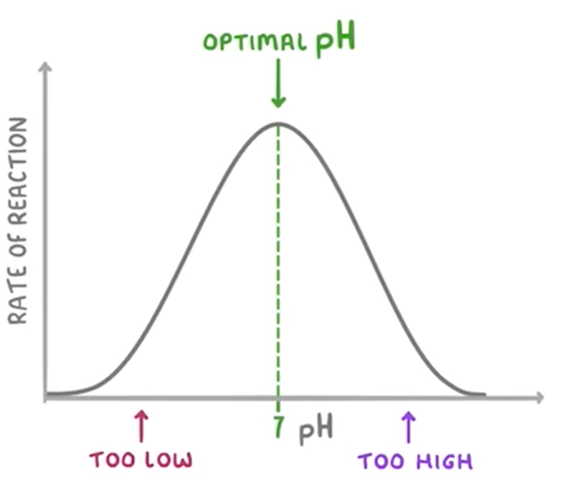
Factors Affecting Enzyme Activity:
https://www.youtube.com/watch?v=n9He_FK6nao
pH: Enzymes also have an optimal pH range for their activity. Any changes from this range can alter the enzyme's shape and affect its function.
Most enzymes work best near neutral pH (6 to 8).

Slide 13
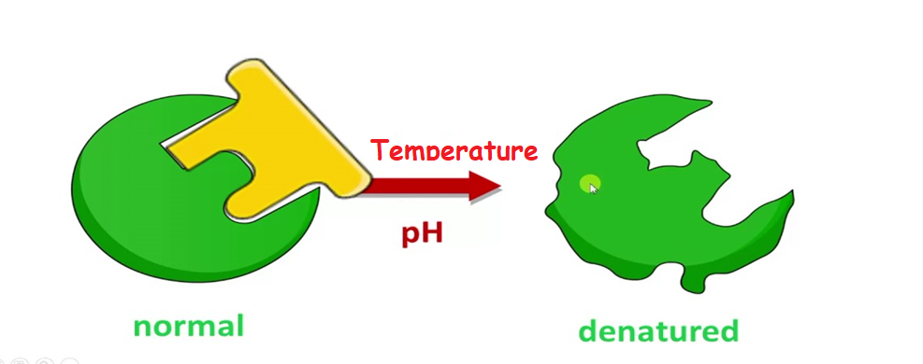
What will happen to the enzyme if the temperature increases or the PH changes ?

Slide 14
Questions
Q1) Explain why enzymes are called biological catalysts.
Q2) Complete the table:
Nutrient | Enzyme used to digest it | Organ(s) where digestion takes place
Carbohydrate
Protein
Fat

Slide 15
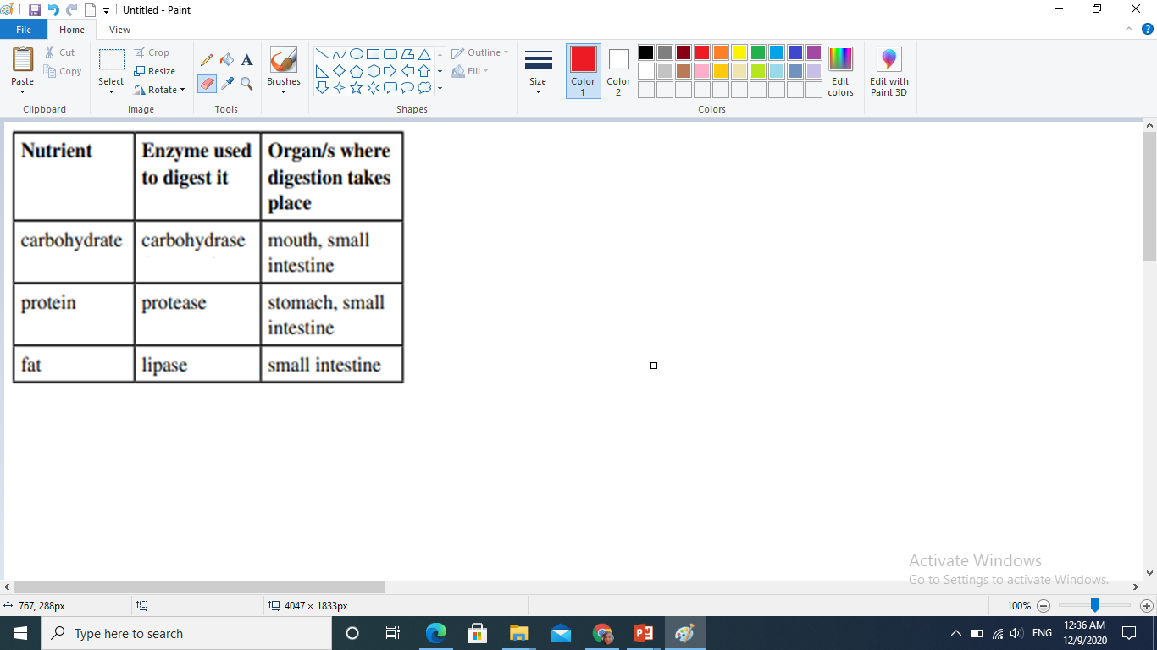
Questions
Q1) Explain why enzymes are called biological catalysts.
The term ‘biological’ means they are made by living cells. The term ‘catalysts’ means that they speed up the rate of chemical reactions.
Q2)
Note : starch is digested by the amylase enzyme in the mouth and the small intestine

Slide 16
Kahoot games
https://play.kahoot.it/v2/oauth2/authenticated?code=cp-JEHM4Vu5FKNpc-kmEkepm8fBSyCDiM3T2YZCwQkg&state=e66232f55fb7442d8cdfd159b7d4aad4
https://play.kahoot.it/v2/oauth2/authenticated?code=Q1Y6rVaotUCWy27R2rk3AqZOMmnmZXCFWXLeH5Ms440&state=789d13b10d2842d7abd99570a4ef48bd

