Slide 1
Learning Objective
To investigate what happens to mass and weight on different planets.
Success Criteria
To calculate mass and weight on different planet.
To explain the difference between mass and weight.

Slide 2
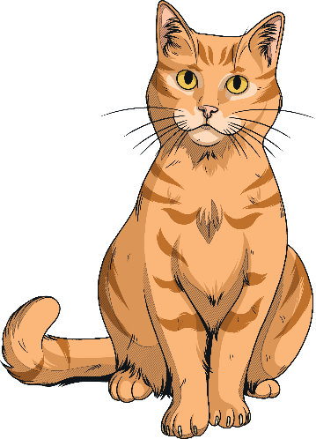
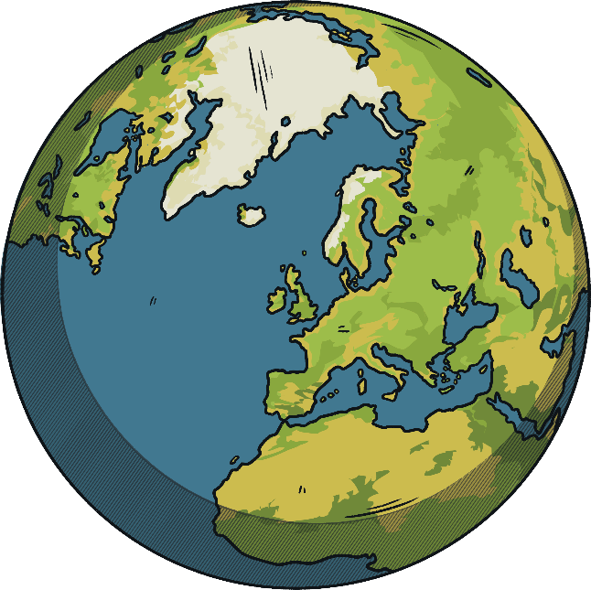
Gravity
The Earth has a large mass compared with everything that is on Earth.
The Earth’s gravitational field strength is larger than our own, so we don’t notice the gravitational force that our own bodies exert.
On Earth, everything is pulled to the Earth’s canter.
The Earth has a gravitational field strength of 10 newtons per kilogram (N/kg).
This means every kilogram on Earth has a force of 10 newtons acting on it.

Slide 3
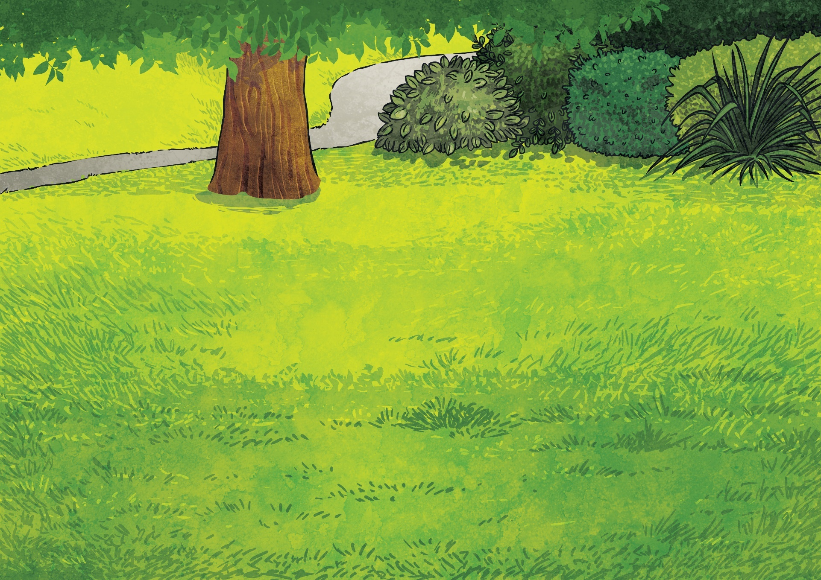
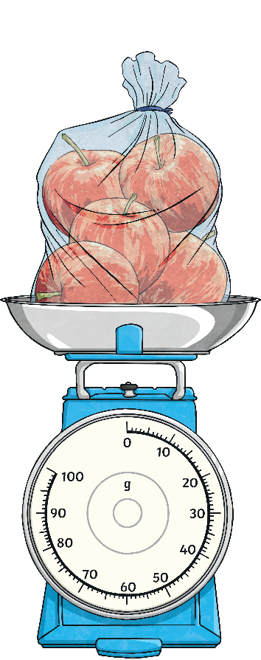
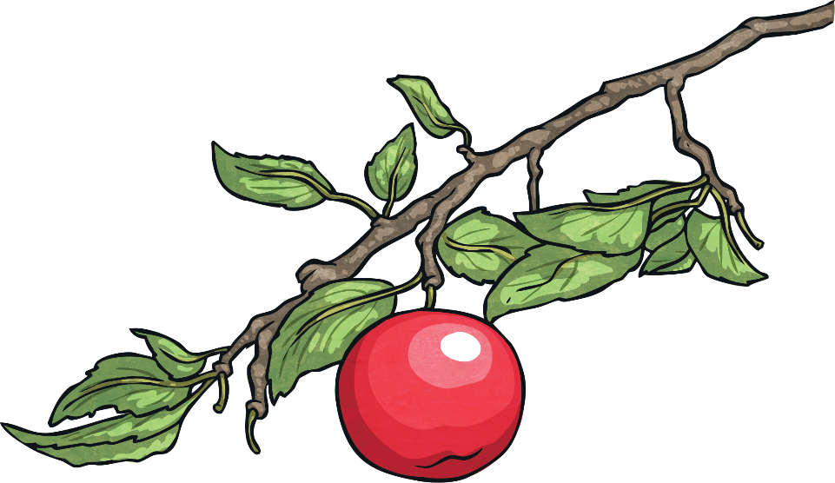
Mass is how much matter (or ‘stuff’) is inside an object. It is measured in kilograms (kg).
Weight is how strongly gravity is pulling an object down. It is measured in newtons (N).

Slide 4
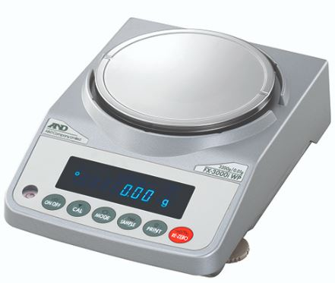
The gravitational field strength on Earth is 10N/kg.
We use the force meter to measure the weight
For measuring the mass we use Balance or scale .

Slide 5
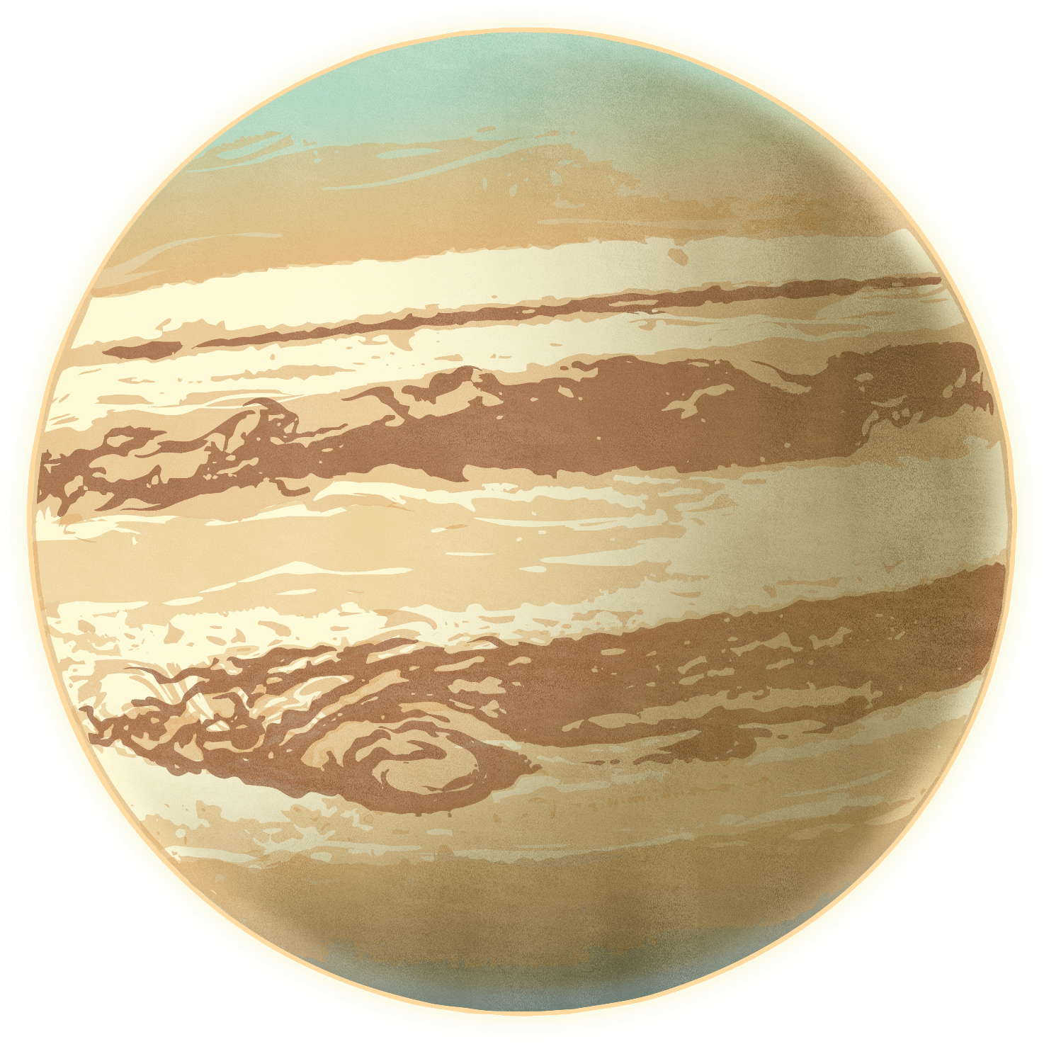
On any planet, the weight can be calculated by multiplying the mass by the gravitational field strength of the planet.
This is the equation to calculate the weight on any planet :
Weight (N)= Mass (kg) * Gravitational field
strength (N/Kg)

Slide 6
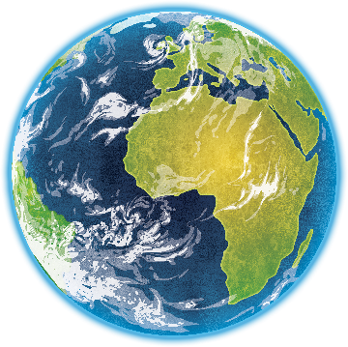
Jupiter is a much bigger planet than Earth so it has a stronger gravitational pull. Although an object would have the same mass on Jupiter as anywhere else, it would weigh much more due to the gravity pulling it more strongly.

Slide 7
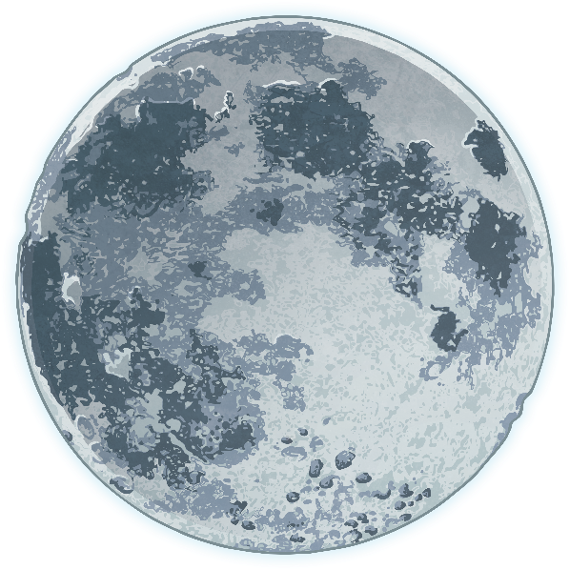
An object's mass will stay the same even in a place with weaker gravity, like the Moon.
However, an object’s weight can change! If the object were on the Moon, although it would have the same mass, it would weigh much less as the gravity would not be pulling it down as strongly. The Moon’s gravity is much weaker than the Earth’s.

Slide 8
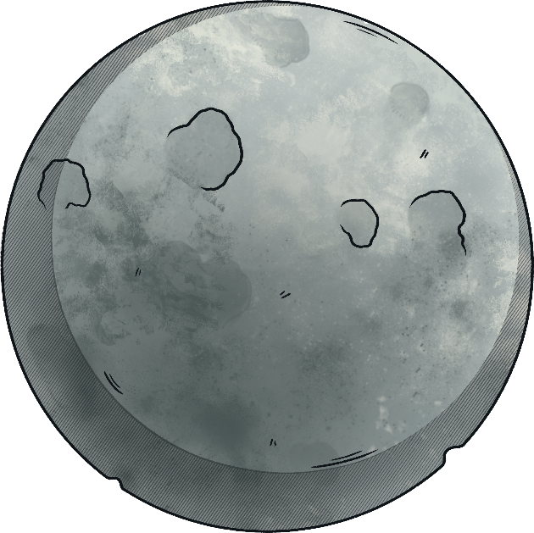
Weight and Mass
Questions:
1. How much does a person of mass 50 Kg weigh on Earth?
Knowing that the gravitational field strength of Earth is 10 N/Kg.
2. How much does the same person weigh on the moon?
Knowing that the gravitational field strength of the moon is 1.6 N/Kg.

Slide 9
Measuring Weight
Planet | Weight (N) | Mass (kg)
Earth
Mercury
Venus
Mars
Jupiter
Saturn
Uranus
Neptune
Gravitational Field Strength (N/kg)
2
0.74
1.78
0.74
5
2.08
1.78
2.24
0.2
0.2
0.2
0.2
0.2
0.2
0.2
0.2
10
3.7
8.9
3.7
25
10.4
8.9
11.2
* This table is not for memorize.

Slide 10
Mass vs Weight
Mass | Weight
Sort the statements below into the correct columns.
The total amount of force acting on an object due to gravity.
The amount of matter an object is made up of.
Measured in newtons (N).
Measured in kilograms (kg).

Slide 11
Mass vs Weight
Mass | Weight
The amount of matter an object is made up of. | The total amount of force acting on an object due to gravity.
Measured in kilograms (kg). | Measured in newtons (N).
The value does not change when an object’s location changes. | It depends on the gravitational field strength of the planet .

