Slide 1
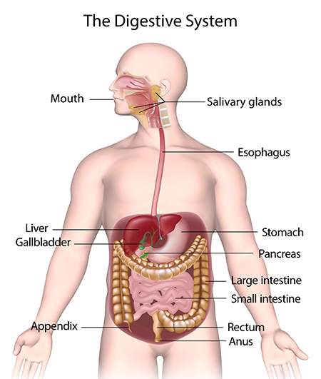
The digestive system
https://www.youtube.com/watch?v=v3E1txcKPe8
https://www.youtube.com/watch?v=B0CRWq3nc80

Slide 2
What is digestion ?
It is the break down of food into smaller molecules and nutrients needed to be used for energy, growth, and cell repair.

Slide 3
How does food move through the digestive system?
The digestive tract (or the alimentary canal) is a long twisting tube through which the food goes down to our system. It starts at the mouth going through the pharynx, esophagus, stomach, small intestines, large intestines, rectum and anus.
The food particles get digested in every stage of the alimentary canal as they move.

Slide 4
Types of Digestion
Mouth
Mechanical (physical) - your teeth rip, break and crush food particles.
Chemical – saliva contains enzymes that break down food molecules and makes it slippery mass of food that will slide down easier.

Slide 5
Esophagus
Moves food from the throat to the stomach using muscle movement called peristalsis.
If acid from the stomach gets in here that’s heartburn.
Notes:
A good way to describe peristalsis is an ocean wave moving through the muscle.
These diagrams don’t separate the esophagus from the mouth functions, you might want to talk about what happens in the mouth too.

Slide 6
Stomach
J-shaped muscular bag that stores the food you eat, breaks it down into tiny pieces.
Mixes food with Digestive Juices that contain enzymes to break down Proteins and Lipids.
Acid (HCl) in the stomach Kills Bacteria.
Food found in the stomach is called Chyme.
Notes:
The stomach takes around 4 hours to do it’s job on the food, depending on what kinds of food are digested.

Slide 7
Small Intestine
Small intestines are roughly 7 meters long.
Nutrients from the food pass into the bloodstream through the small intestine walls.
Secretes digestive enzymes.

Slide 8
Large Intestine
About 1.5 meters long.
Accepts what small intestines don’t absorb.
Absorbs water into the bloodstream.
Includes the Rectum, which is the last segment of the large intestine and serves as short term storage by holding the feces until it can expelled.
Notes:
Depending on the maturity of the group, you can talk about the feces leaving via the anus.
Mention the appendix at the bottom of the ascending colon and that it might have been used long ago but is not today
Mention the portions of the large intestine, ascending, transverse, descending, sigmoid, and rectum (last one if the audience is mature enough)

Slide 9
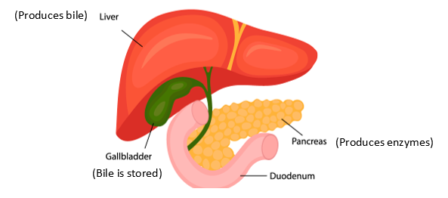
Accessory Organs / The Glands
Not part of the path of food, but play a critical role.
Include: Liver, gall bladder, and pancreas
Bile helps digest fat
digest fats, carbohydrates and proteins

Slide 10
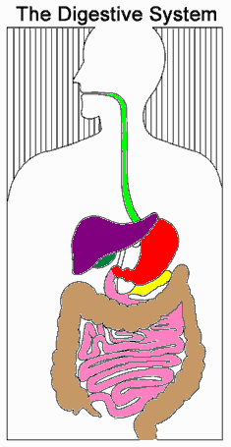
Write the name of each colored organ:
Green:
Red:
Pink:
Brown:
Purple:
Dark green:
Yellow:

Slide 11
How did you do?
Green: Esophagus
Red: Stomach
Pink: Small Intestine
Brown: Large Intestine
Purple: Liver
Dark green: Gall Bladder
Yellow: Pancreas

Slide 12
Questions
Explain why most foods need to be digested.
Describe the route fibre takes through your body when you eat it.
Explain the difference between mechanical digestion and chemical digestion.
When your mouth 'waters' it makes saliva. Give two reasons why you need saliva.
What happens to food in your stomach?
Describe the two main processes that happen in your small intestine.
How do small food molecules such as glucose get from your alimentary canal (gut) to your cells?

Slide 13
Questions
1. Explain why most foods need to be digested.
Digestion breaks large molecules down into smaller molecules that can be absorbed by the small intestine to the blood .
2. Describe the route fiber takes through your body when you eat it.
mouth ------ esophagus ------ stomach -----duodenum----- small intestine ------ large intestine -------rectum ----- anus
3. Explain the difference between mechanical digestion and chemical digestion.
Mechanical digestion to cut solid food into smaller pieces .
Chemical digestion uses enzymes to break large food molecules into smaller ones .

Slide 14
Questions
4. When your mouth 'waters' it makes saliva. Give two reasons why you need saliva.
Saliva contains an enzyme that begins the breakdown of starch.
It also makes food slippery and soft so it is easier to swallow.
5. What happens to food in your stomach?
It mixes with protease enzyme to digest protein in the presence of hydrochloric acid , hydrochloric acid also kills microbes .

Slide 15
Questions
6. Describe the two main processes that happen in your small intestine.
Most large molecules are digested in the small intestine using enzymes.
These small molecules are absorbed into the bloodstream.
7. How do small food molecules such as glucose get from your alimentary canal (gut) to your cells?
Small food molecules are absorbed by the walls of the small intestine and pass into the blood. The blood carries them to cells all over the body

Slide 16
Questions
8. Decide whether statements a-f refer to mechanical digestion, chemical digestion or both.
Digestion begins in our mouth.
Teeth chew food to break up large pieces.
Chewing increases the surface area of solid foods.
Enzymes help large molecules to break down.
Digestion ends in your small intestine.

Slide 17
Questions
8. Decide whether statements a-e refer to mechanical digestion, chemical digestion or both.
Digestion begins in our mouth. both
Teeth chew food to break up large pieces. mechanical
Chewing increases the surface area of solid foods. mechanical
Enzymes help large molecules to break down. Chemical
Digestion ends in your small intestine. Chemical

Slide 18
Live worksheet- https://www.liveworksheets.com/worksheets/en/Natural_Science/Digestive_system/The_digestive_system_qm1349010jv

