Slide 1
FORMING PLURAL NOUNS
SINGULAR AND PLURAL

Slide 2
LET’S BEGIN BY REVIEWING THE RULES

Slide 3
RULE #1 : ADDING (S)

Slide 4
RULE # 2: ADDING (ES)

Slide 6
RULE #3: WORDS ENDING WITH A “Y”

Slide 7
MORE EXAMPLES:

Slide 8
RULE #4: WORDS ENDING WITH “F” OR “FE”

Slide 9
RULE #5: SOME NOUNS ARE IRREGULAR

Slide 10
IRREGULAR NOUNS:

Slide 11
IRREGULAR NOUNS MUST BE MEMORIZED!

Slide 12
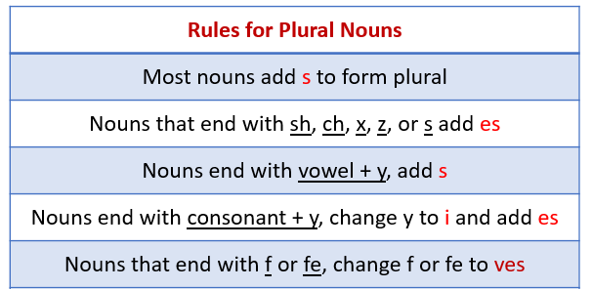
LET’S REVIEW:

