Slide 1
Quoted Speech and Saying Verbs
Learning Objective: To be able to use speech marks correctly and to use different saying verbs.

Slide 2
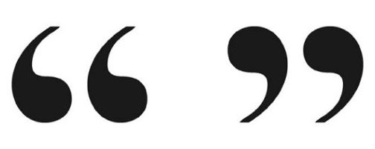
What are quotation marks (speech marks)?
Quotation marks are used to show someone's exact words.
They go before and after the person’s exact words.

Slide 3

How should we place quotation marks?
Open the quotation with a small 66.
Begin with a capital letter.
End the quoted speech with the correct punctuation.
Close the quotation with a small 99.
Make sure to use a saying verb with the name of the person speaking.
“This is a great book!” Sam shouted.

Slide 4
How should we place quotation marks?
If the quotation comes at the end, make sure to place a comma after the saying verb. For example:
The teacher asked, “Did you like this book?”
If the quotation comes at the beginning, no need to place a comma. For example:
“Did you like this book?” asked the teacher.

Slide 5
Which sentence is correct?
A. “after dinner, we are going out for ice-cream!” Dad announced.
B. “After dinner, we are going out for ice-cream”! Dad announced.
C. “After dinner, we are going out for ice-cream!” Dad announced.

Slide 6






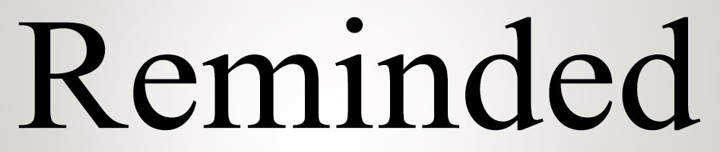

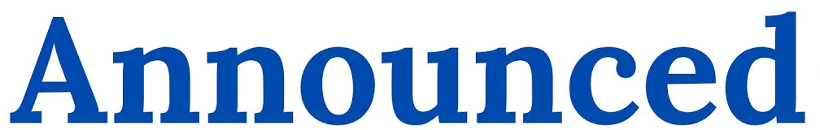

Saying Verbs are verbs that indicate speaking

Slide 7

Now Let’s Practice!

