Slide 1
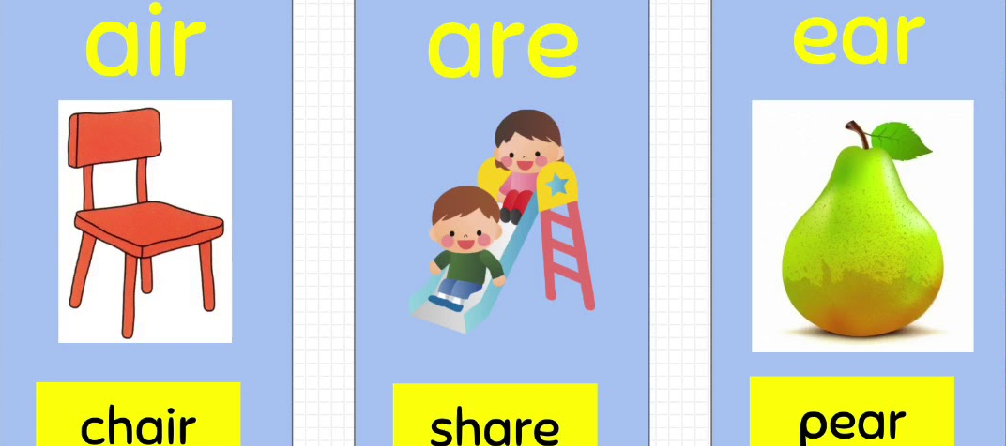
Words with ear are air

Slide 2

Objective
Identify words with ear air are

Slide 3

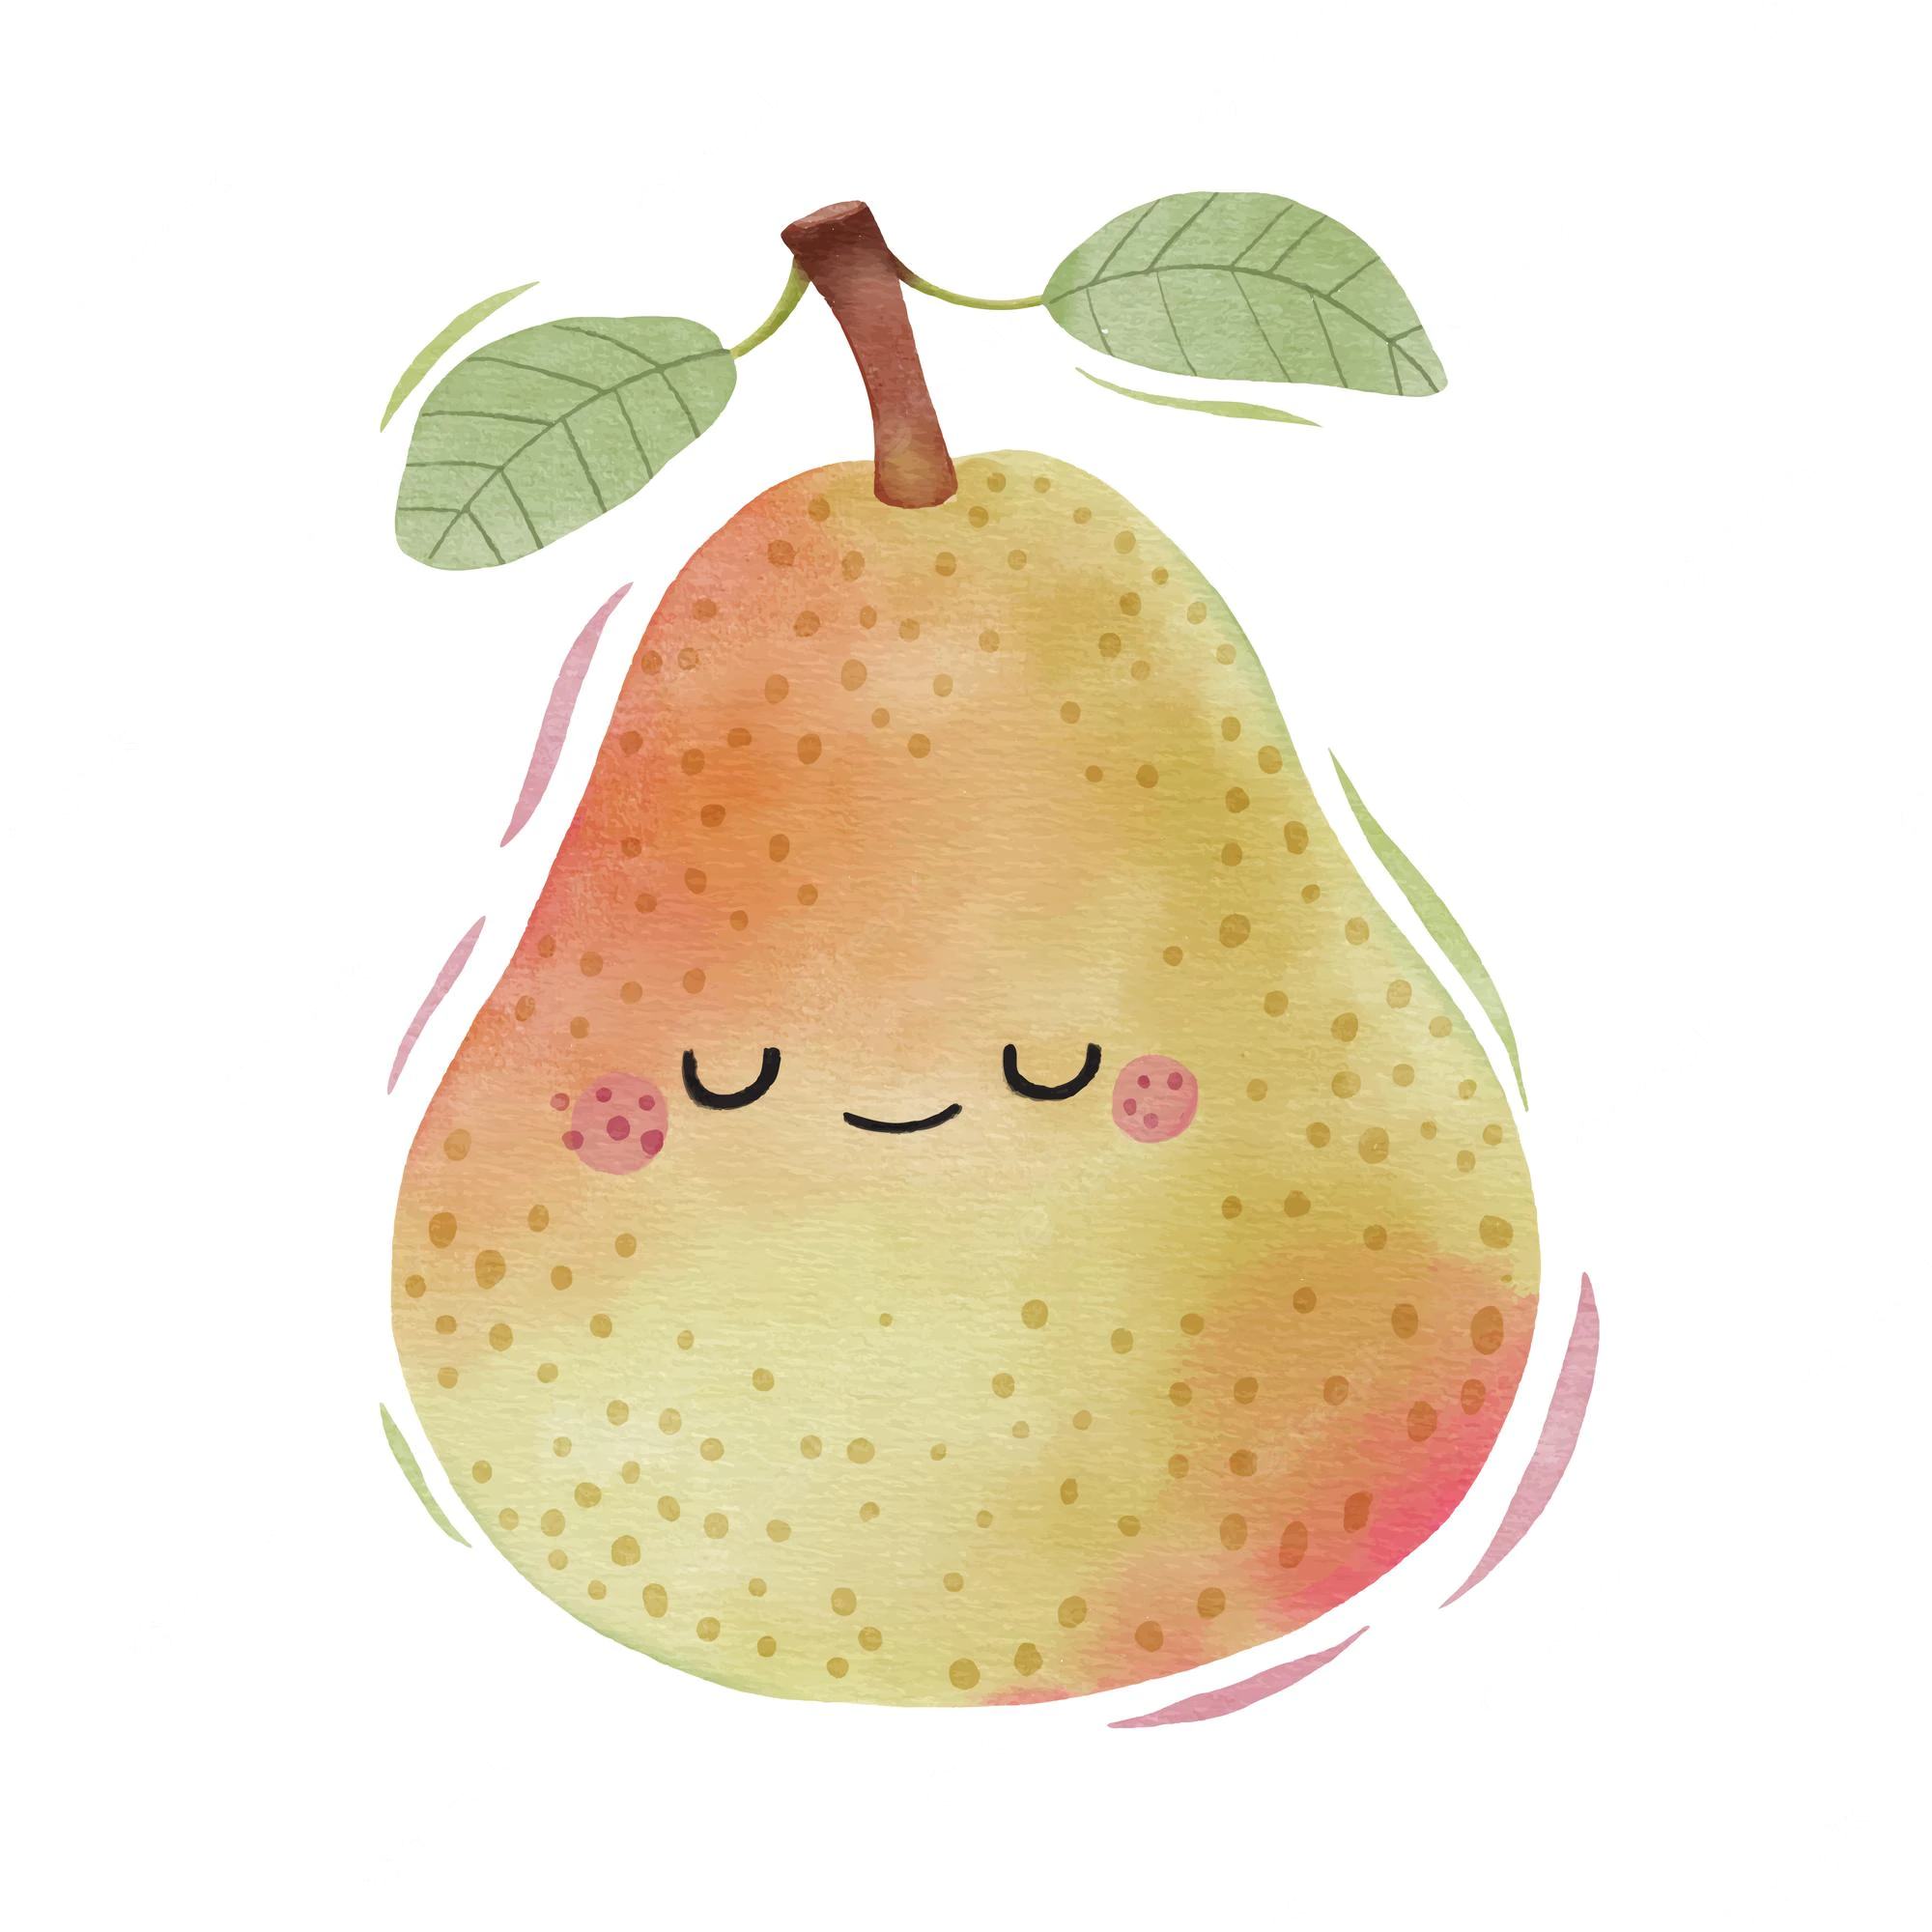
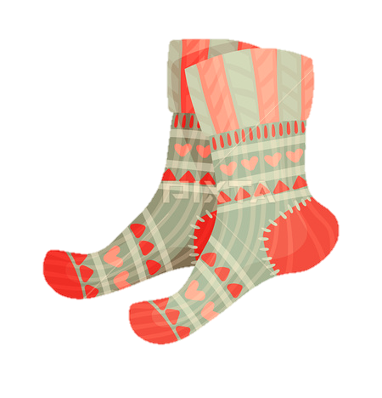
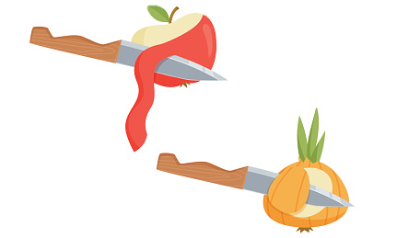
Listen to this sound!
There are three main ways we can spell this sound /air/
Sometimes, words have the same sound, but different spellings.
air as in pair
two
ear as in pear
fruit
are as in pare
To peel

Slide 4
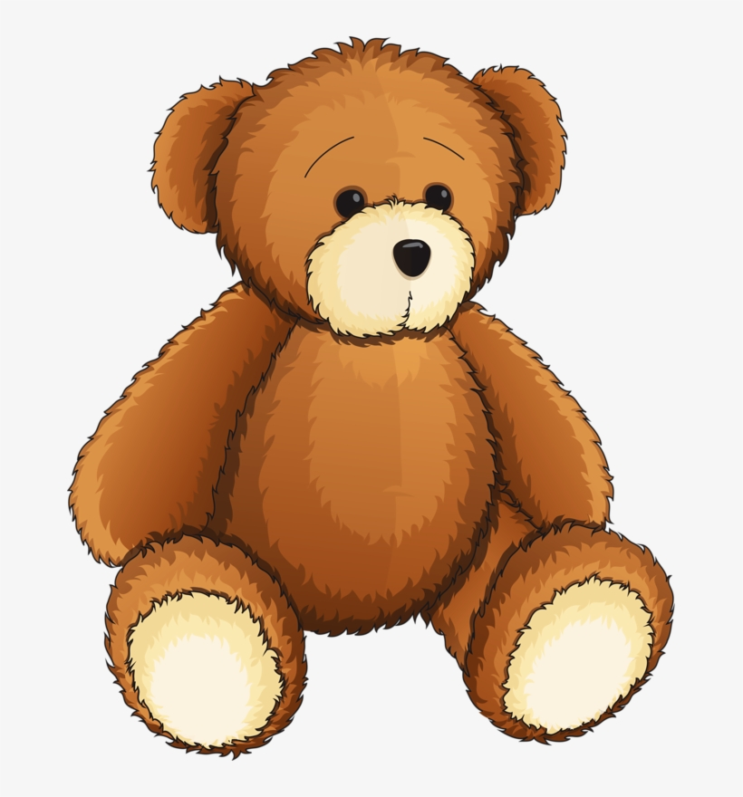


Help me say those words and let’s listen to the vowel sound !
hair
square
bear

Slide 5

Let’s a watch a video to learn more about the /air/ sound
https://www.youtube.com/watch?v=A-w6SlbFQgY&t=2s

Slide 6

Riddle
There are no rules to help us decide which spelling to use but a practical and fun hobby can help us understand the spelling of words better
Do you know this hobby?
Reading!

