Slide 2
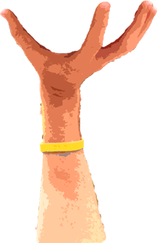
Phelps ___________ swim when he was born
1/15
NEXT

Slide 3
Phelps couldn’t swim when he was born
but he _________ swim really fast now.
2/15
NEXT

Slide 4
My aunt ________ jump high. She was the best.
3/15
NEXT

Slide 5
My aunt could jump high. She was the best.
But now she ________ do it because she is 90.
4/15
NEXT

Slide 6
He ___________ drive a car when he was a child
5/15
NEXT

Slide 7
He couldn’t drive a car when he was a child
but he _______ drive trucks now. He is a truck driver.
6/15
NEXT

Slide 8
Cats ________ climb trees
7/15
NEXT

Slide 9
Cats can climb trees
but elephants _________ do it.
8/15
NEXT

Slide 10
In 1820 people __________ travel to America by plane
9/15
NEXT

Slide 11
In 1820 people couldn’t travel to America by plane
but they _________ go there by boat.
10/15
NEXT

Slide 12
Babies _______ sleep all day along
11/15
NEXT

Slide 13
Babies can sleep all day along but I ________ do it
because I have to work.
12/15
NEXT

Slide 14
He called me for help because he _________ do his homework alone.
13/15
NEXT

Slide 15
When she was 1 she __________ speak
14/15
NEXT

Slide 16
When she was 1 she couldn’t speak but now
she is bilingual. She _______ speak Spanish and English.
15/15
EXIT

