Slide 1
Daily message
Today, we are going to read a new page from the story (Zack).

Slide 2
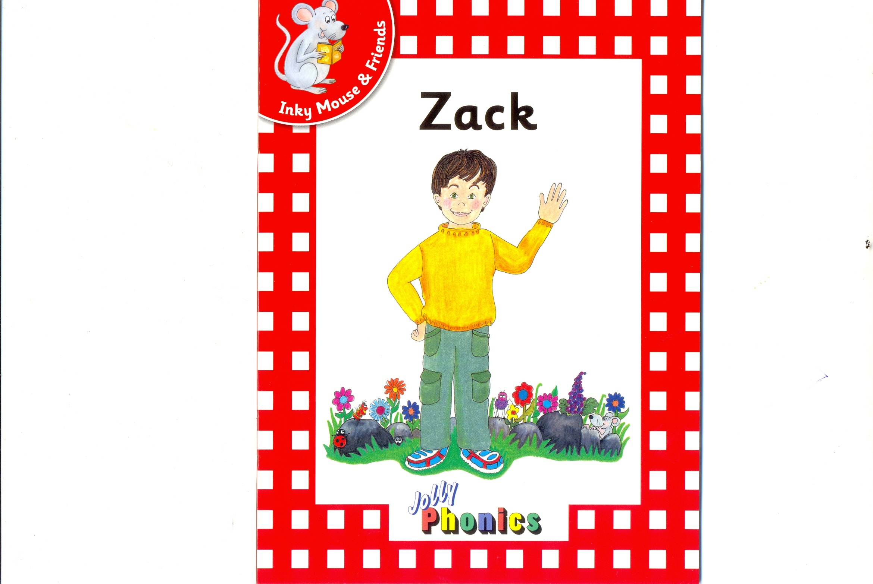

Slide 3
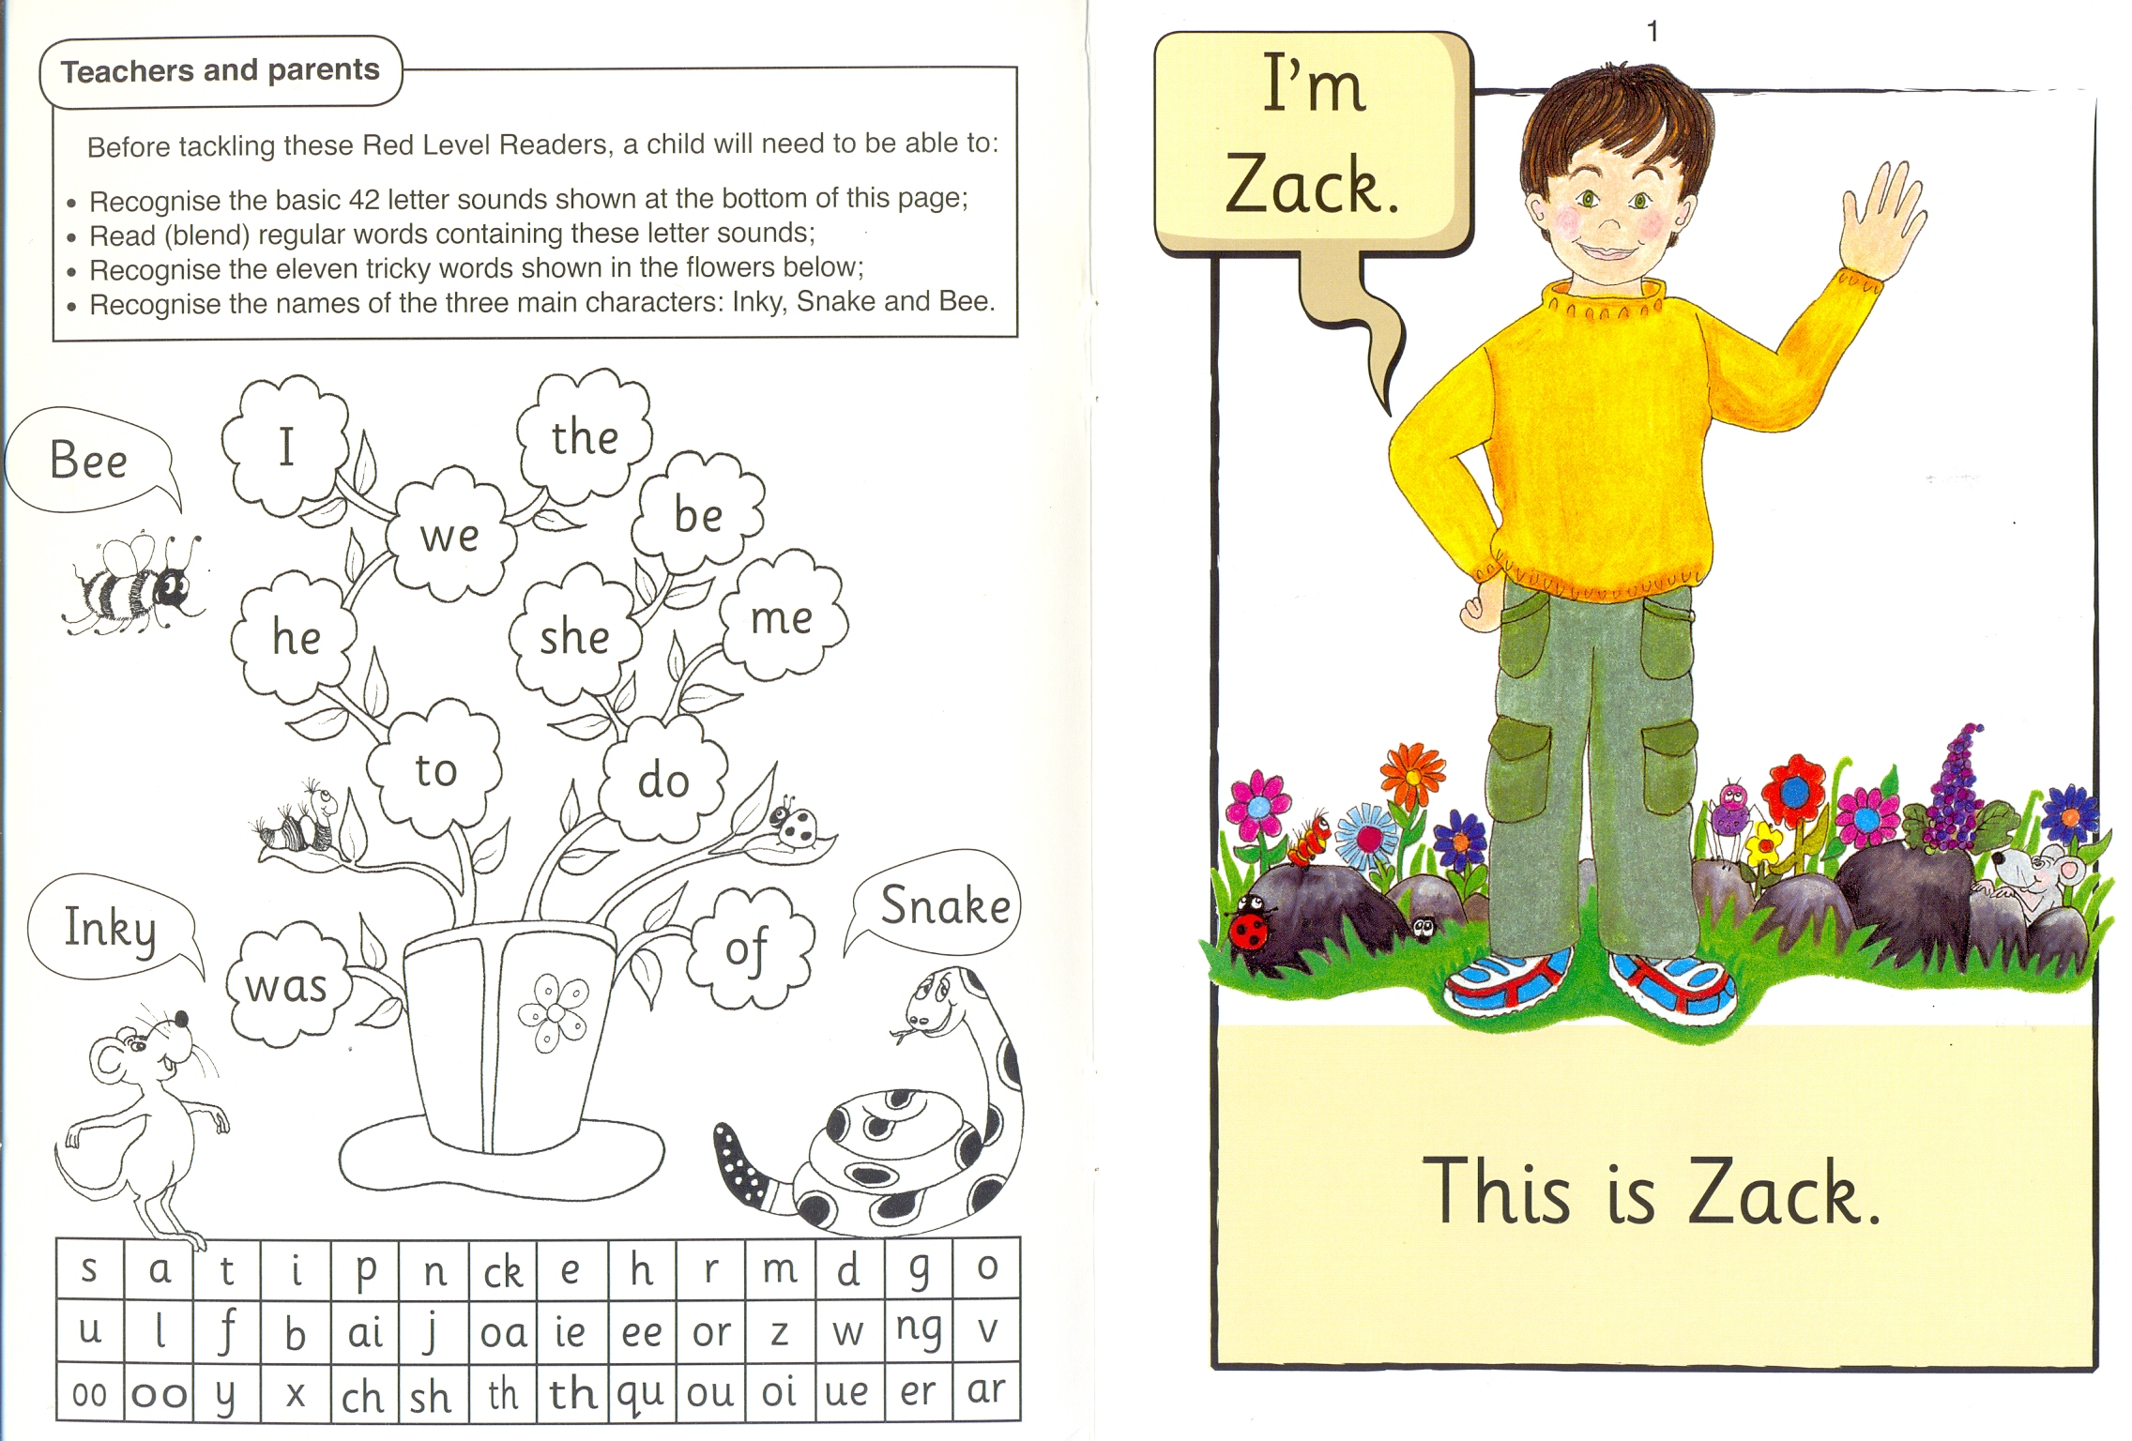

Slide 12
Zack

Slide 13
Jess

Slide 14
Rags

Slide 15
Inky

Slide 16
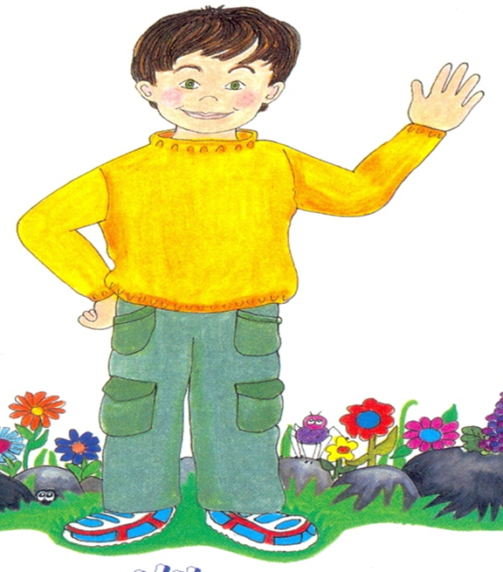
Jess
Zack
Inky
I 2 3

Slide 17
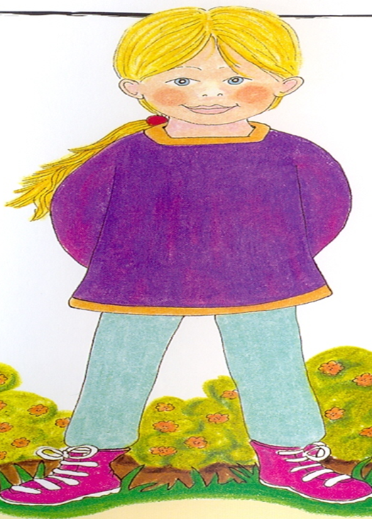
Rags
Jess
Zack
I 2 3

Slide 18
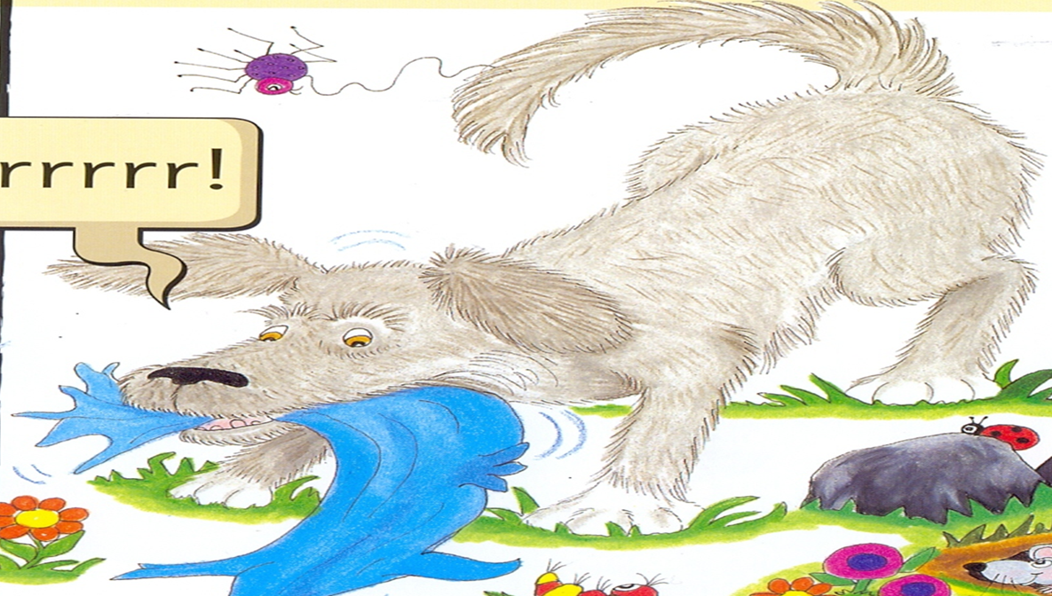
Zack
Rags
Inky
I 2 3

Slide 19
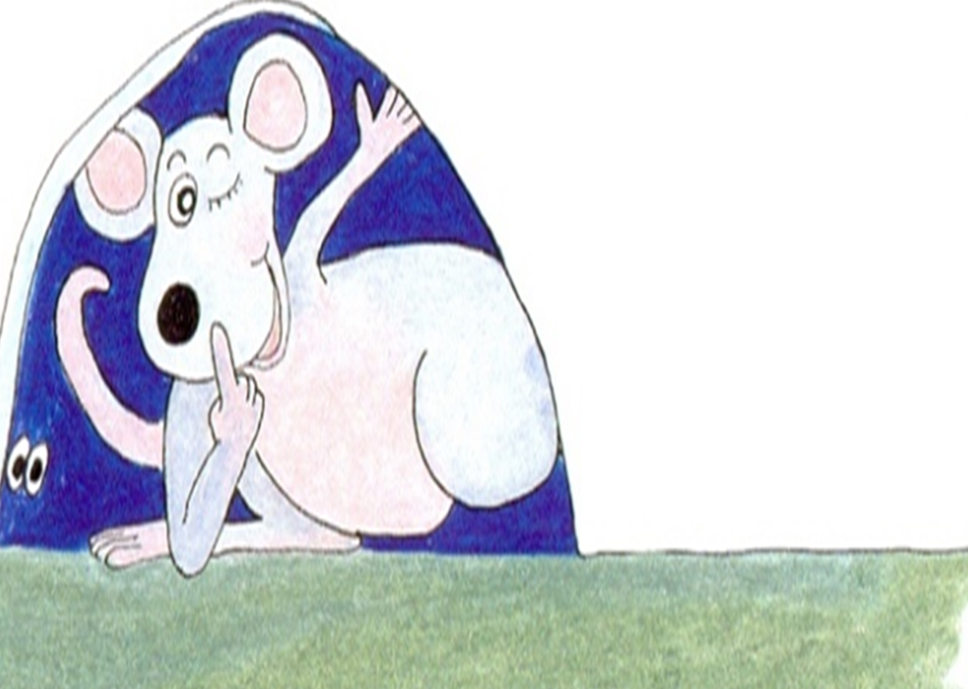
Inky
Zack
Jess
I 2 3

Slide 20
is
This
2
I

Slide 21
sister
Rags
I 2

Slide 22
is
sister

Slide 23
the
dog
I 2

Slide 24
Zack
I`m
This
the
I 2 3 4
Jess
is
sister
dog
5 6 7 8

Slide 25
I`m Zack.
This is Zack.

Slide 26
This is Zack`s sister, Jess.

Slide 27
This is Rags the dog.

