Slide 2
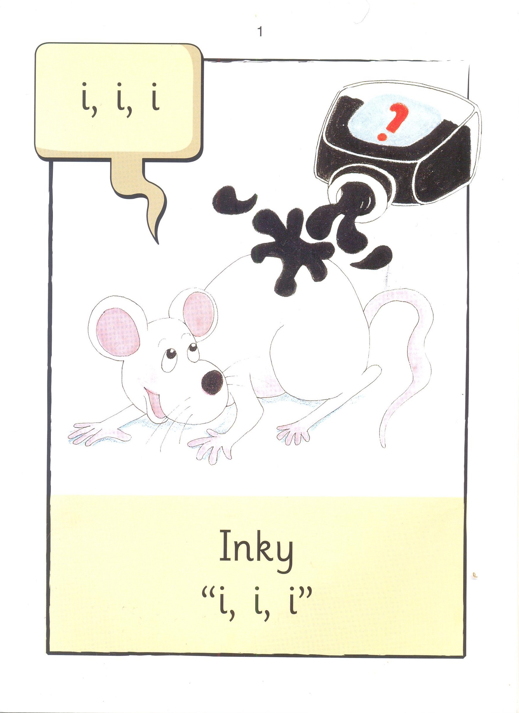

Slide 5
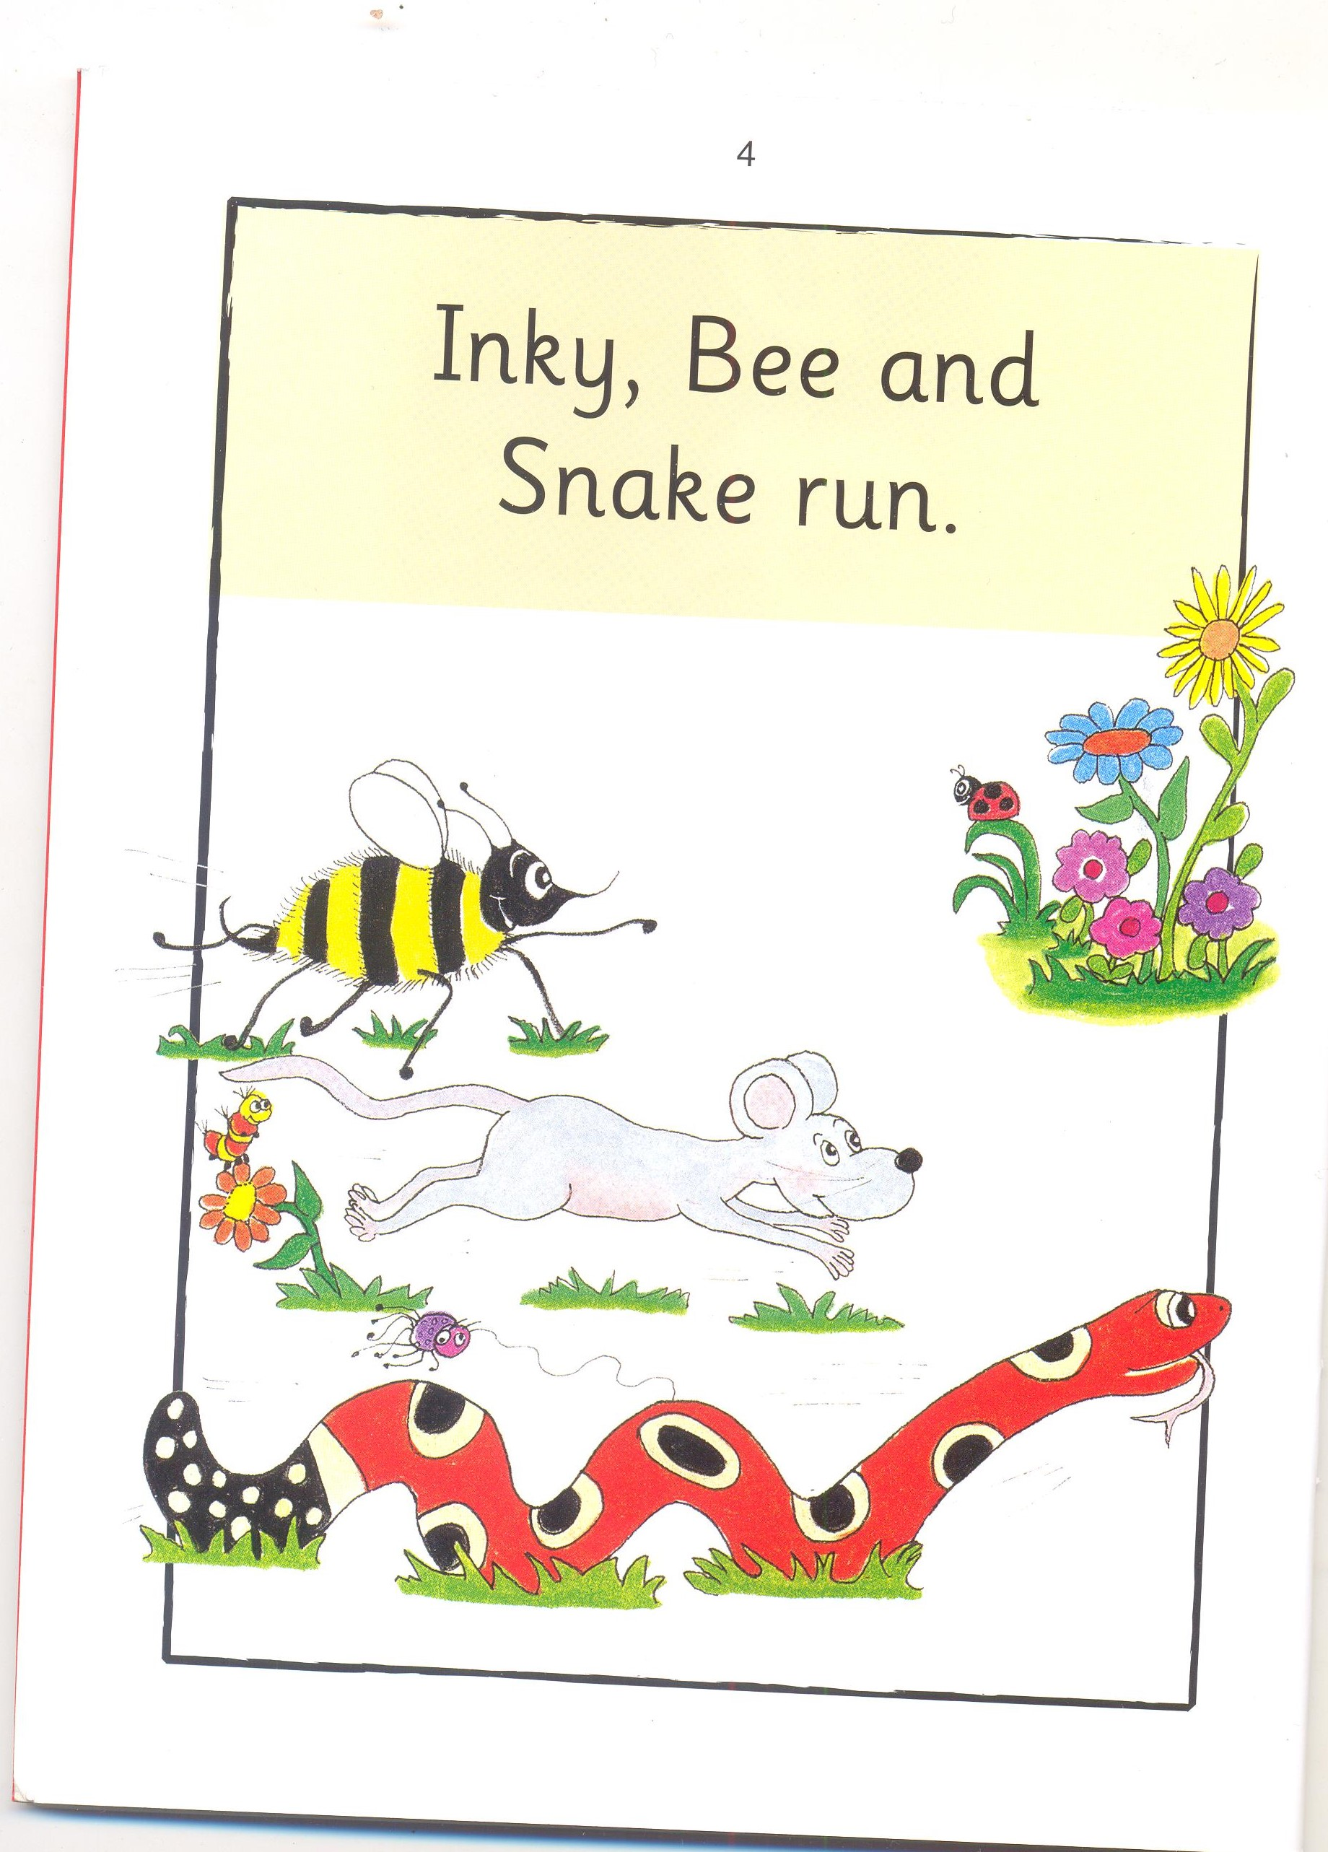

Slide 6
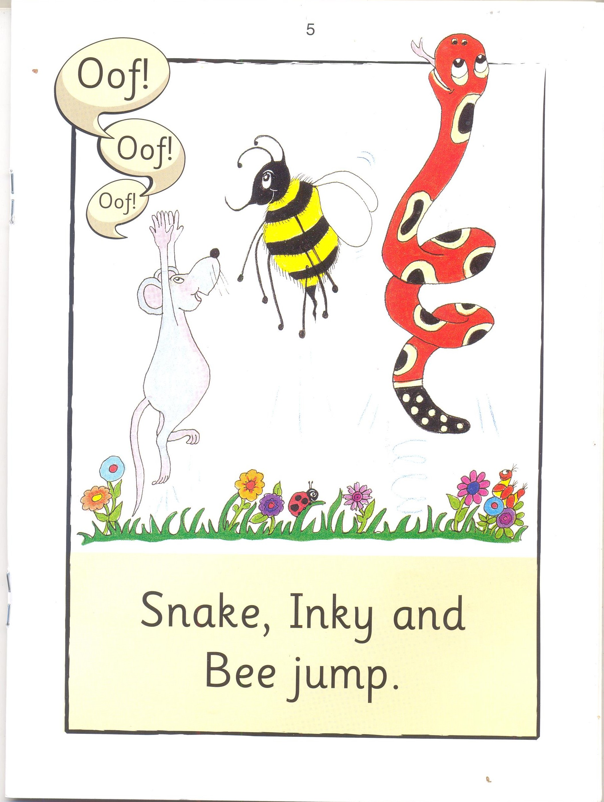

Slide 8
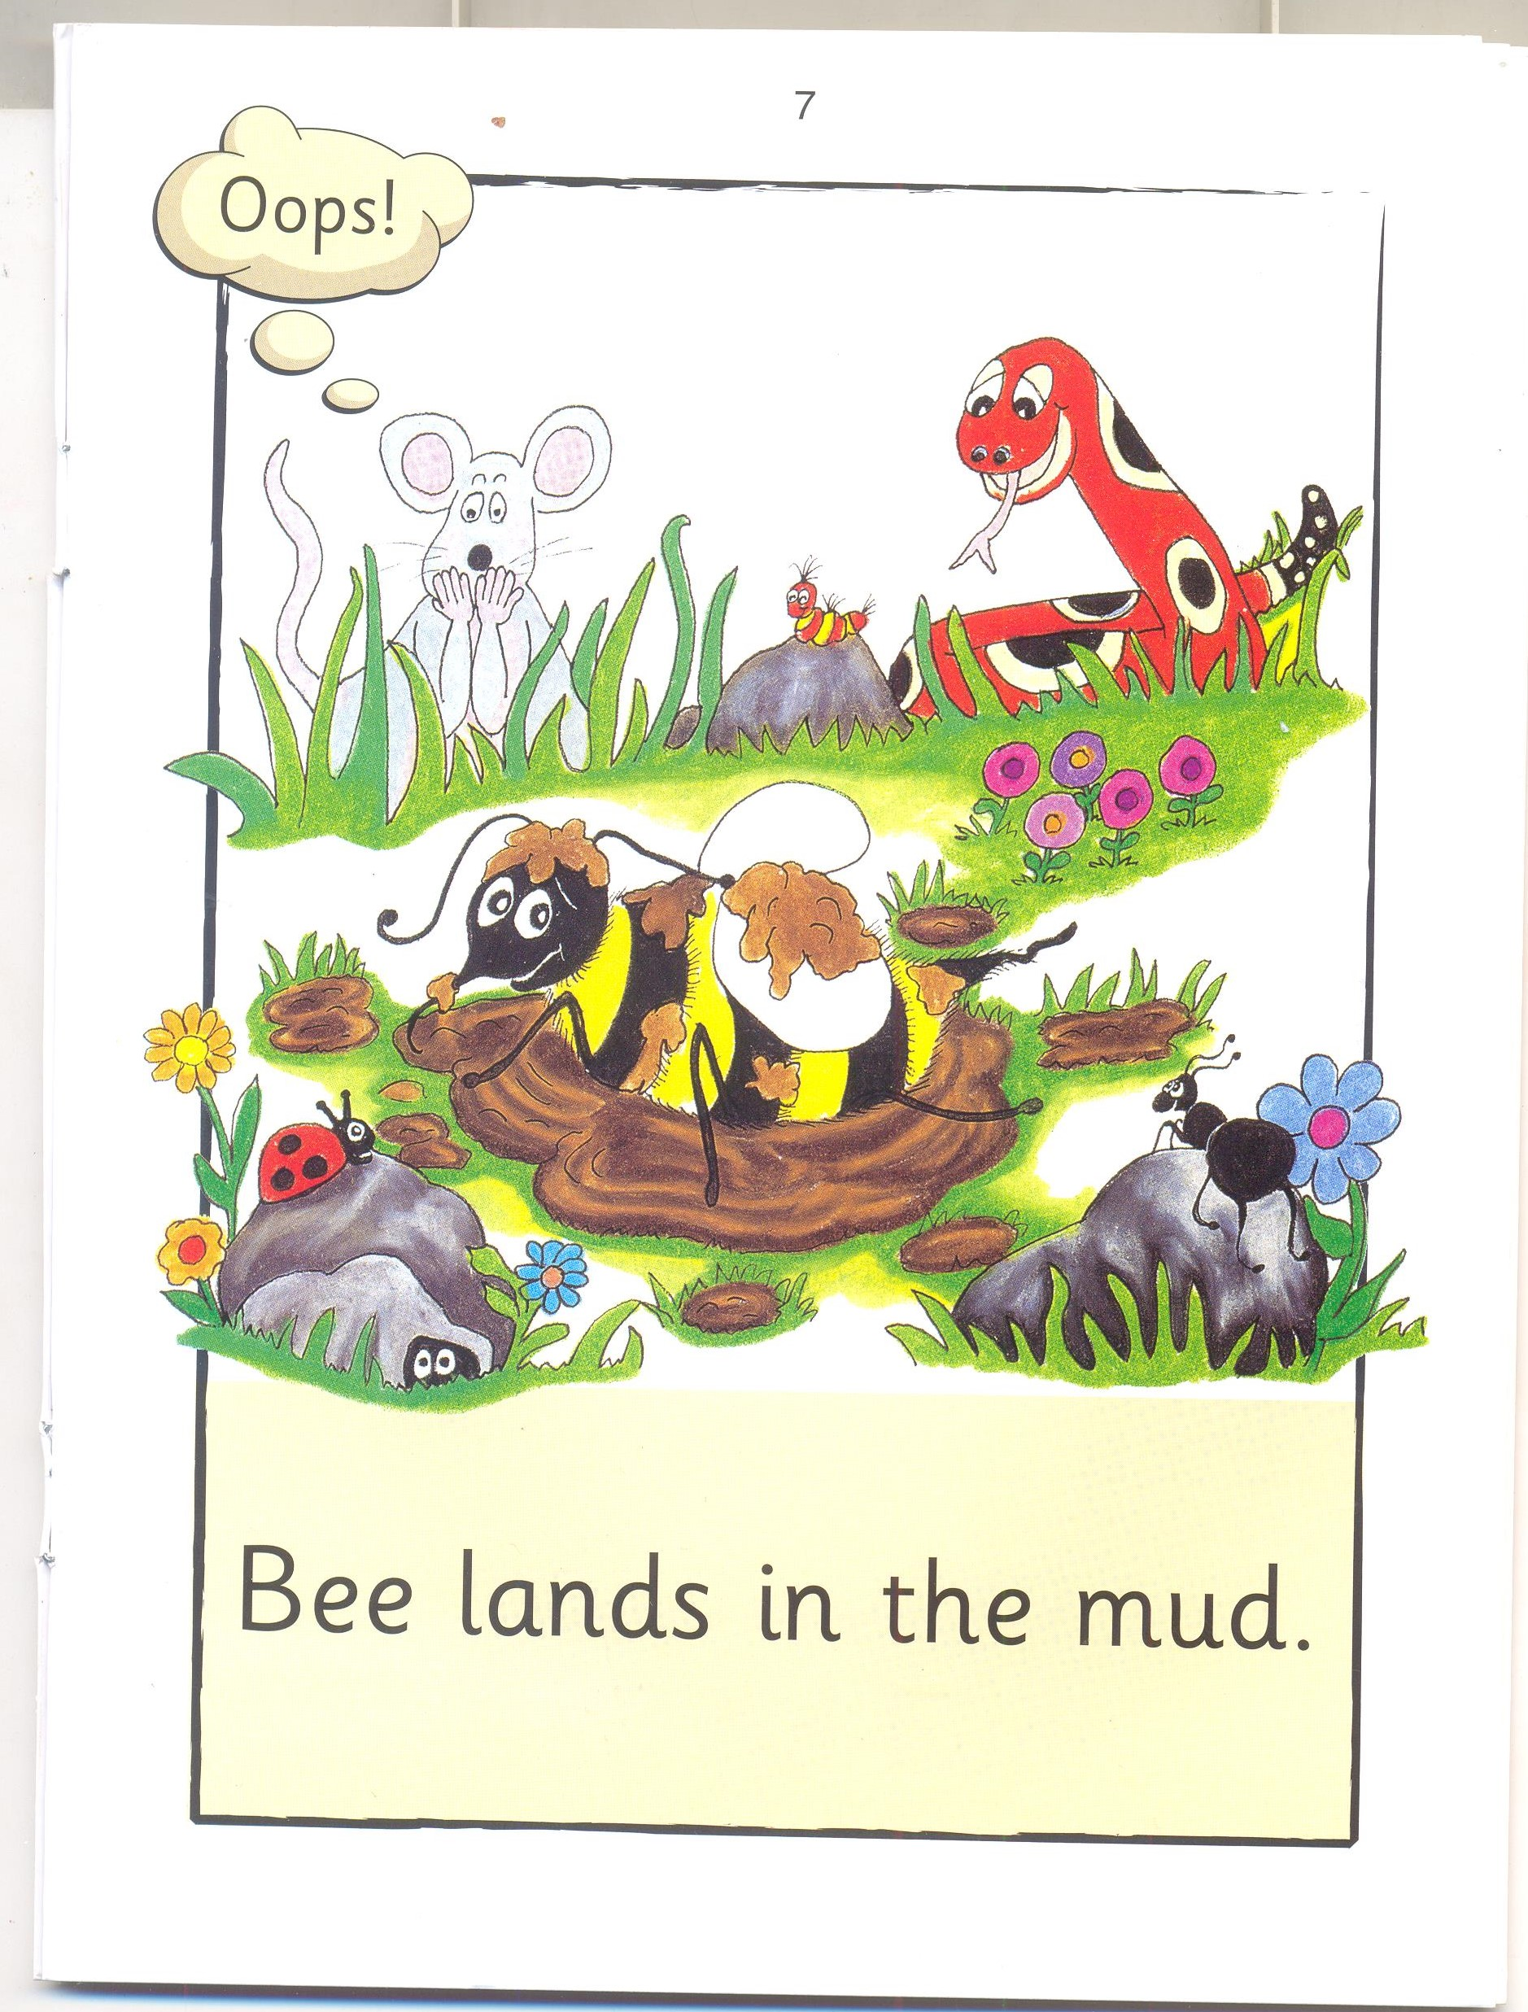

Slide 10
Inky Mud
l 2

Slide 11
Bee Inky
I 2

Slide 12
Mud Snake
I 2

Slide 13
run jump
I 2

Slide 14
Jump run
I 2

Slide 15
jumps lands
I 2

Slide 16
lands scrub
I 2

Slide 17
help jump
I 2

Slide 18
Mud

Slide 19
Inky

Slide 20
Bee

Slide 21
Snake

Slide 22
and

Slide 23
run

Slide 24
jump

Slide 25
splash

Slide 26
in

Slide 27
the

Slide 28
lands

Slide 29
help

Slide 30
to

Slide 31
scrub

Slide 32
off

