Slide 1


Slide 2
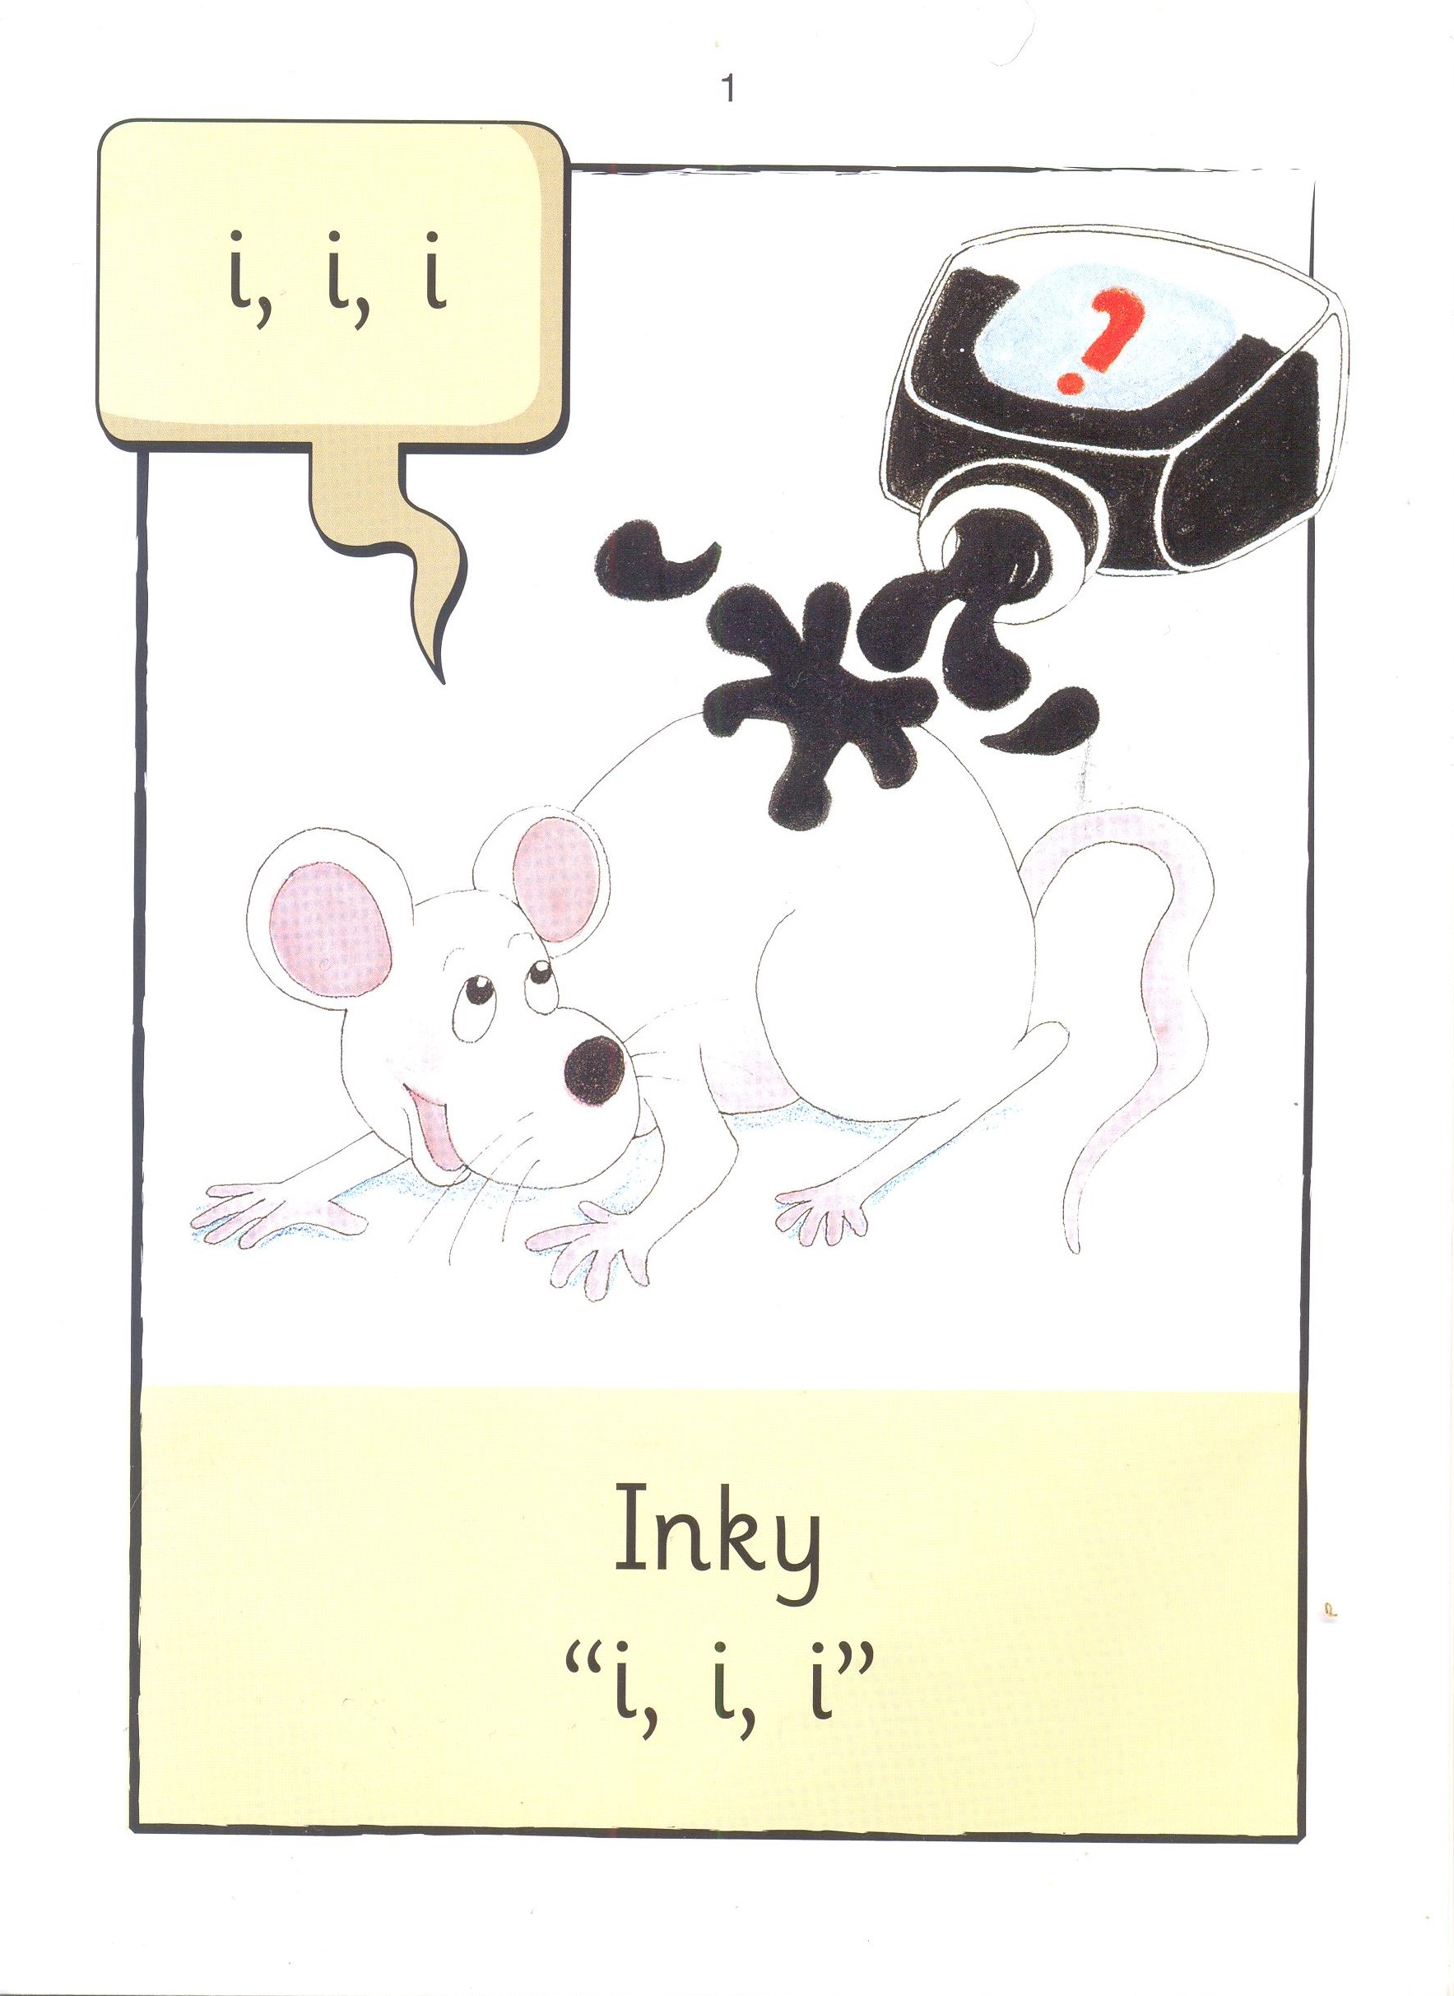

Slide 3


Slide 4
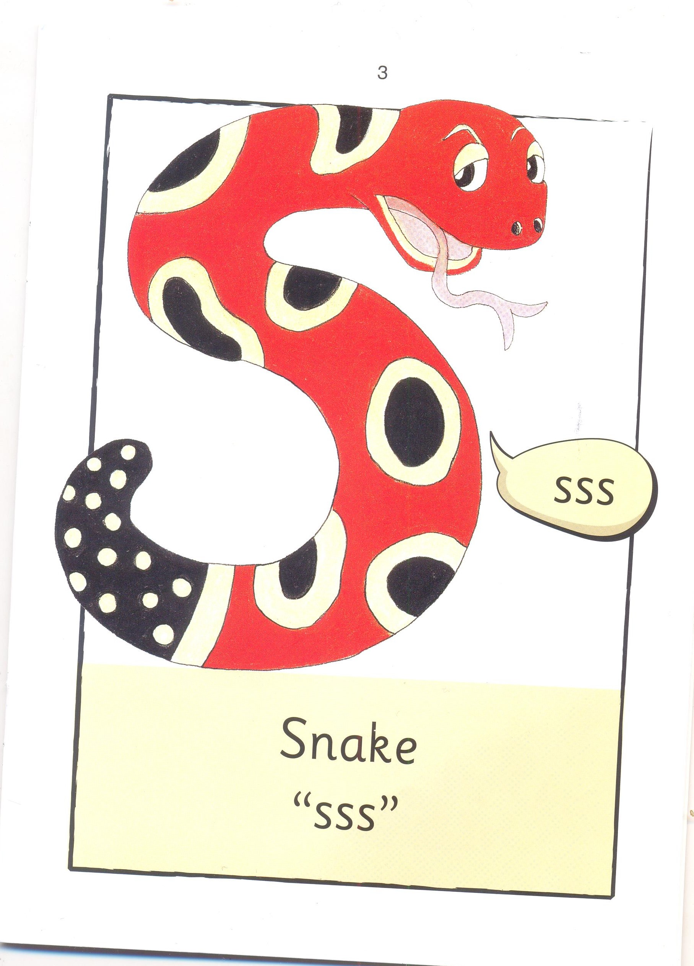

Slide 5
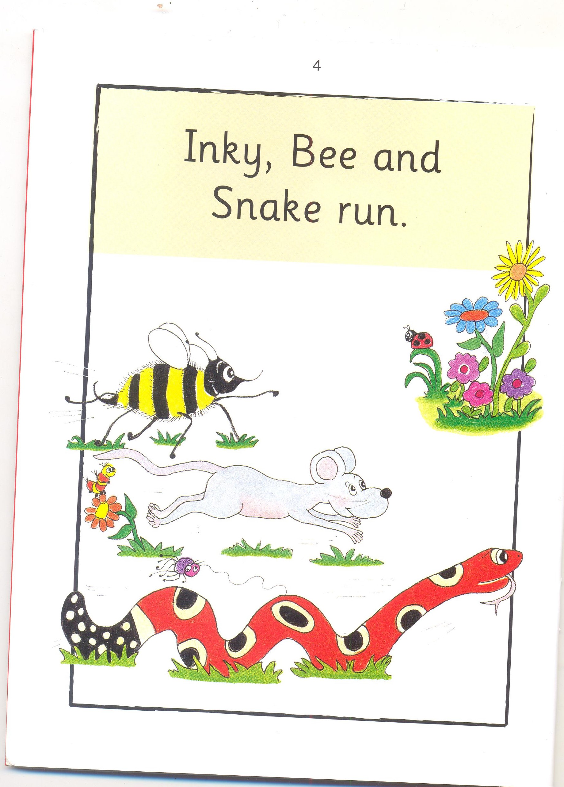

Slide 6
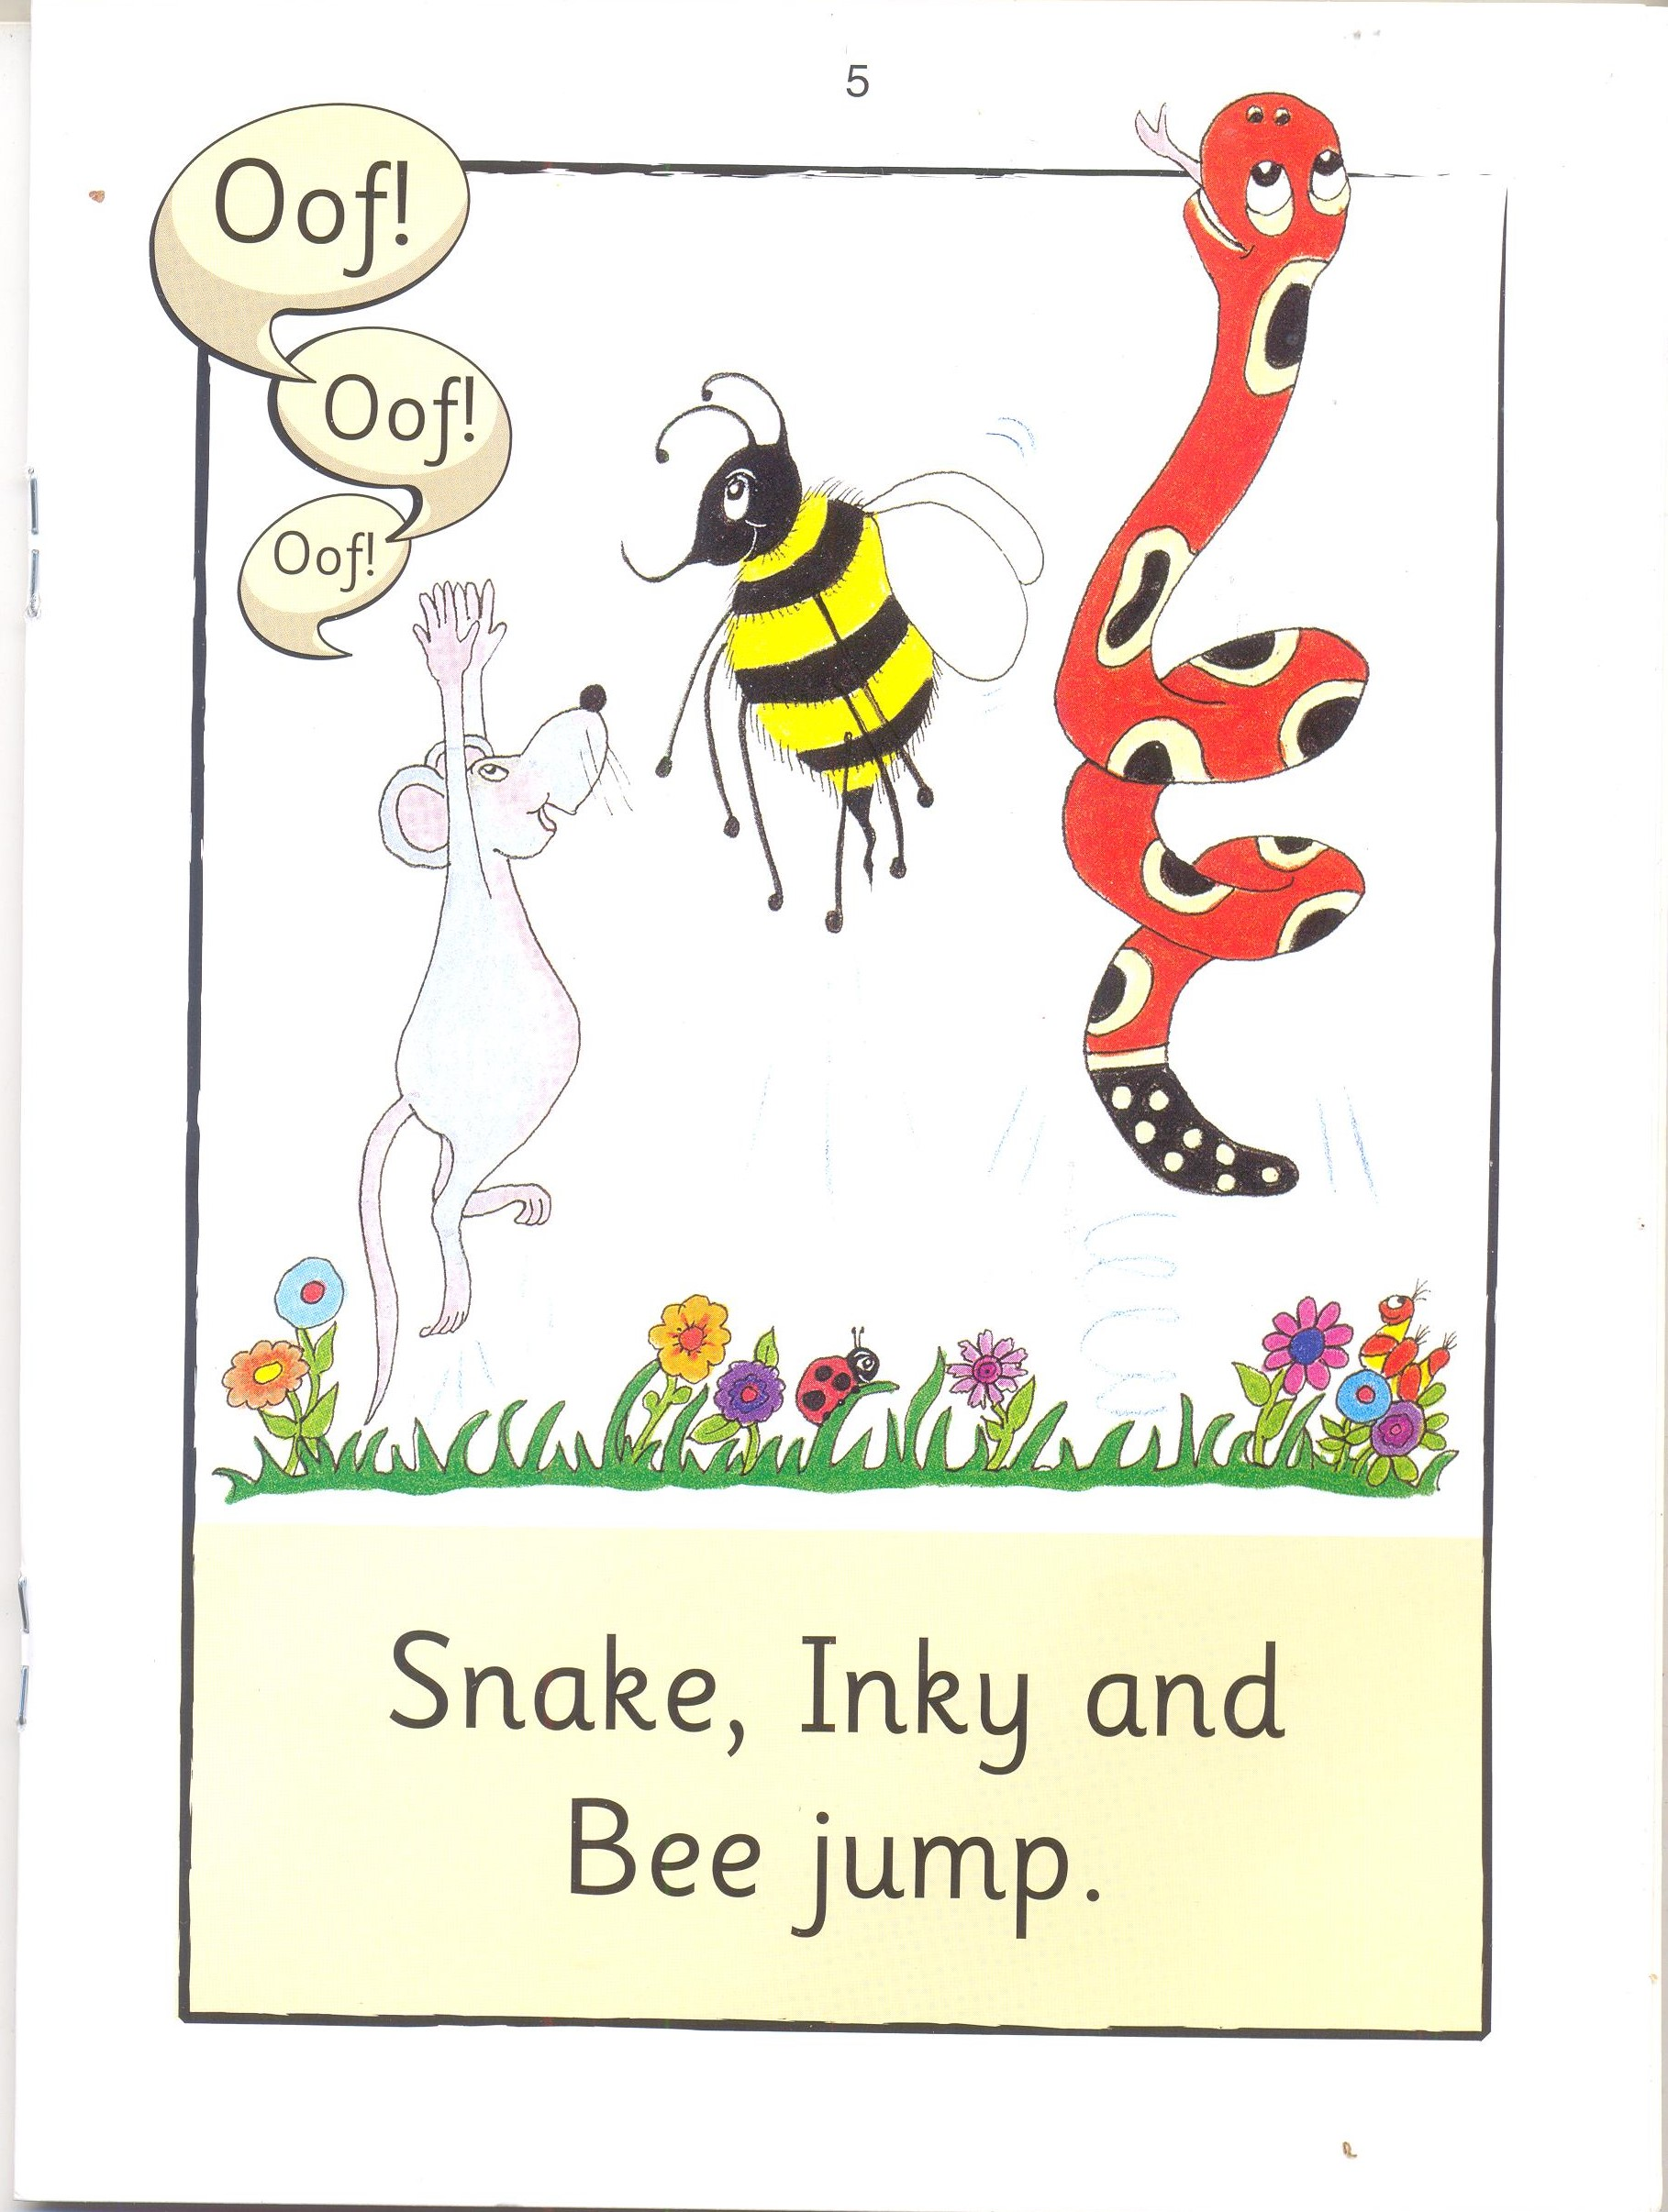

Slide 7
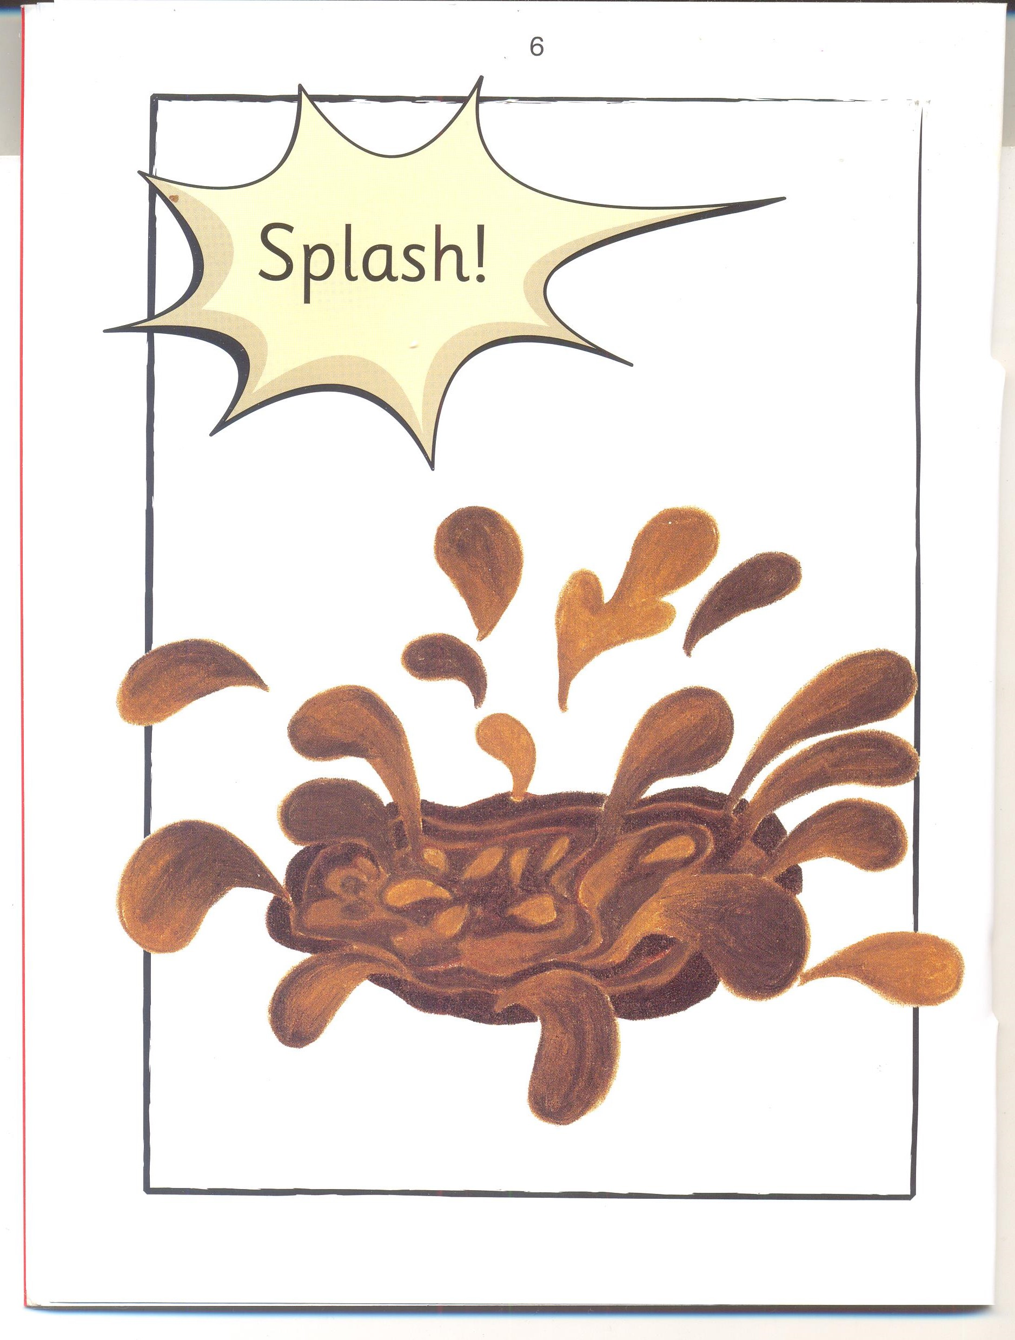

Slide 8
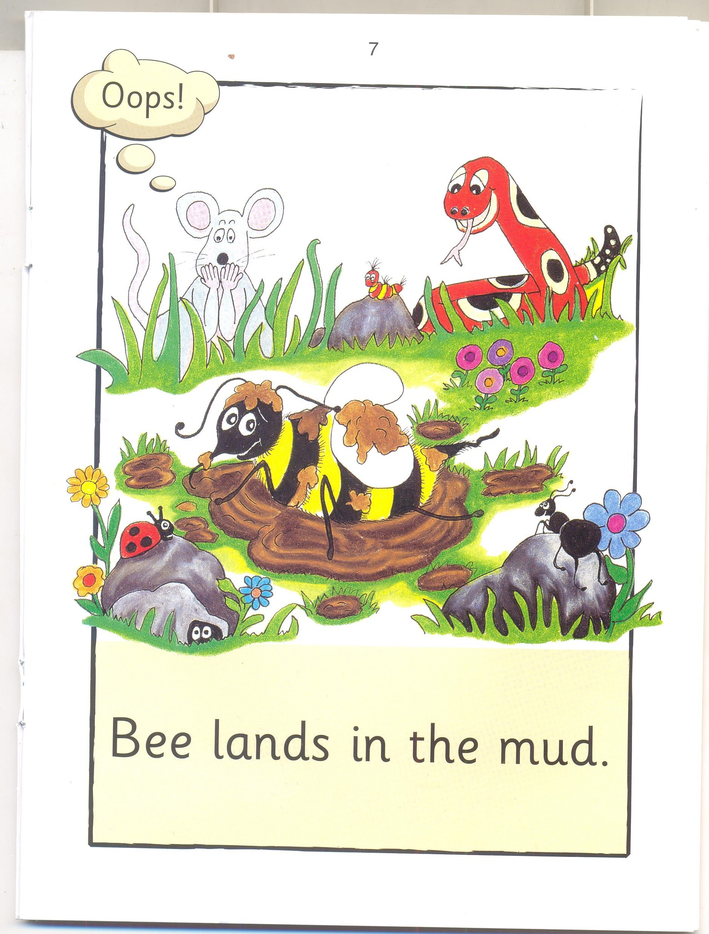

Slide 9
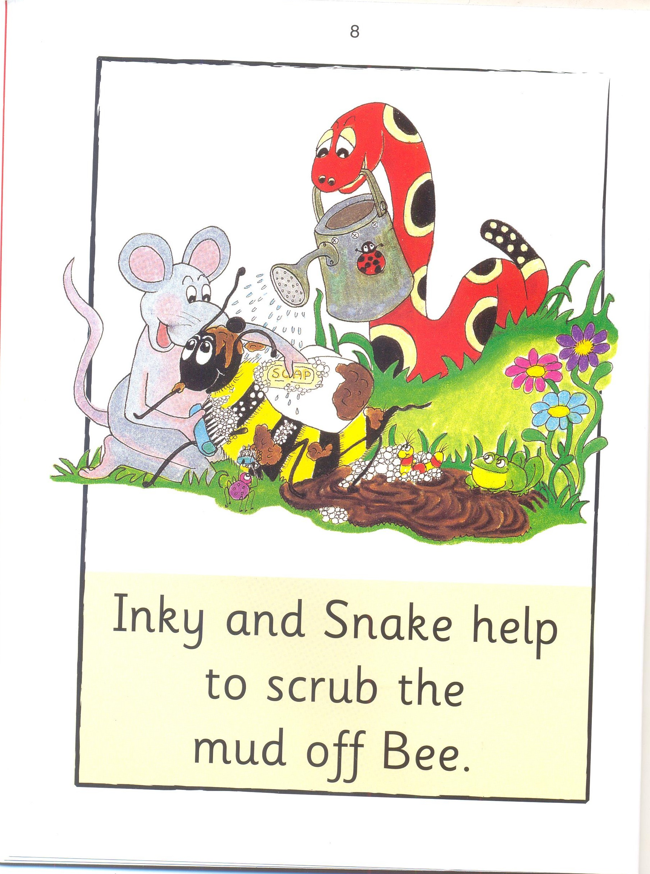

Slide 10
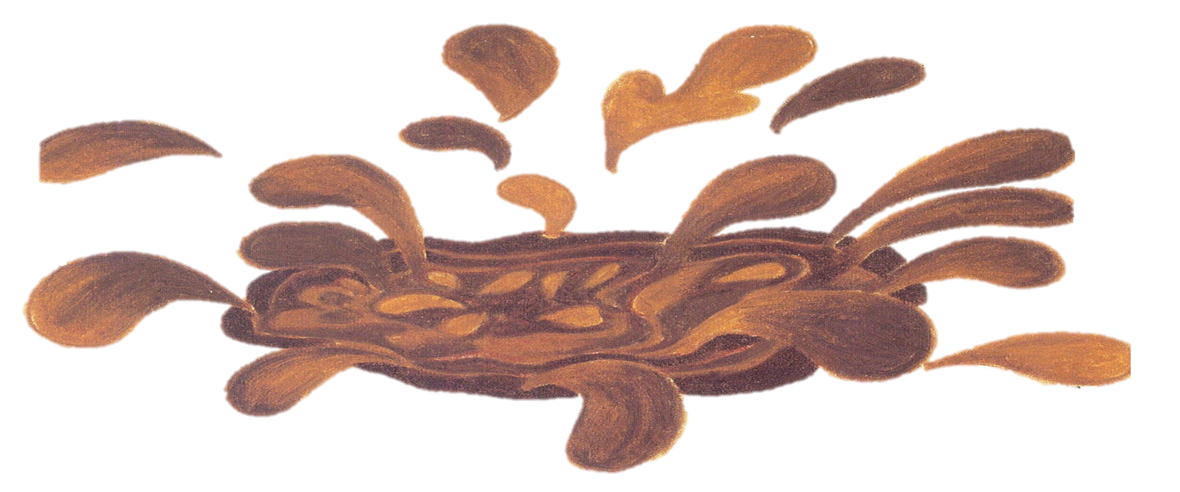


Inky Mud
l 2

Slide 11
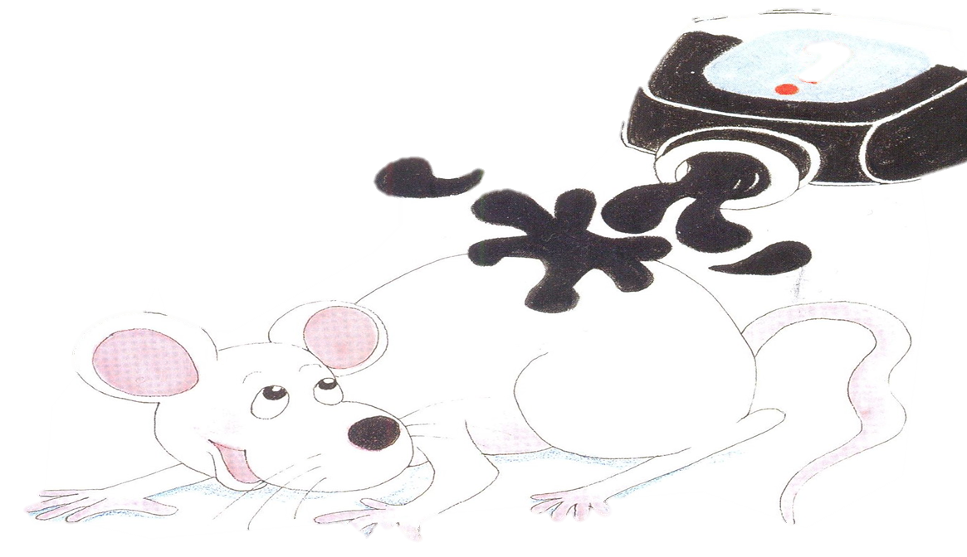


Bee Inky
I 2

Slide 12
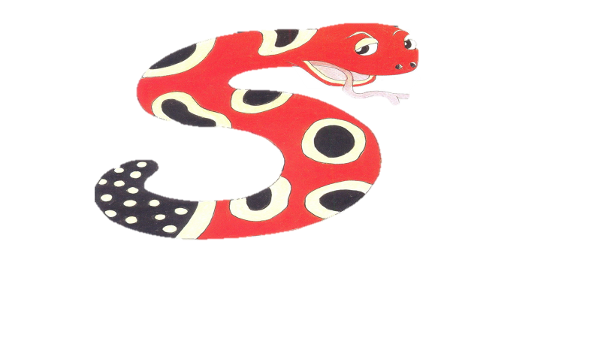


Mud Snake
I 2

Slide 13
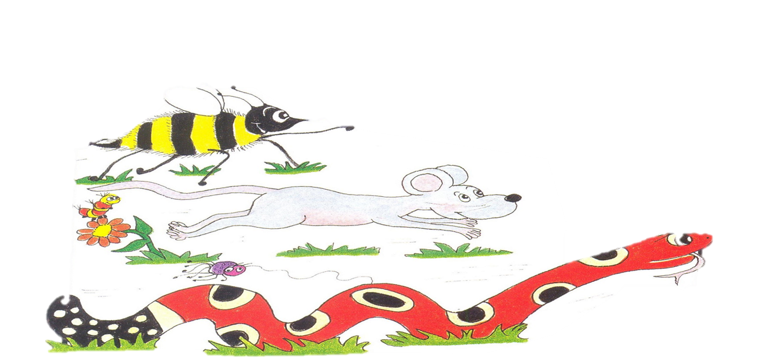

run jump
I 2

Slide 14



Jump run
I 2

Slide 15
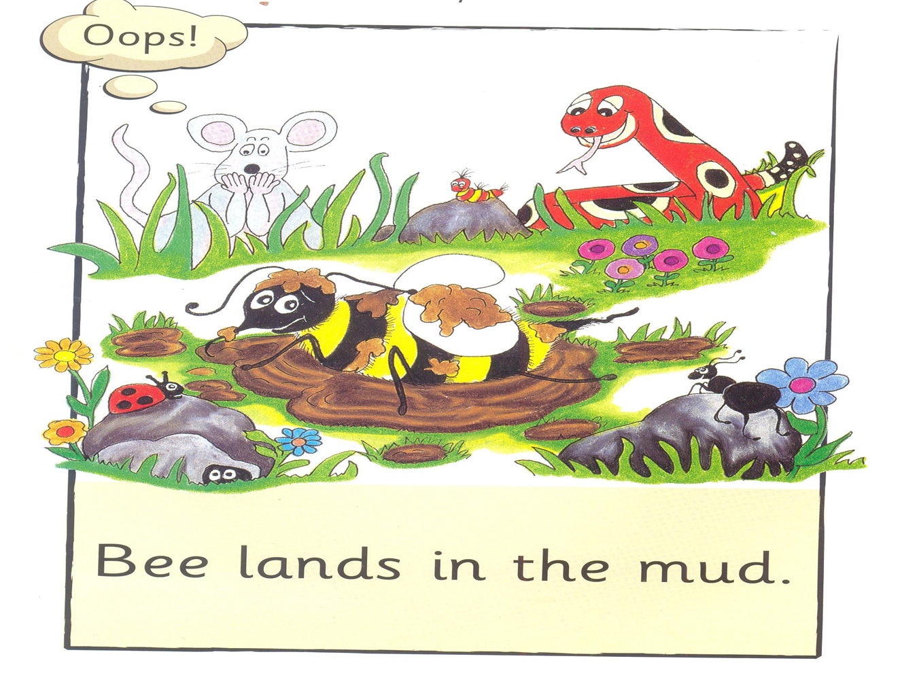

jumps lands
I 2

Slide 16
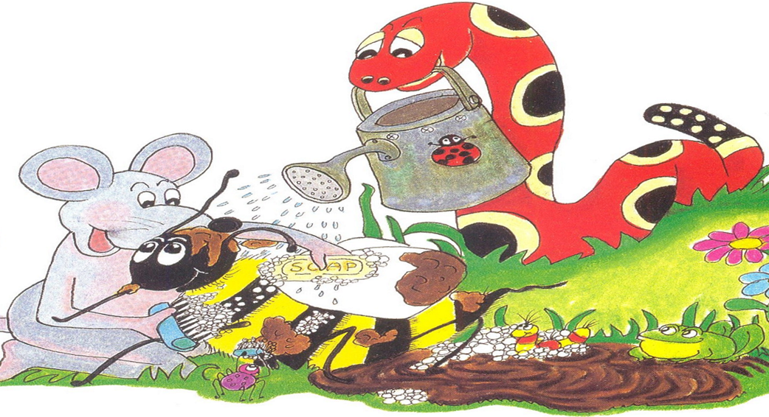


lands scrub
I 2

Slide 17
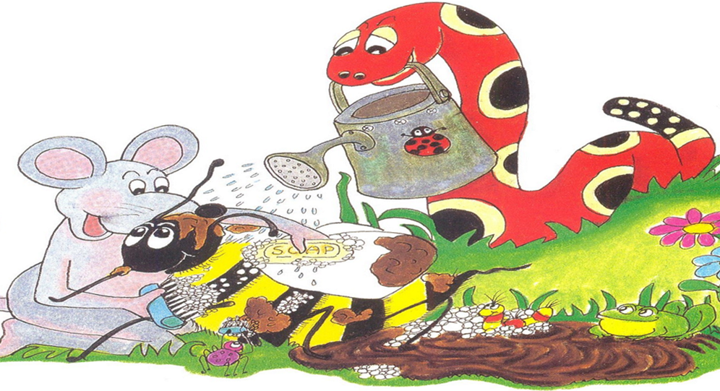


help jump
I 2

Slide 18
Mud

Slide 19
Inky

Slide 20
Bee

Slide 21
Snake

Slide 22
and

Slide 23
run

Slide 24
jump

Slide 25
splash

Slide 26
in

Slide 27
the

Slide 28
lands

Slide 29
help

Slide 30
to

Slide 31
scrub

Slide 32
off

