Slide 1
Daily message
Today , we are going to read new tricky words.

Slide 2

Tricky words

Slide 3
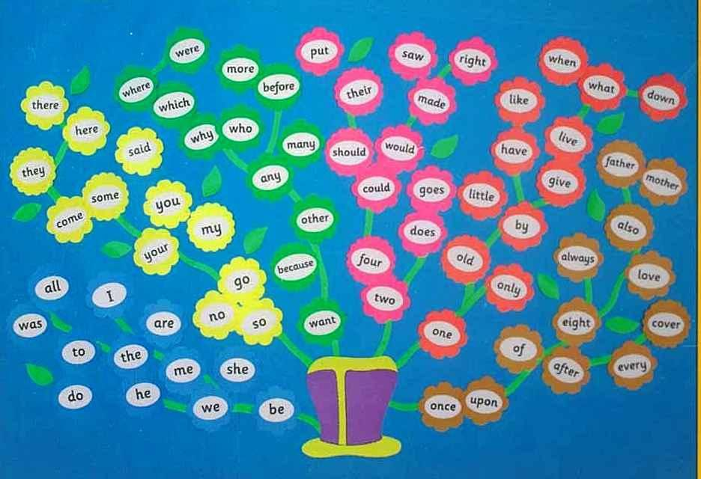

Slide 4
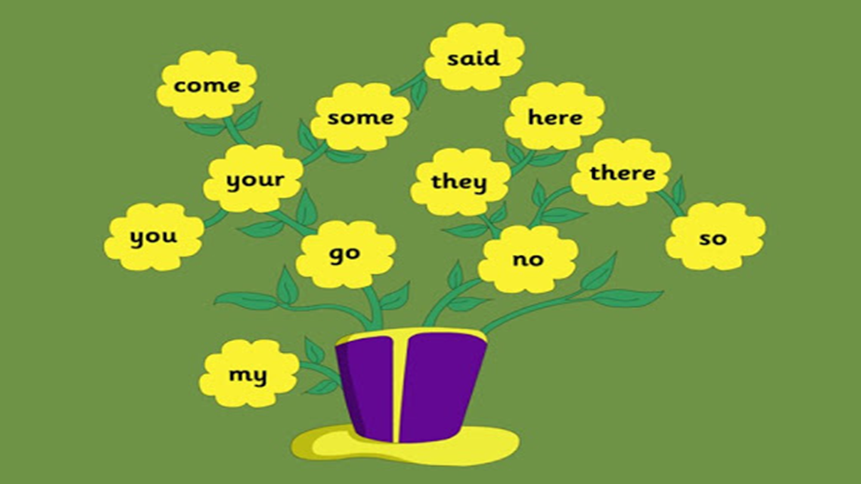

Slide 5


he

Slide 6
be

Slide 7
we

Slide 8
me

Slide 9
she

Slide 10
the

Slide 11
I

Slide 12
to

Slide 13
do

Slide 14
all
o

Slide 15

was

Slide 16

are

Slide 17


come
u

Slide 18
some
u

Slide 19

here

Slide 20

there
a

Slide 21
they
a

Slide 22
said
e

Slide 23
no
Say my name

Slide 24

go

Slide 25
so

Slide 26
You
.
.

Slide 27
Your
. .
.

Slide 28
my
i

Slide 29


you
your

Slide 30

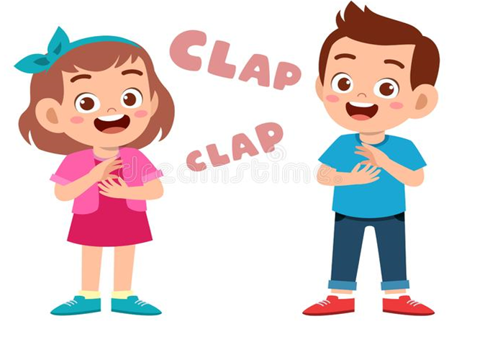
no
so
go

Slide 31


go
no

Slide 32


my
so

Slide 33


so

Slide 34

you
my

Slide 35

you

Slide 36

go

Slide 37

so

Slide 38

my

Slide 39

your

Slide 40

no

Slide 41
you
no
so
my
your
go

Slide 42

You are my best friend.

Slide 43


This is your book.

