Slide 1
The Monkey's Paw

Slide 2
One reason to read literature is to learn how to avoid or understand common problems. Literature transfers lessons through themes, which means messages about life.

Slide 3
In some stories the theme is explicit or stated directly in the text.

Slide 4
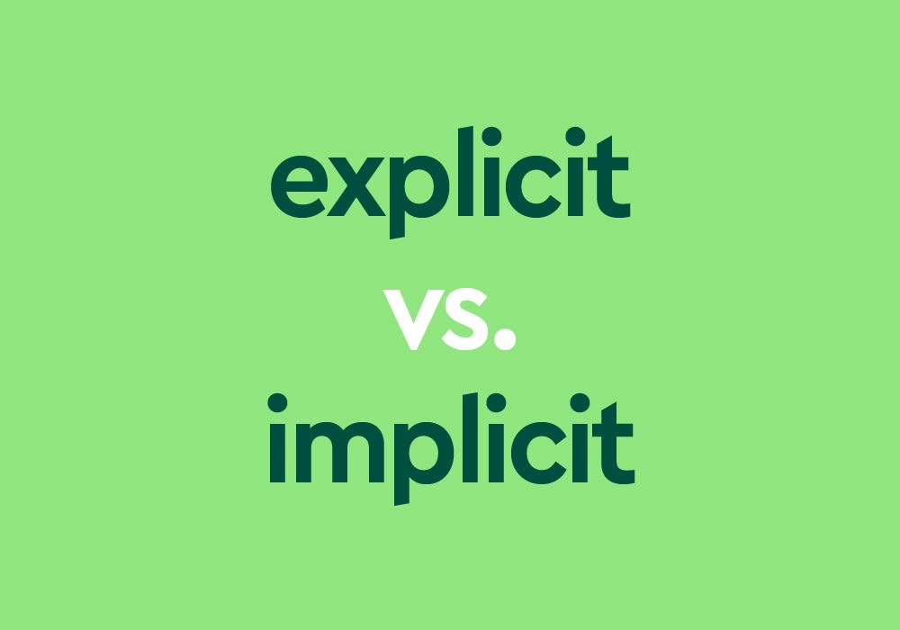
In most cases , the theme is implicit, or not stated directly. Readers must Infer or guess

Slide 5
Clues in the text can include the ways that characters interact with each other. For instance, Who treats whom lovingly?

Slide 6
Warm up

Slide 7
The story you will read is about a monkey’s paw that grants wishes. Write a brief paragraph about something you might want to change, and describe the possible effects of having your wish granted.

Slide 8
What might the details about the father hint about the future events in the plot? Paragraph 1

Slide 9
The father seems like the type of person who might take risks or do dangerous things.

Slide 10
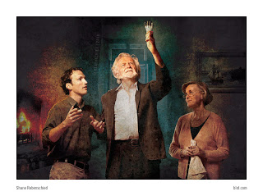
How does the information about the Whites’ guest help building suspense? Paragraph 13

Slide 11
The author uses foreshadowing( suggesting something in advance) to prepare the reader for strange and unexpected events.

Slide 12
What does this lesson suggest about the story’s theme? Paragraph 26

Slide 13
It suggests the theme about the dangerous that interfering with fate.

Slide 14
How do you think the paw might affect the main character’s relationships? Paragraph 35-44

Slide 15
The family might develop different points of view about what to do with the paw.

Slide 16
How have the Whites’ views of the paw changes? Paragraph 58- 61

Slide 17
The paw’s movement scares Mr. White. Herbert still seems confident that the paw is powerless. Mrs. White is nervous about the husband’s reaction but tries to assure him that he imagined the paw’s movement.

Slide 18
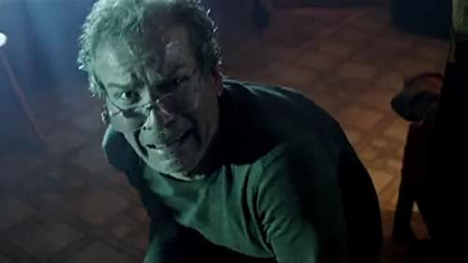
What are some possible causes of the man’s behavior ? Paragraph 76

Slide 19
The man’s action create suspense and suggest that he has bad news, and something bad may have happened to Herbert.

Slide 20
Why do you think the author includes this description ? Cite evidence to support your ideas. Paragraph 96- 100

Slide 21
The description slows the pacing of the story, suggesting a calm lull, before an increase in tension.

