Slide 1
Singular and plural

Slide 2
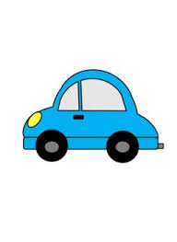
How many cars are there?
One car

Slide 3

Abracadabra

Slide 4
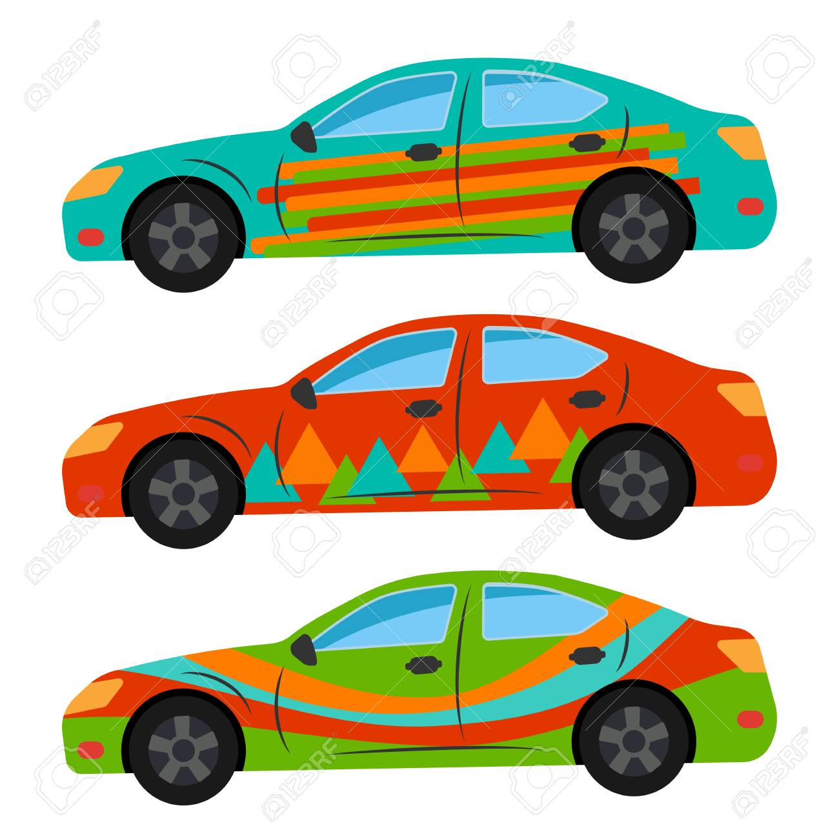
How many cars are there?
Three car
s

Slide 5

How many pencils are there?
One pencil

Slide 6
Abracadabra

Slide 7

How many pencils are there?
Four pencil
s

Slide 8
boy
cats
tortoises
car
brothers
S
P
P
S
P

Slide 9
elephant
cup
book
flower
sister
elephants
cups
books
flowers
sisters

