Slide 1
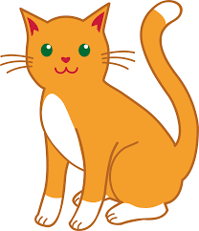
cat

Slide 2
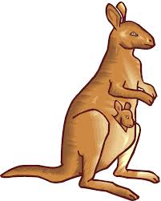
kangaroo

Slide 3

can

Slide 4
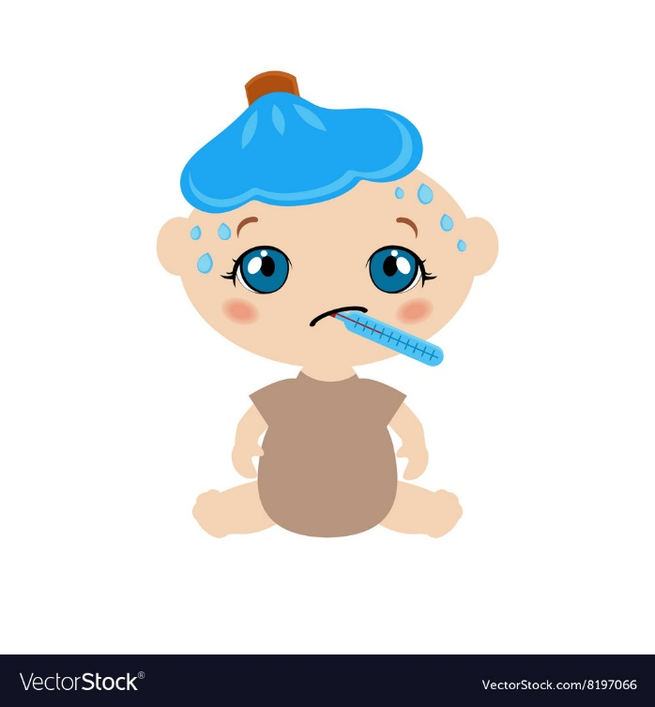
sick

Slide 5
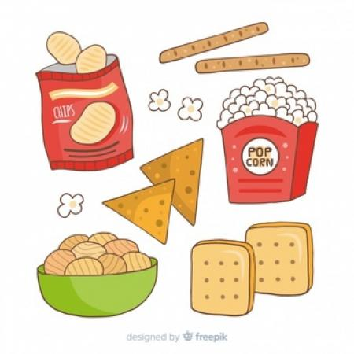
snack

Slide 6
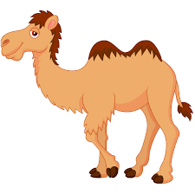
camel

Slide 7
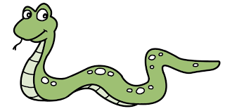
snake

Slide 8
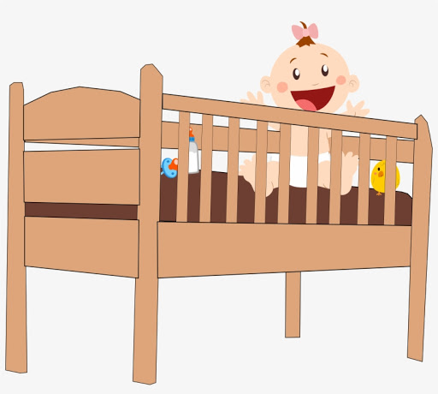
cot

Slide 9
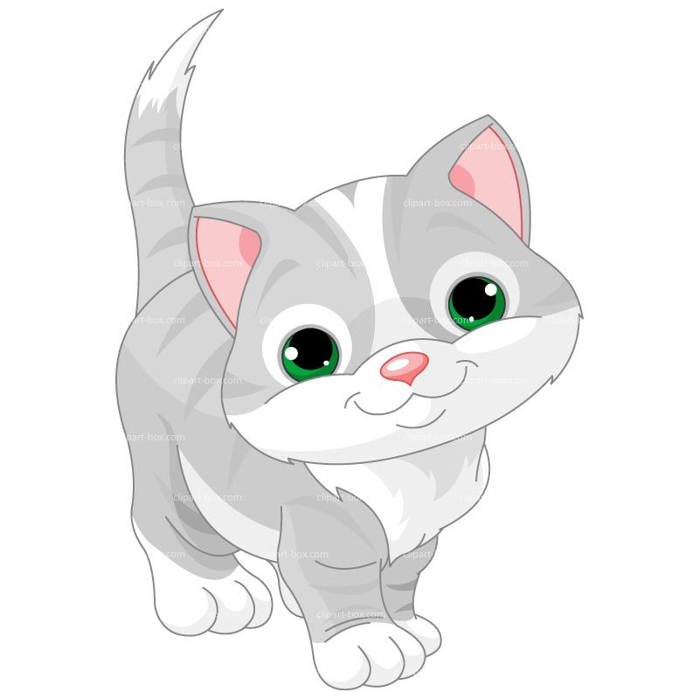
kitten

Slide 10
Cat

Slide 11
kip

Slide 12
pick

Slide 13
sack

