Slide 1
C c . .

Slide 2
K k . .

Slide 3
ck .

Slide 4
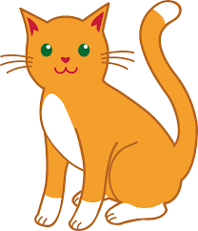
cat

Slide 5
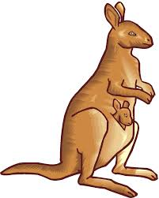
kangaroo

Slide 6
can

Slide 7
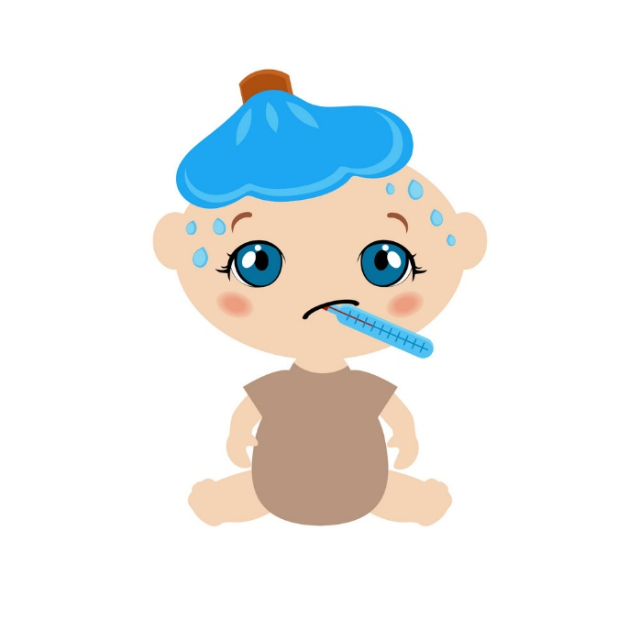
sick

Slide 8
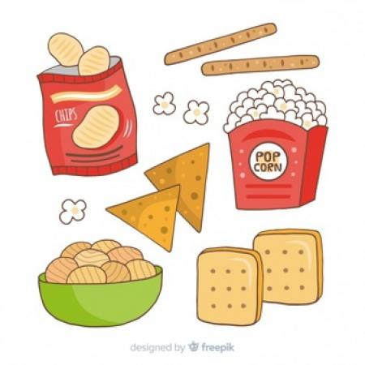
snack

Slide 9
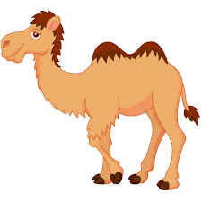
camel

Slide 10
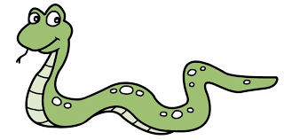
snake

Slide 11
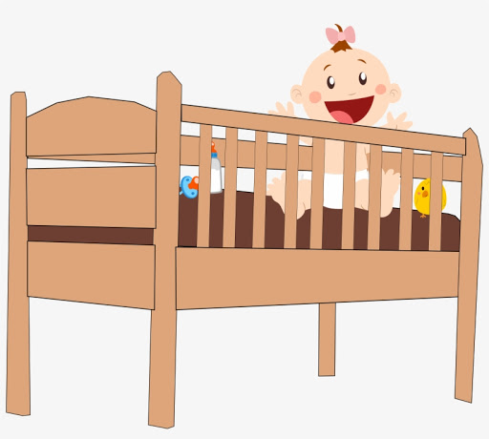
cot

Slide 12
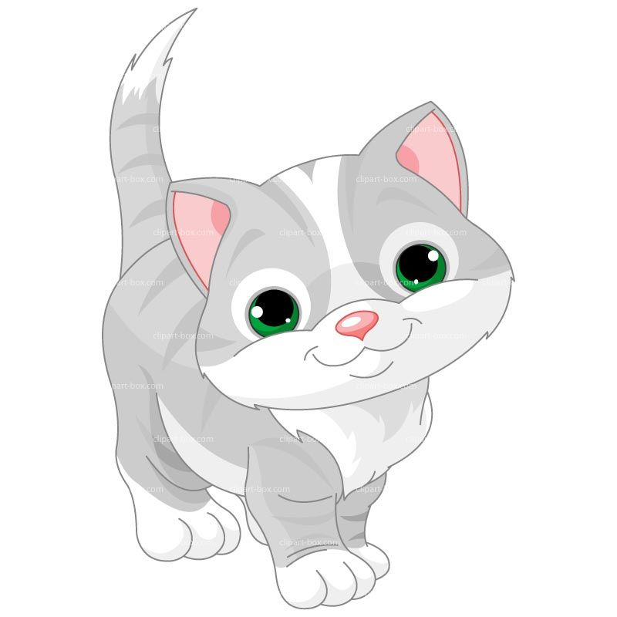
kitten

Slide 13
Cat

Slide 14
kip

Slide 15
pick

Slide 16
sack

Slide 17
Cap . . .

Slide 18
pack . . .

Slide 19
kit . . .

Slide 20
sick . . .

