Slide 1

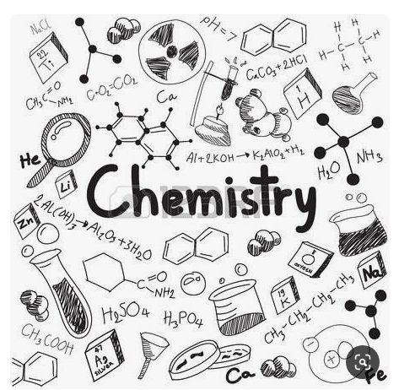
Lesson 1.4 :
(Boiling, evaporating and condensing)
Lesson 1.6 :
(Melting, freezing and subliming)

Slide 2
What is a Physical change?
A change in which the original substance remains as it is and no new substance is formed .
Examples :
Freezing
Melting
Boiling
Evaporation
Condensation
Sublimation

Slide 3
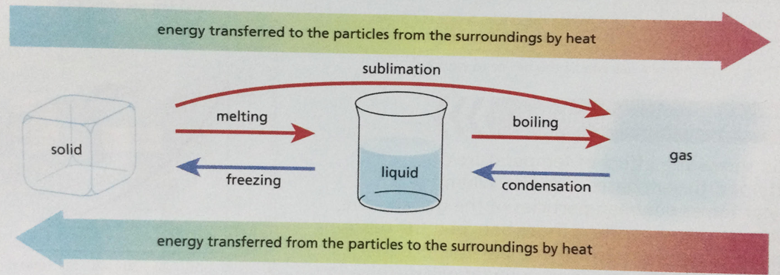
What is Changing State?
Changing state is the process of turning solid into gas or liquid by changing its temperature. Everything we see, touch or smell is made of matter. States of matter can change with the addition or removal of heat.

Slide 4
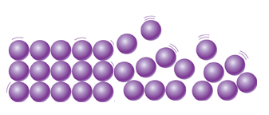
The particle theory
When a solid is heated all the particles receive more energy and move more strongly and push each other a little further apart.
If the solid is heated further, the energy makes the particles vibrate so strongly that they slide over each other and become a liquid.
Heat

Slide 5
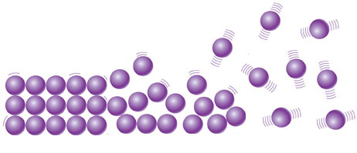
The particle theory
When a liquid is heated all the particles receive more energy and move more quickly.
The fastest particles escape from the liquid surface forming a gas or they collect in the liquid to form bubbles, then the bubbles rise to the surface and burst into the air.
Increasing Temperature

Slide 6
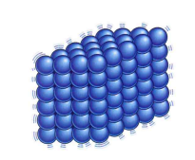
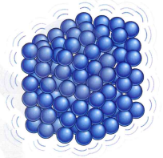
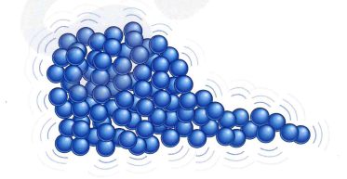
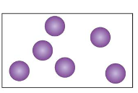
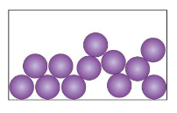
How would the arrangement, movement and separation of particles change when the state of a substance changes?
melting
ENERGY
melting
boiling
evaporating

Slide 7
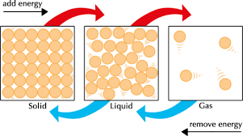

Slide 8
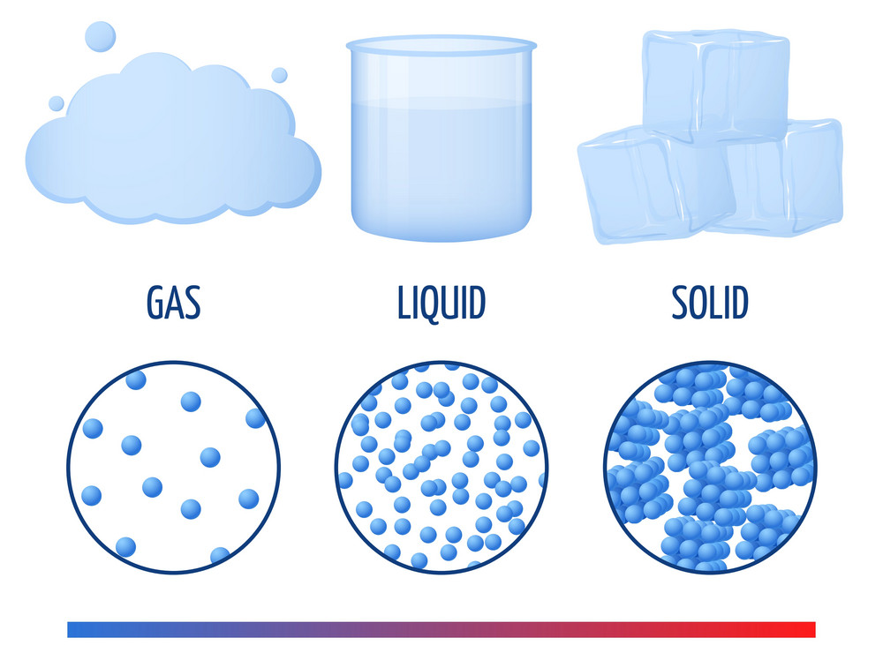
Changing the State of Water's Matter
The state of water at room temperature is liquid. However, we can change the state of its matter by changing the temperature. Cooling water to 0ºC turns the water into ice, which is solid. This is called the freezing point.
Water can also be turned into vapor, which is gas, by heating it up to 100ºC. This is called the boiling point. Both boiling and freezing points come at different temperatures for different substances.

Slide 9
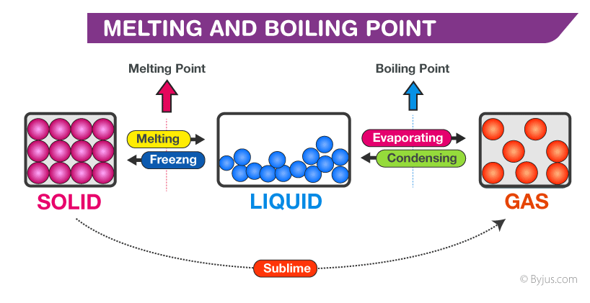

Slide 10
Boiling
Boiling is the process by which a liquid turns into a vapor when it is heated to its boiling point.
The boiling point is the temperature at which boiling occurs for a specific liquid.
How Does boiling Occur?
https://www.youtube.com/watch?time_continue=7&v=Py0GEByCke4&feature=emb_title

Slide 11
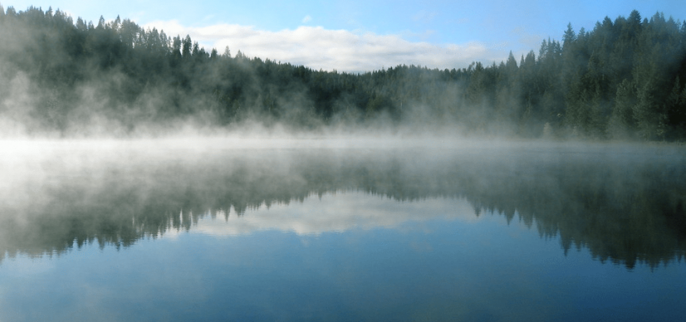
Evaporation
Evaporation happens when a liquid substance becomes a gas. When water is heated, it evaporates. The particles move and vibrate so quickly that they escape into the atmosphere as water vapor. Heat from the sun, or solar energy, powers the evaporation process.

Slide 12
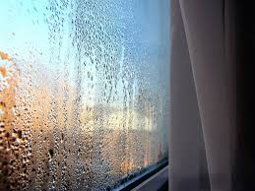
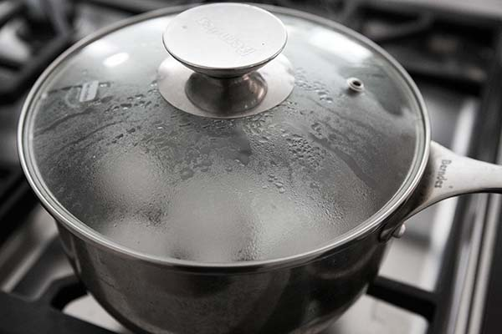
Condensation
Gas Liquid
Warm , moist air + Cold object = Condensation
Notes:
air

Slide 13
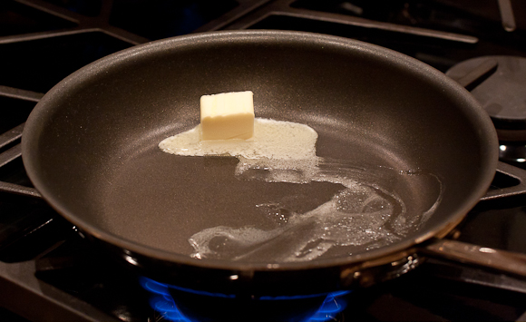
Melting
Melting is a process that results in the phase transition of a substance from a solid to a liquid. This occurs when the internal energy of the solid increases, typically by the application of heat , which increases the substance's temperature to the melting point.
The melting point of a substance is the temperature at which it changes state from solid to liquid.

Slide 14
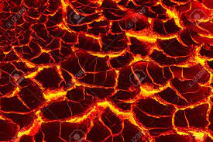
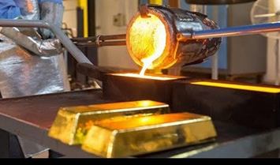
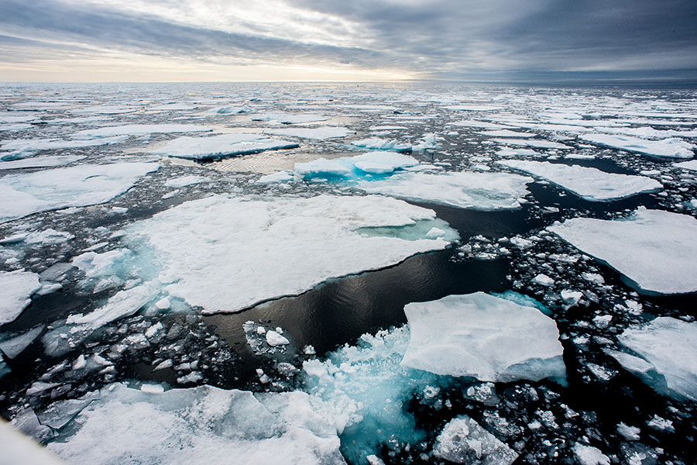
Examples of Solid to Liquid
Rocks to lava - rocks in volcanos can be heated until they become molten lava.
Metal to molten liquid - metals can be molten down and reforms into solid.
Ice to water - ice returns to its water form after being left in temperatures above freezing

Slide 15
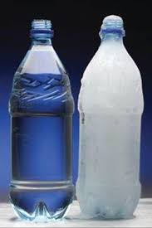
Freezing
Freezing is a phase transition where a liquid turns into a solid when its temperature is lowered below its freezing point.

Slide 16

Other substances can freeze into solids at temperature much higher or lower than the freezing point of water.
For example, when molten wax runs down the side of a candle it freezes and becomes a solid before it reaches the bottom.

Slide 17
Sublimation
Sublimation is the transition of a substance directly from the solid to the gas state, without passing through the liquid state.
The reverse process of sublimation is deposition, in which a substance passes directly from a gas to a solid phase.

Slide 18
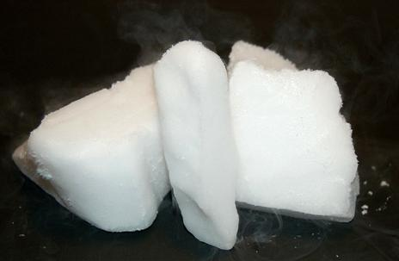
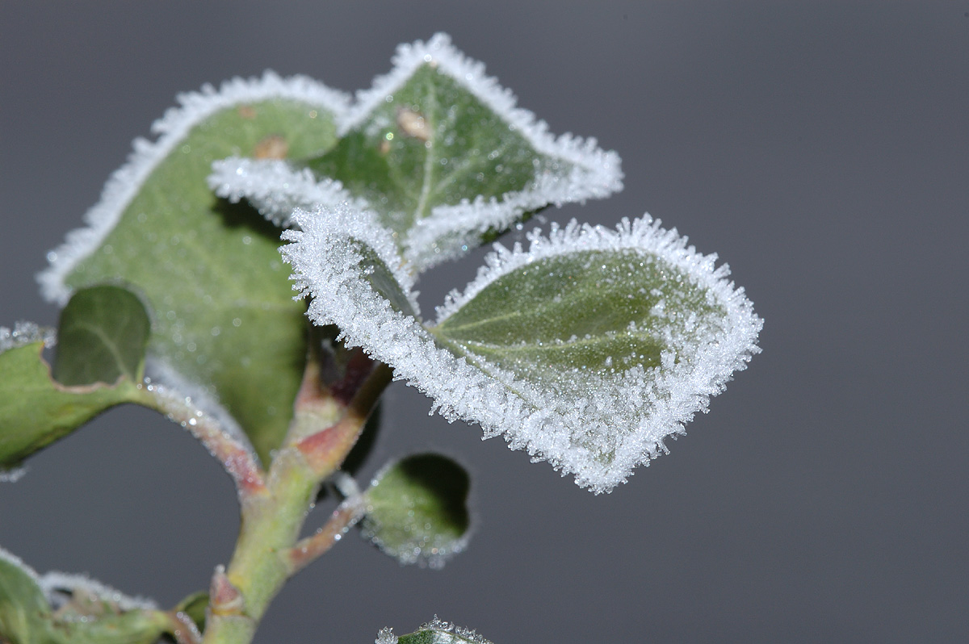
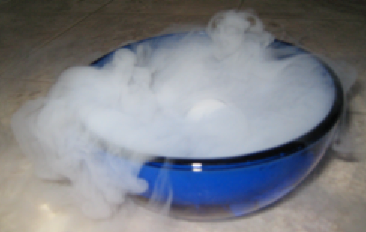
Sublimation- deposition
Solid Gas
Gas Solid

