Slide 1
Group one
s a t i p n

Slide 2
S s

Slide 3
A a

Slide 4
T t

Slide 5
I i

Slide 6
P p

Slide 7
N n

Slide 8
s sa sat
. . . . . .
.

Slide 9
S si sit
. .. ...

Slide 10
p pa pan
. . . . . .

Slide 11
  n na nap
  . . . . . .

Slide 12
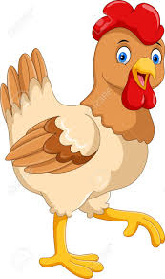
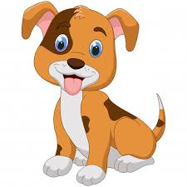
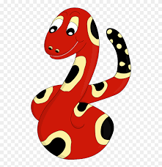



Circle the pictures that have the sound nnnnn

Slide 13
Match capital and small letters
S A T I P N
t p s a n i

