Slide 1
Unit 9 “Decimals and percentages”

Slide 2
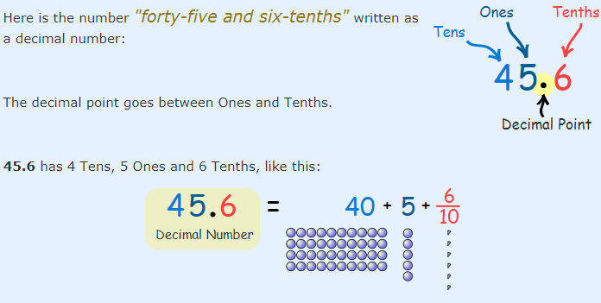
A Decimal Number (based on the number 10) contains a Decimal Point.

Slide 3
Place value.
When we write numbers, the position (or "place") of each digit is important.
For example:
In the number 327:
the "7" is in the Ones position, meaning 7 ones (which is 7),
the "2" is in the Tens position meaning 2 tens (which is 20),
and the "3" is in the Hundreds position, meaning 300.

Slide 4
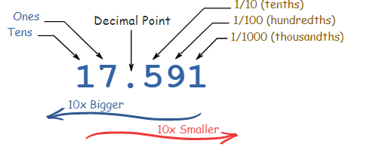
If we have a decimal number:

Slide 5
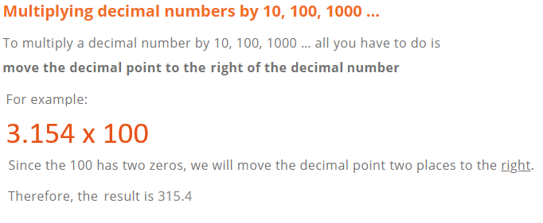
Multiplying and dividing decimals by powers of 10.

Slide 6
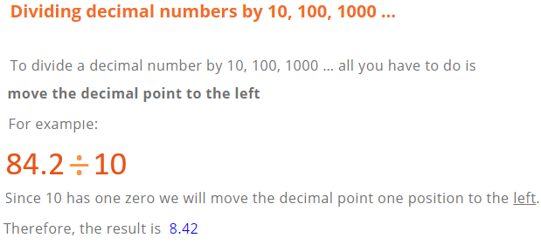
P. 131, Ex 9A
Q1 + 2 + 3

Slide 7
Rounding
Rounding means making a number simpler but keeping its value close to what it was.
The result is less accurate but easier to use.

Slide 8
How to round numbers?
Decide which is the last digit to keep.
Leave it the same if the next digit is less than 5 (this is called rounding down).
But increase it by 1 if the next digit is 5 or more (this is called rounding up).
P. 133, Ex 9B
Q1 (a,b,c,d) + Q2 (a,b,c,d)
+ Q3 (a,b,c,d) + Q4 (a,b,c,d)
+ 9 + 10

