Slide 1
Daily message
Today , we are going to read new tricky words.

Slide 2

Tricky words

Slide 3
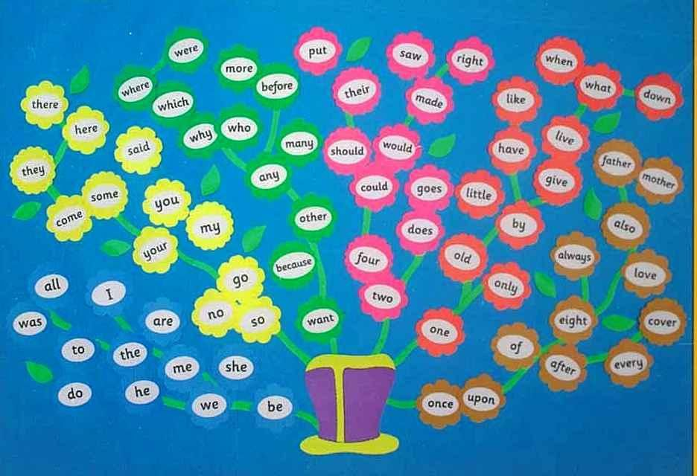

Slide 4
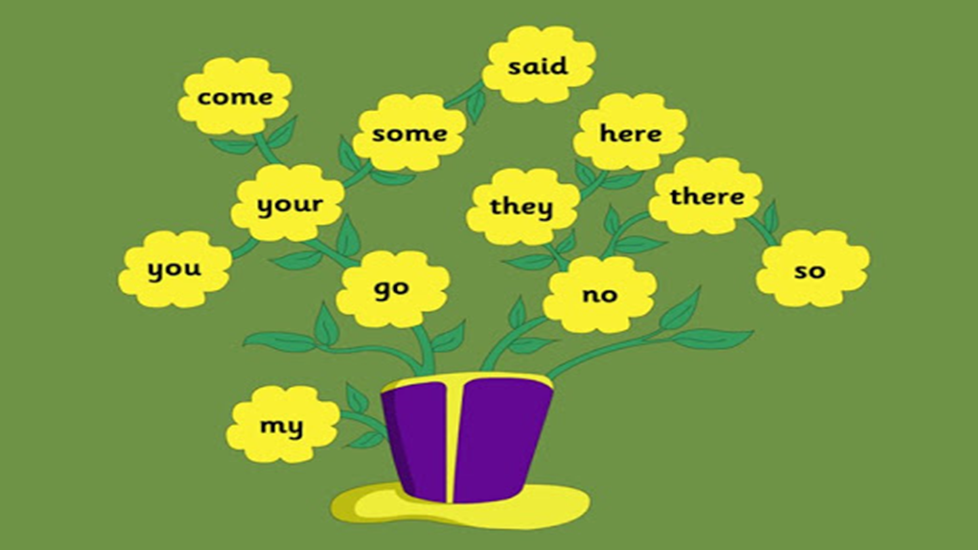

Slide 5


he

Slide 6
be

Slide 7
we

Slide 8
me

Slide 9
she

Slide 10
the

Slide 11
I

Slide 12
to

Slide 13
do

Slide 14
all
o

Slide 15

was

Slide 16

are

Slide 17

said
e

Slide 18

no
Say my name

Slide 19

go

Slide 20
so

Slide 21
You
.
.

Slide 22
Your
. .
.

Slide 23
my
i

Slide 24


you
your

Slide 25

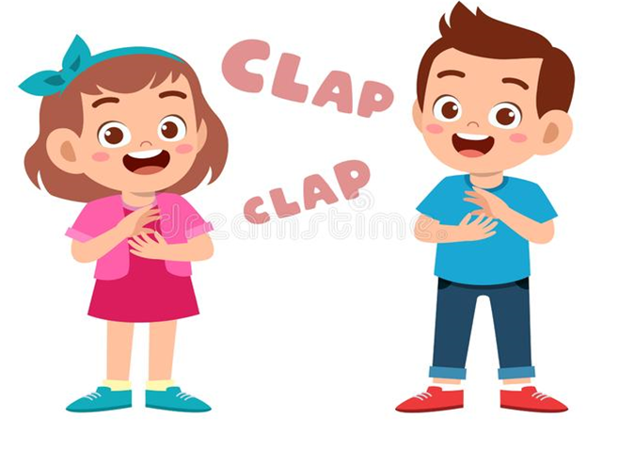
no
so
go

Slide 26


go
no

Slide 27


my
so

Slide 28


so

Slide 29

you
my

Slide 30

you

Slide 31

go

Slide 32

so

Slide 33

my

Slide 34

your

Slide 35

no

Slide 36
you
no
so
my
your
go

