Slide 1
Homophones Ex. D page 23

Slide 2
The difference between sight and site https://www.youtube.com/watch?v=V86F9oiqRZw

Slide 4
The difference between desert and dessert https://www.youtube.com/watch?v=OyTIFXOuduo

Slide 5
The difference between knew and new https://www.youtube.com/watch?v=RMhoeMxKdCc

Slide 6
The difference between accept and except https://www.youtube.com/watch?v=y3te-7ekGo8

Slide 7
The difference between lose and loose https://www.youtube.com/watch?v=aycAQ-9CNgw https://www.youtube.com/watch?v=OunBb67Cg2A

Slide 8
Knew: Verb, means had information in your mind. New: already existing but seen, experienced, or acquired recently or now for the first time.

Slide 9
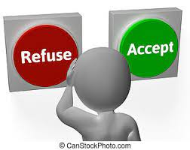
Accept: to say “yes "to something. Except: not including something or someone.

Slide 10
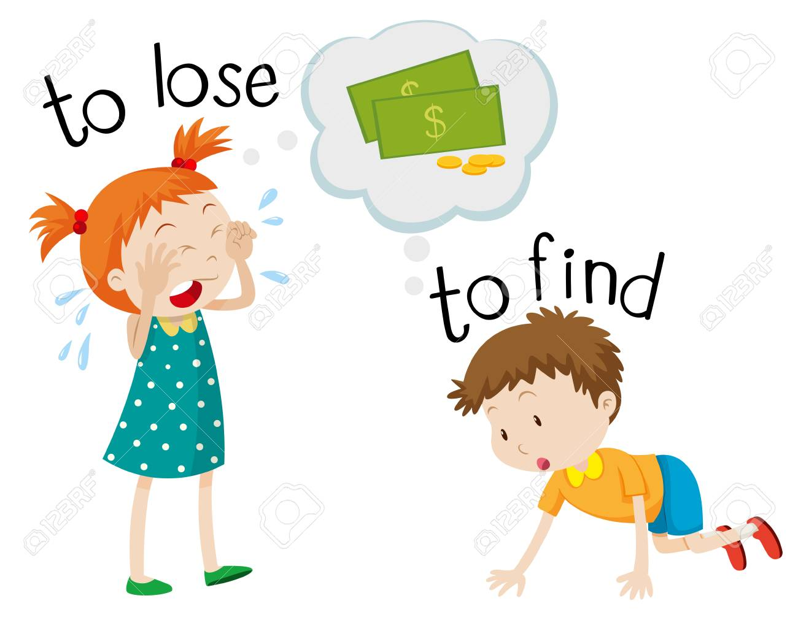
lose and loose lose: to stop having something that you had before loose: Adj, not tied up.

Slide 11
desert : noun, a large area of land , covered with sand, that is hot and has little water. Dessert: noun, something sweet that is eaten after the main part of a meal.

Slide 12
sight : noun, something that you can see. Site: noun, a piece of land that is used for building on or for another special purpose.

