Slide 1
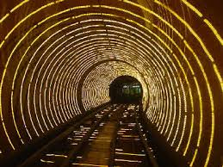
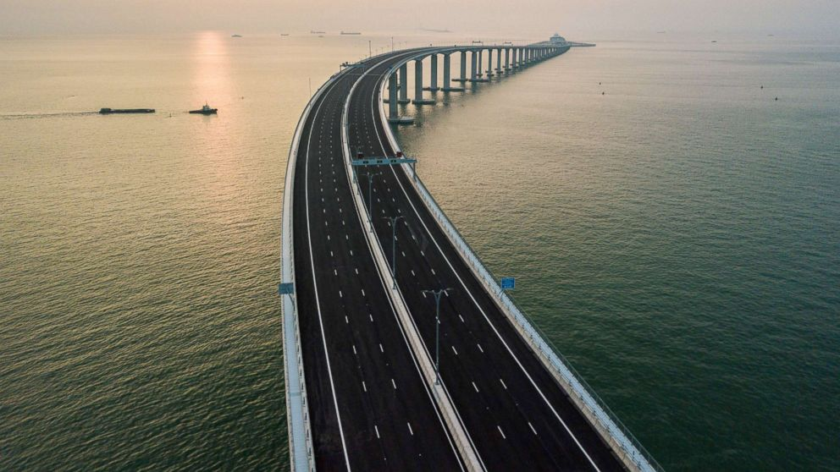
Overcoming Earth’s obstacles Reading comprehension before reading https://www.youtube.com/watch?v=yIZcXmHbFGQ

Slide 2
Top 10 Most Famous Bridges https://www.youtube.com/watch?v=33v5rItnpac What Makes Bridges So Strong? # 3 https://www.youtube.com/watch?v=oVOnRPefcno the types of bridge # 2 https://www.youtube.com/watch?v=rYd1GczW1jg

Slide 3
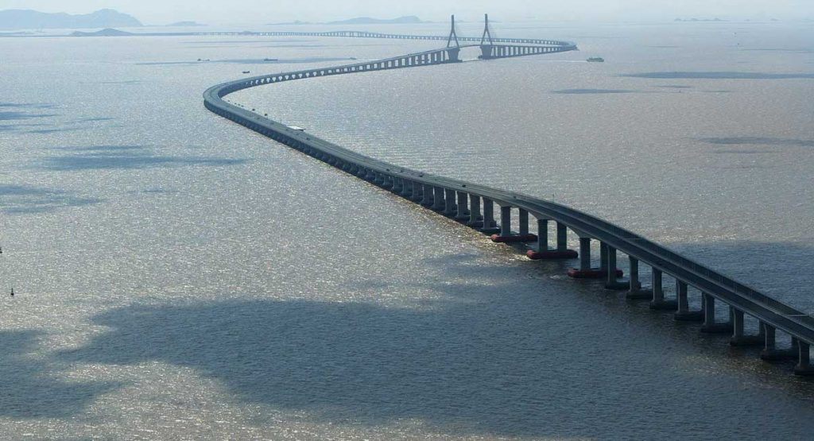
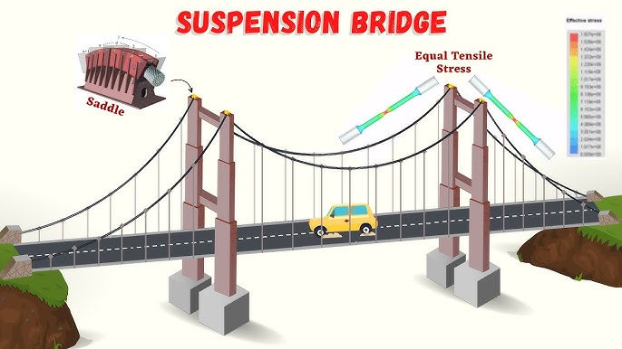
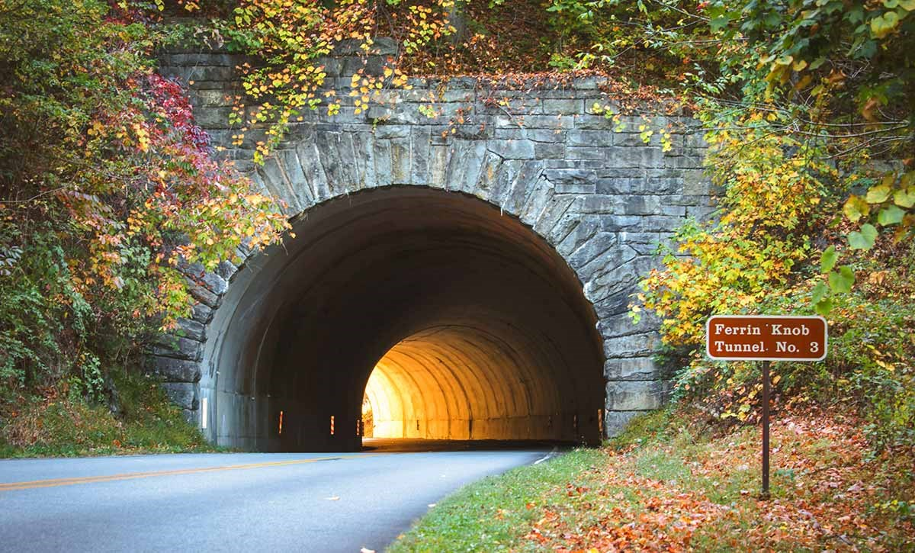
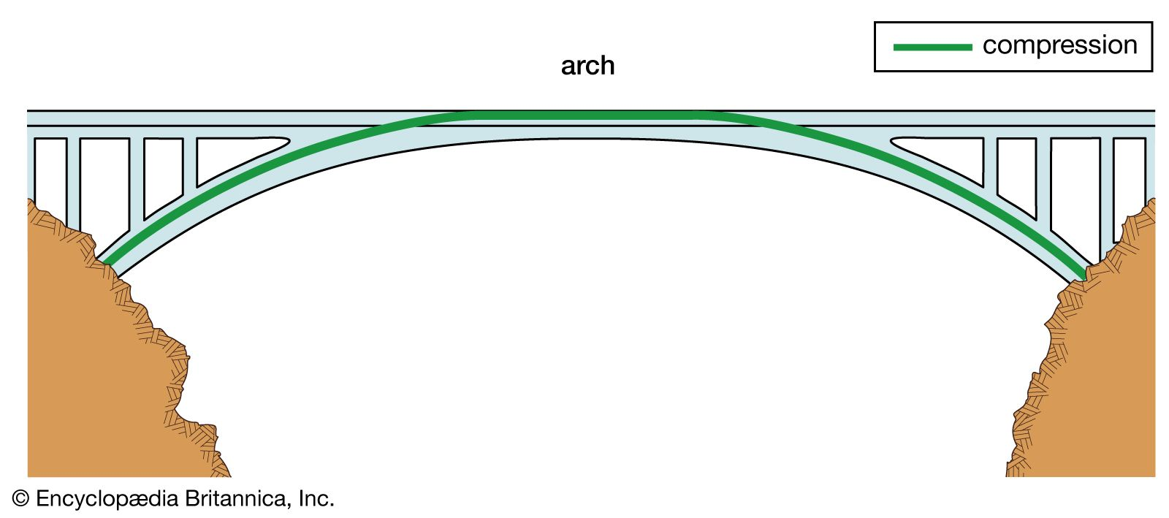

Slide 4
Google search for different types of bridges and why a tunnel is sometimes better than a bridge?

Slide 5
Understand Ex. C page 20

Slide 6
Q. 1 Three factors an engineer considers before building a bridge or a tunnel a) the distance to be traversed. b)the composition of soil at the site. C) what needs to be transported across or through.

Slide 7
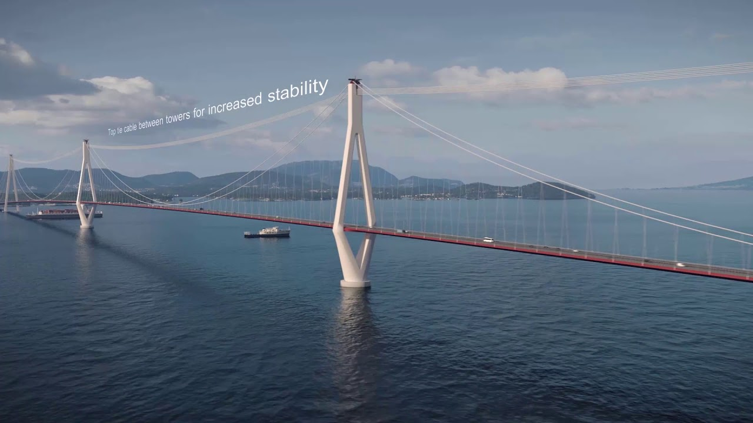
Q. 2 suspension bridges are used to cover long distances.

Slide 8
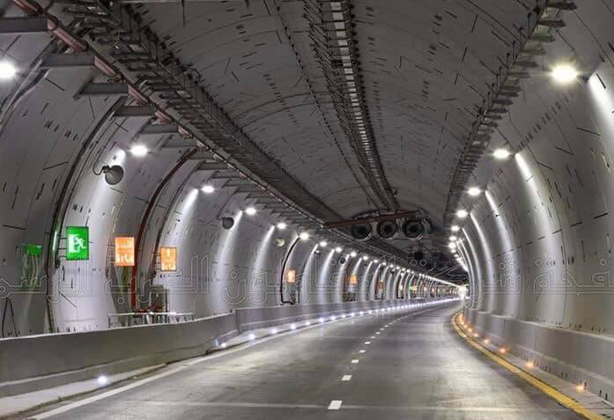
Q.3 They should build a tunnel because it can protect from the weather and carry heavy weights.

Slide 9
Ex. D page 20 Look at the words , then use them to complete the sentences. Commonly/ suspension/ factors/ load bearing/ stacks/ aqueducts

