Slide 1


Get Ready / Words
Page 16 / Unit 2
Objective: Understand words about bridges and tunnels.
Task #1: Listen and say the words.
Task #2: Students will listen and read the sentences to figure out the meaning of the new word.
Task# 3: Pair work, activity (Run and Match).
Task # 4: Group work activity, Integrate the new vocabulary in writing short story.

Slide 2
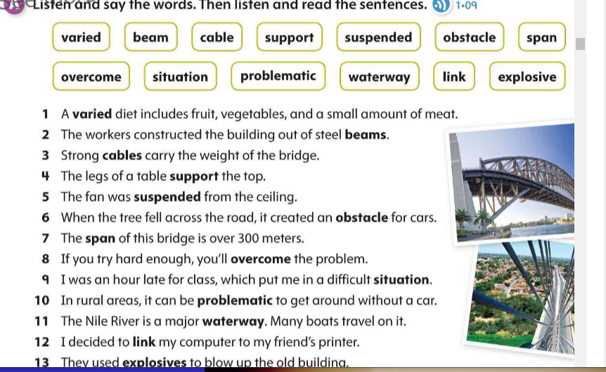

Slide 3
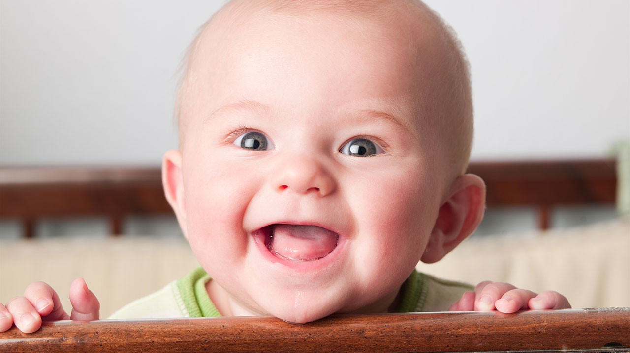
Activity
Run and Match
Baby/ woman/ man/ grandfather/ grandmother …….

Slide 4
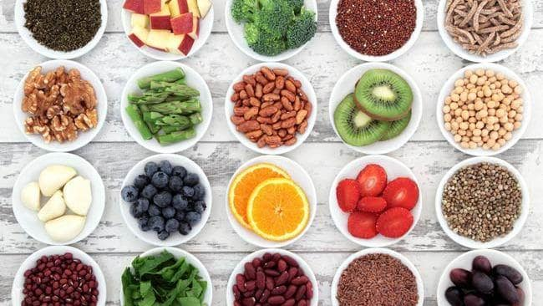
1. Varied 2. beam 3. cable 4. support 5. suspended 6. obstacle 7. span 8. overcome 9. situation
10. problematic 11. waterway 12. link 13. explosive

Slide 5
Varied
Adj: having many different kinds of things or activities.

Slide 6
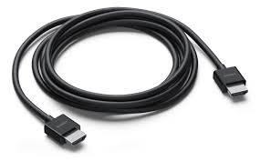
1. Varied 2. beam 3. cable 4. support 5. suspended 6. obstacle 7. span 8. overcome 9. situation 10. problematic 11. waterway 12. link 13 explosive

Slide 7
Cable
Noun, a set of wires, covered by plastic, that carries electricity, signals, etc

Slide 8

1. Varied 2. beam 3. cable 4. support 5. suspended 6. obstacle 7. span 8. overcome 9. situation 10. problematic 11. waterway 12. link 13 explosive

Slide 9
suspended
Adj. hanging from something

Slide 10
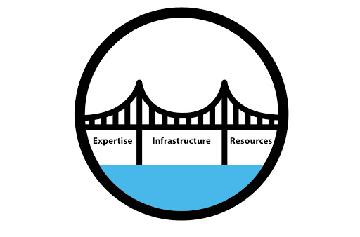
1. Varied 2. beam 3. cable 4. support 5. suspended 6. obstacle 7. span 8. overcome 9. situation
10. problematic 11. waterway 12. link 13 explosive

Slide 11
Span noun: the length of something from one end to the other.

Slide 12
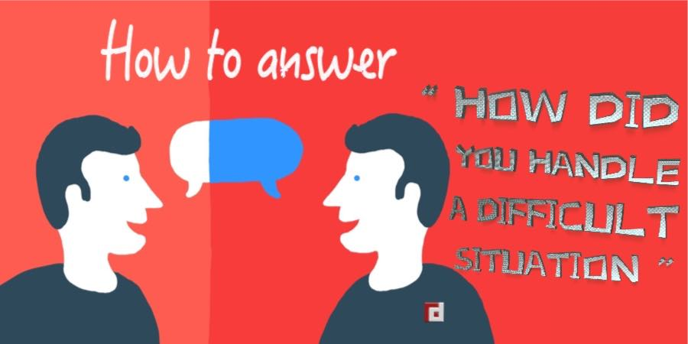
1. Varied 2. beam 3. cable 4. support 5. suspended 6. obstacle 7. span 8. overcome 9. situation
10. problematic 11. waterway 12. link 13 explosive

Slide 13
Situation noun: the things that happen in a particular place or time.

Slide 14
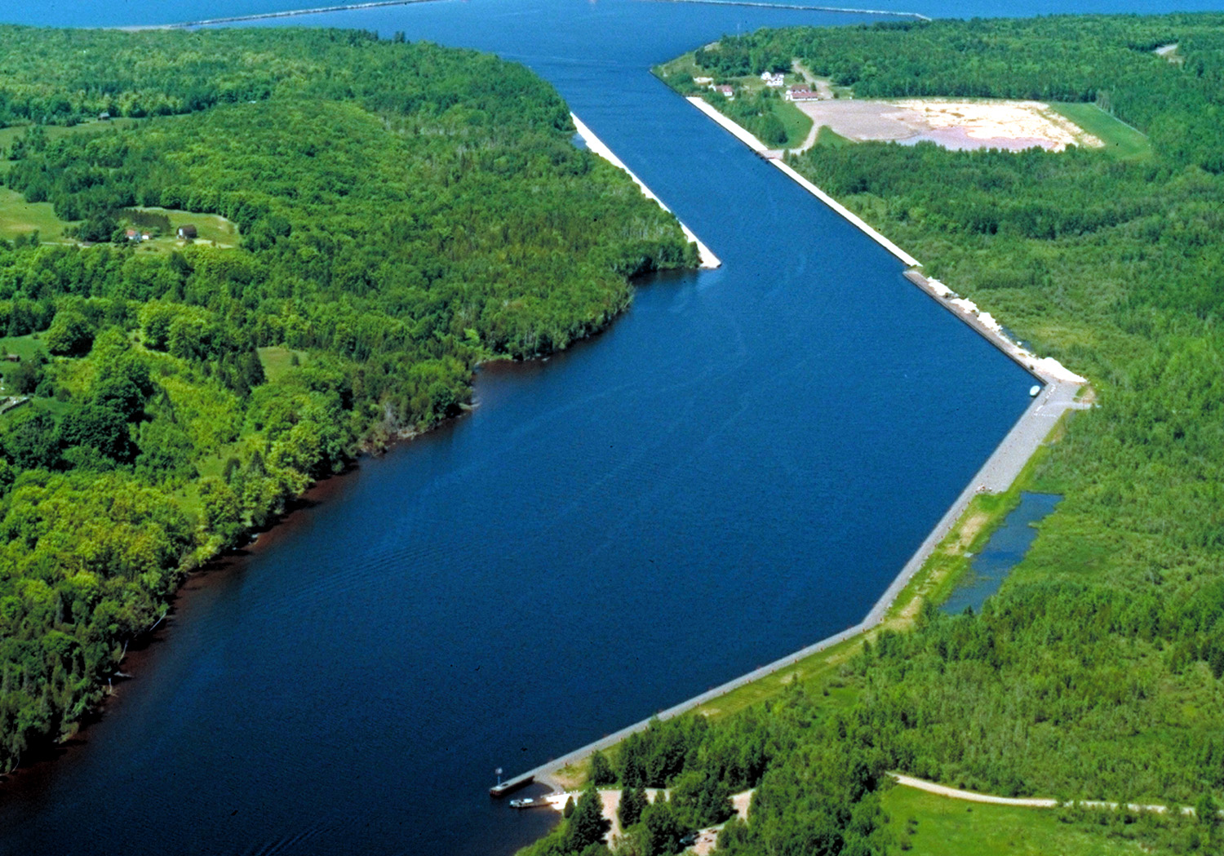
1. Varied 2. beam 3. cable 4. support 5. suspended 6. obstacle 7. span 8. overcome 9. situation
10. problematic 11. waterway 12. link 13 explosive

Slide 15
Waterway
Noun: a river, etc. along which boats or ships can travel

Slide 16
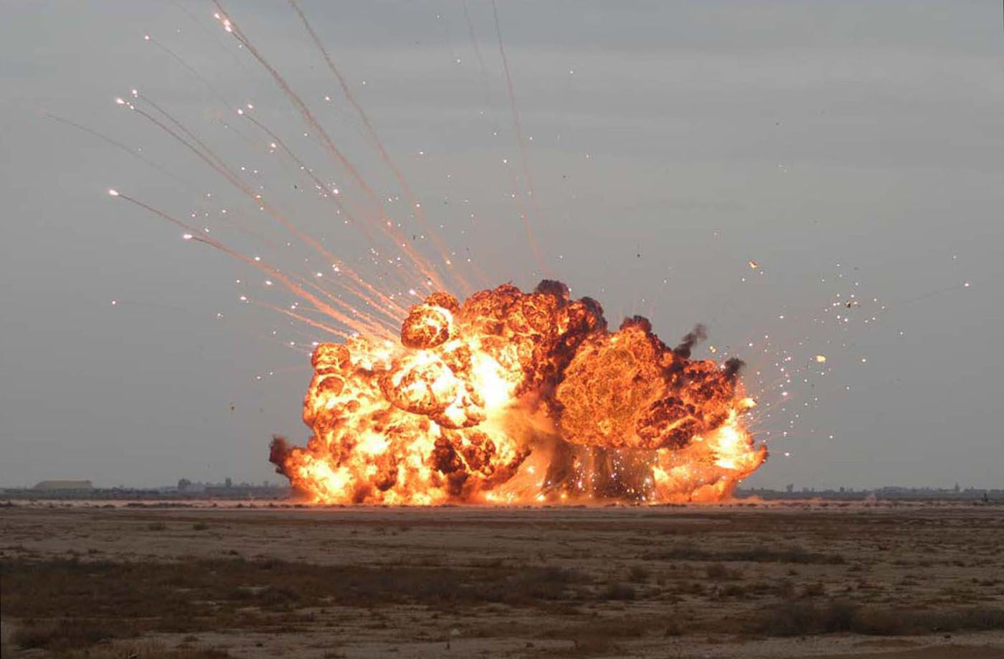
1. Varied 2. beam 3. cable 4. support 5. suspended 6. obstacle 7. span 8. overcome 9. situation
10. problematic 11. waterway 12. link 13 explosive

Slide 17
Explosive noun: a substance that can explode.

Slide 18
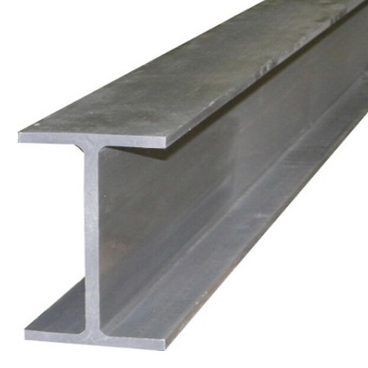
1. Varied 2. beam 3. cable 4. support 5. suspended 6. obstacle 7. span 8. overcome 9. situation
10. problematic 11. waterway 12. link 13 explosive

Slide 19
Beam
Noun, A long piece of wood, metal, etc. that is used to support weight, for example in the floor or ceiling of a building.

Slide 20
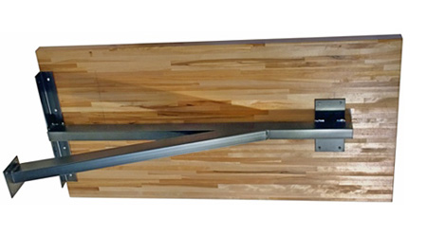
1. Varied 2. beam 3. cable 4. support 5. suspended 6. obstacle 7. span 8. overcome 9. situation
10. problematic 11. waterway 12. link 13 explosive

Slide 21
support verb: 1. to carry the weight of someone or something
2. to help someone or something by saying that you agree with them.

Slide 22

1. Varied 2. beam 3. cable 4. support 5. suspended 6. obstacle 7. span 8. overcome 9. situation
10. problematic 11. waterway 12. link 13 explosive

Slide 23
Obstacle noun: something that makes it difficult for you to go somewhere or do sth.

Slide 24

1. Varied 2. beam 3. cable 4. support 5. suspended 6. obstacle 7. span 8. overcome 9. situation
10. problematic 11. waterway 12. link 13 explosive

Slide 25
overcome verb: to manage, to control or defeat someone or sth.

Slide 26

1. Varied 2. beam 3. cable 4. support 5. suspended 6. obstacle 7. span 8. overcome 9. situation
10. problematic 11. waterway 12. link 13 explosive

Slide 27
link adj: relating to the limbic system of the brain.

Slide 28
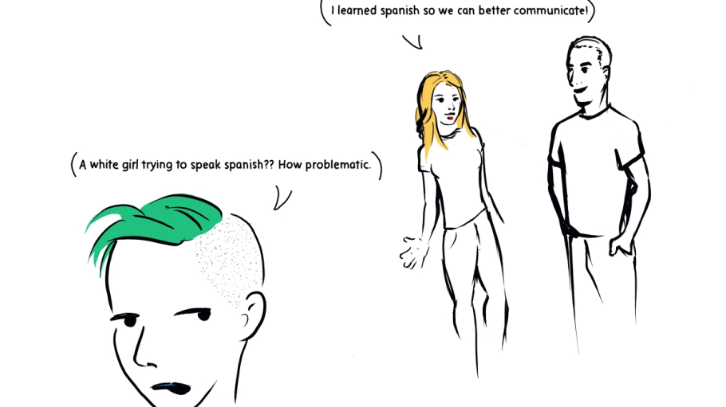
1. Varied 2. beam 3. cable 4. support 5. suspended 6. obstacle 7. span 8. overcome 9. situation
10. problematic 11. waterway 12. link 13 explosive

Slide 29
problematic
Adj. presenting a problem or difficulty.

