Slide 1


Writing a Letter of Complaint
To write an effective letter using Persuasive techniques.

Slide 2

When would we use this type of letter?

Slide 3


When we are unhappy with something:
-a product (something we have bought)

Slide 4


a service (something we have experienced-) like a waitress being rude in a café).

Slide 5

What do we need to do in this type of letter?

Slide 6

Introduction
State the reason why we are writing: I am writing to complain…..

Slide 7
Body
Give the reasons why we are complaining, supported by evidence:
I was shocked by the rudeness of your staff. The waitress ignored me in your café on Friday while I was waiting at the counter.

Slide 8




Conclusion
State what you would like to happen.
I would appreciate you speaking to the member of staff concerned about their attitude to customers.
I would hope that in future products are checked before being sold to make sure they work properly.

Slide 9

Sum up your feelings, and sign off the letter appropriately:
Once again, let me say how disappointed I am and how I hope you will deal with this problem quickly.
        Yours Sincerely,

Slide 10



Structure Reminders

Slide 11





Remember to use Persuasive techniques!!
Powerful vocabulary: disgusted, outraged, appalling, devastating,
Questions: How would you feel if this had happened to you? Can you imagine how I felt?
Flattery: I am sure that in your position as Senior Manager, you will deal with this promptly.
Bribery: I was hoping to purchase another TV from you, and should this be solved quickly, intend to do so in the next few weeks.
Warn: I advise you to retrain your staff as it would not look very good if you started to lose customers due to poor service.

Slide 12
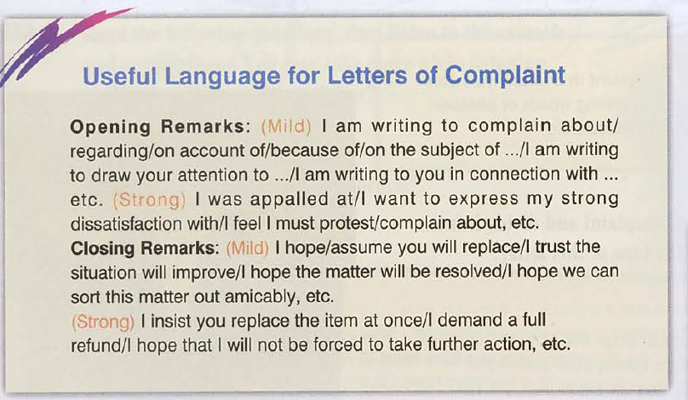

Slide 13
Appropriate letter format Dear Mr/Mrs…
Why I am writing I am writing to complain
Reasons for my complaint Broken TV, cut my hand on the glass,
Evidence It does not turn on, and there was broken glass in the box when I opened it..
Persuasive techniques I am disgusted, Can you imagine how painful it was cutting my hand?
What I want to happen now I demand an immediate refund
Sum up my feelings I hope you appreciate how horrified I am
Appropriate ending Yours Sincerely,

Slide 14

In pairs Read the letter and state the topic of each paragraph
Successful writing book page 48

Slide 15
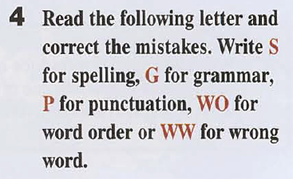
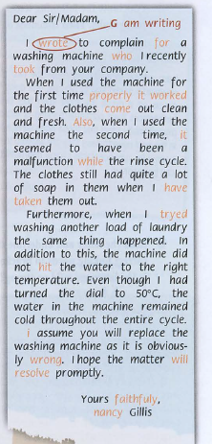

Slide 16
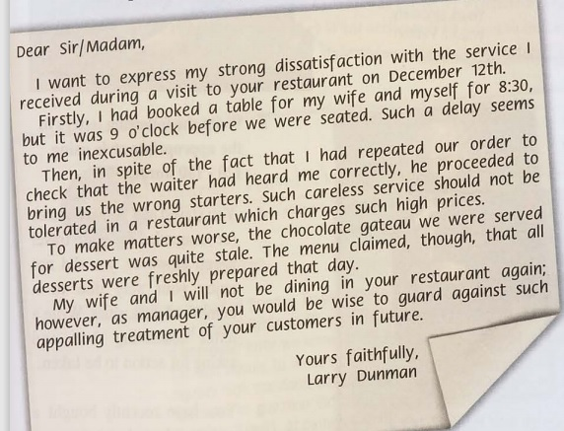

Slide 17
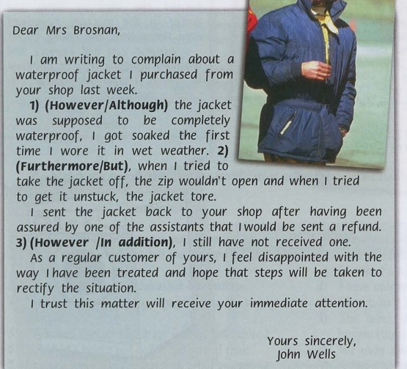

Slide 18
Dear Sir/ Madam,
I am writing to you to make a complaint about the item that I had ordered last May 7, 2009.
The product that I received seemed to be what I ordered, but when taken out of the box to install it, I found that it was malfunctioning. There were also a lot of missing parts mentioned in the manual but which were not in the box with the item.
Here are the details of the product that I bought, and I have attached the invoice and receipts for this transaction.
I wish to ask for a replacement for the product I ordered, or if that is not possible, a refund.
I look forward to your response.
Sincerely,
[Senders Name]
[Senders Title]

