Slide 1
Forces

Slide 2
Aim
To identify forces acting on objects.
Success Criteria
I can identify forces as pushes and pulls.
I can identify and explain the different forces acting on objects.

Slide 3
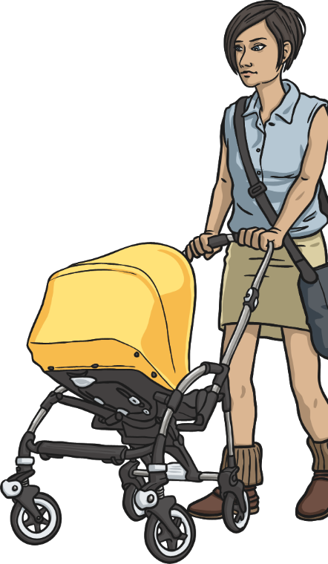
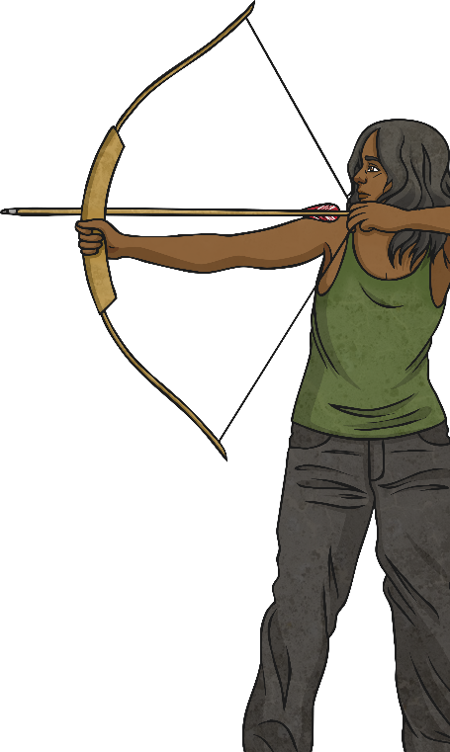
What Are Forces?
Forces are often referred to as pushes and pulls.
Look at the pictures below and talk to your partner about whether each picture shows an example of a pushing or pulling force.

Slide 4
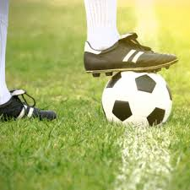
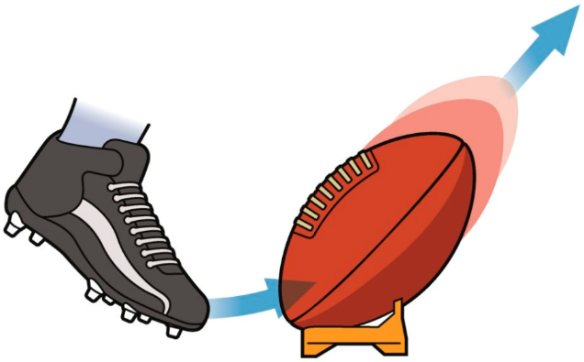
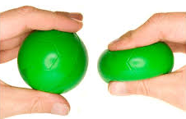
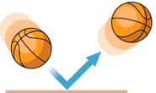
What can the forces do?
Forces can:
1. Start to move an object or stop it from moving.
2. Change the shape of an object.
3. Make an object move faster or slower or change the direction of movement.

Slide 5
Balanced and unbalanced forces
If the forces on an object are the same size but in opposite directions, then they will cancel out, and we say that the forces are balanced.
If the forces acting on an object are balanced, then its motion will not change.

Slide 6
Balanced forces
1) The car isn’t moving
Forces are balanced (no forward or backward force)
Car remains stationary
2) The car is moving
Forces are balanced
Car travels at a constant (steady) speed.
The resultant force is zero
The car will keep traveling at a constant (steady) speed.

Slide 7
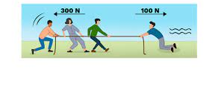
Unbalanced forces
- If the forces are not equal and opposite, then they are unbalanced.
When the forces are unbalanced then the motion of the object will change.
The resultant force is the difference between the forward and the backward force.

Slide 8
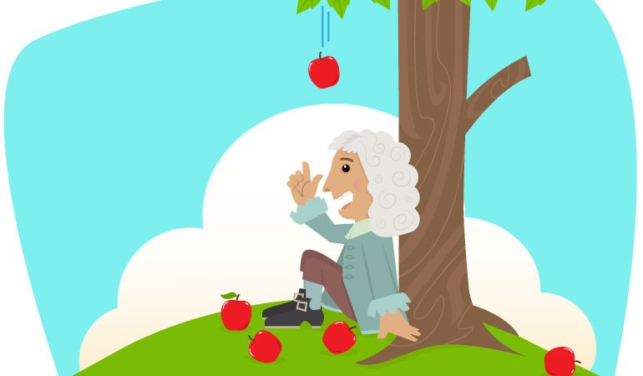
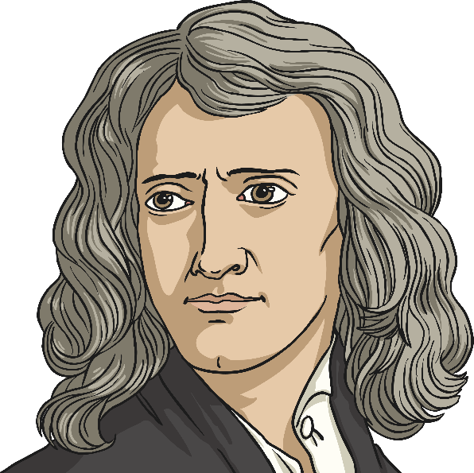
Forces
Forces are measured in Newton.
The unit of force is named after -Isaac Newton.

Slide 9
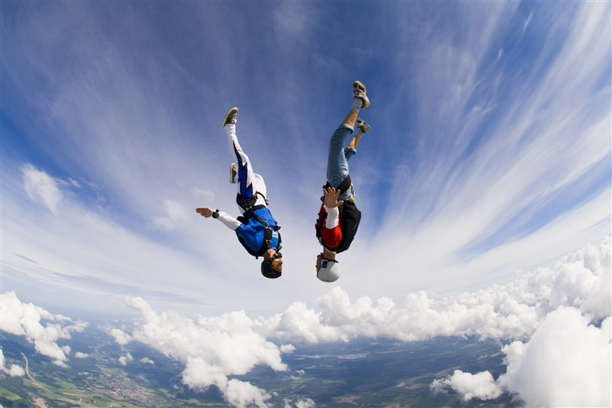
Can you think of some forces around you?

Slide 10
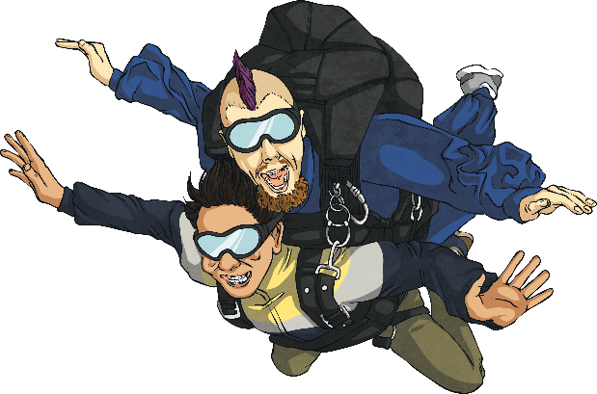
1. Gravity
Gravity is a pulling force exerted by the Earth. The gravitational force from the Earth pulls in a direction towards the centre of the Earth.
Gravity is pulling the skydivers towards the Earth.
gravity

Slide 11
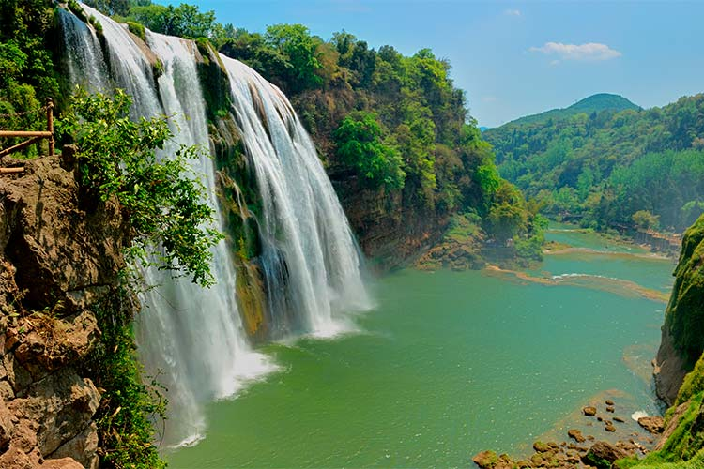
Water falls towards the ground because of the Earth’s gravitational force.
We fall towards the ground when we jump, because of the Earth’s gravitational force.

Slide 12
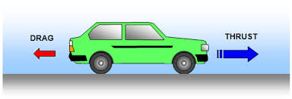
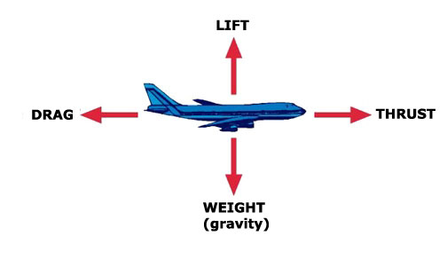
2. Thrust
Thrust is generated by the engines that cause a system to accelerate.

Slide 13
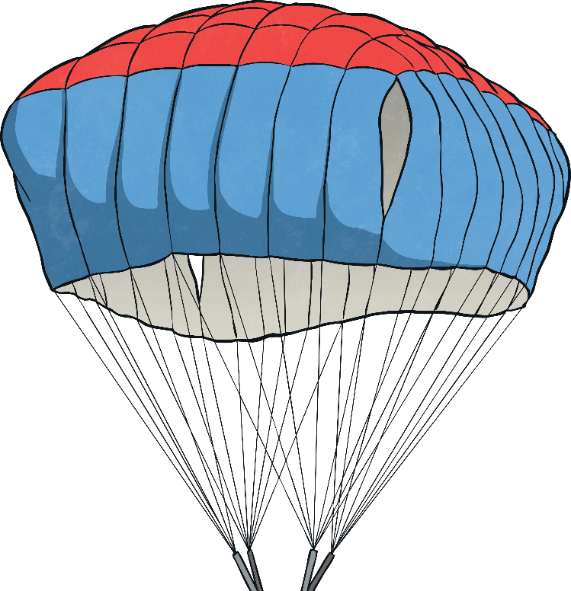
3) Air resistance
In this image, you can see that a force is slowing the skydivers down.
This force is pushing in the opposite direction to gravity.

Slide 14
Air resistance is the name of the force that is pushing up against the parachute.
Gravity is pulling the skydivers towards the ground. However, they are slowed down because a force (air resistance) pushes against the inside of the parachute and they descend more slowly.
Gravity and air resistance are opposing forces in this situation.
air resistance
gravity

Slide 15
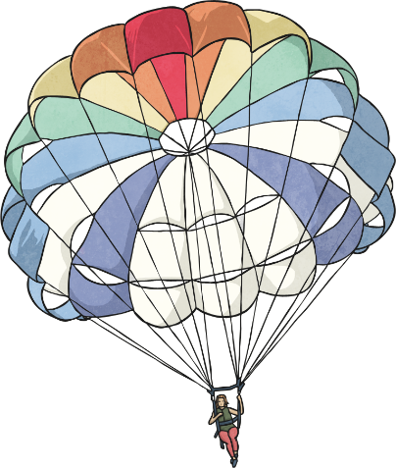
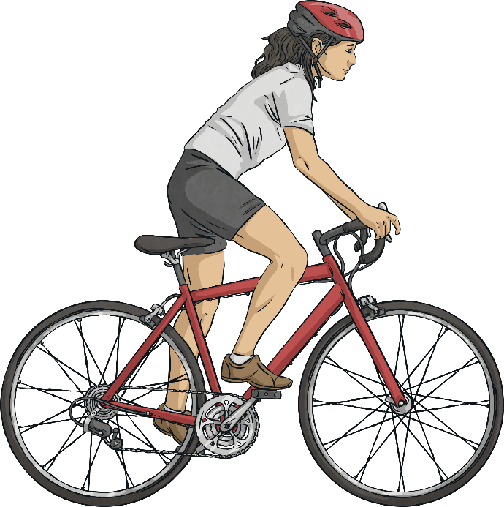
Air resistance can be a useful force, but it can also be unhelpful in certain situations.
Gravity
air resistance
Thrust
air resistance
Air resistance pushes the cyclist back, opposing the cyclist’s force (thrust), in this situation air resistance is an unhelpful effect.

Slide 16
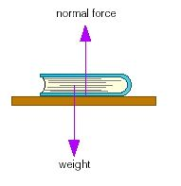
4.Normal force
The normal force is an everyday force that is felt when a surface pushes against an object that is placed on that surface.
Normal
Air resistance
Friction
Gravity

Slide 17
5. Friction force
Which type of force enables us to hold a glass or to walk without slipping ????
All these actions would not be possible or easy without frictional force.

Slide 18
All surfaces create friction on an object moving over them.
Friction is a force.
Friction produces heat.
Friction is the force that opposes motion when two surfaces are in contact.

Slide 19
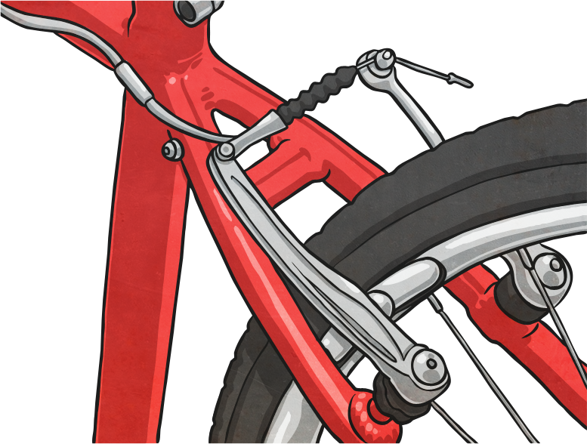
The brakes on a bicycle or car work by creating friction between the brake pad and the wheels.
Friction can be unhelpful too – friction on a bike chain can make the bike harder to pedal.

Slide 20
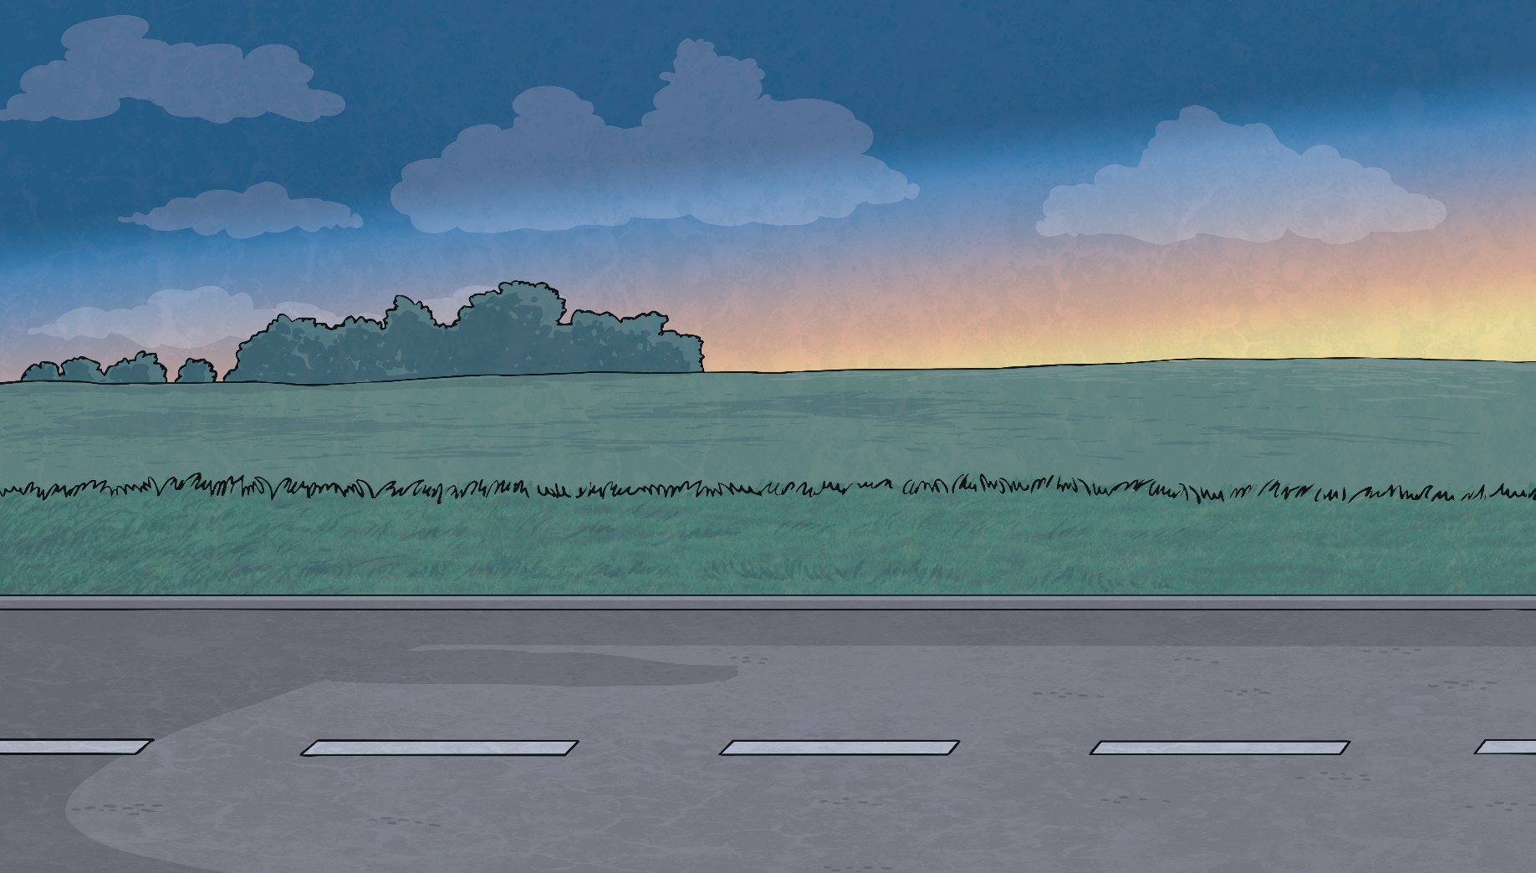
What forces do you think might be represented by the arrows in this image?
Normal
Air resistance
Thrust
friction
Gravity

Slide 21
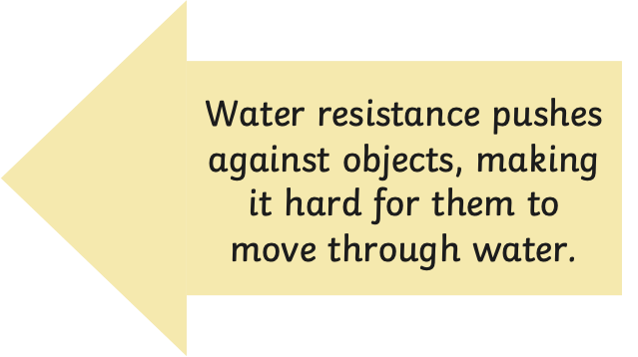
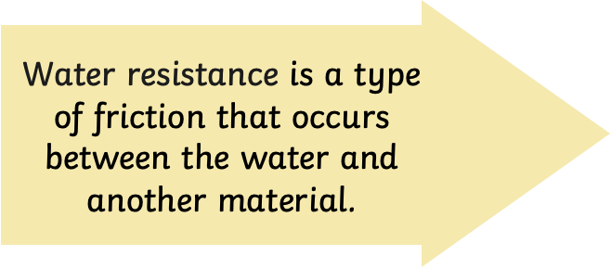
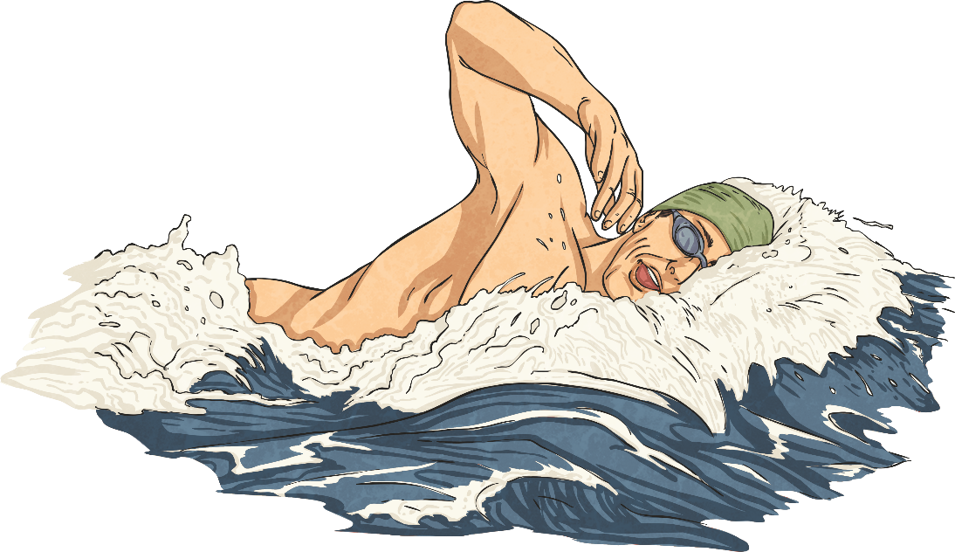
6.Water resistance
water resistance
Thrust

Slide 22
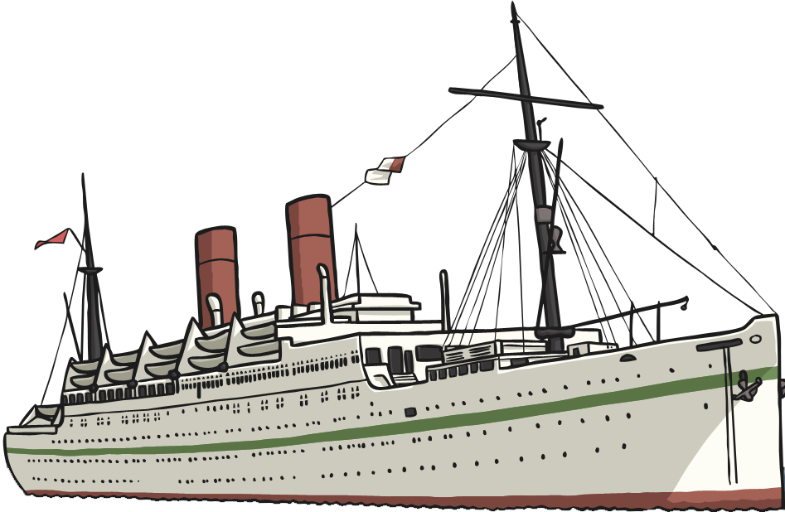
7.Upthrust
In this example, the boat doesn’t sink because there is an up thrust force created by the volume of water. It is the balance of the gravity and the up thrust force that keeps the boat floating.
gravity
Upthrust

