Slide 1
Words ending in -er, -or, -ar
Student Book page 15

Slide 2
What is a suffix?
A Suffix is a group of letters added to the end of a word.

Slide 3
Word ending in –er and –or denote:
People: teacher, governor, doctor, minister.
Certain activities: sponsor, runner, swimmer.
Machines and tools: calculator, hammer, screwdriver.

Slide 4
The suffix –er is used to create new words every day:
For example: rapper, twitterer, carjacker.

Slide 5
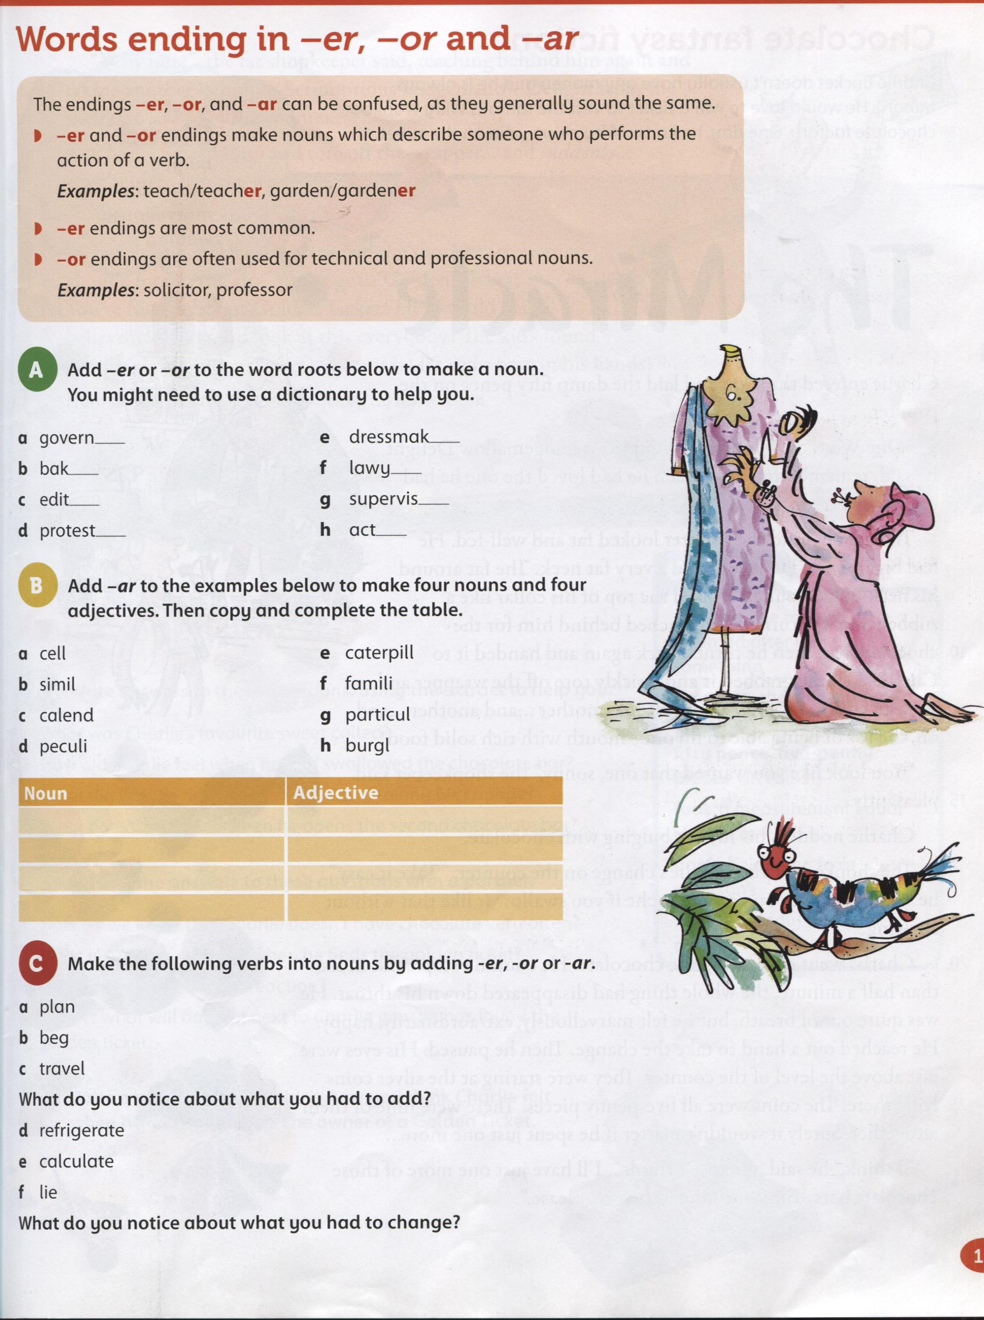

Slide 6
or
er
er
er
or
or
er
or

Slide 7
ar
ar
ar
ar
ar
ar
ar
ar
cellar
similar
calendar
peculiar
caterpillar
familiar
burglar
particular

Slide 8
planner
beggar
traveller
You double the consonant before adding the suffix
refrigerator
calculator
liar
You take off the “e” before adding the suffix

Slide 9
Work book page 9

Slide 10
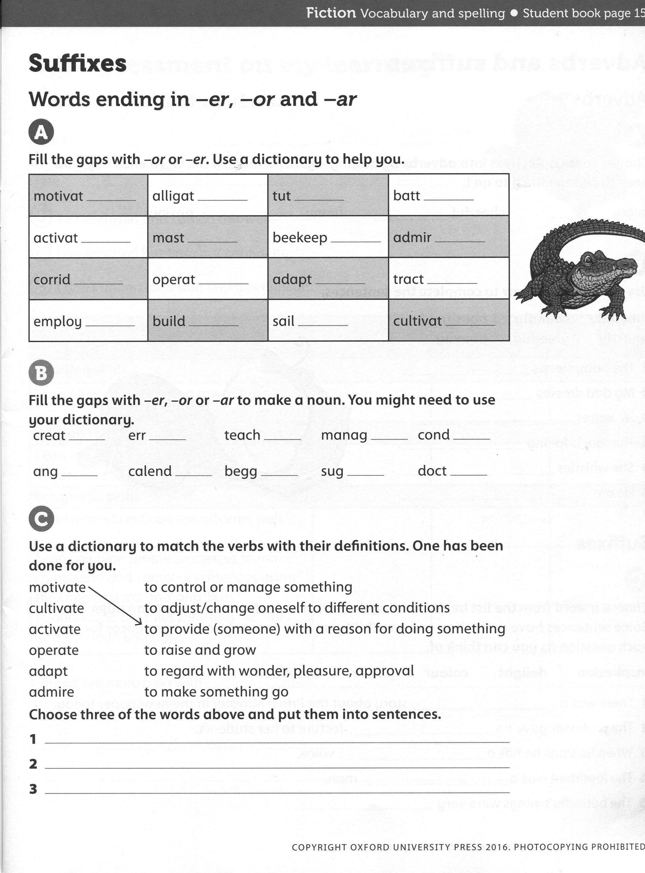
or
or
or
er
or
er
er
er
or
or
er
or
er
er
or
or

Slide 11
or
or
er
er
or
er
ar
ar
ar
or

