Slide 1

Addition

Slide 2
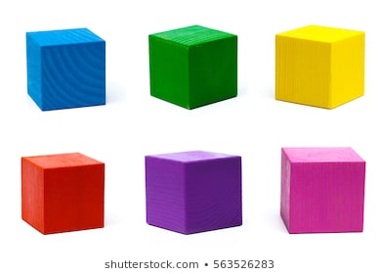

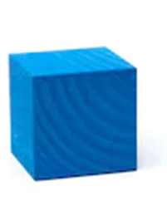
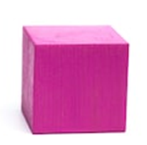
+
=
+
=
+
=

Slide 3

+
=
+
=
+
=

Slide 4
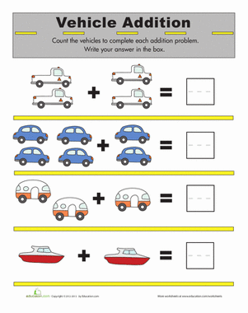
4
5
3
2

Slide 5
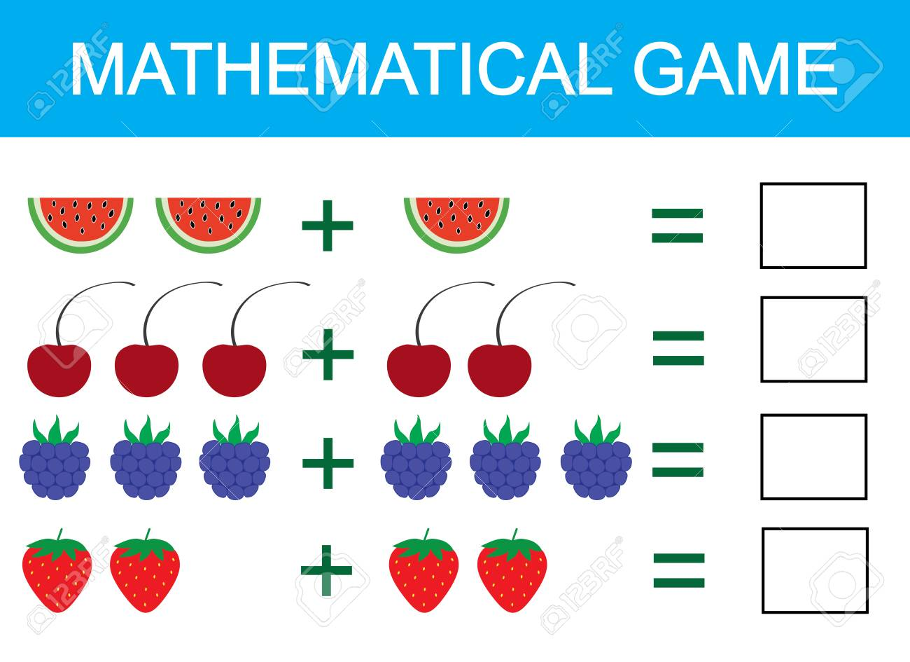
3
5
5
4

Slide 6

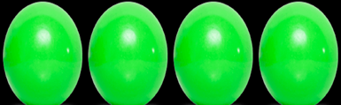


3
+
=
5
=
2
+

Slide 7

l + 0 =
l
2 + 2 =
4

Slide 8


2 + 3 =
5
l + 2 =
3

Slide 9
3
l + 2 =
3 + 2 =
4 + 0 =
5
4

Slide 10
4
2 + 2 =
+ l =
3 + 0 =
5
3

