Slide 1
One more than
1 more than

Slide 2
Count from 1 to 30
01 2 3 4 5 6 7 8 9 10 11 12 13 14 15 16 17 18 19 20 21 22 23 24 25 26 27 28 29 30

Slide 3
Count backwards from 10 to 0
10 9 8 7 6 5 4 3 2 1 0

Slide 4
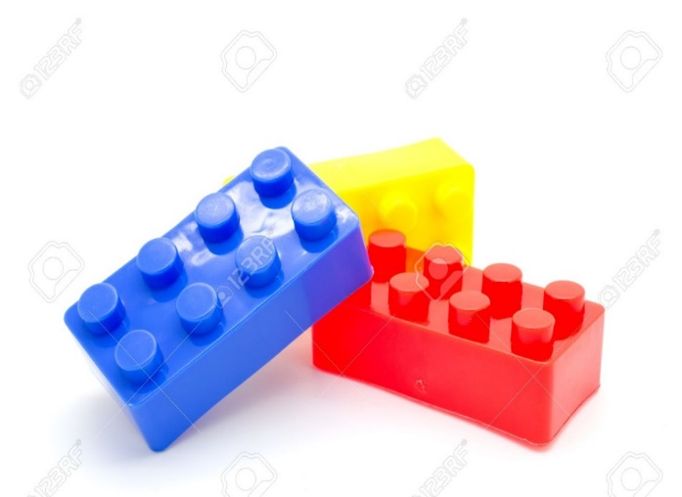
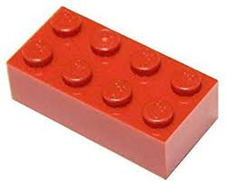
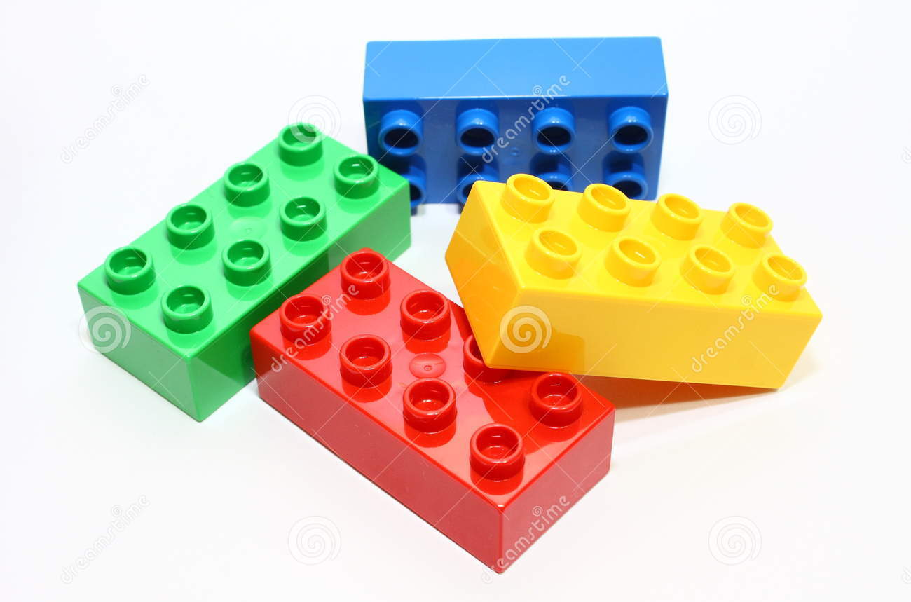

Slide 5
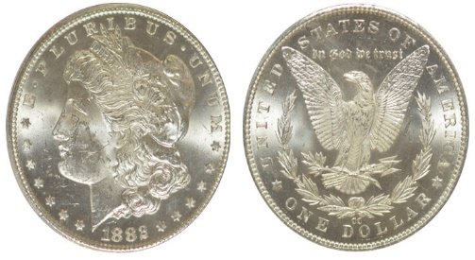
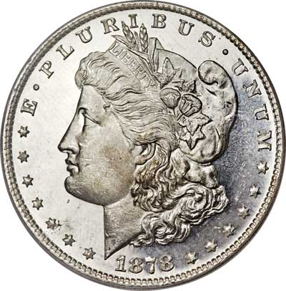
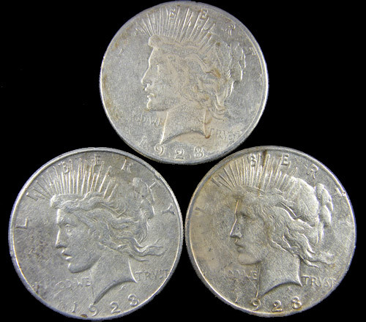

Slide 6


Slide 7
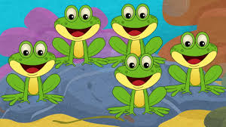

Slide 8
One more than 2 is ………… 3 one more than 4 is…………. 5 one more than 3 is…………. 4 one more than 1 is…………. 2 one more than 0 is…………..1

Slide 9
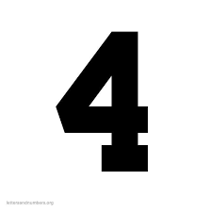




One more than 3 is
One more than 1 is
One more than 4 is
One more than 2 is
One more than 0 is

Slide 10


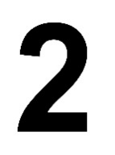
One more than 2 is
One more than 4 is
One more than 0 is
One more than 3 is
One more than 1 is

